Slide 1

SmileMart
Created By:
Some revature cohort from years ago, it’s all a blur at this point ngl

Slide 2
Table of Contents
Meet The Team
What is “SmileMart”?
Scrum Methodology
Trello
Iterative Planning / Development
Application Architecture
ERD
Client Server
High Level Overview
Use Case Diagrams
User Use-Case Diagram
Manager Use-Case Diagram
Test Results
Security (JWT)
DEMO!
Conclusion
Next Steps!

Slide 3
Meet The Team!
Team Lead: John Rumrill
Back - End:
Manager: Sidney Bowe
Aruna Assija
Brian Lam
Chikaosolu Amaechi (Products/Categories)
James Ta
Thomas Harding - (Products/Orders)
Ward Alhadid
Yanyan Jiang
Front - End:
Manager: Jonathan Tackett
Daniel Istre - (React Context, JWT)
Gaetano Barreca - (Register, Login, documentation (README))
Jeremy Eddy
Mcanthony Benson Okey

Slide 4

What is SmileMart?
One-stop online shop for everything that makes you smile!
e-commerce platform offers a wide range of Products!

Slide 5
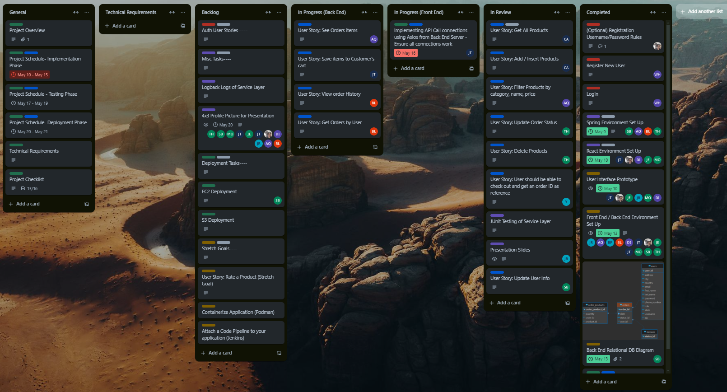
Scrum Methodology:
Trello
Notes:
During the development process, we utilized Trello to create a visual Story Board. The Backlog section contained a list of user features that haven’t been started yet. By placing tasks into categories, we were able to keep track of everyone’s progress and see which tasks still needed to be worked on.

Slide 6
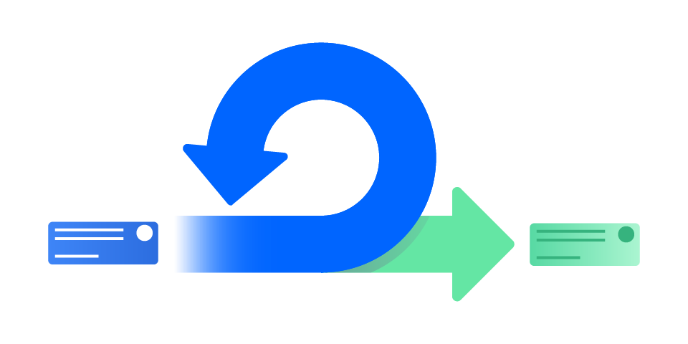
Scrum Methodology:
Iterative Planning / Development
Trello Board for Iterative Development
Split Team into Front End / Back End
Regular Stand Up Meetings
Structured Coding & Development
GitHub for Version Control
Notes:
As you saw in the previous slide, we relied heavily on the Trello Board to keep everyone in the group up to date with the current status of our project. We split our team up into 2 groups - the Front End Team and the Back End Team. This allowed us to more easily communicate with all of our members and provided a smaller environment for collaboration. Every day we held daily meetings, both as a full team and as Front End/Back End teams. Once everyone finished their features, they were made into a Pull Request on GitHub and reviewed by the team managers.

Slide 7
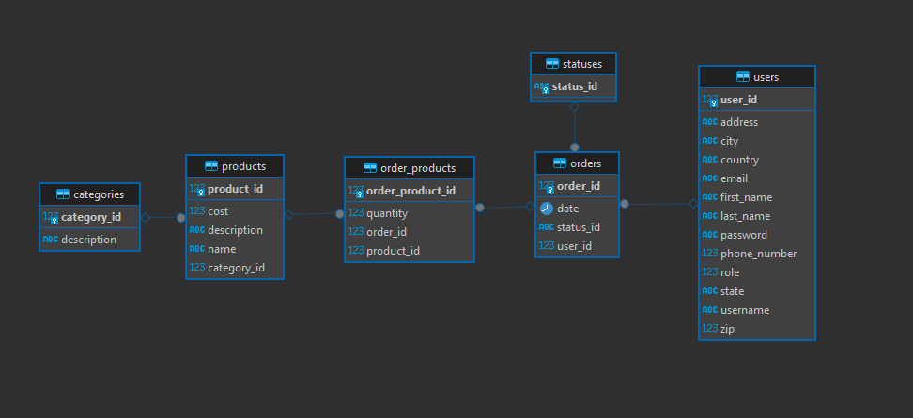
Application Architecture:
Relational Database

Slide 8
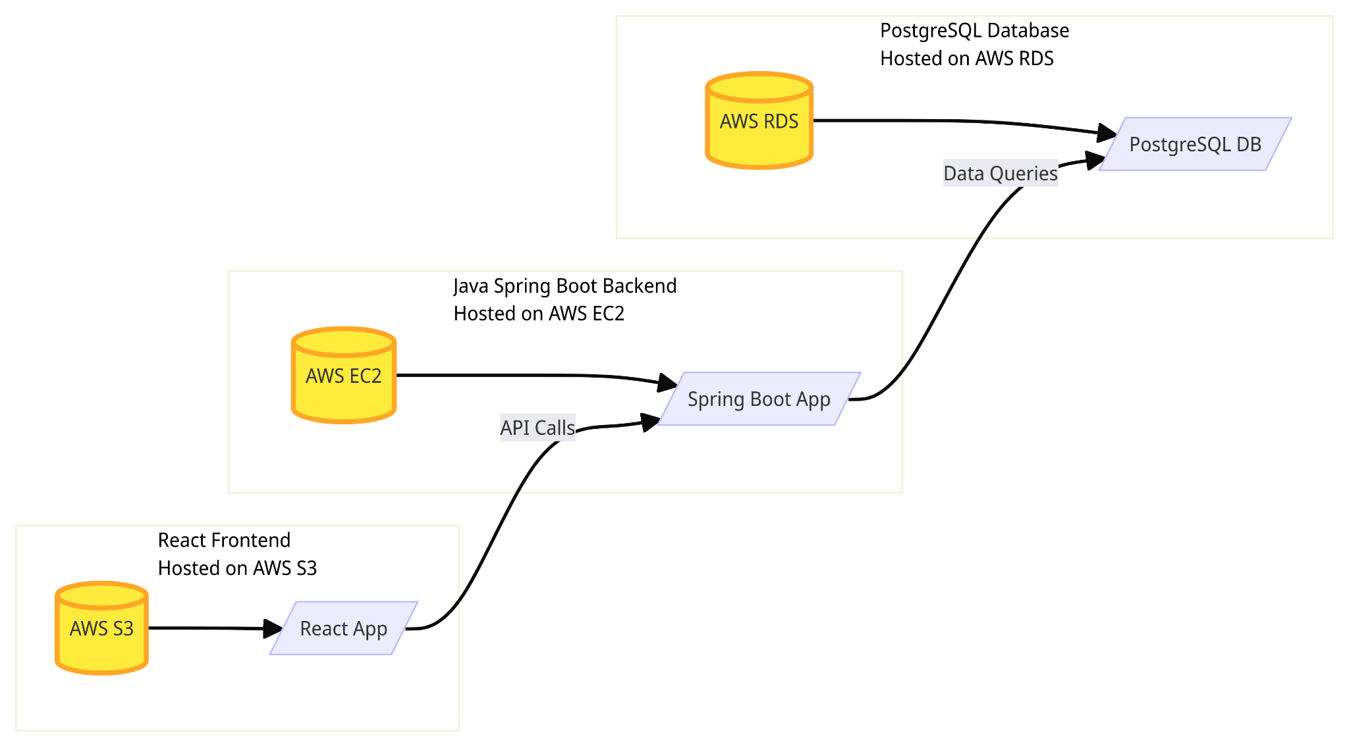
Application Architecture:
Client - Server Model

Slide 9
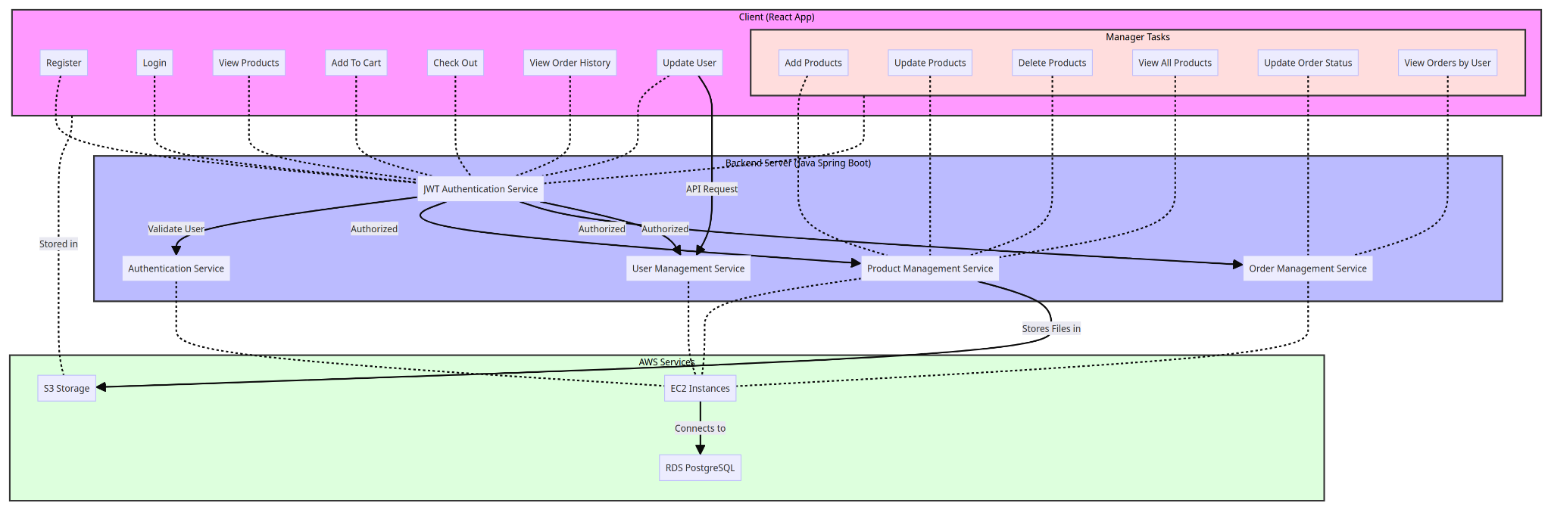
Application Architecture:
High Level Overview

Slide 10
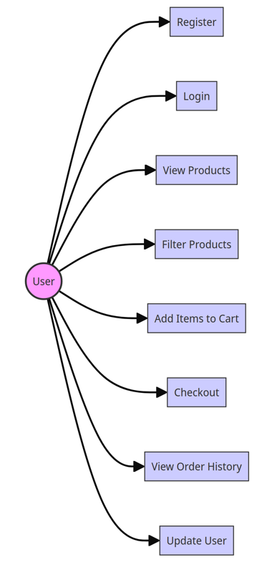
Use Case Diagram:
User Use-Case
User Should Be Able To:
Create an Account
Login
View All Products
Filter Products
Add Products to Cart
Checkout Cart
View Purchase History
Update their Information

Slide 11
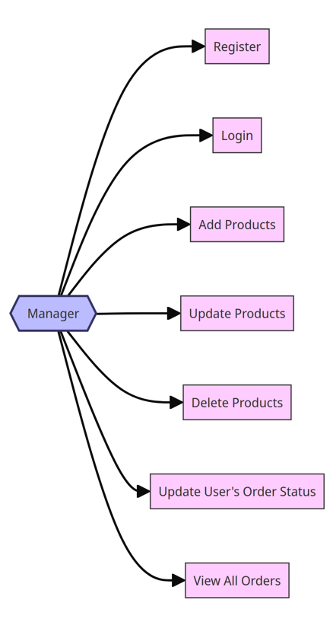
Use Case Diagram:
Manager Use-Case
Managers Should Be Able To:
Create an Account
Login
Insert Products
Update Products
Remove Products
Update Status of an Order
View All Orders

Slide 12
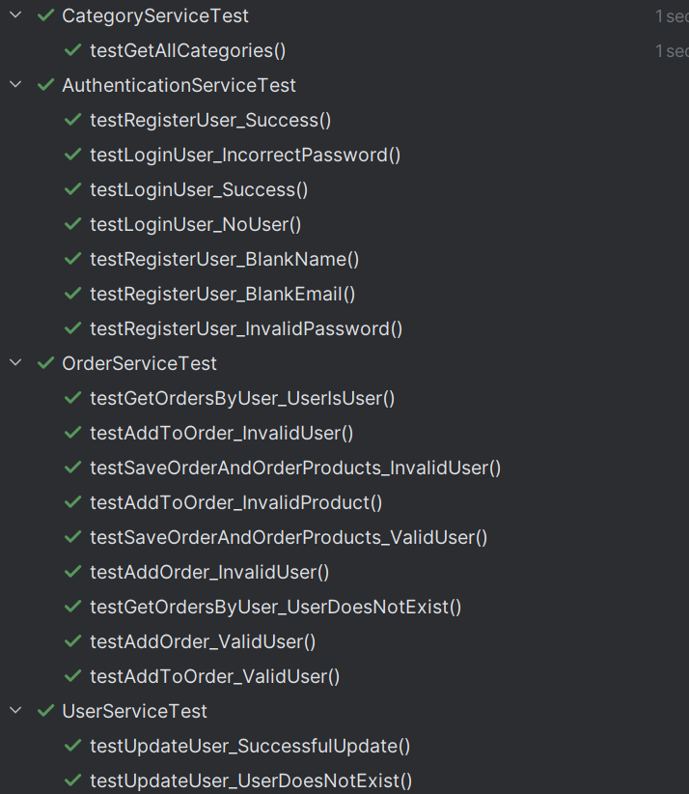
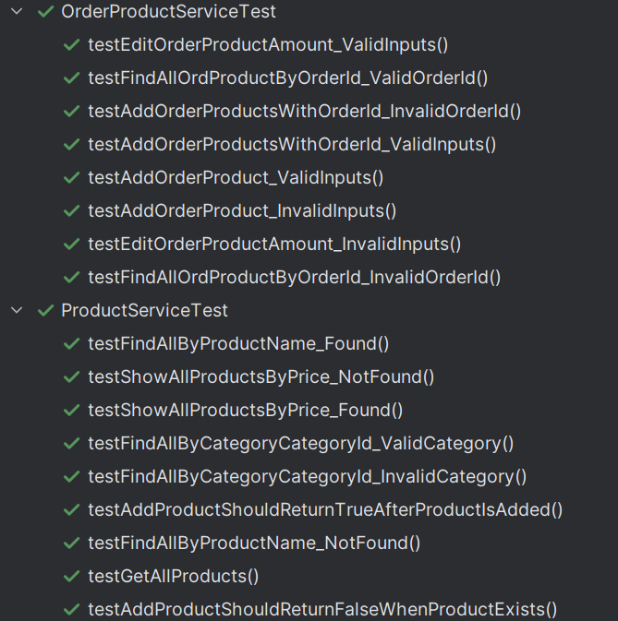
Test Results

Slide 13
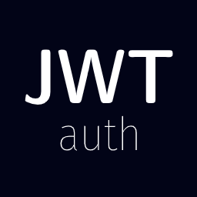
Security (JWT)
Developed JWT For Security in SmileMart
Standard for Transmitting Information
No need to use Store Session
Simplifies Scaling
Reduces Server Load
Secure Token Structure using Encryption Algorithms

Slide 14
DEMO!

Slide 15
Conclusion | Next Steps!
Next Steps
Add Payment Processor
Adding Suppliers
Update User Interface

Slide 16
Thank you for listening!
Q&A

