Slide 1

Architecture of a Python Flask app
Stage 5-6
ICTENSW 20265 Conference
Ben Jones
14/03/2026

Slide 2
Acknowledgement of Country
I’d like to begin by acknowledging the Traditional Owners of the land on which we meet today, the Gadigal people of the Eora nation and pay my respects to Elders past and present.
They are the first engineers, teachers and learners on these lands.

Slide 3
Forking Repository & Deploy a Codespace

Slide 4
Todays Repos
Today’s Template
https://github.com/benpaddlejones/ICTENSW_2026_Architecture_of_a_basic_Flask_app
Examples:
https://github.com/benpaddlejones/myAIChatbot
https://github.com/benpaddlejones/myCipherForge
Flask Template: https://github.com/TempeHS/TempeHS_Python-Flask_DevContainer

Slide 5
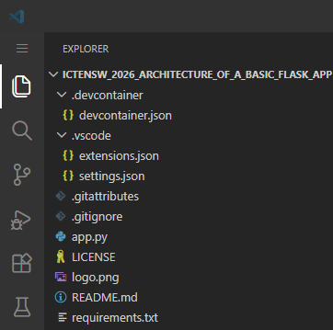
Auto configure VSCode & Codespaces
.devcontainer/devcontainer.json
Configure Codespaces including dependencies, extensions and ports
.vscode/extensions.json
Pre-fill extension suggestion list
.vscode/settings.json
Pre-configure workspace settings
requirements.txt
Dependencies to be installed by Codespaces, student should be keeping this up to date!
Notes:
Explain how the auto-configuration of VSCode and Codespaces can improve the experience of first-time coders in VSCode.

Slide 6
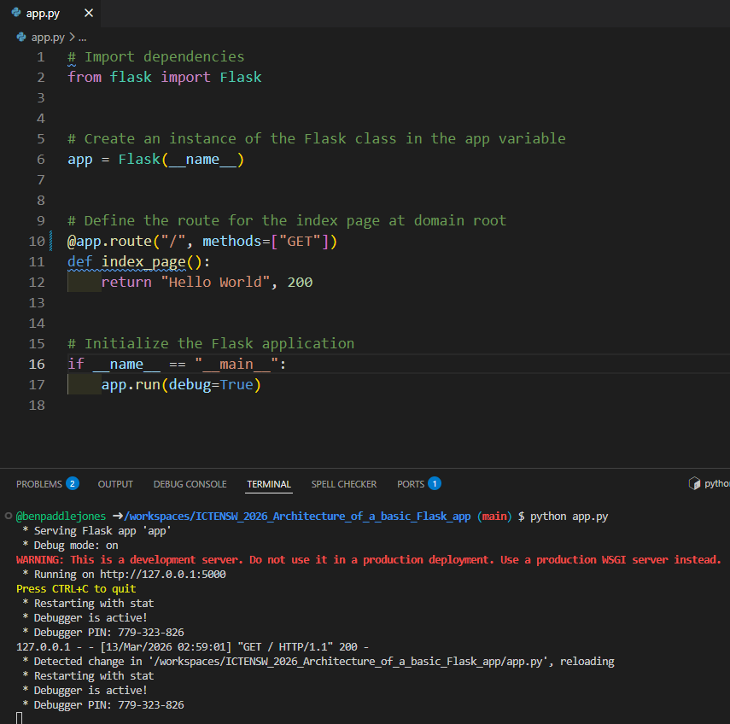
Run the Flask app
Run the Python script
Python app.py the in-built server is commonly called the development server, in Flask’s case it’s Werkzeug’s built-in development Web Server Gateway Interface. It will out put to the terminal:
Start up info
Requests
Errors and tracebacks
Server reload
Students will need to know:
How to access UI
How to kill/restart app
Notes:
Explain how the auto-configuration of VSCode and Codespaces can improve the experience of first-time coders in VSCode.

Slide 7
Let’s build something and explore the architecture
feature: implemented a index template
feature: implement layout template and extend index.html
feature: implement bootstrap menu
feature: bootstrap login form renders
feature: implement frontend to backend data pass
feature: server logo from static folder and render in navbar
Notes:
Explain how the auto-configuration of VSCode and Codespaces can improve the experience of first-time coders in VSCode.

