Slide 1

Rust: StackOverflow’s “Most Loved Language” for 4+ Years
By Benjamin Perumala
Notes:
The little crab on the right is the unofficial mascot, Ferris
People who use Rust are often called cRUSTaceans
https://rustacean.net/

Slide 2
Who Designed It?
Created by Graydon Hoare from Mozilla in 2006
Mozilla started sponsoring Rust in 2009
However, Rust mostly independent now
Version 1.0 released in May 2015
New major edition every 3 years
Stack Overflow’s “Most Love Language” for 4+ years
Notes:
August 2020, Mozilla laid off most of Rust team
Language mostly unaffected as core people worked on it outside of work
Many other companies (AWS, Huawei, Google, and Microsoft) also sponsored the team to continue work on the language

Slide 3
“Most Loved Language”? What is Rust?
A low-level compiled language
Strongly typed w/ type inference
Like C but with more abstraction
No Garbage Collector (fast)
Memory Safe (no race conditions, segfaults, or nullpointers)
Benefits of C/C++ without drawbacks*
Notes:
*Rust is still a low-level language so low-level system knowledge is often assumed

Slide 4

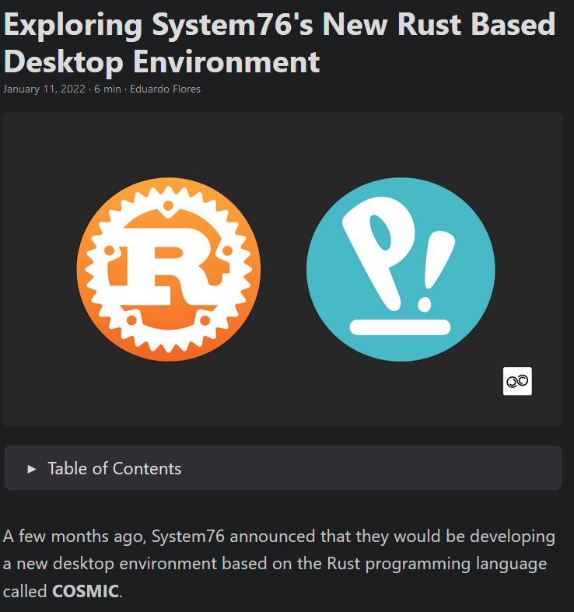
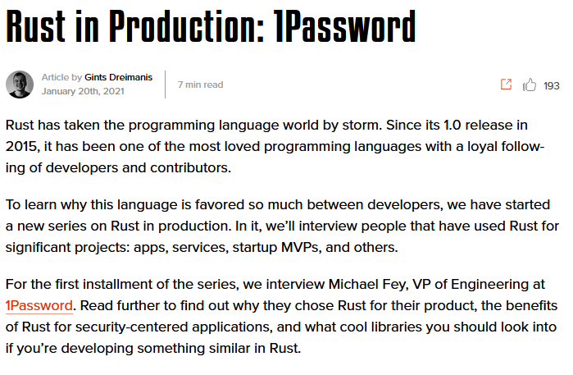


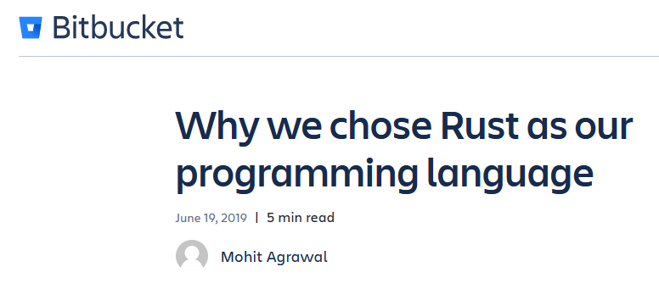
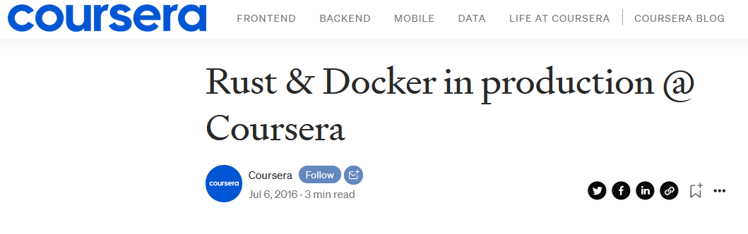
Who Uses It?
Mozilla
Discord
Atlassian
Dropbox
System76
Cloudflare
1Password
RedHat CoreOS
NodeJS Package Manager (NPM)
Coursera
Notes:
Mozilla – core functionality of Firefox browser
Discord – lots of internal tools
Atlassian (Source code storage BitBucket)– analytics
Dropbox – infrastructure
System76 (computer manufacturer and makers of Pop!_OS Linux distro) – Linux Desktop Environment and production tools (hardware certification. Image flashing, etc.)
Cloudflare (CDN, DNS, DDoS protection) – core edge logic
RedHat CoreOS (major OS used for their k8s container management service) – build tools
NodeJS Package Manger – infrastructure
Coursera - infrastructure

Slide 5
Disclaimer
Presentation from a Fullstack Web Developer
Python, HTML, JavaScript
None are very high performing wrt C or Rust
High levels of abstraction and no pointers
Only C experience from CS 352 and CS 453
No C++ (or any other variants) experience
No experience with Go
Notes:
I mostly code in Python and Javascript. These are very powerful languages but neither of them are low level
Worked with C but not much. Have not worked with any other C variants
I also have no experience with Go (see next slide)

Slide 6
Rust vs Go - Computer Speed vs Developer Speed
Go - quick to learn and use
Fast Developer Speed
Rust - runtime very efficient
Fast Computer Speed
Look at a Go group project and compare the two!
Notes:
Rust is compared to Go quite a lot
Go is quick to learn while Rust is quick to run. Trade-off between developer time and computer time
Go has a garbage collector which gave Discord some issues
Their code was very efficient but Go kept unnecessarily running the garbage collector and tanking performance
Unoptimized Rust code matched heavily optimized Go code when it came to performance
https://discord.com/blog/why-discord-is-switching-from-go-to-rust
NodeJS Online Package Manager (NPM) noted it took roughly an hour to rewrite one of their libraries in NodeJS, 2 days in Go, and a week in Rust
https://www.infoq.com/news/2019/03/rust-npm-performance/

Slide 7
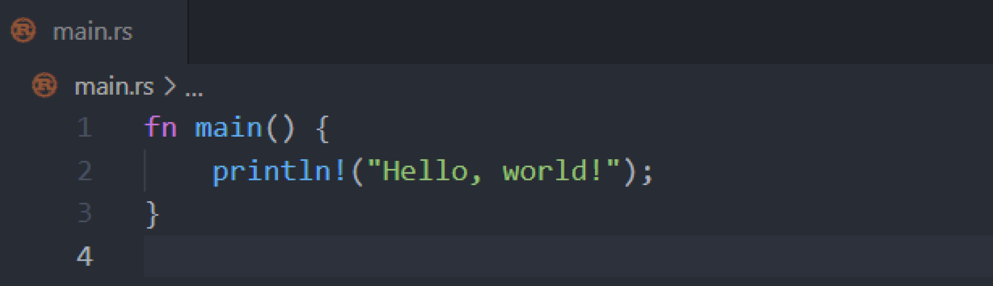
Week 1 – Hello World!
Syntax akin to C and Java

Slide 8
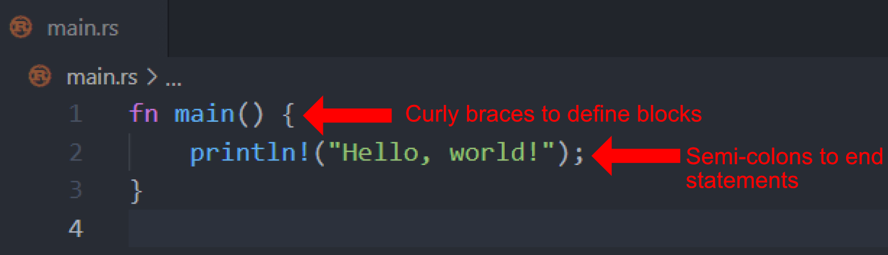
Week 1 – Hello World!
Syntax akin to C and Java

Slide 9
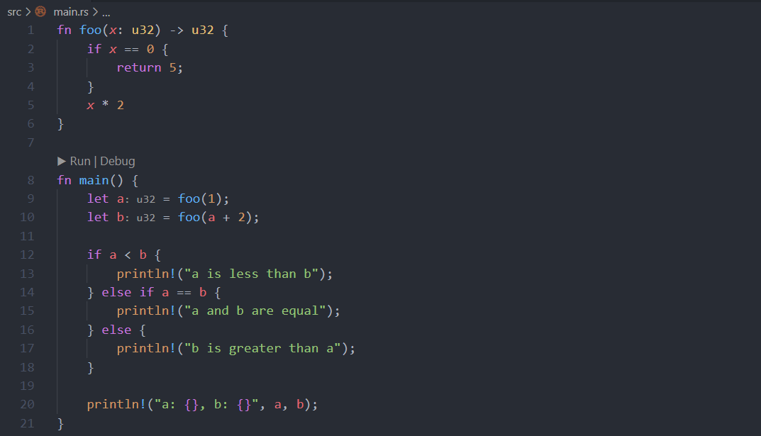
Week 1 – Functions, Variables, Conditionals

Slide 10
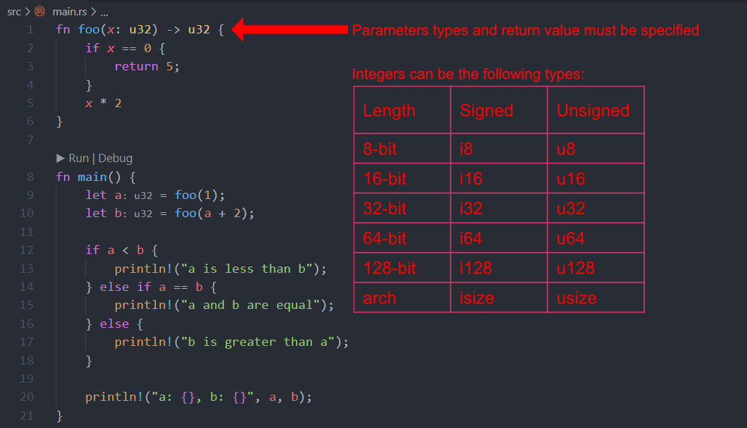
Week 1 – Functions, Variables, Conditionals
Notes:
Rust also has floats. They can be 32-bit (f32) or 64-bit (f64)

Slide 11
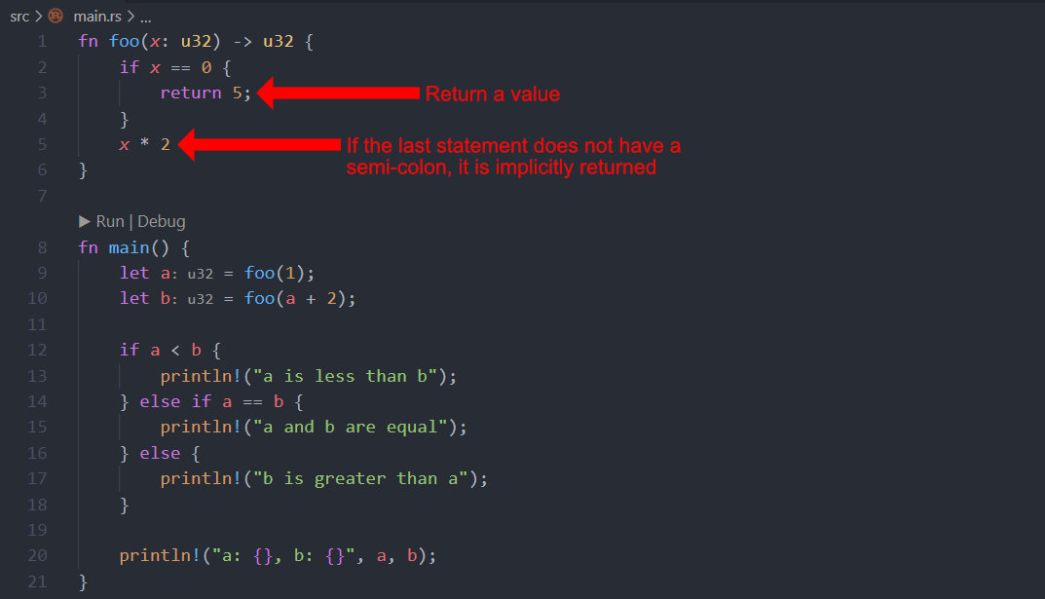
Week 1 – Functions, Variables, Conditionals
Notes:
It may be confusing here, but many Rust functions often have a single large statement which returns a value. It makes more sense within that context

Slide 12
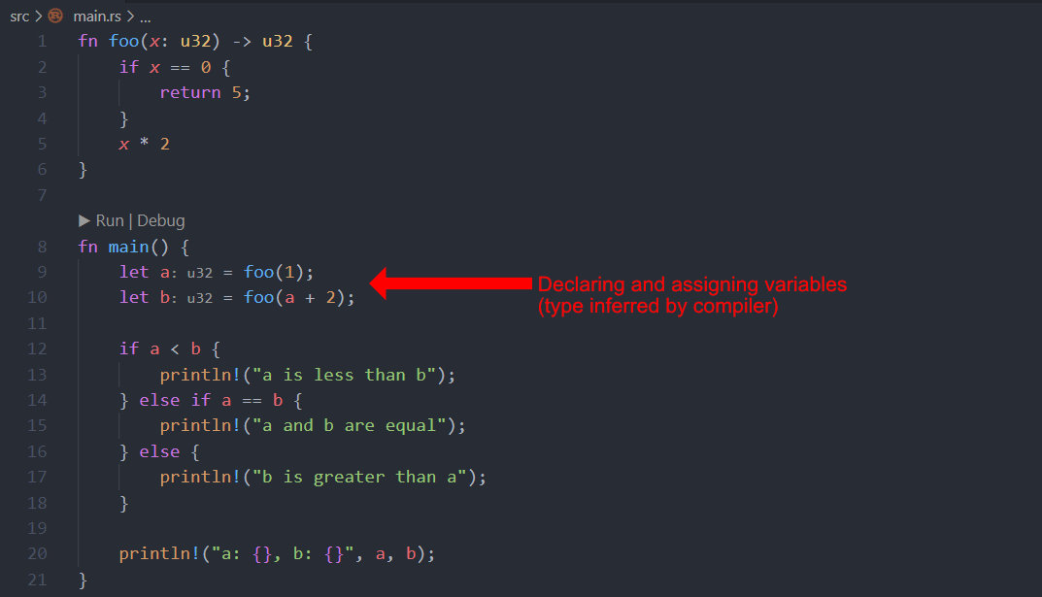
Week 1 – Functions, Variables, Conditionals
Variables are immutable by default
Gray text (like : u32) is the inferred type from the compiler and is not explicitly typed.
VSCode renders this for convenience
Notes:
Note the gray : <u32>. This is the inferred type from the compiler and was not explicitly typed out
All gray text is things inferred by the compiler and displayed by VSCode

Slide 13
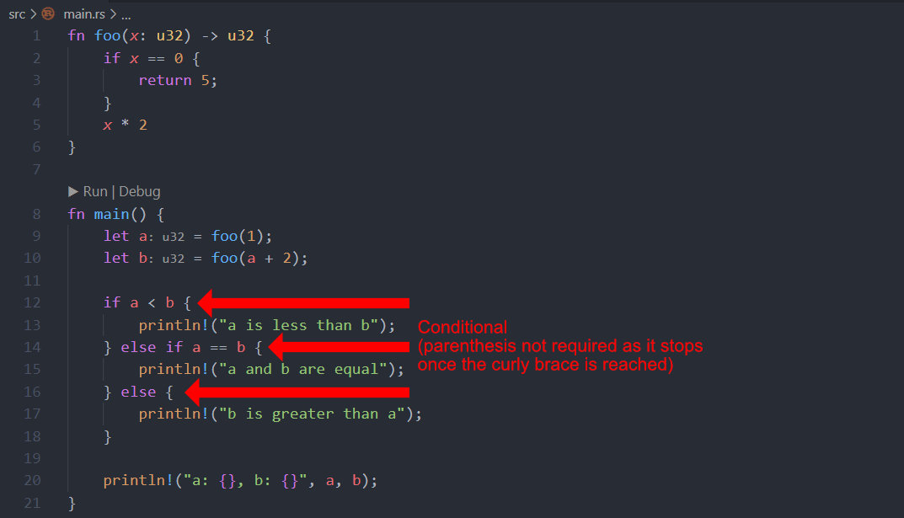
Week 1 – Functions, Variables, Conditionals
Notes:
If conditions must have the curly braces. Rust intentionally does not support an if with a single statement and no curly braces

Slide 14
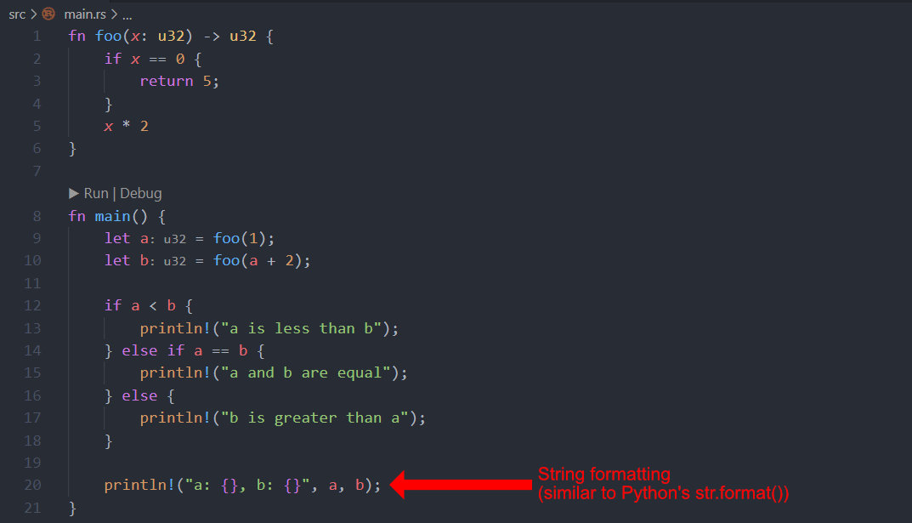
Week 1 – Functions, Variables, Conditionals

Slide 15
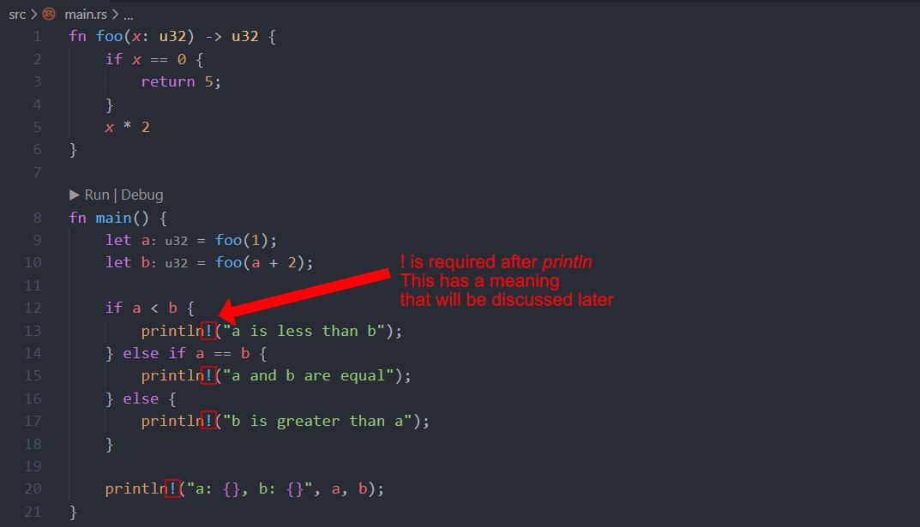
Week 1 – Functions, Variables, Conditionals
Notes:
The “!” at the end defines a “Macro.” Again, won’t talk about this until much later.

Slide 16
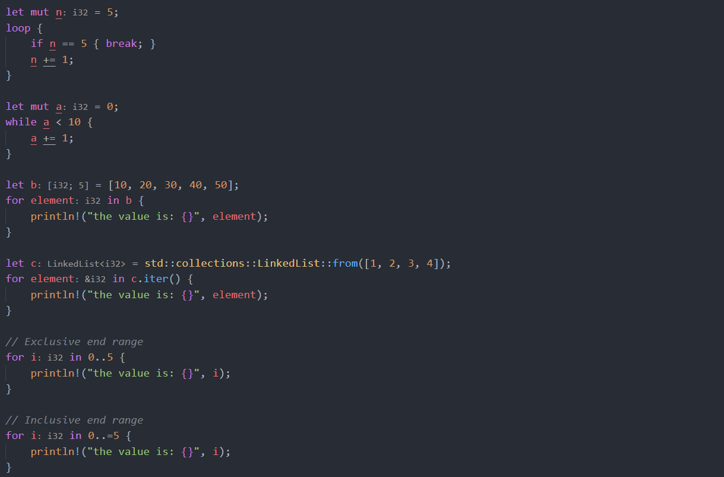
Week 1 – Loops
Notes:
Loop blocks can yield results (which can then be assigned to variables)
Makes it easier to stick to single assignments for variables

Slide 17
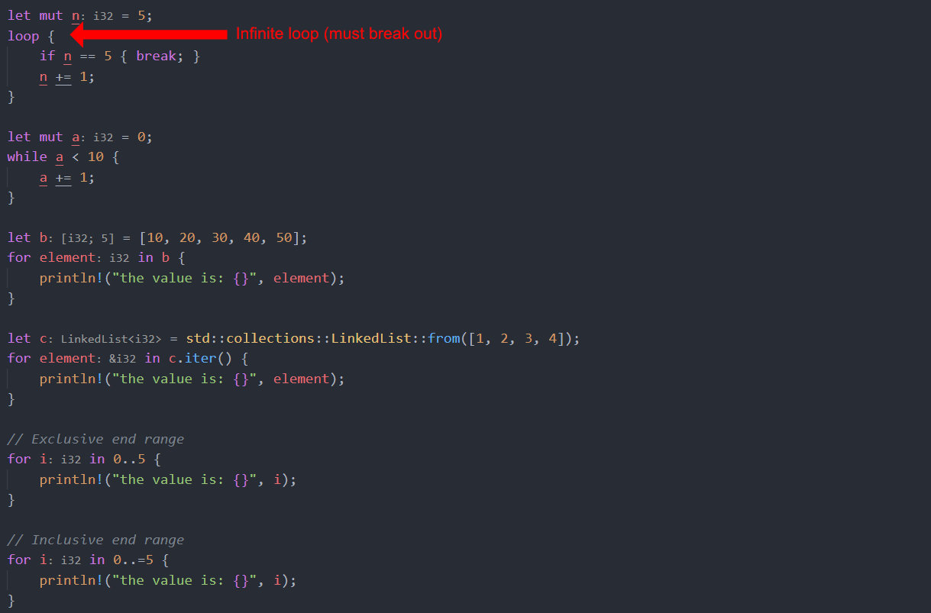
Week 1 – Loops
Notes:
If you want to leave the loop, you must break out. If you don’t break out, you will be within that loop forever (compiler is fine with that).

Slide 18
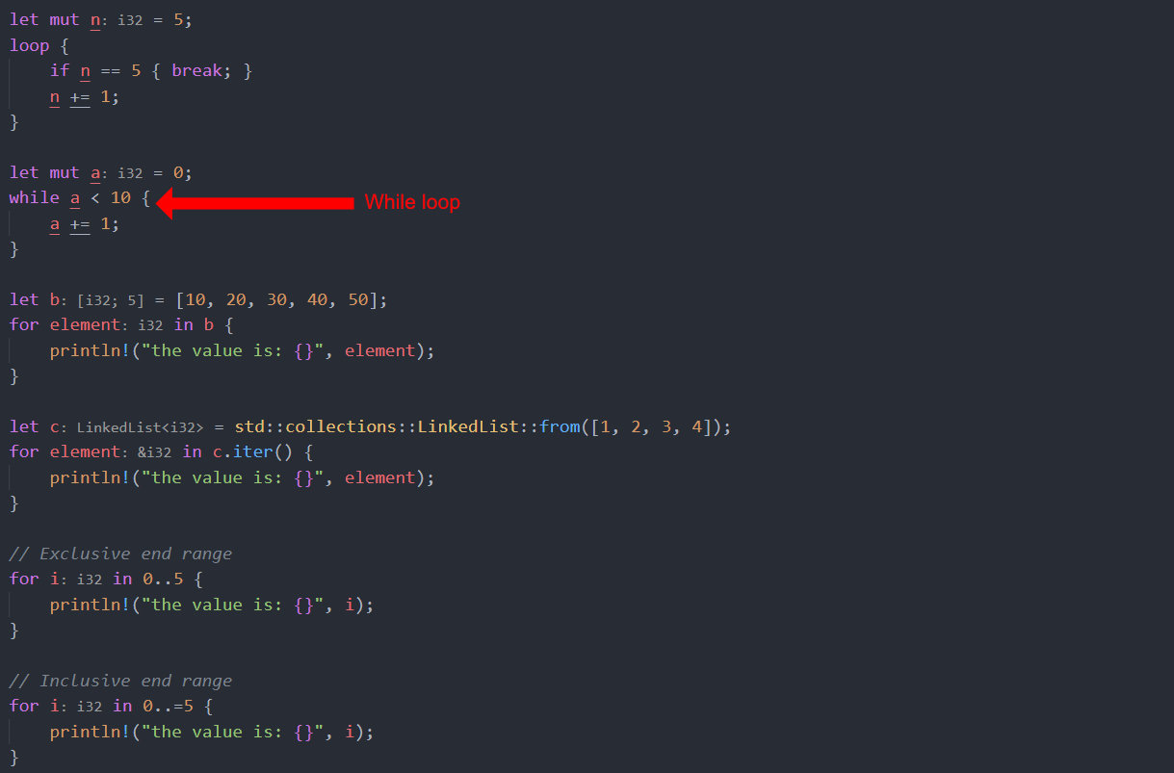
Week 1 – Loops
Notes:
Loop blocks can yield results (which can then be assigned to variables)
Makes it easier to stick to single assignments for variables

Slide 19
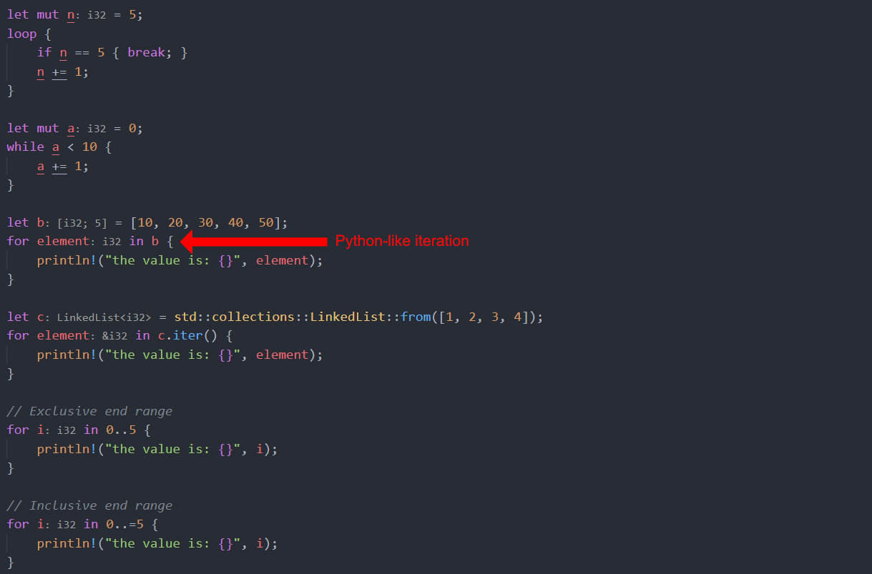
Week 1 – Loops
Notes:
Loop blocks can yield results (which can then be assigned to variables)
Makes it easier to stick to single assignments for variables

Slide 20
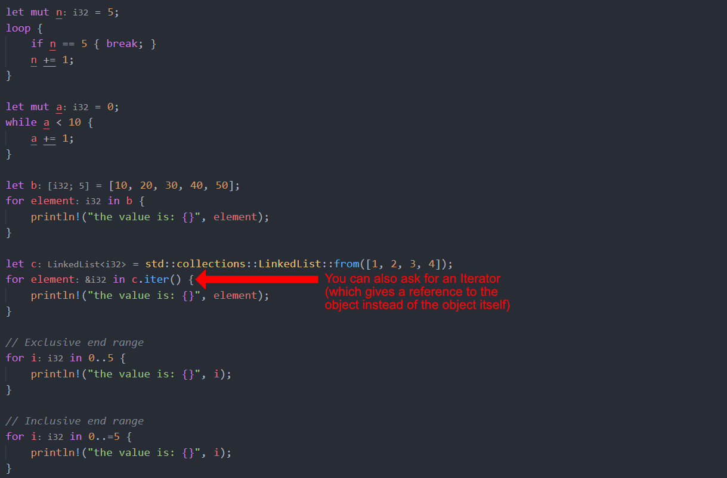
Week 1 – Loops
Notes:
Loop blocks can yield results (which can then be assigned to variables)
Makes it easier to stick to single assignments for variables
Rust also has a standard collections library that has Linked Lists (and many other data types)

Slide 21
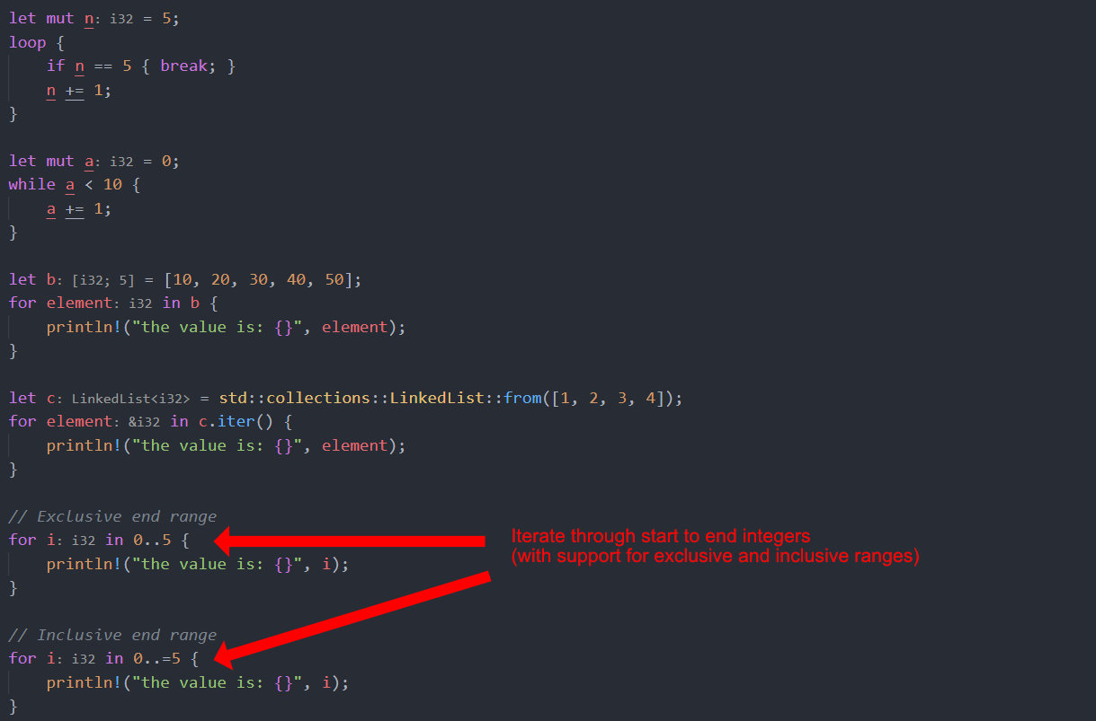
Week 1 – Loops
Notes:
Loop blocks can yield results (which can then be assigned to variables)
Makes it easier to stick to single assignments for variables

Slide 22
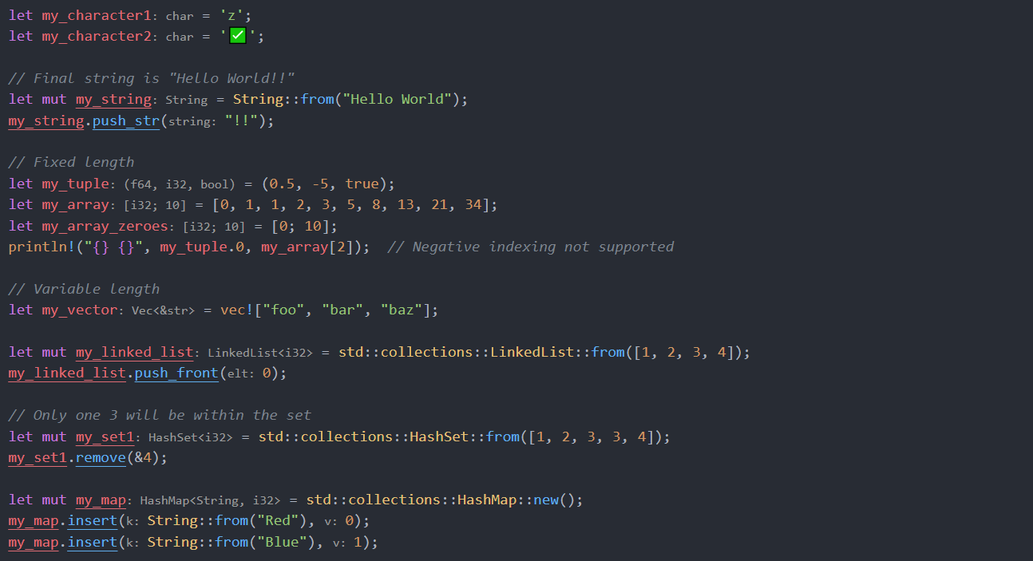
Week 1 – Other Data Types
Notes:
Chars support utf8
str (“Hello World”) vs String (String::from(“Hello World!”))
str is “primitive” (immutable). String is a class definition with many helpful methods
Like int vs Integer in Java
Arrays are fixed length (Vectors are able to change size like Java ArrayList or Python Lists)
my_array_zeroes [0; 10] – second value is the length. First value is the value that the array is filled with.
Standard Collection has LinkedList, HashSet, HashMap, and a few other items
Full path used to reference items. Importing std::collections can make this smaller
use std::collections::{LinkedList, HashSet, HashMap} would let you just call LinkedList, HashSet, and HashMap instead of std::collections::*

Slide 23
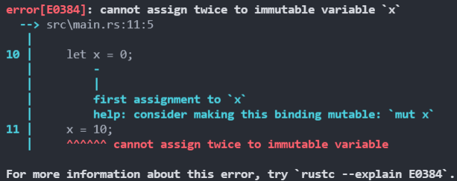

Week 1 – Immutable vs Mutable
Variables immutable by default
Allows for compiler optimizations
Add “mut” before variable name to make it a mutable variable

Slide 24

Week 1 – Borrowing References
Like C, we can get a reference to a variable
The compiler keeps track of all references
When a variable is no longer references, it can be deallocated
Compiler deallocates node (not a garbage collector)
Notes:
Emphasis on the compiler deallocating the nodes.
Because there’s no garbage collector, the runtime performance is higher than Go, Python, etc. where processing power is required to deallocate objects.

Slide 25
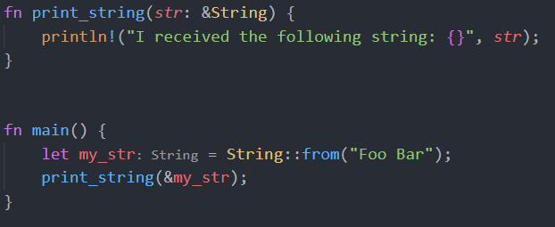
Week 1 – Borrowing References
References can be passed to other functions

Slide 26
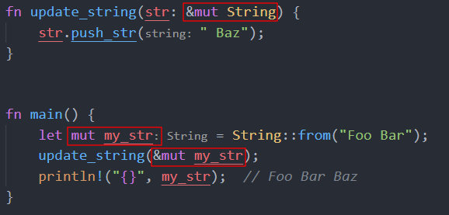
Week 1 – Borrowing References
If a function wants to update a variable, a mutable reference must be passed
Notes:
Red boxes show additions of mutable flag. Variable must be made mutable, and a mutable reference must then be passed. The function definition also must request a mutable reference.

Slide 27
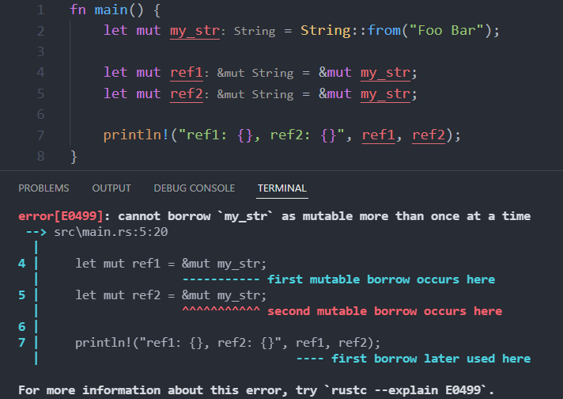
Week 1 – Borrowing References
You can only have one mutable reference at a time
Allows for compiler optimizations and prevents hard to find bugs
Notes:
Two mutable references at the same time can get very complicated and bug prone. Rust does not allow this which saves developers some headache.
Rust can also further optimize the output code as there’s only ever one mutable reference at a given time.

Slide 28
Week 1 – The Helpful Compiler
Creates an exhaustive Proof of your code
Finds many errors before runtime
Detailed error descriptions
Did you handle every case?
Are your types correct?
Knows when every variable is used or modified
Compiler heavily optimized output binaries
Handles allocation and deallocation of objects
Remember: no garbage collector!
Notes:
Higher-order Rust functions (not shown yet) + the compiler’s proof catches many errors before they become an issue during runtime.
Compiler can heavily optimize final output – especially when immutable variables are used.

Slide 29
Week 2 – Hello Cargo!
With C Project:
Create Makefile (specify linking)
Write your code
Execute make command
With Rust Project:
Use `cargo`
Notes:
Cargo is a Command Line Interface (CLI)

Slide 30
Week 2 – Hello Cargo!
$ cargo init hello-cargo/
$ tree hello-cargo/
hello-cargo/
├── Cargo.lock
├── Cargo.toml
└── src
└── main.rs
├── .gitignore
└── .git
└── <omitted>
Notes:
Cargo creates a new project within $(pwd)/hello-cargo/
$(pwd) is the current working directory
Cargo.lock is needed to work; can mostly be ignored

Slide 31
Week 2 – Hello Cargo!
$ cargo init hello-cargo/
$ tree hello-cargo/
hello-cargo/
├── Cargo.lock
├── Cargo.toml – Define name, version, dependencies, etc.
└── src
└── main.rs
├── .gitignore
└── .git
└── <omitted>
Notes:
Defines program name, it’s semantic version, authors of the code as well as external dependencies

Slide 32
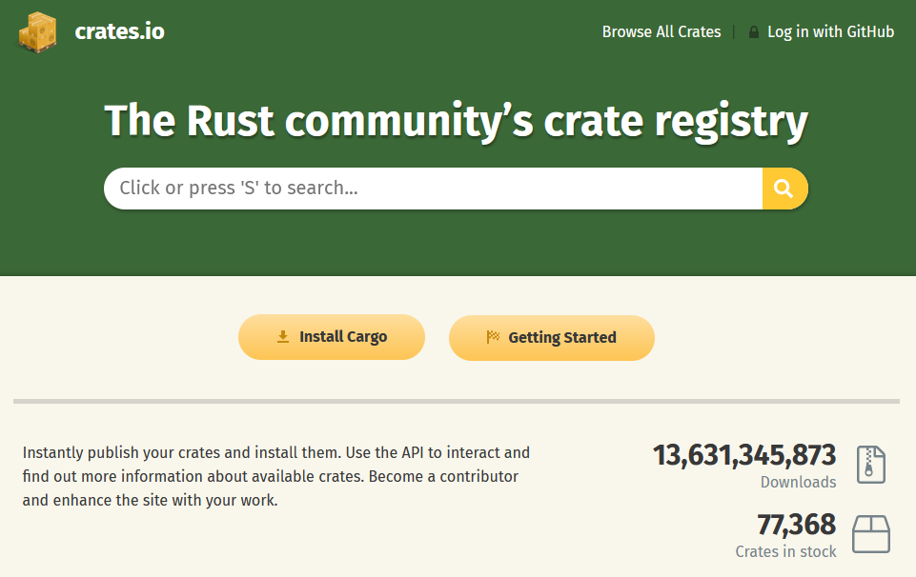
Week 2 – Hello Cargo!
$ cargo init hello-cargo/
$ tree hello-cargo/
hello-cargo/
├── Cargo.lock
├── Cargo.toml – Use online crates
└── src
└── main.rs
├── .gitignore
└── .git
└── <omitted>
Notes:
Rust has a large community which creates “crates” or libraries which you can download and use
Define crate (and version) in Cargo.toml and the cargo CLI will handle downloading, linking, etc.

Slide 33
Week 2 – Hello Cargo!
$ cargo init hello-cargo/
$ tree hello-cargo/
hello-cargo/
├── Cargo.lock
├── Cargo.toml
└── src – Source code lives here (Cargo figures out linking)
└── main.rs – contains simple “Hello World” print statement
├── .gitignore
└── .git
└── <omitted>
Notes:
main.rs contents: fn main() { println!(“Hello World!”); }

Slide 34
Week 2 – Hello Cargo!
$ cargo init hello-cargo/
$ tree hello-cargo/
hello-cargo/
├── Cargo.lock
├── Cargo.toml
└── src
└── main.rs
├── .gitignore – Git VSC
└── .git – Git VSC
└── <omitted>
Notes:
Cargo conveniently initializes Git for us (most programming projects use Git for version control)
VSC = Version Control Software
.gitignore specifies which directories and files to ignore
ie VSC should not track compiled binaries or intermediate objects
.git folder contains initial Git state (cargo basically runs `git init` for you)

Slide 35
Week 2 – Hello Cargo!
$ cargo run
Compiling hello-cargo v0.1.0 (<directory omitted>)
Finished dev [unoptimized + debuginfo] target(s) in 0.31s
Running `target\debug\hello-cargo.exe`
Hello World!
Notes:
Rust comes with many CLIs (like the rust compiler `rustc`)
Cargo handles communicating with the compiler and running our programs for us
Other Rust CLIs include ones like `rustdoc` which generates HTML documentation akin to javadocs
`cargo doc` can interface with this and generate documentation (stored in target/doc)

Slide 36
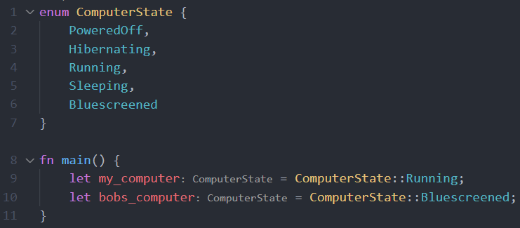
Week 2 – Enums
Notes:
Instead of using a period, two colons are used to specify an enum option (Running and Bluescreened in this case)

Slide 37
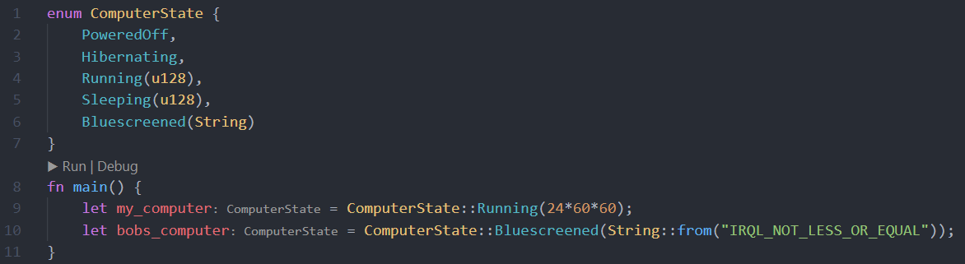
Week 2 – Enums
Enums can have associated data with specific states
Notes:
Specific states can also hold additional data. Here PoweredOff and Hibernating store nothing. Running and Sleeping both hold an unsigned 128bit integer (say for uptime) and Bluescreened can hold a String ( say for a BSOD debug message)
This is a simple example, and this can be extended further
Additional data can be specified by using a tuple – which allows the storage of multiple items

Slide 38
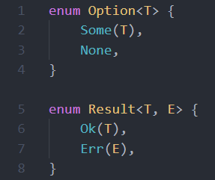
Week 2 – Special Enums
Rust provides two special kinds of structs
T and E are generic types
T – our result
E – some sort of exception
Option
Allows our functions the ability to return “Nothing”
Result
Allows our functions to handle exceptions
Notes:
Instead of returning a direct result, we can return Option<T> to allow for the returning of “None” or “null”
Result<T, E> allows us to check if we got an error (ie trying to open a file failed)
If we return an enum, the Rust compiler can check to make sure the caller accounts for every possible case.

Slide 39
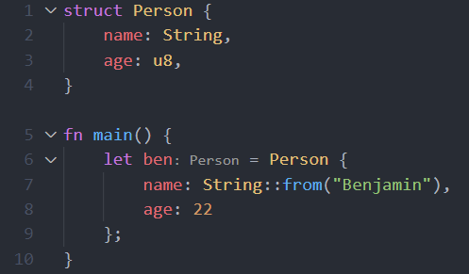
Week 2 – Structs
Rust does not have “Classes” Lower-level struct view is used
Notes:
Rust showing more of its low-level nature. There are no classes. Instead, structs (like C) are used.

Slide 40
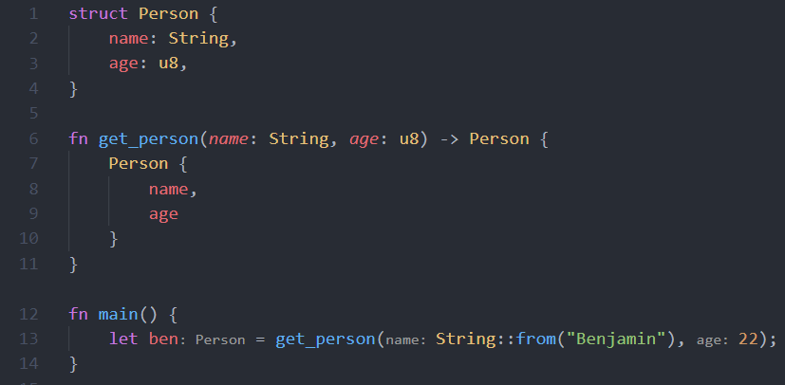
Week 2 – Struct
Notes:
get_person is an example of the Factory Pattern
get_person uses shorthand syntax for defining a new struct. The variable name must match a struct field.

Slide 41
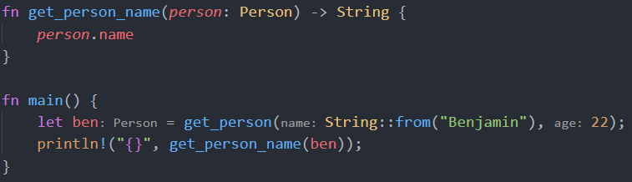
Week 2 – Structs
Structs can be passed to functions exactly like variables
Mutable references can also be used like variables
Notes:
Prints out “Benjamin”
Again, notice how get_person_name has a single statement at the end which gets returned (implicit return)

Slide 42
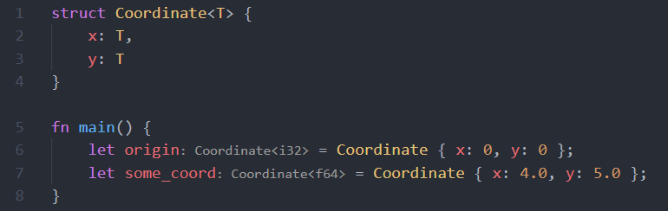
Week 2 – Side Tangent: Generics
Rust supports Generic types like Java
This lets structs hold many different types
Notes:
x and y fields are both type “T”. This allows Coordinates to be used for both integers and floating points
`origin` contains integers while `some_coord` contains floating points
Both fields must be the same type; you cannot mix and match. If you want more types, you must specify that within the angled brackets after Coordinate: struct Coordinate<S, T> { x: S, y: T }

Slide 43
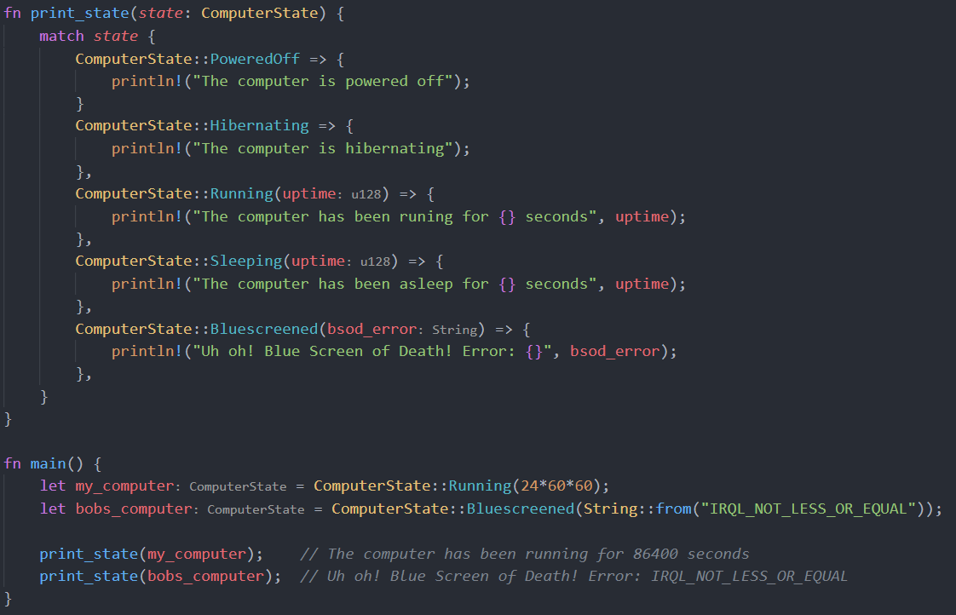
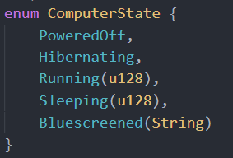
Week 3 – Match Cases
A very powerful switch/case-like tool
Notes:
Take for example our ComputerState. We can handle each case and print something different
If a state has associated information, we can get that and do something with it
Each state can also return a value
You can then assign the value to an immutable variable
It’s good practice to keep variables immutable as the compiler can optimize our code
Pattern matching works for strings and other types as well

Slide 44
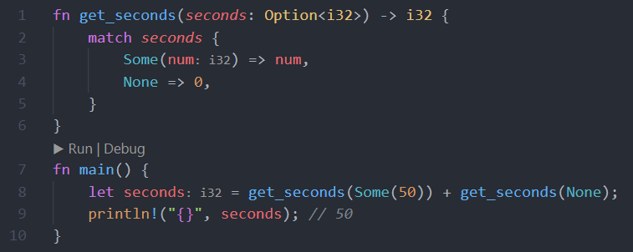
Week 3 – Match Cases
Match also works with Option<T> and Result<T, E>
Notes:
Match with Option<T> and Result<T, E> can lead to very efficient code
`seconds` ends up 50 since our get_seconds() function can handle None or an integer

Slide 45
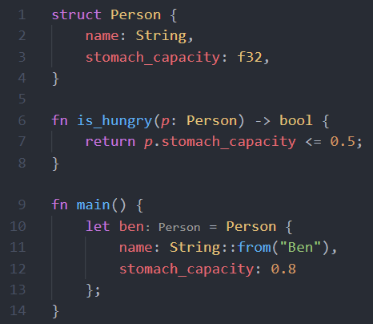
Week 3 – Traits
Rust has structs not classes
We can make functions which act like methods

Slide 46
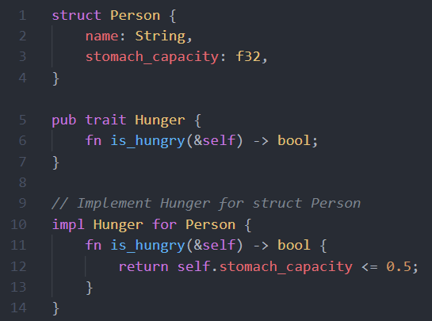
Week 3 – Traits
Rust provides “traits” which can act like interfaces
Traits can be applied to structs you didn’t define
Notes:
A Trait is like a contract. If you implement a Trait, you must implement all the required methods
Traits can also implement default behavior (like abstract classes in Java)
Traits can be implemented on any struct outside of the struct declaration
Add additional functionality to imported libraries
The return and semicolon can be removed from line 12 and the function would work the same

Slide 47
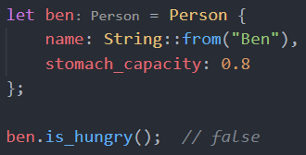
Week 3 – Traits
Rust provides “traits” which can act like methods
Traits can be applied to structs you didn’t define
Notes:
Calling a method uses the “dot syntax”

Slide 48
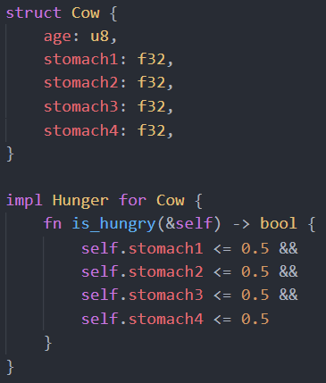
Week 3 – Traits
The same trait can be used on multiple structs
Now we can create functions which takes Cows and People and sees if either are hungry
Notes:
Traits allow us to have common functionality over many structs
Example for cow (which has four stomachs) shown
There are other ways of implementing the four stomachs – for example, using an array
Four fields were used to keep things simple

Slide 49
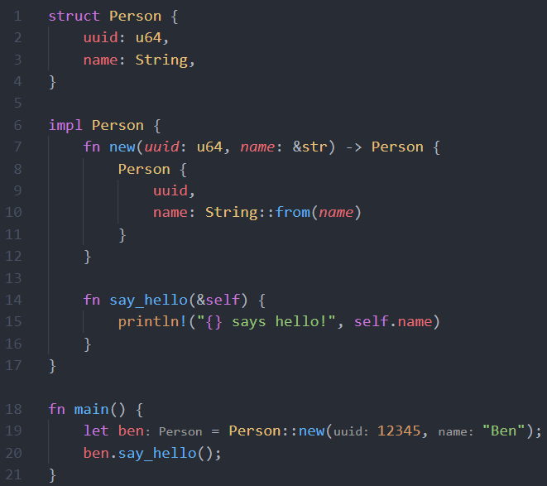
Week 3 – Methods Without Traits
Methods can also be defined on a struct without traits
Constructor is a method
Notes:
Very similar to `impl <trait> for <struct>` just without the trait part
The new constructor is simply a method – there’s nothing special about it like other languages
Factory function which creates a new person
`new()` can take in a String instead of a &str and it would work just the same. Do what’s most convenient

Slide 50
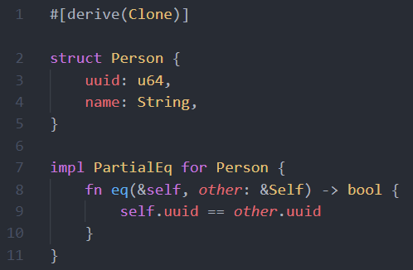
Week 3 – Derivable Traits
Many built-in traits
Clone, PartialEq, etc.
Notes:
Clone allows Rust to make a deep copy of the Person object
PartialEq allows for comparison between Person structs to see if they’re equal
Rust also has traits for checking if structs are less than, less than or equal, etc.

Slide 51
Week 4 – Aside
Most things in this week are “cool things to know”
In a class, you would not be expected to know how to effectively use these

Slide 52
Week 4 – Unsafe Code
Rust’s safety prevents the user from mistakes
Safety also prevents some valid code from working
What if programmer knows what they’re doing?
Notes:
When Rust does not have enough information to determine if code is valid, it will air on the side of caution and not allow it
Sometimes programmers get frustrated because they know it should work. Solution? Unsafe code

Slide 53
Week 4 – Unsafe Code
Mark blocks of code as “unsafe”
Unsafe code allows for:
Dereferencing raw pointers
Calling an unsafe function or method
Access or modify a mutable static variable
Implement an unsafe trait
Access fields of Unions
Notes:
Unsafe mode reduces some of the checks the compiler does
Unsafe code allows for things an advanced C programmer would likely be comfortable with

Slide 54
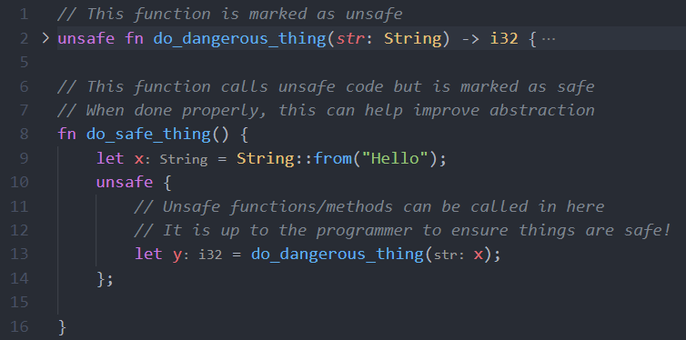
Week 4 – Unsafe Code
Notes:
Hardware can be unsafe. Since Rust is a low-level language, it must take this into consideration
Anything within the unsafe block is not checked by the safety part of Rust’s compiler
It is up to the programmer to make sure code is safe!
Other portions of the compiler still run (like the borrow checker)
Functions can “wrap” unsafe code and make them into safe functions (and increase abstraction)

Slide 55
Week 4 – Macros
Macros are pieces of code that write other pieces of code
Metaprogramming
All macro functions end with a !
println!()
vec![]
Depending on arguments given, macro can generate different code

Slide 56
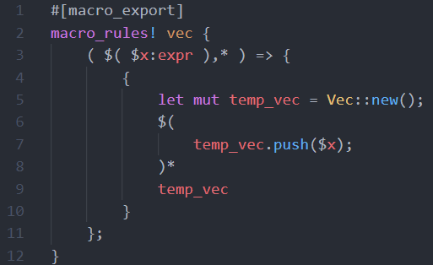
Week 4 – Macros
Example of (simplified) vec! macro
Macros get complex fast
Easy to use but hard to create
Notes:
Syntax is strange but looking at lines 5-9, you can see a Vector is being created. Then for each $x, it is being added to the vector. Once all the items have been pushed, the vector is returned

Slide 57
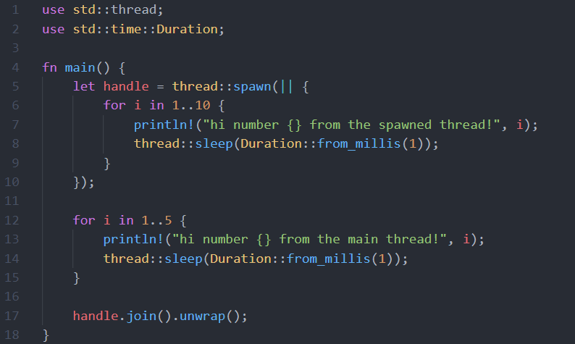
Week 4 – Concurrency (Multithreading)
Spawn many threads to do work
Immutable variables work very well with threads
Memory safety ensures no race conditions
Notes:
Lines 5-10 use a separate thread than 12-15 (those use the main thread)
A program can be split into many threads to parallelize workload
Rust variables are immutable by default. This model makes concurrency very easy.
Immutable variables means we don’t have to keep updating state across all threads
High performance runtime + concurrency = awesomeness

Slide 58
Pros to Rust
No garbage collector - fast runtime
Memory safe (no segfaults, race conditions, etc.)
Errors are checked during compile time
Relatively high-level thinking for a low-level language
Package manager allows for sharing of code
Built with Concurrency in mind
Lots of community crates (“packages”)

Slide 59
Cons to Rust
Compilation may take a long time
Not as widespread adoption as Java or Python
Less resources, packages, etc. online
Community crates do not cover everything
Low level language design philosophies must still be considered
Documentation heavily details use of CPU caches, stack vs heap, etc.
Not high level like Python (may not be a con to some)
Abstraction can make it harder to do very low-level things

Slide 60
Thank You!
Notes:
Don’t forget to compare Rust to a language like Go!

