Slide 1
Portfolio Optimization 投資組合最佳化
J.-S. Roger Jang (張智星)
MIR Lab, CSIE Dept.
National Taiwan University
jang@mirlab.org, http://mirlab.org/jang

Slide 2
Outline
Math background
Linear combination of random variables
Portfolio optimization
Problem definition
Objective functions
Matrix formulas
Efficient frontier
References

Slide 3
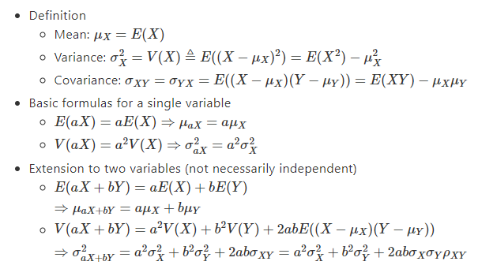
Linear Combination of Random Variables
Given two random variables X and Y
https://hackmd.io/@rogerjang/BJwCkf0LK, with exercise!

Slide 4
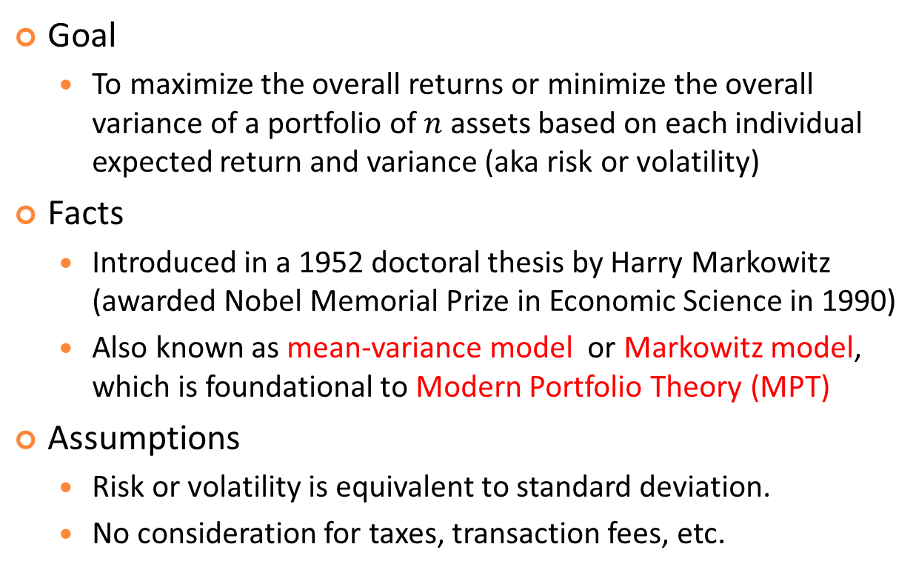
Portfolio Optimization (PO)
Goal
To maximize the overall returns or minimize the overall variance of a portfolio of $n$ assets based on each individual expected return and variance (aka risk or volatility)
Facts
Introduced in a 1952 doctoral thesis by Harry Markowitz (awarded Nobel Memorial Prize in Economic Science in 1990)
Also known as mean-variance model or Markowitz model, which is foundational to Modern Portfolio Theory (MPT)
Assumptions
Risk or volatility is equivalent to standard deviation.
No consideration for taxes, transaction fees, etc.

Slide 5
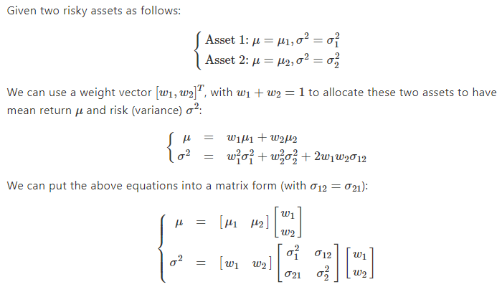
PO for Two Assets: Combined Mean and Variance
μ: Overall mean return
σ: Overall risk or volatility

Slide 6
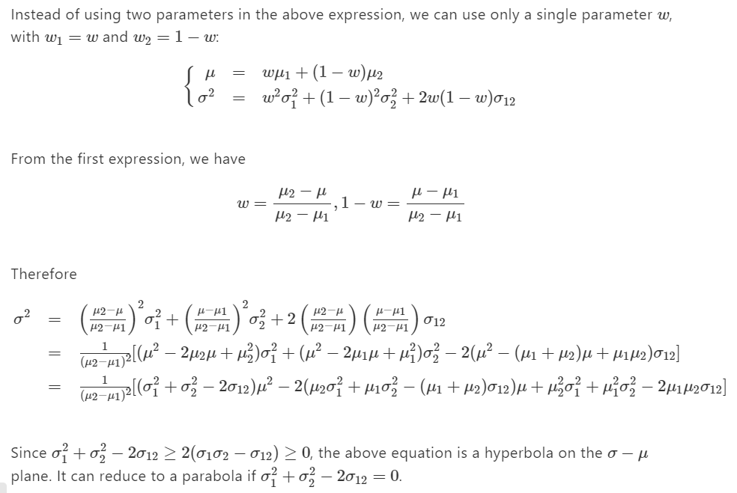
PO for Two Assets: Efficient Frontier
https://hackmd.io/@rogerjang/SJa16FaLt, with exercise!

Slide 7
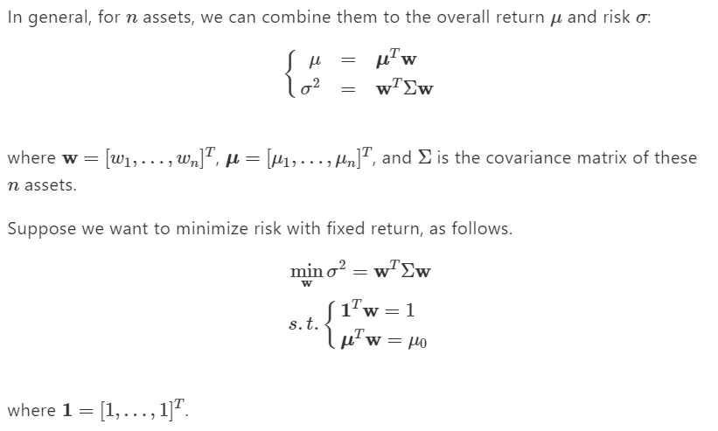
PO for n Assets: Problem Definition

Slide 8
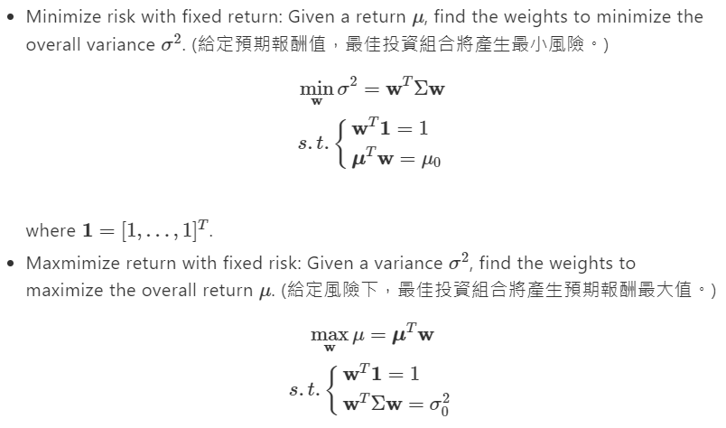
Objective Functions for PO (1/2)

Slide 9
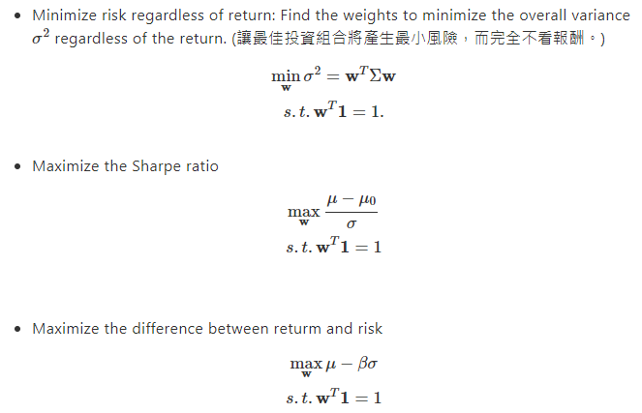
Objective Functions for PO (2/2)
In fact, there are a lot more
objective functions
and constraints in practice!

Slide 10



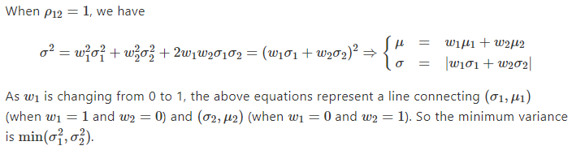
PO_{n=2}: ρ₁₂=1

Slide 11
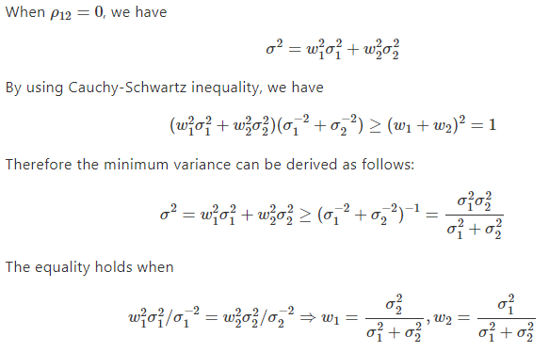
PO_{n=2}: ρ₁₂=0

Slide 12
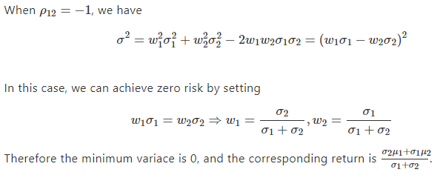
PO_{n=2}: ρ₁₂=-1

Slide 13
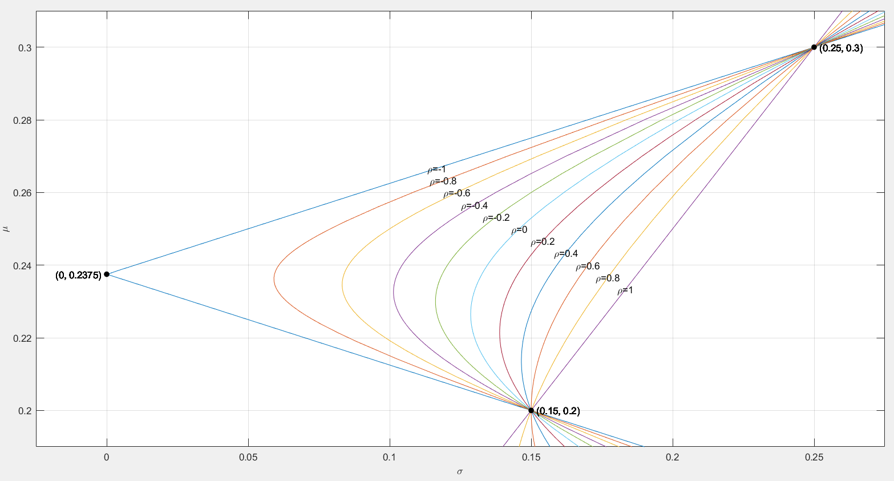
PO_{n=2}: Efficient Frontier with Varying ρ₁₂ (1/2)
n=2: (σ₁, μ₁)=(0.15, 0.2) and (σ₂, μ₂)=(0.25, 0.3)

Slide 14
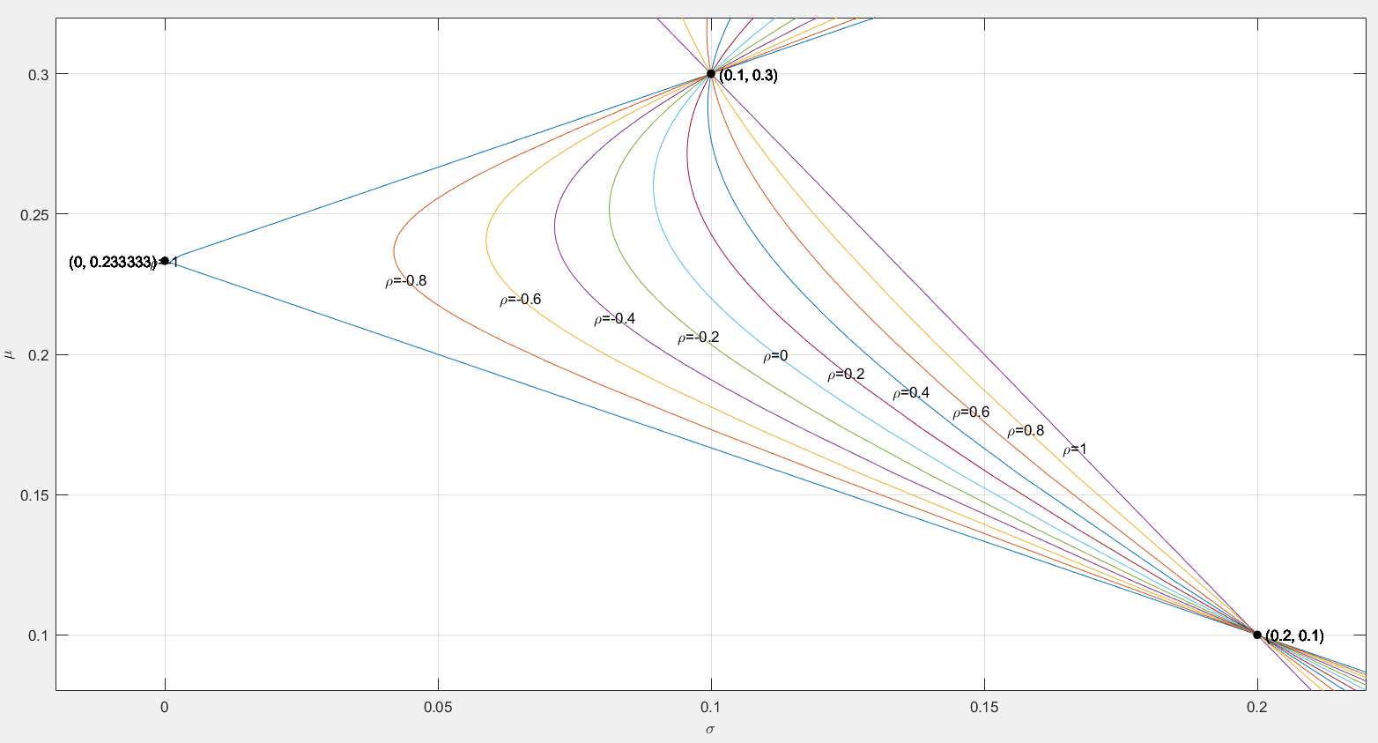
PO_{n=2}: Efficient Frontier with Varying ρ₁₂ (2/2)
n=2: (σ₁, μ₁)=(0.2, 0.1) and (σ₂, μ₂)=(0.1, 0.3)

Slide 15
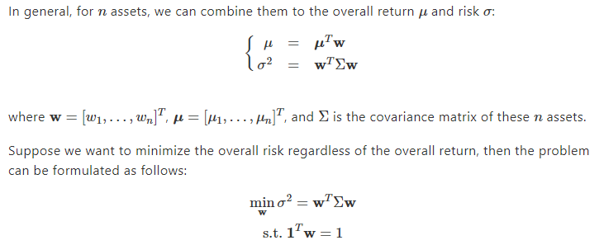
PO_{n}: Min. Variance Only

Slide 16
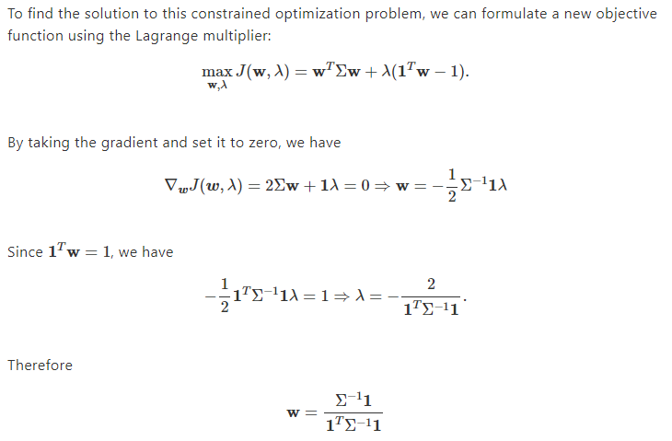
PO_{n}: Min. Variance Only (Block-form Solution)

Slide 17
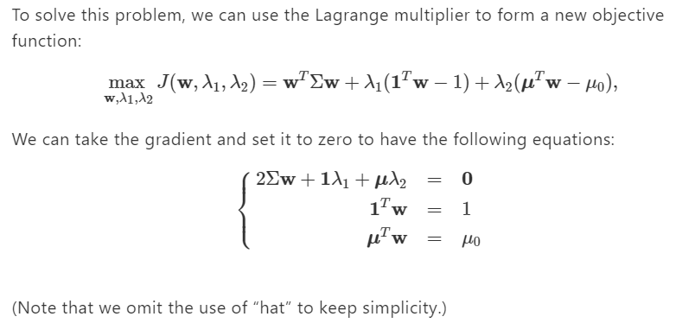
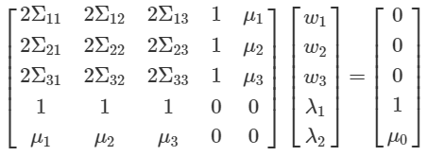
PO_{n}: Min. Var. with Fixed Return
When n=3

Slide 18
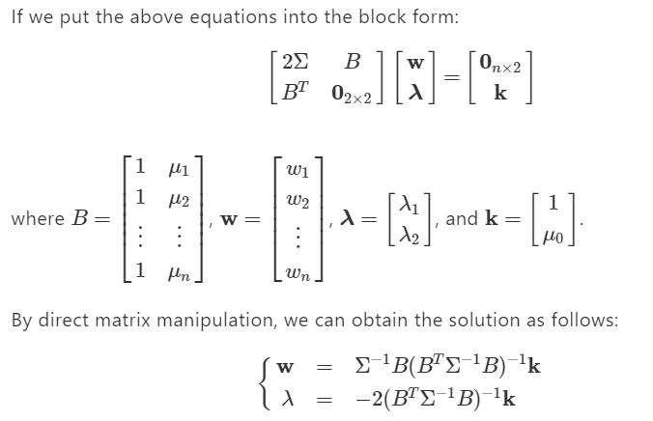
PO_{n}: Min. Var. with Fixed Return (Block-form Solution)
1
https://hackmd.io/@rogerjang/BkXxCdCIF, with exercises!

Slide 19
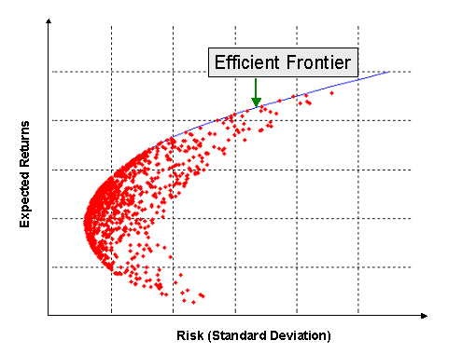

Efficient Frontier
Efficient frontier for portfolio optimization
Max $μ$ (return) with fixed $σ^{2}$ (risk)
Min $σ^{2}$ (risk) with fixed $μ$ (return)
Max Sharpe ratio $\left(=\frac{μ−μ_{f}}{σ}\right)$
Max $μ−βσ$
Min $σ^{2}$
Minimum-variance portfolio

Slide 20
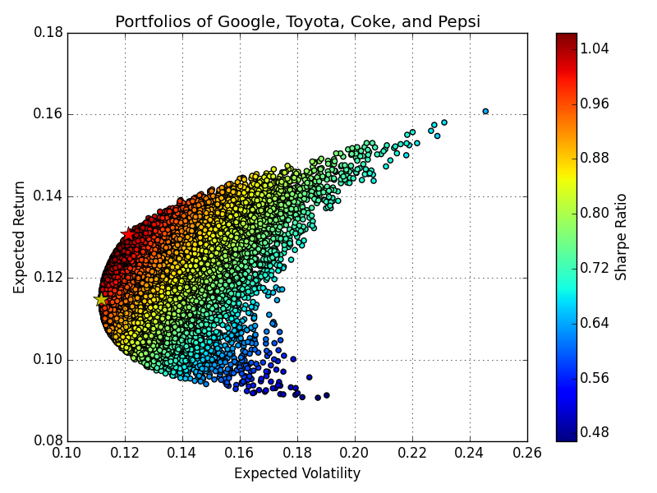
Resources
Investment Portfolio Optimization (with Python code)
More references:
https://hackmd.io/@rogerjang/SJN4FQbvF

Slide 21
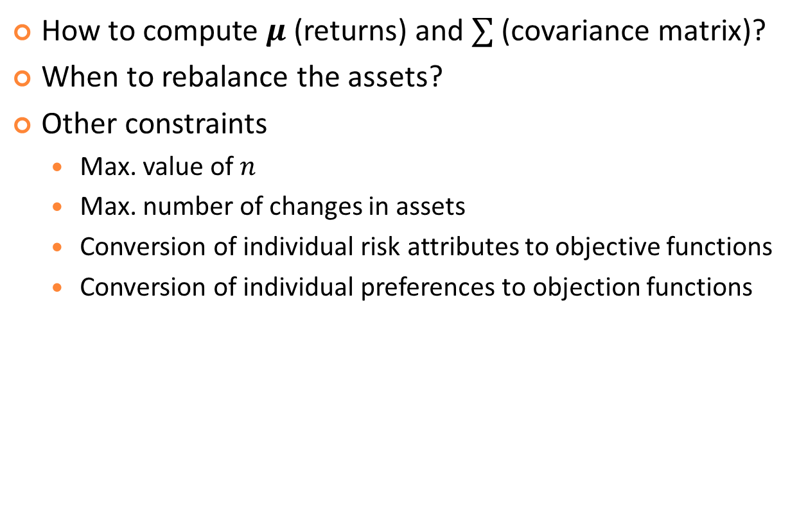
Other Things to Consider
How to compute $μ$ (returns) and $∑$ (covariance matrix)?
When to rebalance the assets?
Other constraints
Max. value of $n$
Max. number of changes in assets
Conversion of individual risk attributes to objective functions
Conversion of individual preferences to objection functions

Slide 22

Exercise: How to Compute Covariance Matrix
Find the covariance matrix of two assets with yearly returns as follows: X=[1 4 3 2 0], Y=[3 1 1 2 3].
Solution:
mean(X)=2, mean(Y)=2
X2=X-mean(X)=[-1 2 1 0 -2], Y2=Y-mean(Y)=[1 -1 -1 0 1]
A=[X2; Y2] (X2 on top of Y2, with a dim of 2X5)
Covariance matrix = (A*A^{T})/4=

Slide 23
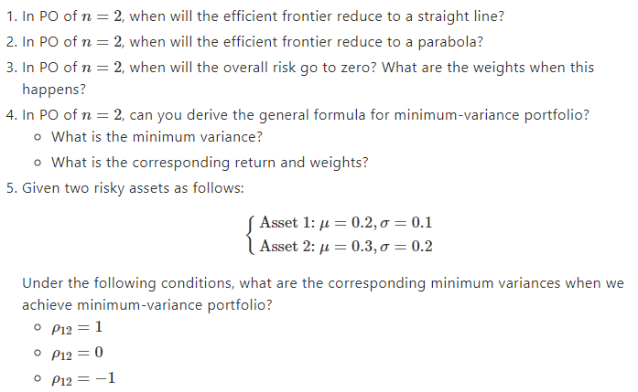
Exercises: PO with n=2

Slide 24
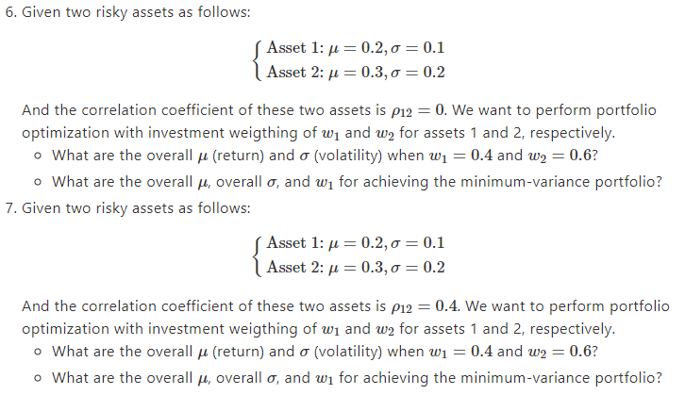
Exercises: PO with n=2

Slide 25
References
References at hackmd (with detailed math formula)
Intro to portfolio optimization
Objective functions for portfolio optim.
Portfolio for 2 assets
Portfolio optim.: Min. risk only
Portfolio optim.: Min. risk with fixed return
References

