Slide 1
USP Chapter <797>
Revised Chapter
Published 11/1/2022
Go-Live 11/1/2023
TN BOP Adherence 01/01/2024

Slide 2
Objectives
Key Terms and Abbreviations
Cleaning and Disinfecting
Hand Hygiene and Garbing
Microbial Contamination Risk Levels
Moving of Materials into and out of the Primary and Secondary Engineering Controls [PEC/SEC]
Beyond Use Dating

Slide 3
Key Terms
Cleaning – The physical removal of visible dirt, debris, and other contaminants from surfaces and equipment within a sterile compounding facility.
Disinfecting – The process of eliminating or reducing the number of microorganisms on surfaces, equipment, and other items within a sterile compounding facility, to a level that is considered safe for compounding sterile preparations
Deactivation – utilizing approved chemical agent(s) to render a hazardous drug or chemical inactive or inert
Decontamination – to physically remove the hazardous drug or chemical from a surface or area
Terminal Clean - the process of thoroughly cleaning and disinfecting a compounding area or room after all compounding activities have been completed

Slide 4
Abbreviations
Isopropyl Alcohol
IPA
Compounded Sterile Preparations
CSPs
Standardized Operating Procedures
SOPs
Primary Engineering Controls
PEC

Slide 5
Cleaning and Disinfecting

Slide 6
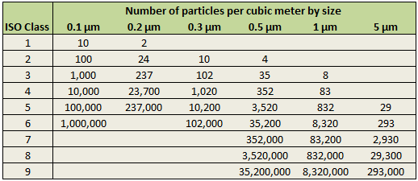
Pharmacy Cleanroom Cleaning Procedures
The number of particles allowable in each ISO class is federally regulated
Number of particles equal to and greater than 0.5mm measured in one cubic foot of air for each class of cleanroom
Inadequate cleaning allows biological particles to remain, compromising sterility and enabling non-viable particles to transport microorganisms

Slide 7
Cleaning Cleanrooms
Cleaning is an essential step as it removes organic and inorganic materials that may harbor microorganisms or interfere with disinfection
Using a detergent or surfactant solution for cleaning removes dirt, grime, grease, particulates and microbial contamination
Cleaning precedes Disinfection

Slide 8
Disinfecting Cleanrooms
Sanitization is crucial for a USP 797-compliant compounding or hospital pharmacy, but it can be confusing when developing cleaning protocols due to the many types of disinfectants available
Disinfectants can be categorized into oxidizing & non-oxidizing agents
Oxidizing agents - broad spectrum and the ability to kill spores
Non-oxidizing agents are organism specific
Oxidizing agents kill a broad range of organisms, including spores. Non-oxidizing agents are specific to certain organisms.
General oxidizing agents can pose risks to cleaning workers, so caution should be exercised when using them

Slide 9
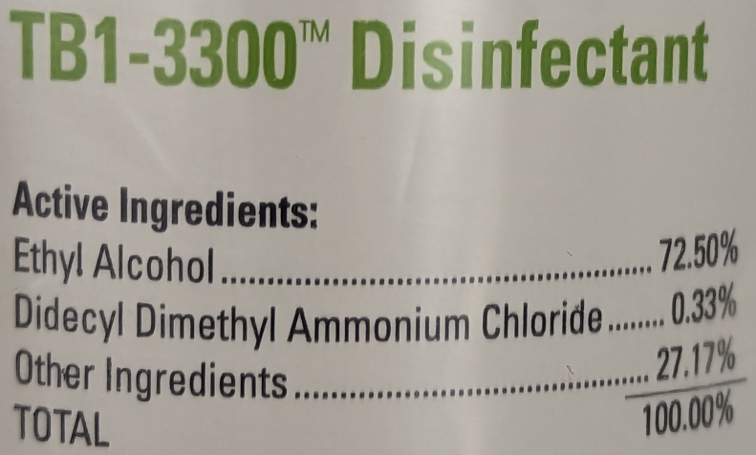
Disinfecting Cleanrooms
Non-oxidizing agents
Alcohols
Quaternary Ammonium Compounds (e.g. benzalkonium chloride)
Chlorhexidine
Sodium hypochlorite
Iodophors
e.g. TB1-3300

Slide 10
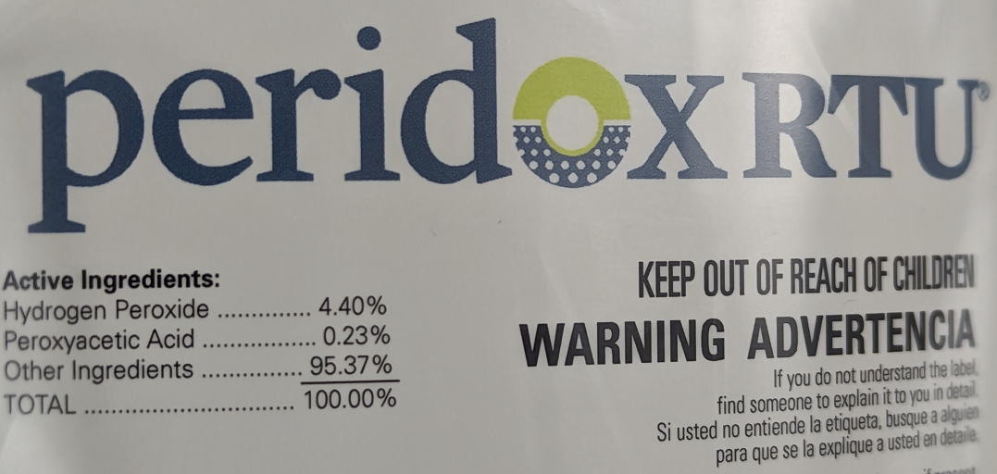
Disinfecting Cleanrooms
Oxidizing agents
Halogens
Peracetic acid
Hydrogen peroxide
e.g. PeridoxRTU

Slide 11
Disinfecting Cleanrooms
IPA, 3% hydrogen peroxide, and 2% sodium hypochlorite are effective sanitizing agents for ISO Class 5 compounding cleanrooms
The CDC affirms 500 ppm sodium hypochlorite solution is effective against most bio-contamination, but it lacks detergent action for cleaning soil and residue

Slide 12
Disinfecting Cleanrooms
To prevent the development of resistant microbes, it is advised to rotate disinfecting agents. This can be done by using a 2% bleach solution for 6 days and a detergent-based disinfectant on one day, which should be periodically changed to ensure it is included in the weekly and monthly cleaning routines. It is recommended to use a sporicide during monthly or quarterly cleaning cycles. Using this approach is cost-effective as hard-surface disinfectants are much more expensive than bleach solutions.
Consult the manufacturers' instructions and cleanroom consultants to ensure that the cleaning agents and tools are compatible, as their purposes and usage can vary greatly. It is important to talk with cleanroom consultants to ensure that cleanroom wipes and disinfectants are compatible
Perform a sterile IPA rinse after use of disinfectant to remove residue

Slide 13
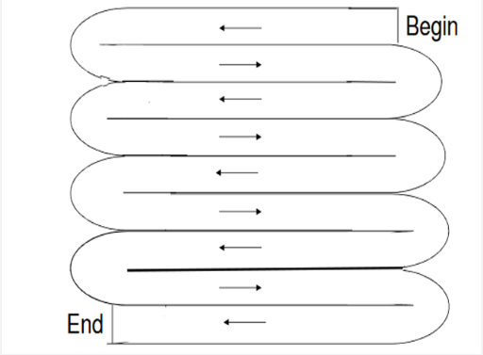
Cleaning and Disinfecting
At the start of each compounding shift, wipe all ISO Class 5 workstation surfaces with the specified cleaning and disinfecting agent, wetting surfaces thoroughly and allowing for proper exposure time. Use a "figure 8" pattern for more effective cleaning. Mops work well for flat surfaces, while lint-free wipers are better for smaller and detailed elements. Use a step stool to clean hard-to-reach areas safely

Slide 14
Daily Cleaning and Disinfecting with TB1-3300
1 minute dwell time
ISO 5 – PECs
ISO 7 - High touch and horizontal surfaces, sink, pass-through(s), and all other areas where sterile IPA is used daily
ISO 7 - Floors

Slide 15
Daily Cleaning and Disinfecting with PeridoxRTU
3 minute dwell time
ISO 5 - Biological Safety Cabinet/Chemo Hood
Daily at the end of shift for decontamination

Slide 16
Bi-Weekly Cleaning and Disinfecting
After TB1-3300 has achieved dwell time of one minute, and has dried completely, apply a rinse of IPA to prevent buildup and remove streaking on surfaces

Slide 17
Weekly Terminal Clean with PeridoxRTU
3 minute dwell time, allow to dry, and IPA rinse if needed
ISO 5 – Primary Engineering Controls
ISO 7
Ceilings, Walls, Shelving and Bins
High touch and horizontal surfaces
Sink and Floors
ISO 8 – Pass-thru window

Slide 18
Cleanroom Spills
In ISO 5 – use lint-free wipes with sterile water
In ISO 7 or 8 – may use lint-free wipes with tap water
Follow the SOP-specified cleaning agent to prevent chemical reactions with pharmaceutical components

Slide 19
Cleaning and Disinfecting Hardware
Mops
Use dedicated mop handles, heads, and covers for specific areas to prevent cross-contamination. Avoid using the same equipment for cleaning floors, walls, and ceilings or different ISO Class areas. Higher quality equipment such as bucketless cleanroom mop systems can reduce the number of mopping systems needed. Specific mop head and covers are used for cleaning different areas. Spraying cleaning agent and using a lint-free swivel mop head and cover is an effective cleaning method for floors, ceilings, and walls
Our process to dispose of covers and wipes that have been used is to place in a large zip lock bag for proper trash disposal after cleaning.

Slide 20
Cleaning and Disinfecting Hardware
Wipes
Use lint-free wipes for ISO Class 5 and higher areas, and larger wipes are more efficient. Dry lint-free wipes dipped in diluted cleaning solution are economical for cleaning surfaces such as laminar airflow hoods, workbenches, furniture, and bio-safety cabinets. Pre-saturated wipes are often the most effective and convenient for proper disinfection, but disposal regulations should be considered. Lint-free wipes can also be used to wipe items before bringing them into a critical environment
Our process to dispose of covers and wipes that have been used is to place in a large zip lock bag for proper trash disposal after cleaning.

Slide 21
Pharmacy Cleanroom Cleaning Procedures
Start cleaning from the cleanest area, ISO Class 5, to the dirtiest, ISO Class 7
Clean from top to bottom: ceilings, walls, equipment and furniture, then floors
Perform daily cleaning at the end of each compounding shift, according to the shift schedule (morning, evening, night)
For ISO Class 5, wipe workstation surfaces with designated sanitizing agent at the beginning of each compounding day
Ensure thorough wetting of surfaces with cleaning and disinfectant solutions, and follow manufacturer’s recommendations for contact time and rinse steps

Slide 22
Pharmacy Cleanroom Cleaning Procedures
Daily ISO Class 5 cleaning checklist (done at beginning and end of shift)
Mix cleaning and disinfecting agents if necessary
Prepare disinfecting agents and tools for cleaning
Empty waste receptacles and replace liners daily, or as needed
Remove full hazardous-waste receptacles and biohazardous materials
Clean sinks, countertops, cart tops, stool tops, and sharps containers
Clean and disinfect ISO Class 5 workstation with designated agents
Mop floors using a figure 8 pattern to reduce particle residue

Slide 23
Pharmacy Cleanroom Cleaning Procedures
Weekly ISO 5 Cleanroom Cleaning Checklist
Gather cleaning supplies, including manufactured cleaning products if necessary
Empty waste and hazardous waste receptacles
Clean all surfaces from top to bottom, including windows, walls, doors, and countertops
Sanitize non-compounding furniture and storage areas
Clean and disinfect ISO Class 5 workstations and compounders, noting any solution rotations
Mop floors using a figure 8 pattern to minimize particles
Document the cleaning in a cleaning log

Slide 24
Pharmacy Cleanroom Cleaning Procedures
Monthly ISO 5 Cleanroom Cleaning Checklist
Mix cleaning and disinfecting agents, including sporicide, as recommended, and update the monthly cycle log
Empty waste and hazardous waste receptacles and replace liners
Clean sinks, countertops, cart and stool tops, and exterior of sharps containers
Empty, clean, and sanitize storage shelving and bins
Clean ceilings, windows, walls, doors, and all other horizontal surfaces from top to bottom
Clean and sanitize non-compounding furniture, such as carts, stools, and waste containers
Clean and sanitize refrigerators and incubators (not kept in controlled environments)
Clean ISO Class 5 workstations and compounders, noting any rotation of solutions
Disinfect ISO Class 5 workstations and compounders with designated agents
Mop floors using a figure 8 pattern to reduce leaving behind particles

Slide 25
Hand Hygiene and Garbing

Slide 26
Demonstrating Core Skills
To compound CSPs independently or oversee personnel, training is required to demonstrate knowledge and skills for sterile manipulations and maintaining appropriate environmental conditions. This training must be completed initially and every six months in the following:
Hand Hygiene
Garbing
Cleaning and disinfection
Principles of movement of materials and personnel within the compounding area

Slide 27
Personal Hygiene and Garbing
Proper personal hygiene and garbing are crucial to minimize contamination of cleanrooms and CSPs. Skin cells shed by individuals contain microorganisms, making it necessary to take appropriate steps, including hand hygiene and garbing, to reduce the risk of contamination in compounding areas where Category 1, Category 2 or Category 3 CSPs are prepared

Slide 28
Hand Hygiene
Must wash hands and forearms up to the elbows with soap and water for at least 30 seconds
Clean underneath fingernails under warm water, using a disposable nail cleaner
Must use non-refillable soap containers
Dry hands and forearms with low-lint disposable towels or wipes
Brushes and hand dryers must not be used
Sanitize hands with alcohol-based rub prior to donning sterile gloves

Slide 29
Garbing for Category 1 & Category 2 CSPs
All garments, shoe covers, head and face coverings must be low lint
Sterile gloves must be powder free, and must be free of holes, punctures or tears
IPA 70% must be applied immediately prior to compounding, and regularly throughout the process
If any garb becomes visibly soiled, replace immediately
Donning and doffing garb should not occur at the same time and place (e.g. shift change)
Individual gowns may be reused within the same shift, if the gown remains in the Ante Room. All other garb must be replaced each time when entering the Buffer Room.

Slide 30
Garbing for Category 3 CSPs
No exposed skin allowed in buffer room
Face and neck must be covered
All low-lint outer garb must be sterile
Disposable garb cannot be reused
Laundered garb must not be reused without being laundered and resterilized

Slide 31
Hand Hygiene and Garbing Summary
Go to the bathroom, secure hair if needed, clean personal glasses if needed
Remove all cosmetics
Remove jewelry, watch, earbuds, necklace, etc. if needed
Enter anteroom, don face and head covers (beard cover if needed)
Don shoe covers, ensuring that covered shoes are across Line of Demarcation
Perform appropriate hand hygiene
Don gown
Enter the buffer room
Apply alcohol-based hand rub to your hands and wrists
Don sterile gloves

Slide 32
Microbial Contamination Risk Levels

Slide 33
Category 1 CSPs
Compounding with aseptic technique in ISO Class 5 or better, using no more than 3 sterile ingredients, products compounds and/or devices
Examples
Simple transfers of sterile medications from one container to another, such as transferring sterile saline from a large bottle to a small syringe for injection.
Reconstitutions of sterile powders, such as mixing a powdered antibiotic with sterile water to create a solution for injection.
Dilutions of sterile liquids, such as diluting a concentrated medication with sterile saline to achieve the desired dose.
Dispensing sterile medications from a manufacturer's container into a sterile syringe or bag for immediate use or administration to a single patient.

Slide 34
Category 2 CSPs
Compounded multiple or small doses of sterile products for administration to multiple patients or a single patient on multiple occasions, with aseptic technique in ISO Class 5 or better . The compounding process involves complex aseptic manipulations, takes a long time and may involve mixing or dissolution. These products are administered over several days and do not contain broad-spectrum bacteriostatic substances
Examples
Total parenteral nutrition (TPN) solutions
Batches of intravenous solutions, such as oxytocin 20 units in D5LR 1000mL

Slide 35
Category 3 CSPs
Require increased

