Slide 3
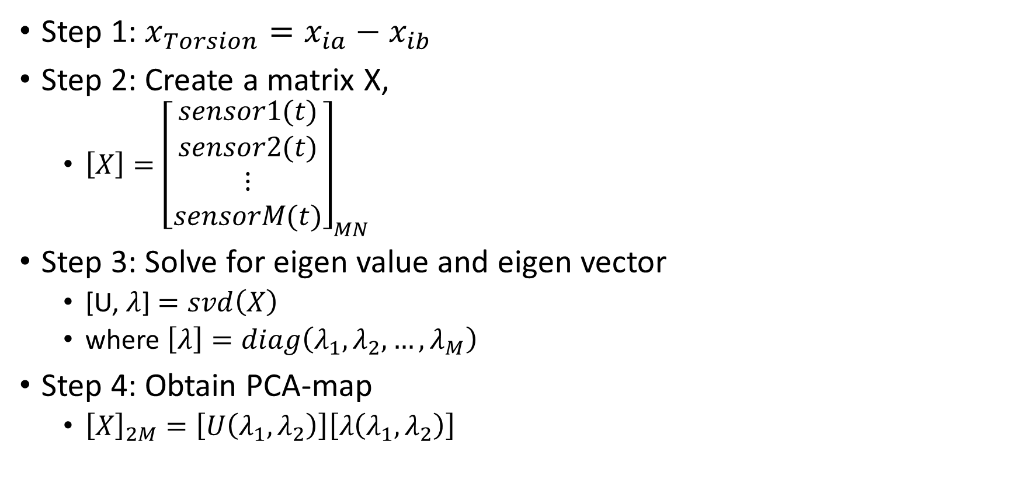
Torsion data
Step 1: $x_{Torsion}=x_{ia}−x_{ib}$
Step 2: Create a matrix X,
$\left[X\right]={\left[\begin{matrix}\begin{matrix}sensor1(t) \\ sensor2(t)\end{matrix} \\ ⋮ \\ sensorM(t)\end{matrix}\right]}_{MN}$
Step 3: Solve for eigen value and eigen vector
[U, $λ$] $=svd\left(X\right)$
where $\left[λ\right]=diag\left(λ_{1},λ_{2},…,λ_{M}\right)$
Step 4: Obtain PCA-map
${\left[X\right]}_{2M}=\left[U\left(λ_{1},λ_{2}\right)\right]\left[λ\left(λ_{1},λ_{2}\right)\right]$

