Slide 1
Integrating React/Redux and Legacy
Megan Conley
Team Travel UI

Slide 2
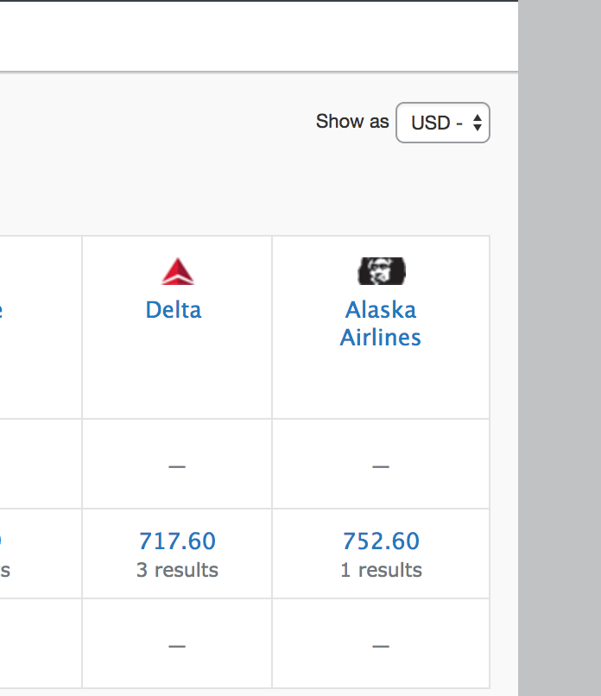
How do we integrate into legacy instead of replacing entirely?
And why do we want to do it at all?
Break the seal
Proof of concept that we can build new features that are performant and maintainable
Develop skills
Ramp the team up on React/Redux with smaller features before building a new page

Slide 3
Package up what we need from React/Redux
Parent page is outside the lifecycle
The component needs to bring with it the functions to render itself and to call actions
Entry point per shop type
Air/rail (transit), car, hotel, ground each could have different requirements

Slide 4
Components, Actions, API context
API Context
Get the JWT from session and the orchestration URL from the config
exportComponent
Export functions to render component, wrap in store if needed, stores on the global nui object
exportActions
Binds actions to nui namespace so they can be invoked directly
Create and export callbacks
When we need the component to interact with the legacy page
Bundled up in the webpack entry points to be committed into SVN

Slide 5
Code samples
In NUI – ApiContext, exportComponents, exportActions, exportCallbacks, transit/ground/hotel/car.js entry points
In legacy – availability_*.js

