Slide 1

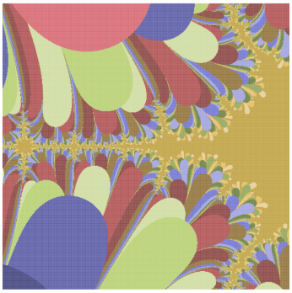
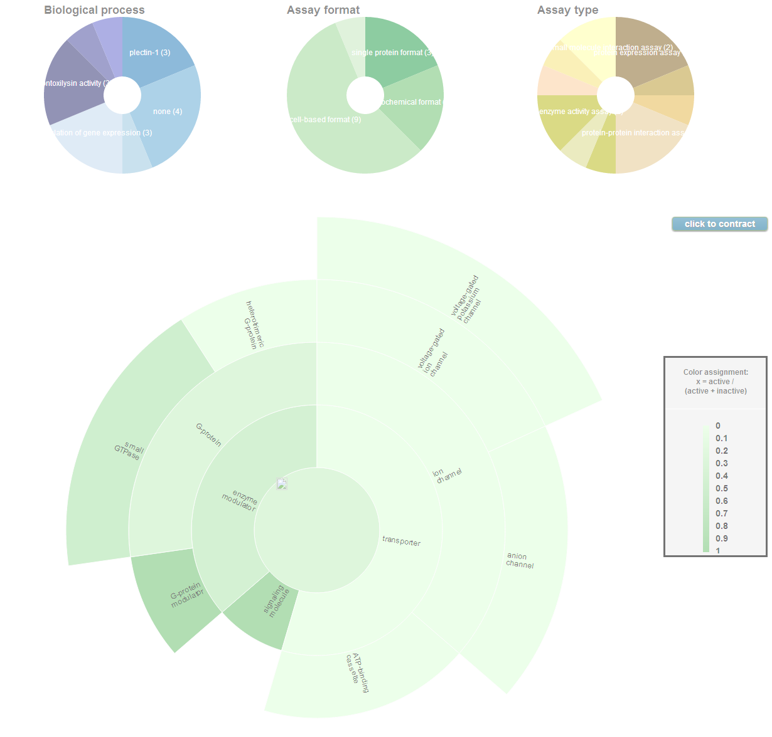
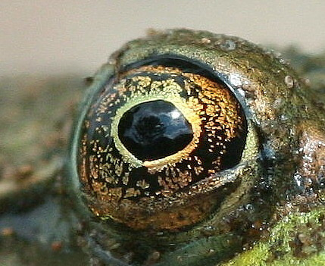
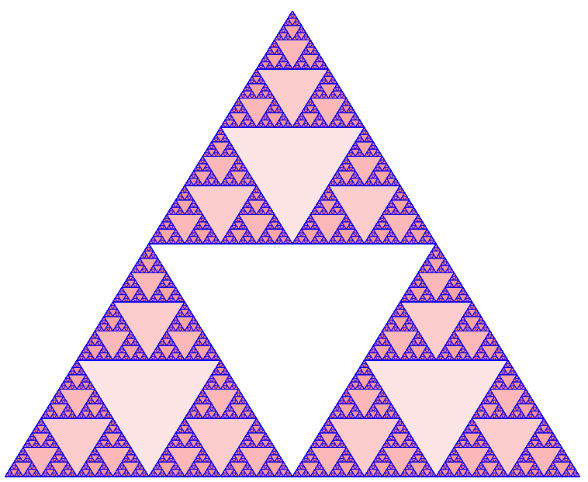
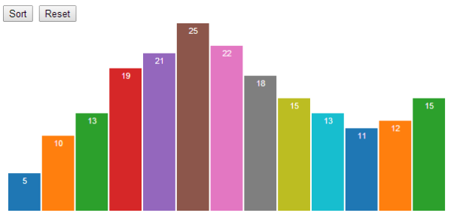
D3, JavaScript, and my search for the perfect picture

Slide 2

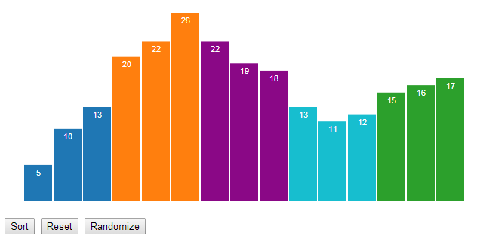
What does it mean to be simple?
demo
Notes:
Programming is an exercise in complexity minimization. Without the object orientation, how do we achieve that end?
Display the swirling histogram demo
Animated transitions are pretty, but they also serve a purpose: they make it easier to follow the data. This is known as object constancy: a graphical element that represents a particular data point (such as Ohio) can be tracked visually through the transition. This lessens the cognitive burden by using preattentive processing of motion rather than sequential scanning of labels.

Slide 3

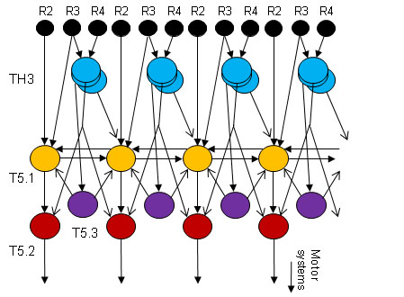
The interpretation of an image in the eye of a toad
Jörg-Peter Ewert (University of Kassel) studied the eyes of toads, then identifies and models the local processing
Frog movie
(https://www.youtube.com/watch?v=l3Es9cNH7I8)
Notes:
Jörg-Peter Ewert is from University of Kassel in Germany

Slide 4
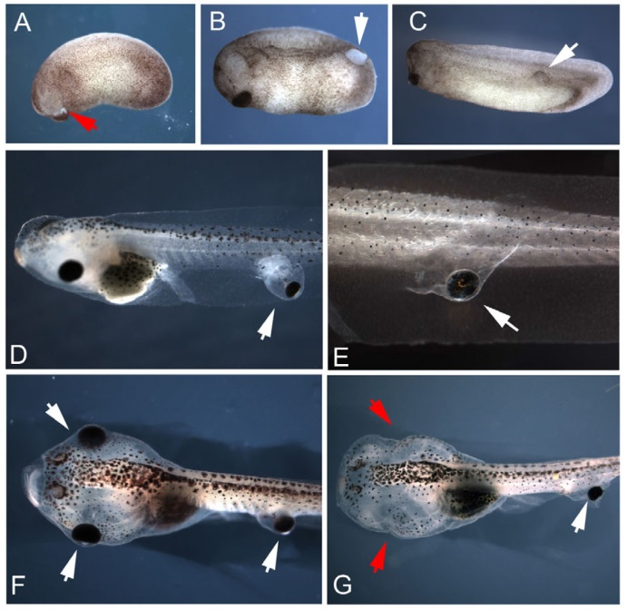
Toad eyes can respond even without obvious neural connection
“Ectopic eyes outside the head in Xenopus tadpoles provide sensory data for light-mediated learning”
Blackiston, D., and Levin, M
J Exp Biol 216, 1031-1040.
(Tufts University, laboratory of Michael Levin)
Notes:
Humans are relentlessly visual creatures
Douglas J. Blackiston and
Michael Levin*
Ectopic eyes outside the head in Xenopustadpoles provide sensory data for light-mediated learning
https://www.youtube.com/watch?v=l3Es9cNH7I8
doi: 10.1242/​jeb.074963March 15, 2013J Exp Biol 216, 1031-1040.

Slide 5
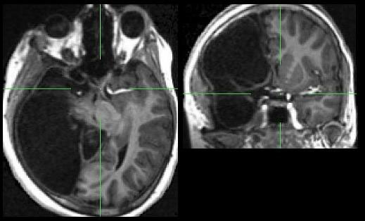
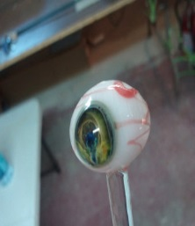
How then to interpret images in the context of the human brain?
"half of the human brain is devoted directly or indirectly to vision"
Prof. Mriganka Sur, Department of Brain and Cognitive Sciences, MIT
Notes:
Either try to restrict the message only to that which was intended, or else let the images fly and rely on the brain to filter out the spurious conclusions

Slide 6

Scientific graphics, technical presentations and the perfect graphic
Austere scientific graphics serve a different purpose then pictures in a PowerPoint deck. Can a partially recognized
picture can make a page feel more 'comfortable‘? Can we leverage these processes to serve a pedagogical purpose?
Notes:
Are mathematics and spoken language vastly different?
A scientific graphics, stripped of all ornamentation, comes blanketed with a thick layer of abstraction.
A photograph might be entirely ornamentation, comes with an overcoat of associations but entirely escapes the abstraction layer.

Slide 7

The road to maintainable, extensible D3-based graphics?

Slide 8
5 guiding ideas
As an aid to managing complexity we might:
Choose good tools
Focus on control of scope
Utilize known patterns
Build using stepwise refinement
Design graphics to minimize cognitive distance

Slide 9
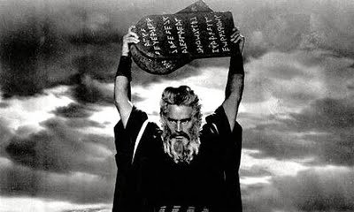
Proposed best practices

Slide 10

Part 1: the tools
Notes:
If good programming is indeed an exercise in complexity minimization, how do we achieve that without the object orientation?

Slide 11
Javascript
Javascript is dynamic, (executing many behaviors at runtime) prototype-based (as opposed to class inheritance) scripting language with first-class functions (functions have properties and methods, can be nested, and support lexical closures). Early versions of the JavaScript have been available since 1996.
Notes:
If good programming is indeed an exercise in complexity minimization, how do we achieve that without the object orientation?

Slide 12
D3
D3 stands for “Data-Driven Documents”, and it is a JavaScript library that allows the creation of dynamic, interactive graphics which are run in a web browser. Is highly dependent on web standards and attempts to avoid the finding a new proprietary framework. It was released in August of 2011.

Slide 13
Tools
demo
HTML5
CSS3
DOM
SVG
Browser development environment
Jasmine

Slide 14
Tools
demo
HTML5
CSS3
DOM
SVG
Browser development environment
Jasmine

Slide 15
Tools
demo
HTML5
CSS3
DOM
SVG
Browser development environment
Jasmine

Slide 16
Tools
demo
HTML5
CSS3
DOM
SVG
Browser development environment
Jasmine

Slide 17
Tools
demo
HTML5
CSS3
DOM
SVG
Browser development environment
Jasmine

Slide 18
Tools
demo
HTML5
CSS3
DOM
SVG
Browser development environment
Jasmine
demo

Slide 19

Part 2: encapsulation
Notes:
If good programming is indeed an exercise in complexity minimization, how do we achieve that without the object orientation?
My favorite javascript oddities

Slide 20
Encapsulation: remember that Javascript is NOT block scoped
x;
==> undefined
{
var x = 1;
}
x;
==> 1
Notes:
also not that VAR keeps away the globals

Slide 21
Encapsulation: remember that Javascript is NOT block scoped
x;
==> undefined
{
var x = 1;
}
x;
==> 1
Notes:
also not that VAR keeps away the globals

Slide 22
Encapsulation: remember that Javascript is NOT block scoped
x;
==> undefined
{
var x = 1;
}
x;
==> 1
Notes:
also not that VAR keeps away the globals

Slide 23
Encapsulation: keep your namespaces clean
var cbbo = {}; // not safe
cbbo.myVar = 123;
if ( typeof cbbo === "undefined") {
cbbo = {}; // not succinct
}
var cbbo = cbbo || {}; // Nice!

Slide 24
Encapsulation: keep your namespaces clean
var cbbo = {}; // not safe
cbbo.myVar = 123;
if ( typeof cbbo === "undefined") {
cbbo = {}; // not succinct
}
var cbbo = cbbo || {}; // Nice!

Slide 25
Encapsulation: keep your namespaces clean
var cbbo = {}; // not safe
cbbo.myVar = 123;
if ( typeof cbbo === "undefined") {
cbbo = {}; // not succinct
}
var cbbo = cbbo || {}; // Nice!

Slide 26
Encapsulation: immediately invoked function declarations are your friend
console.log('x1='+typeof x);
(function(){
var x=47;
console.log('y1='+typeof x);
})();
console.log('x2='+typeof x);

Slide 27
Encapsulation: immediately invoked function declarations are your friend
console.log('x1='+typeof x);
(function(){
var x=47;
console.log('y1='+typeof x);
})();
console.log('x2='+typeof x);

Slide 28
Encapsulation: immediately invoked function declarations are your friend
console.log('x1='+typeof x);
(function(){
var x=47;
console.log('y1='+typeof x);
})();
console.log('x2='+typeof x);

Slide 29
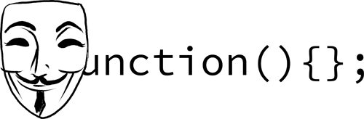
Encapsulation: favor assignment of anonymous functions
x(); // ERROR -- x is declared but still undefined
y(); // y can run before it is declared
var x=function(){
console.log('here I am x');
};
function y(){
console.log('here I am y');
};

Slide 30
Encapsulation: favor assignment of anonymous functions
x(); // ERROR -- x is declared but still undefined
y(); // y can run before it is declared
var x=function(){
console.log('here I am x');
};
function y(){
console.log('here I am y');
};

Slide 31
Encapsulation: favor assignment of anonymous functions
x(); // ERROR -- x is declared but still undefined
y(); // y can run before it is declared
var x=function(){
console.log('here I am x');
};
function y(){
console.log('here I am y');
};

Slide 32
Graphical encapsulation: typical object heirarchy
Chart
Guide
Frame
Graph
Axis
Form
Contour
Point
Rule
Scale
Label
Curve
Symbol
Label

Slide 33


Graphical encapsulation by source file
demo

Slide 34
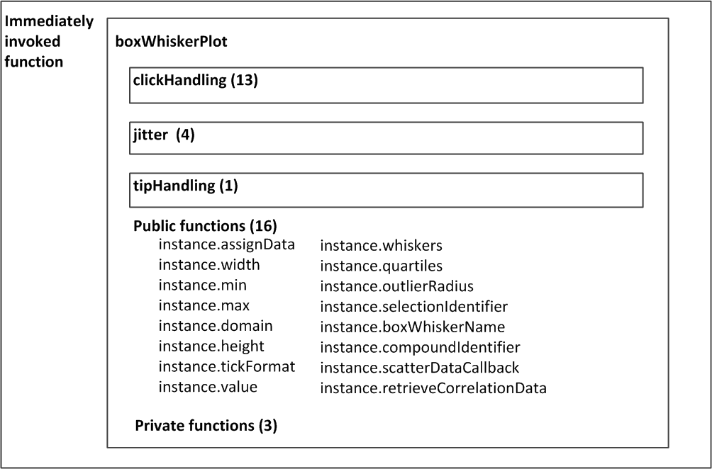
Graphical encapsulation with functional nesting
Notes:
Grand total for one file equals 78 functions

Slide 35

Part 3: the patterns
Notes:
If good programming is indeed an exercise in complexity minimization, how do we achieve that without the object orientation?

Slide 36
Patterns: know this
Unlike many other common languages, the value of the this construct depends on the syntax of the caller.
Furthermore, essential language elements (ex. methods, modules, and constructors) are only patterns, not core language constructs.

Slide 37

this in a function
var x=function(){
console.log('this='+this);
}
x()
this=[object Window]
Notes:
In Javascript, functions, methods, and constructors are only patterns, not core language constructs.

Slide 38
this in a function
var x=function(){
console.log('this='+this);
}
x()
this=[object Window]
Notes:
In Javascript, functions, methods, and constructors are only patterns, not core language constructs.

Slide 39

this in a method
var obj={
hi:function(){
console.log('this='+this);
}
}
obj.hi()
this=[object Object]
Notes:
In Javascript, functions, methods, and constructors are only patterns, not core language constructs.

Slide 40
this in a method
var obj={
hi:function(){
console.log('this='+this);
}
}
obj.hi()
this=[object Object]
Notes:
In Javascript, functions, methods, and constructors are only patterns, not core language constructs.

Slide 41

this in a constructor
function hi(friend) {
this.myFriend=friend;
}
var myVar = new hi(‘joe’);
myVar
{ myFriend: ‘joe’}
Notes:
In Javascript, functions, methods, and constructors are only patterns, not core language constructs.

Slide 42
this in a constructor
function hi(friend) {
this.myFriend=friend;
}
var myVar = new hi(‘joe’);
myVar
{ myFriend: ‘joe’}
Notes:
In Javascript, functions, methods, and constructors are only patterns, not core language constructs.

Slide 43
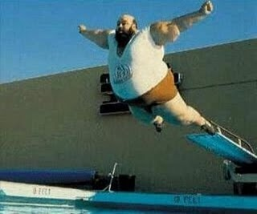
Custom assignment of this
var xx=function(myParm){
console.log('this='+this+',myParm='+
myParm);
}
xx('f')
this=[object Window], myParm=f
xx.call('g','f')
this=g, myParm=f
Notes:
Functions have built-in call method for custom receivers:
Under ES5 every function has a “bind” method which provide a way to assign a custom receiver across one or more calls. Useful when currying and in other applications.

Slide 44
Custom assignment of this
var xx=function(myParm){
console.log('this='+this+',myParm='+
myParm);
}
xx('f')
this=[object Window], myParm=f
xx.call('g','f')
this=g, myParm=f
Notes:
Functions have built-in call method for custom receivers:
Under ES5 every function has a “bind” method which provide a way to assign a custom receiver across one or more calls. Useful when currying and in other applications.

Slide 45
Custom assignment of this
var xx=function(myParm){
console.log('this='+this+',myParm='+
myParm);
}
xx('f')
this=[object Window], myParm=f
xx.call('g','f')
this=g, myParm=f
Notes:
Functions have built-in call method for custom receivers:
Under ES5 every function has a “bind” method which provide a way to assign a custom receiver across one or more calls. Useful when currying and in other applications.

Slide 46
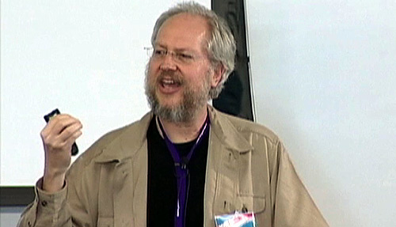
The ‘Crockford Effect’
Douglas Crockford wrote a hugely influential book in 2008:
“Most programming languages contain good and bad parts, but JavaScript has more than its share of the bad … This authoritative book scrapes away these bad features to reveal a subset of JavaScript that's more reliable, readable, and maintainable than the language as a whole…”
demo
He also went on to write JSLint to codify and enforce his ideas. His approach is workable and self consistent, it isn’t the only way to write good JavaScript.

Slide 47
Patterns: Looping in Javascript
Iterators are generally better than looping.
var dict=[{ name:joe, age:22},
{ name:bob, age:23}];
var justNames = [];
dict.forEach( function(x) {
justNames.push(x.name);
}
Though under ES5 maps are the best way to modify arrays.
var nameSlashAge = dict.map(function(x) {
return x.name+’/’+ x.age;
})
Notes:
Under ES5 every function has a “bind” method which provide a way to assign a custom receiver across one or more calls. Useful when currying and in other applications.

Slide 48
Patterns: Looping in Javascript
Iterators are generally better than looping.
var dict=[{ name:joe, age:22},
{ name:bob, age:23}];
var justNames = [];
dict.forEach( function(x) {
justNames.push(x.name);
}
Though under ES5 maps are the best way to modify arrays.
var nameSlashAge = dict.map(function(x) {
return x.name+’/’+ x.age;
})
Notes:
Under ES5 every function has a “bind” method which provide a way to assign a custom receiver across one or more calls. Useful when currying and in other applications.

Slide 49
JavaScript Patterns
Closure pattern: good for private data.
var u1=function(myParm){
this.getParm=function(){
return "your parm is "+myParm;
}
}
I call it the ‘Object pattern’
var u2=function(myParm){
this.myParm=myParm;
this.getParm=function(){
return "your parm is "+this.myParm;
}
}
Notes:
Under ES5 every function has a “bind” method which provide a way to assign a custom receiver across one or more calls. Useful when currying and in other applications.

Slide 50
JavaScript Patterns
Closure pattern: good for private data.
var u1=function(myParm){
this.getParm=function(){
return "your parm is "+myParm;
}
}
The ‘Object pattern’
var u2=function(myParm){
this.myParm=myParm;
this.getParm=function(){
return "your parm is "+this.myParm;
}
}
Notes:
Under ES5 every function has a “bind” method which provide a way to assign a custom receiver across one or more calls. Useful when currying and in other applications.

Slide 51
JavaScript Patterns
Stephan Stefanov’s ‘module pattern’. Good for building libraries.
var u3=(function(){
var _myParm,
setParm=function(myParm){
_myParm=myParm;
},
getParm=function(){
return "your parm is "+_myParm;
};
return {
setParm:setParm,
getParm:getParm
}
}());
Notes:
but probably not a good way to build reusable objects

Slide 52
JavaScript Patterns
A good pattern for ‘extensible objects’
var u4=function(myParm){
var _holder={},
_myParm = myParm;
_holder.getParm = function(){
return "your parm is "+_myParm;
}
return _holder;
}
Notes:
Under ES5 every function has a “bind” method which provide a way to assign a custom receiver across one or more calls. Useful when currying and in other applications.

Slide 53

D3 patterns– method chaining (1/2)
A commonly used pattern in D3 involves returning a consistent object with each call so that methods can be chained
svg.selectAll(‘circle’)
.attr(‘cx’, 50)
.attr(‘cy’, 100)
.attr(‘r’, 3.5);
A JavaScript pattern makes this construction easy to implement…
Notes:
Use Sierpinski example here?

Slide 54

D3 patterns– method chaining (2/2)
JavaScript implementation:
instance.width = function (x) {
if (!arguments.length) return width;
width = x;
return instance;
};
Note also that this pattern combines
getters and setters into a single function
Notes:
Use Sierpinski example here?

Slide 55
D3 patterns- charts as closures
Combine the method chaining slides into one example
function myChart(){
function instance () {
// chart generation code goes here
}
instance.width = function (x) {
if (!arguments.length) return whiskers;
whiskers = x;
return instance;
};
return instance;
}
Notes:
Use Sierpinski example here?

Slide 56
Part 4: stepwise refinement
demo
Notes:
If good programming is indeed an exercise in complexity minimization, how do we achieve that without the object orientation?

Slide 57
Better graphics through stepwise refinement
Niklaus Wirth has been promoting stepwise refinement since the 1970s, and in an age of Agile methodologies this approach makes all the more sense. In the context of Data Driven Documents (where data leads and different representations follow user requirements) this idea may become even more important.
Notes:
Accessibility: Because you bring your hard-won knowledge of JavaScript, CSS, etc the tools are ultimately very accessible to you.
Expressiveness: Using all of the complexities of the multiple underlying systems provides a huge range of possible graphical capabilities
Performance: Avoiding all of the abstractions of high level graphical libraries allows you to better leverage the capabilities of the computer
Here’s a quote from the 2011 IEEE paper: “provides a close cognitive mapping between the toolkit representation and the desired result, reducing the gulf of execution for designers and improving accessibility”. Is this idea really meaningful.

Slide 58

The ‘Bostock Effect’
Mike Bostock wrote Protovis as a declarative graphical library (released 2009) as a PhD student in the Stanford Visualization Group. The project was abandoned in 2011 to make way for D3.
demo
D3 attempts to minimize the distinction between data storage and visual representation ( Bostock describes it as a ‘representation-transparent approach to visualization’). The novelty of this approach leads to code that may initially seem perplexing, but in the long run offers advantages in terms of accessibility, expressiveness and performance.
Notes:
Accessibility: Because you bring your hard-won knowledge of JavaScript, CSS, etc the tools are ultimately very accessible to you.
Expressiveness: Using all of the complexities of the multiple underlying systems provides a huge range of possible graphical capabilities
Performance: Avoiding all of the abstractions of high level graphical libraries allows you to better leverage the capabilities of the computer
Here’s a quote from the 2011 IEEE paper: “provides a close cognitive mapping between the toolkit representation and the desired result, reducing the gulf of execution for designers and improving accessibility”. Is this idea really meaningful.

Slide 59
Core D3 - selections (1)
One of the central elements in D3 is the ‘selection’. Be not confused – W3C has selectors (and D3 adopts the W3C Selectors API), but in D3 these atomic operands yield selections
d3.selectAll(‘.triangles’)
d3.select(‘#myFavoriteId’)
d3.selectAll(‘[name=value]’)
Notes:
Use Sierpinski example here?

Slide 60
Core D3 -- selections (2)
Selections are modified arrays of elements pulled from the current document. D3 uses operators to implicitly act upon these arrays, so explicit looping is often avoided
_svg.selectAll("polygon")
.attr('fill', function () {
return "rgba(255,0,0,0.2)"
});
Notes:
Use Sierpinski example here?

Slide 61
D3 patterns– built in multiplicity
If you can call it once then why not call it over and over?
myChart(selection);
selection.call(myChart);
my(selection) {
selection.each(function(d, i) {
// generate chart here;
// `d` is the data and `i` is the index
});
}
Notes:
Use Sierpinski example here?

Slide 62
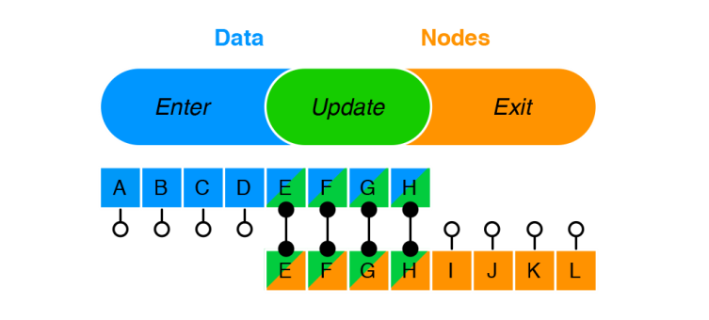
Core D3 -- data
The data operator binds input data to selected nodes in the DOM. Data joins are managed with the enter and exit subselections
Data joins are crucial for efficient dynamic visualization
Notes:
Use Sierpinski example here?

Slide 63
D3 patterns– enter/ update/exit
A central pattern which helps to define the D3 as declarative versus being built around imperatives.
var svg = d3.select("body")
.append("svg")
var triangle = svg.selectAll("polygon")
.data(products);
triangle.enter().append("polygon");
triangle.exit().remove();
Notes:
Use Sierpinski example here?

Slide 64

Part 5: cognitive distance
demo
Notes:
If good programming is indeed an exercise in complexity minimization, how do we achieve that without the object orientation?

Slide 65
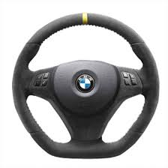
Principle of mapping
Donald Norman in his 1980 book “The Design of Everyday Things” provides examples of good and bad mapping. The first, like a steering wheel, takes advantage of physical analogies and cultural standards. Bad mappings are pure abstractions and therefore easily forgotten.
Notes:
If good programming is indeed an exercise in complexity minimization, how do we achieve that without the object orientation?

Slide 66
Graphics imply mappings
Start with a physical space S. A graphic maps S to a graphical space P
f: S → P
Good graphics a often continuous, meaning that a small distance between elements in S corresponds to a small distance between associated elements in P
Notes:
There are exceptions, such as geographical maps

Slide 67
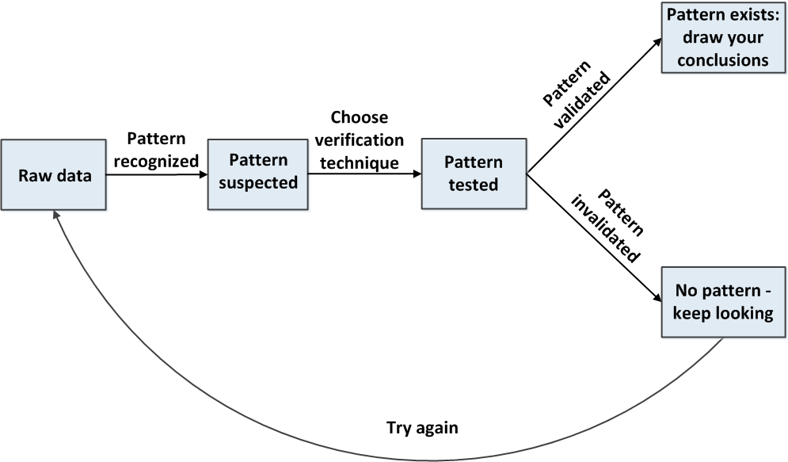
Finding the signal in the noise

Slide 68
Is there a mental landscape?
Most theories of perception postulate at least two stages of processing:
pre-attentive, perceived without effort
Higher cognitive, consciously analyzed
It is possible that pre-attentive is metric whereas higher cognitive spaces are not.
demo
Notes:
There are exceptions, such as geographical maps

Slide 69
Acknowledgments
Chemical biology platform
Other people helped
Steve Brudz
Dan Durkin
Jacob Asiedu
Dave Lahr
Eleanor Howe
Mary Pat Happ
Jeri Levine
Gil Walzer
Patrick McCarren
Vlado Dancik
Karen Emmith
Jason Rose
Mike Quintin
Xiaorong Xiang
Bang Wong
Noam Shoresh
Ted Liefeld
Corey Flynn
Maskull Lasserre
Notes:
Use Sierpinski example here?

Slide 70
Books worth having:
Effective JavaScript, David Herman.2013, Person Education
JavaScript: The Good Parts, Douglas Crockford,2008, O’Reilly
JavaScript Patterns, Stoyan Stefanov,2010, O’Reilly
Secrets of a JavaScript Ninja, John Resig,2013, Manning Publications
The Grammer of Graphics, Leland Wilkinson,2005, Springer Science
Notes:
Under ES5 every function has a “bind” method which provide a way to assign a custom receiver across one or more calls. Useful when currying and in other applications.

Slide 71
Acknowledgments
Chemical biology platform
Other people helped
Steve Brudz
Dan Durkin
Jacob Asiedu
Dave Lahr
Eleanor Howe
Mary Pat Happ
Jeri Levine
Gil Walzer
Patrick McCarren
Vlado Dancik
Karen Emmith
Jason Rose
Mike Quintin
Xiaorong Xiang
Bang Wong
Noam Shoresh
Ted Liefeld
Corey Flynn
Maskull Lasserre
Notes:
Use Sierpinski example here?

Slide 72
Books worth having:
Effective JavaScript, David Herman.2013, Person Education
JavaScript: The Good Parts, Douglas Crockford,2008, O’Reilly
JavaScript Patterns, Stoyan Stefanov,2010, O’Reilly
Secrets of a JavaScript Ninja, John Resig,2013, Manning Publications
The Grammer of Graphics, Leland Wilkinson,2005, Springer Science
Notes:
Under ES5 every function has a “bind” method which provide a way to assign a custom receiver across one or more calls. Useful when currying and in other applications.

