Slide 1
D3: scaling the learning curve and coding effectively

Slide 2
How I've organized this presentation:
Overview of the topic
Introduction to D3
Core JavaScript concepts
Advanced JavaScript concepts

Slide 3
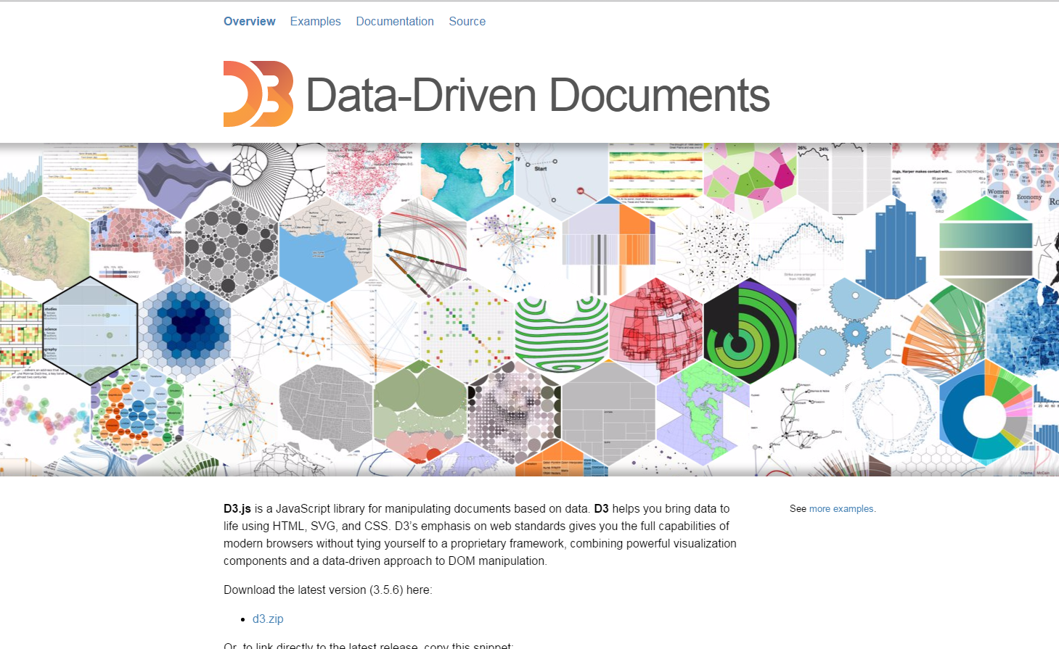
http://d3js.org/

Slide 4

http://vis.stanford.edu/papers/d3

Slide 5

Frostbitten fingers,
the right tool for the right job,
and proper preparations

Slide 6
Our job: extracting order from chaos
For the informaticist, "effort per byte" increases
data
tables
visualizations
design
For the consumer, complexity decreases
(Or maybe, comprehension per unit time increases)

Slide 7
Data to knowledge conversion pipeline
HTML
CSS
Javascript
Data in DOM
expressed in SVG
Images/interactivity
in a browser
+
Knowledge
Raw data

Slide 8

0 to 100 km/hr in 2.2 seconds

Slide 9
Introduction to D3
Notes:
If good programming is indeed an exercise in complexity minimization, how do we achieve that without the object orientation?

Slide 10

D3 can be hard to learn because it is not a language (though maybe a DSL). It is a JavaScript library which combines a collection of web development tools

Slide 11
Tools
HTML5
CSS3
DOM
SVG
Browser development environment
Jasmine

Slide 12
Tools
HTML5
CSS3
DOM
SVG
Browser development environment
Jasmine

Slide 13
Tools
HTML5
CSS3
DOM
SVG
Browser development environment
Jasmine

Slide 14
Tools
HTML5
CSS3
DOM
SVG
Browser development environment
Jasmine

Slide 15
Tools
HTML5
CSS3
DOM
SVG
Browser development environment
Jasmine

Slide 16

simplest possible graphic
<body>
<svg>
<rect width="250" height="250">
</svg>
</body>
svg
result -->
<body>
<script>
d3.select('body')
.append('svg')
.append('rect')
.attr('height', 250)
.attr('width', 250);
</script>
</body>
D3

Slide 17
Pattern for storing data in the DOM
d3.select("body")
.selectAll("div.fee")
.data([4, 8, 15])
.enter()
.insert("div")
.attr('class','fee')
.text(function(d) { return ""+d; });
D3
result -->
4
8
15
<body>
<div class="fee">4</div>
<div class="fee">8</div>
<div class="fee">15</div>
</body>
html

Slide 18
Motivational graphics
terrestrial map
celestial map

Slide 19
Pattern for storing data in the DOM
d3.select("body") <-- returns "selection"
.selectAll("div.fee") <-- returns "selection"
.data([4, 8, 15]) <-- returns "update"
.enter() <-- returns "enter"
.insert("div") <-- returns ""
.attr('class','fee') <-- returns ""
.text(function(d) { return ""+d; }); <-- returns ""

Slide 20
Pattern for storing data in the DOM
var upd=d3.select("body").selectAll("circle").data([6,8]);
upd.attr('class',function(d){console.log('old'+d)});
upd.enter().append("circle").attr('class',function(d){console.log('new'+d)});
upd.attr('class',function(d){console.log('old and new'+d);return 'c'+d})
upd.exit().remove()
upd=d3.select("body").selectAll("circle").data([3,4,5]);
upd.attr('class',function(d){console.log('old'+d)});
upd.enter().append("circle").attr('class',function(d){console.log('new'+d)});
upd.attr('class',function(d){console.log('old and new'+d);return 'c'+d})
upd.exit().remove()

Slide 21
var tools= (function(){
var holder, // private variable
updSel=function(data){ // generate an 'update' selector
holder=d3.select("body").selectAll("circle").data(data);
console.log('stored array -> '+data);
},
updOverlap=function(data){ // examine data we stored
var overlap=[];
holder.attr('class',function(d){overlap.push(d)});
console.log('overlap -> '+overlap);
},
updNew=function(data){ // generate 'enter' selector, use it to append to DOM
var newstf=[];
holder.enter().append("circle").attr('class',function(d){newstf.push(d)});
console.log('newstf -> '+newstf);
},
updEverything=function(data){ // data resulting after using the 'enter' selector
var everything=[];
holder.attr('class',function(d){everything.push(d)})
console.log('everything -> '+everything);
},
updExit=function(data){ // generate 'exit' selector
holder.exit().remove()
};
return { // make methods publicly available
updSel:updSel,
updOverlap:updOverlap,
updNew:updNew,
updEverything:updEverything,
updExit:updExit
}
})();

Slide 22

D3 patterns– method chaining (1/2)
A commonly used pattern in D3 involves returning a consistent object with each call so that methods can be chained
svg.selectAll(‘circle’)
.attr(‘cx’, 50)
.attr(‘cy’, 100)
.attr(‘r’, 3.5);
A JavaScript pattern makes this construction easy to implement…
Notes:
Use Sierpinski example here?

Slide 23

D3 patterns– method chaining (2/2)
JavaScript implementation:
instance.width = function (x) {
if (!arguments.length) return width;
width = x;
return instance;
};
Note also that this pattern combines
getters and setters into a single function
Notes:
Use Sierpinski example here?

Slide 24
D3 patterns- charts as closures
Combine the method chaining slides into one example
function myChart(){
function instance () {
// chart generation code goes here
}
instance.width = function (x) {
if (!arguments.length) return whiskers;
whiskers = x;
return instance;
};
return instance;
}
Notes:
Use Sierpinski example here?

Slide 25
Real-world graphics
Manhattan plot

Slide 26

Core JavaScript concepts
Notes:
If good programming is indeed an exercise in complexity minimization, how do we achieve that without the object orientation?

Slide 27
Javascript
Javascript is dynamic, (executing many behaviors at runtime) prototype-based (as opposed to class inheritance) scripting language with first-class functions (functions have properties and methods, can be nested, and support lexical closures). Early versions of the JavaScript have been available since 1996.
Notes:
If good programming is indeed an exercise in complexity minimization, how do we achieve that without the object orientation?

Slide 28
Encapsulation: remember that Javascript is NOT block scoped
x;
==> undefined
{
var x = 1;
}
x;
==> 1
Notes:
also not that VAR keeps away the globals

Slide 29
Encapsulation: remember that Javascript is NOT block scoped
x;
==> undefined
{
var x = 1;
}
x;
==> 1
Notes:
also not that VAR keeps away the globals

Slide 30
Encapsulation: remember that Javascript is NOT block scoped
x;
==> undefined
{
var x = 1;
}
x;
==> 1
Notes:
also not that VAR keeps away the globals

Slide 31
Encapsulation: keep your namespaces clean
var cbbo = {}; // not safe
cbbo.myVar = 123;
if ( typeof cbbo === "undefined") {
cbbo = {}; // not succinct
}
var cbbo = cbbo || {}; // Nice!

Slide 32
Encapsulation: keep your namespaces clean
var cbbo = {}; // not safe
cbbo.myVar = 123;
if ( typeof cbbo === "undefined") {
cbbo = {}; // not succinct
}
var cbbo = cbbo || {}; // Nice!

Slide 33
Encapsulation: keep your namespaces clean
var cbbo = {}; // not safe
cbbo.myVar = 123;
if ( typeof cbbo === "undefined") {
cbbo = {}; // not succinct
}
var cbbo = cbbo || {}; // Nice!

Slide 34
Encapsulation: immediately invoked function declarations are your friend
console.log('x1='+typeof x);
(function(){
var x=47;
console.log('y1='+typeof x);
})();
console.log('x2='+typeof x);

Slide 35
Encapsulation: immediately invoked function declarations are your friend
console.log('x1='+typeof x);
(function(){
var x=47;
console.log('y1='+typeof x);
})();
console.log('x2='+typeof x);

Slide 36
Encapsulation: immediately invoked function declarations are your friend
console.log('x1='+typeof x);
(function(){
var x=47;
console.log('y1='+typeof x);
})();
console.log('x2='+typeof x);

Slide 37
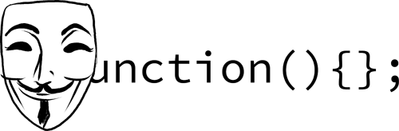
Encapsulation: favor assignment of anonymous functions
x(); // ERROR -- x is declared but still undefined
y(); // y can run before it is declared
var x=function(){
console.log('here I am x');
};
function y(){
console.log('here I am y');
};

Slide 38
Encapsulation: favor assignment of anonymous functions
x(); // ERROR -- x is declared but still undefined
y(); // y can run before it is declared
var x=function(){
console.log('here I am x');
};
function y(){
console.log('here I am y');
};

Slide 39
Encapsulation: favor assignment of anonymous functions
x(); // ERROR -- x is declared but still undefined
y(); // y can run before it is declared
var x=function(){
console.log('here I am x');
};
function y(){
console.log('here I am y');
};

Slide 40
Advanced Javascript concepts
Linked hierarchies visualization
(backup)
Notes:
If good programming is indeed an exercise in complexity minimization, how do we achieve that without the object orientation?

Slide 41
Patterns: know this
Unlike many other common languages, the value of the this construct depends on the syntax of the caller.
Furthermore, essential language elements (ex. methods, modules, and constructors) are only patterns, not core language constructs.

Slide 42

this in a function
var x=function(){
console.log('this='+this);
}
x()
this=[object Window]
Notes:
In Javascript, functions, methods, and constructors are only patterns, not core language constructs.

Slide 43
this in a function
var x=function(){
console.log('this='+this);
}
x()
this=[object Window]
Notes:
In Javascript, functions, methods, and constructors are only patterns, not core language constructs.

Slide 44

this in a method
var obj={
hi:function(){
console.log('this='+this);
}
}
obj.hi()
this=[object Object]
Notes:
In Javascript, functions, methods, and constructors are only patterns, not core language constructs.

Slide 45
this in a method
var obj={
hi:function(){
console.log('this='+this);
}
}
obj.hi()
this=[object Object]
Notes:
In Javascript, functions, methods, and constructors are only patterns, not core language constructs.

Slide 46

this in a constructor
function hi(friend) {
this.myFriend=friend;
}
var myVar = new hi(‘joe’);
myVar
{ myFriend: ‘joe’}
Notes:
In Javascript, functions, methods, and constructors are only patterns, not core language constructs.

Slide 47
this in a constructor
function hi(friend) {
this.myFriend=friend;
}
var myVar = new hi(‘joe’);
myVar
{ myFriend: ‘joe’}
Notes:
In Javascript, functions, methods, and constructors are only patterns, not core language constructs.

Slide 48
Custom assignment of this
var xx=function(myParm){
console.log('this='+this+',myParm='+
myParm);
}
xx('f')
this=[object Window], myParm=f
xx.call('g','f')
this=g, myParm=f
Notes:
Functions have built-in call method for custom receivers:
Under ES5 every function has a “bind” method which provide a way to assign a custom receiver across one or more calls. Useful when currying and in other applications.

Slide 49
Custom assignment of this
var xx=function(myParm){
console.log('this='+this+',myParm='+
myParm);
}
xx('f')
this=[object Window], myParm=f
xx.call('g','f')
this=g, myParm=f
Notes:
Functions have built-in call method for custom receivers:
Under ES5 every function has a “bind” method which provide a way to assign a custom receiver across one or more calls. Useful when currying and in other applications.

Slide 50
Custom assignment of this
var xx=function(myParm){
console.log('this='+this+',myParm='+
myParm);
}
xx('f')
this=[object Window], myParm=f
xx.call('g','f')
this=g, myParm=f
Notes:
Functions have built-in call method for custom receivers:
Under ES5 every function has a “bind” method which provide a way to assign a custom receiver across one or more calls. Useful when currying and in other applications.

Slide 51
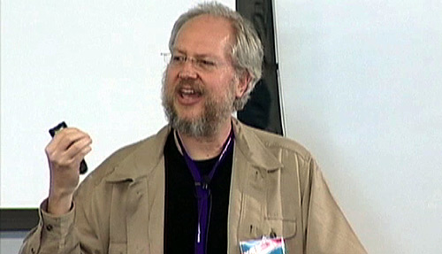
The ‘Crockford Effect’
Douglas Crockford wrote a hugely influential book in 2008:
“Most programming languages contain good and bad parts, but JavaScript has more than its share of the bad … This authoritative book scrapes away these bad features to reveal a subset of JavaScript that's more reliable, readable, and maintainable than the language as a whole…”
demo
He also went on to write JSLint to codify and enforce his ideas. His approach is workable and self consistent, it isn’t the only way to write good JavaScript.

Slide 52
Patterns: Looping in Javascript
Iterators are generally better than looping.
var dict=[{ name:joe, age:22},
{ name:bob, age:23}];
var justNames = [];
dict.forEach( function(x) {
justNames.push(x.name);
}
Though under ES5 maps are the best way to modify arrays.
var nameSlashAge = dict.map(function(x) {
return x.name+’/’+ x.age;
})
Notes:
Under ES5 every function has a “bind” method which provide a way to assign a custom receiver across one or more calls. Useful when currying and in other applications.

Slide 53
Patterns: Looping in Javascript
Iterators are generally better than looping.
var dict=[{ name:joe, age:22},
{ name:bob, age:23}];
var justNames = [];
dict.forEach( function(x) {
justNames.push(x.name);
}
Though under ECMA5 prefer maps to modify arrays.
var nameSlashAge = dict.map(function(x) {
return x.name+’/’+ x.age;
})
Notes:
Under ES5 every function has a “bind” method which provide a way to assign a custom receiver across one or more calls. Useful when currying and in other applications.

Slide 54
JavaScript Patterns
Closure pattern: good for private data.
var u1=function(myParm){
this.getParm=function(){
return "your parm is "+myParm;
}
}
I call it the ‘Object pattern’
var u2=function(myParm){
this.myParm=myParm;
this.getParm=function(){
return "your parm is "+this.myParm;
}
}
Notes:
Under ES5 every function has a “bind” method which provide a way to assign a custom receiver across one or more calls. Useful when currying and in other applications.

Slide 55
JavaScript Patterns
Closure pattern: good for private data.
var u1=function(myParm){
this.getParm=function(){
return "your parm is "+myParm;
}
}
The ‘Object pattern’
var u2=function(myParm){
this.myParm=myParm;
this.getParm=function(){
return "your parm is "+this.myParm;
}
}
Notes:
Under ES5 every function has a “bind” method which provide a way to assign a custom receiver across one or more calls. Useful when currying and in other applications.

Slide 56
JavaScript Patterns
Stephan Stefanov’s ‘module pattern’. Good for building libraries.
var u3=(function(){
var _myParm,
setParm=function(myParm){
_myParm=myParm;
},
getParm=function(){
return "your parm is "+_myParm;
};
return {
setParm:setParm,
getParm:getParm
}
}());
Notes:
but probably not a good way to build reusable objects

Slide 57
D3 in the real world
It's really only a bar chart
Notes:
If good programming is indeed an exercise in complexity minimization, how do we achieve that without the object orientation?

Slide 58
JavaScript timeline
1996: JavaScript created by Brendan Eich for Netscape Navigator
1997: JavaScript begins standardization process
1998
1999: Reg ex, better string handling, try/catch, etc
2000: JavaScript becomes important enough to fight over
2011: ECMA 5 standard released

Slide 59
Browser compatibility
Google Chrome
OK
Firefox
Opera
Internet Explorer (v10 & v11)
Microsoft Edge?
X
Safari for Windows
Internet Explorer (<v.10)

Slide 60
Standard software engineering best practices
Use a repo (GitHub is my recommendation), with lots of branching and committing
Use a 'make' system (I use Gradle as a part of Grails. I know that Grunt is also quite popular)
Incorporate testing into your development cycle (Jasmine is one option, but there are many others)
Iterate frequently to try out your new ideas (Bostock motivates iteration this way "design is a search process")

Slide 61
Looking for ideas...
Flawed presentation of SNPs over a genomic range

Slide 62
Acknowledgments
Medical population genetics
Other people who've helped
David Altshuler
Jose Florez
Jason Flannick
Kaan Yuksel
Marcin von Grotthuss
Marc Duby
Oliver Ruebenacker
Todd Green
Jason Wright
Bang Wong
Noam Shoresh
Maskull Lasserre
Dong-keun Jong
Notes:
Use Sierpinski example here?

Slide 63
Books worth having:
Data-Driven Documents, M. Bostock, et. al. IEEE
Effective JavaScript, David Herman.2013, Person Education
JavaScript: The Good Parts, Douglas Crockford,2008, O’Reilly
JavaScript Patterns, Stoyan Stefanov,2010, O’Reilly
Secrets of a JavaScript Ninja, John Resig,2013, Manning Publications
The Grammer of Graphics, Leland Wilkinson,2005, Springer Science
Notes:
Under ES5 every function has a “bind” method which provide a way to assign a custom receiver across one or more calls. Useful when currying and in other applications.

