Slide 1

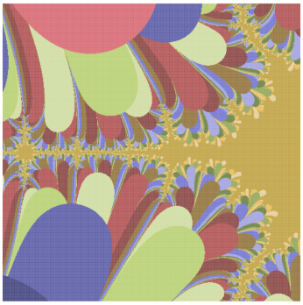
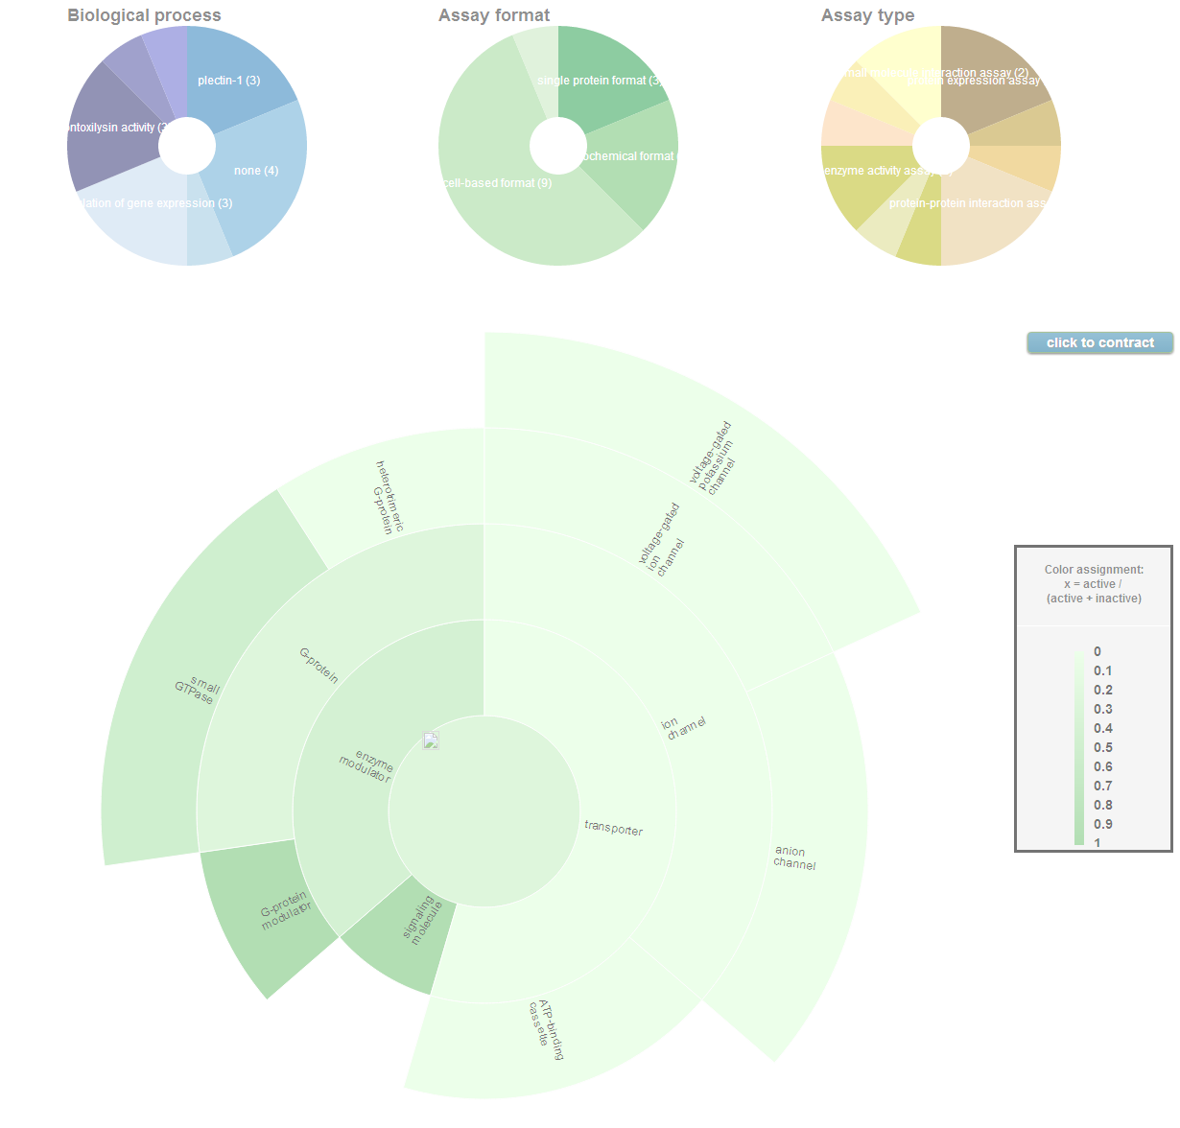
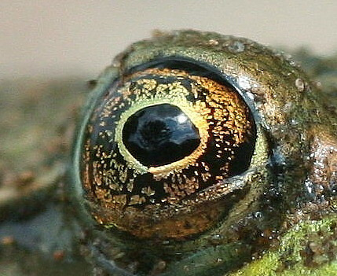
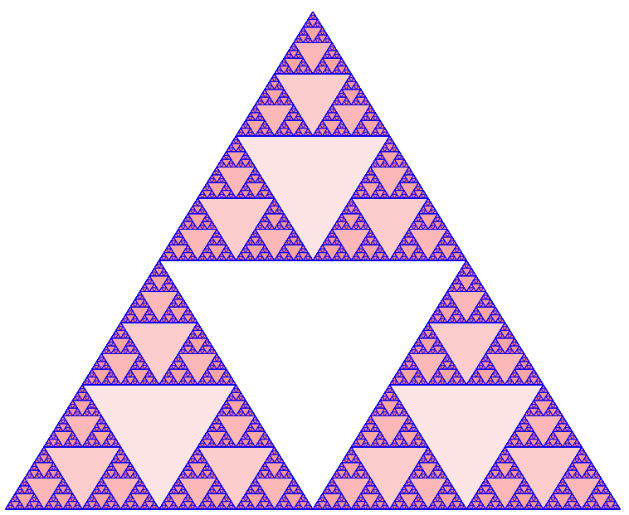
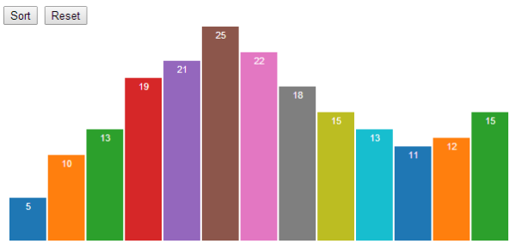
D3, JavaScript, and my search for the perfect picture

Slide 2


What does it mean to be simple?
demo
Notes:
Programming is an exercise in complexity minimization. Without the object orientation, how do we achieve that end?
Display the swirling histogram demo
Animated transitions are pretty, but they also serve a purpose: they make it easier to follow the data. This is known as object constancy: a graphical element that represents a particular data point (such as Ohio) can be tracked visually through the transition. This lessens the cognitive burden by using preattentive processing of motion rather than sequential scanning of labels.

Slide 3

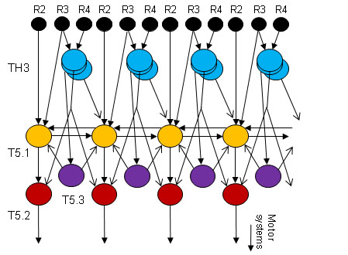
The interpretation of an image in the eye of a toad
Jörg-Peter Ewert studied the eyes of toads, then identifies and models the local processing
Frog movie
Notes:
Humans are relentlessly visual creatures
Douglas J. Blackiston and
Michael Levin*
Ectopic eyes outside the head in Xenopustadpoles provide sensory data for light-mediated learning
https://www.youtube.com/watch?v=l3Es9cNH7I8
doi: 10.1242/​jeb.074963March 15, 2013J Exp Biol 216, 1031-1040.

Slide 4


Toad eyes can respond even without obvious neural connection
Blackiston, D., and Levin, M
J Exp Biol 216, 1031-1040.
"half of the human brain is devoted directly or indirectly to vision"
Prof. Mriganka Sur, Department of Brain and Cognitive Sciences, MIT
How then to interpret images in the context of the human brain?
Notes:
Either try to restrict the message only to that which was intended, or else let the images fly and rely on the brain to filter out the spurious conclusions

Slide 5

Presentations and the perfect graphic
What is the role of an image on a page during a technical presentation? Do images trigger collections of poorly remembered associations, perhaps triggering feelings and ideas? Can an old
picture make a page feel more 'comfortable'? Can we leverage these processes to serve a pedagogical purpose?

Slide 6

The road to maintainable, extensible graphics
With D3, maintainability comes from adopting consistent conventions involving
  JavaScript
  D3
  more…
Notes:
(Immediately Invoked Function Expressions)

Slide 7
What is Javascript?
Javascript is dynamic, (executing many behaviors at runtime) prototype-based (as opposed to class inheritance) scripting language with first-class functions (functions have properties and methods, can be nested, and support lexical closures). Early versions of the JavaScript have been available since 1996.
Notes:
If good programming is indeed an exercise in complexity minimization, how do we achieve that without the object orientation?

Slide 8
What is D3?
D3 stands for “Data-Driven Documents”, and it is a JavaScript library that allows the creation of dynamic, interactive graphics which are run in a web browser. Is highly dependent on SVG, HTML5, CSS3, and DOM and observes many principles pioneered by jQuery. It was released in August of 2011.

Slide 9
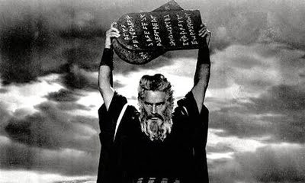
Looking for a few good practices/commandments

Slide 10
Some guiding principles…
If good software engineering is an exercise in managing complexity then we might:
Focus on control of scope
Utilize software patterns
Build code using stepwise refinement
Seek to minimize cognitive distance
Notes:
(Immediately Invoked Function Expressions)

Slide 11
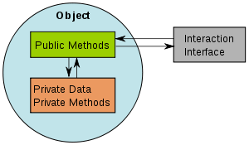
Encapsulation: immediately invoked function declarations are your friend
console.log('x1='+typeof x);
(function(){
var x=47;
console.log('y1='+typeof x);
})();
console.log('x2='+typeof x);

Slide 12

Encapsulation: favor assignment of anonymous functions over function declarations
(function(){
x(); // x can run before it is declared
y(); // ERROR -- y is declared as a variable but is still undefined
var x=function(){console.log('here I am x');};
function y(){console.log('here I am y');};
})();

Slide 13

Encapsulation: whatever else happens out there, my son, know this
Unlike many other common languages, the value of the this construct depends on the syntax of the caller.
Furthermore, essential language elements such functions, methods, and constructors are only patterns, not core language constructs.

Slide 14

this in a function
var x=function(){
console.log('this='+this);
}
x()
this=[object Window]
Notes:
In Javascript, functions, methods, and constructors are only patterns, not core language constructs.

Slide 15

this in a method
var obj={
hi:function(){
console.log('this='+this);
}
}
obj.hi()
this=[object Object]
Notes:
In Javascript, functions, methods, and constructors are only patterns, not core language constructs.

Slide 16

this in a constructor
A constructor:
function hi(friend) {
this.myFriend=friend;
}
Var myVar = new hi(‘joe’)
myVar
{ myFriend: ‘joe’}
Notes:
In Javascript, functions, methods, and constructors are only patterns, not core language constructs.

Slide 17

Custom assignment of this
Functions have built-in call method allowing the assignment of the custom receiver. An example:
var xx=function(myParm){
console.log('this='+this+',myParm='+myParm);
}
xx('f')
this=[object Window], myParm=f
xx.call('g','f')
this=g, myParm=f
Notes:
Under ES5 every function has a “bind” method which provide a way to assign a custom receiver across one or more calls. Useful when currying and in other applications.

Slide 18
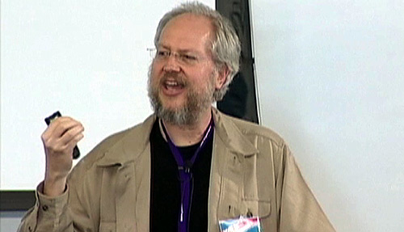
The ‘Crockford Effect’
Douglas Crockford wrote a hugely influential book in 2008:
“Most programming languages contain good and bad parts, but JavaScript has more than its share of the bad … This authoritative book scrapes away these bad features to reveal a subset of JavaScript that's more reliable, readable, and maintainable than the language as a whole…”
He also went on to write JSLint to codify and enforce his ideas. His approach is workable and self consistent, it isn’t the only approach. I think he is a knowledgeable guy and worth reading, but way too likely to throw out the baby with the bathwater.

Slide 19
JavaScript Patterns
Closure pattern: good for private data. Methods must be defined locally, not in prototypes.
var u1=function(myParm){
this.getParm=function(){
return "your parm is "+myParm;
}
}
I’ll call it the ‘Object pattern’
var u2=function(myParm){
this.myParm=myParm;
this.getParm=function(){
return "your parm is "+this.myParm;
}
}
Notes:
Under ES5 every function has a “bind” method which provide a way to assign a custom receiver across one or more calls. Useful when currying and in other applications.

Slide 20
JavaScript Patterns
Stephan Stefanov’s ‘module pattern’. Excellent for building libraries, but probably not a good way to build reusable objects.
var u3=(function(){
var _myParm,
setParm=function(myParm){
_myParm=myParm;
},
getParm=function(){
return "your parm is "+_myParm;
};
return {
setParm:setParm,
getParm:getParm
}
}());
Notes:
May be a good place for the Mandelbrot example?

Slide 21
JavaScript Patterns
Getting closer to a std d3 pattern
var u4=function(myParm){
var _holder={},
_myParm = myParm;
_holder.getParm = function(){
return "your parm is "+_myParm;
}
return _holder;
}
Notes:
Under ES5 every function has a “bind” method which provide a way to assign a custom receiver across one or more calls. Useful when currying and in other applications.

Slide 22
Looping in Javascript (1/2)
Getting for…in is dangerous, but occasionally useful. Prefer for in the case of arrays.
var dict={ joe: 22, bob: 23, mary: 33};
for (var p in dict){
console.log(p + “ has ”+ dict[p]);
}
Though for loops are better for arrays.
var arr= [‘joe’, ‘bob’, ‘mary’];
for (var i = 0; i < arr.length; i++){
console.log(“person=”+ arr[i]);
}
Notes:
Under ES5 every function has a “bind” method which provide a way to assign a custom receiver across one or more calls. Useful when currying and in other applications.

Slide 23
Looping in Javascript (2/2)
Iterators are generally better than looping.
var dict=[{ name:joe, age:22},
{ name:bob, age:23}];
var justNames = [];
dict.forEach( function(x) {
justNames.push(x.name);
}
Though under ES5 maps are the best way to modify arrays.
Var nameSlashAge = dict.map(function(x) {
return x.name+’/’+ x.age;
})
Notes:
Under ES5 every function has a “bind” method which provide a way to assign a custom receiver across one or more calls. Useful when currying and in other applications.

Slide 24
Javascript: embrace being undefined
Undefined is the standard default value in Javascript
var a;
function b(){return;}
function c(){}
a; // = undefined
b(); // = undefined
c(); // = undefinedvar a;
function b(){return;}
function c(){}
a; // = undefined
b(); // = undefined
c(); // = undefined
A good way to recognize variables that haven’t been initialized
If (typeof myVar === ‘undefined’) {
console.log (‘variable myVar is not defined.’);
}

Slide 25

The ‘Bostock Effect’
Mike Bostock wrote Protovis as a declarative graphical library (released 2009) as a PhD student in the Stanford Visualization Group. The project achieved some success, but was abandoned in 2011 to make way for D3.
D3 is different from Protovis, and from every other graphics library as well. It attempts to minimize the distinction between data storage and visual representation ( Bostock describes it as a ‘representation-transparent approach to visualization’). The novelty of this approach leads to code that may initially seem perplexing, but in the long run offers advantages in terms of accessibility, expressiveness and performance.
Notes:
Accessibility: Because you bring your hard-won knowledge of JavaScript, CSS, etc the tools are ultimately very accessible to you.
Expressiveness: Using all of the complexities of the multiple underlying systems provides a huge range of possible graphical capabilities
Performance: Avoiding all of the abstractions of high level graphical libraries allows you to better leverage the capabilities of the computer
Here’s a quote from the 2011 IEEE paper: “provides a close cognitive mapping between the toolkit representation and the desired result, reducing the gulf of execution for designers and improving accessibility”. Is this idea really meaningful.

Slide 26
Core D3 - selections (1)
One of the central elements in D3 is the ‘selection’. Be not confused – W3C has selectors (and D3 adopts the W3C Selectors API), but in D3 these atomic operands yield selections
d3.selectAll(‘.triangles’)
d3.select(‘#myFavoriteId’)
d3.selectAll(‘[name=value]’)
Notes:
Use Sierpinski example here?

Slide 27
Core D3 -- selections (2)
Selections are modified arrays of elements pulled from the current document. D3 uses operators to implicitly act upon these arrays, so explicit looping is often avoided
_svg.selectAll("polygon")
.attr('fill', function () {
return "rgba(255,0,0,0.2)"
});
Notes:
Use Sierpinski example here?

Slide 28
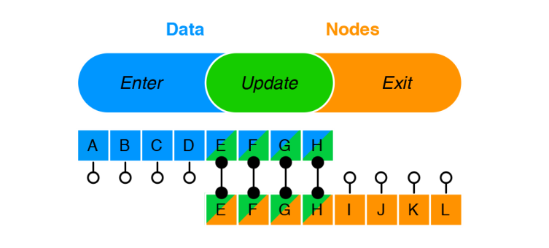
Core D3 -- data
The data operator binds input data to selected nodes in the DOM. Data joins are managed with the enter and exit subselections
Data joins are crucial for efficient dynamic visualizations
Notes:
Use Sierpinski example here?

Slide 29
D3 patterns- charts as closures
Mike Bostock wrote a blog entry about reusable code blocks emphasizing that charts should be implemented as closures. His reusable core looked like this:
function myChart(){
function instance () {
// chart generation code goes here
}
instance.width = function (x) { // standard getter/setter
if (!arguments.length) return whiskers;
whiskers = x;
return instance;
};
return instance;
}
Notes:
Use Sierpinski example here?

Slide 30


D3 – getters should be setters
A commonly used pattern in D3 involves returning a consistent object with each call so that methods can be chained
instance.width = function (x) {
if (!arguments.length) return width;
width = x;
return instance;
};
Notes:
Use Sierpinski example here?

Slide 31

D3 patterns– method chaining (1/2)
A commonly used pattern in D3 involves returning a consistent object with each call so that methods can be chained
svg.selectAll(‘circle’)
.attr(‘cx’, 50)
.attr(‘cy’, 100)
.attr(‘r’, 3.5);
A JavaScript pattern makes this construction easy to implement…
Notes:
Use Sierpinski example here?

Slide 32

D3 patterns– method chaining (2/2)
JavaScript implementation:
instance.whiskers = function (x) {
if (!arguments.length) return whiskers;
whiskers = x;
return instance;
};
Notes:
Use Sierpinski example here?

Slide 33
D3 patterns– enter/ update/exit
A central pattern which helps to define the D3 as declarative versus being built around imperatives.
var _svg = d3.select("body").append("svg")
var triangle = _svg.selectAll("polygon")
.data(products);
triangle.enter().append("polygon");
triangle.exit().remove();
Notes:
Use Sierpinski example here?

Slide 34
D3 patterns– built in multiplicity
If you can call it once then why not call it over and over?
myChart(selection);
selection.call(myChart);
my(selection) {
selection.each(function(d, i) {
// generate chart here; `d` is the data and `this` is the element
});
}
Notes:
Use Sierpinski example here?

Slide 35
Books worth having:
Effective JavaScript, David Herman.2013, Person Education
JavaScript: The Good Parts, Douglas Crockford,2008, O’Reilly
JavaScript Patterns, Stoyan Stefanov,2010, O’Reilly
Secrets of a JavaScript Ninja, John Resig,2013, Manning Publications
Notes:
Under ES5 every function has a “bind” method which provide a way to assign a custom receiver across one or more calls. Useful when currying and in other applications.

