Slide 1
Impact of Distances from Major Roads on Housing Prices
Questions:
What percentage of homes are next to a major road?
How does being next to a major road impact the price of a home?
How would you analyze the accuracy of your major road feature? (You may want to include visualizations)
How would Opendoor make use of this analysis? How would you extend your analysis given more resources / time?

Slide 2
Chose to focus on major motorways
I 8, I 10, AZ 85, AZ 303 Loop, AZ 303, Northern Parkway, AZ 101 Loop, AZ-101 Loop, I 17, I-17, ….
Scale of map is …
Understand how proximity to highway affects price

Slide 3
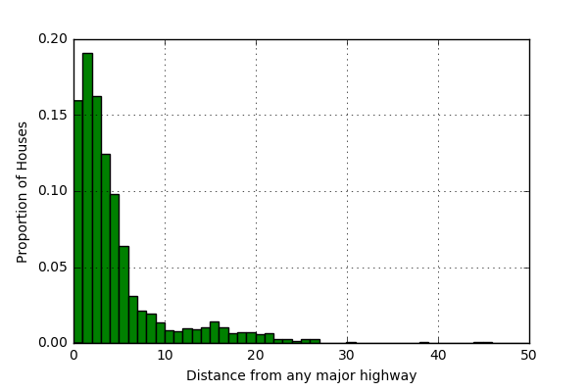
What percentage of homes are near a major road?
15% within 1km
85% within 9 km
mean | 6.9
std | 16.5
min | 0.0
25% | 1.5
50% | 3.0
75% | 5.5
max | 244.1

Slide 4
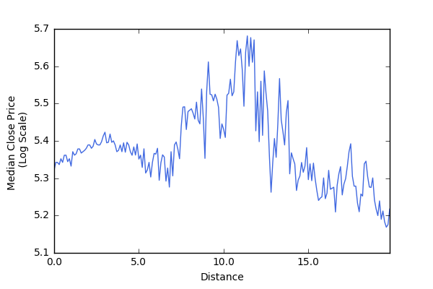
Effect of distance on price of home
Restrict to homes within 15km (93% of data)
Non linear relationship
Negatively correlated for small distances away from the highway
Highly correlated for medium distances (wealthier neighbourhood)
Negatively correlate for large distances

Slide 5
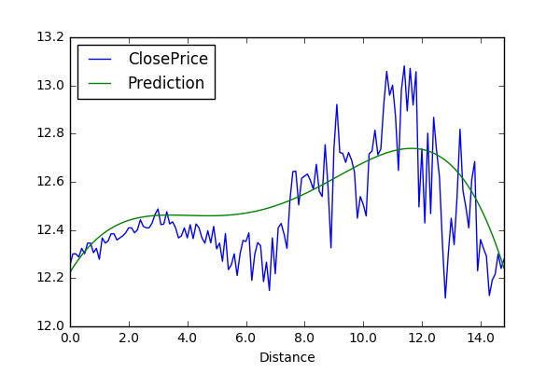
Fit a non linear model
Performance of model:
Mean Absolute Error: $121K
Median Proportion of Error: 31%
R2 score: -0.01
Performance of median model
Mean Absolute Error: $121K
Median Proportion of Error: 30%
R2 score: -0.05

Slide 6

Dist

