Slide 1

Can Android be Open Source and functional?
Ben C. Roose
Electrical Engineering & Computer Science
Systems Administrator, Wichita State University
Maintains Debian, Ubuntu, LTSP, and OpenStack with CFEngine
Notes:
My personal journey of six months with an almost fully open source phone (in software)
First a quick overview of what we are going to talk about!

Slide 2

What are we talking about?
We will look at:
Drilling down: 6 layers of an Android mobile device
Picking your battles: Open Source options for each layer
Practical application: Terms and tools for installing an Android OS
Hard lessons learned: Experiences with an Open Source smartphone
Tips and tricks: Staying open inside the Google ecosystem
Goodbye Google: Rolling your own cloud synchronization
Notes:
Quick run down of what we will talk about over the next 40 minutes!

Slide 3
Why I Decided to Rebuild my Smartphone
Carriers are reducing a user’s ability to manage their own device
Carriers are installing non-removable bloat-ware and tracking apps
Carriers are limiting support/upgrades for older device models
Commercial apps are often opaque with collection and sale of data
If I promote Free & Open Source technologies, ethically shouldn’t I be using Open Source devices as much as I can?
Can a smartphone be productive if limited to only Open Source?
Notes:
I might be egotistical, but as a sysadmin with a masters in computing, I feel I am in a better position to manage my own devices than a bunch of companies primarily interested in turning a profit
Non-root access and carrier lock-in is becoming standard ...and is it just me or are we seeing more and more bloatware and spyware on smartphones sold by carriers like AT&T or Verizon?
I bought a cheap ZTE Z992 from AT&T about 4 years ago. AT&T would not upgrade it beyond Android 4.1.1 (Linux 3.4.0?)
Commercial apps may tell you they are collecting your data, but when you read the lengthy EULAs, you really have no idea who they’re selling that data onto! Look at the current class action lawsuit against Bose for selling user listening metadata of their headphones app to the data mining group Segment.io.
I push for Open Source, but the system in my pocket is running a lot of closed source software. Can I do better ethically?
Now there’s the 64000 dollar question!

Slide 4
Layers of an Android Device (Template)
1: Physical Hardware
2: Hardware Drivers
3: Operating System
4: App Repository
5: User Apps
6: Cloud Storage & Sync
Notes:
ASK: WHAT IS A PROCESS?
CLICK:
According to The Linux Information Project....
They also state:
“Processes are dynamic entities in that they are constantly changing as their machine code instructions are executed by the CPU.”
CLICK:
Each process on a system can be identified by a Process Identification number (PID).
ASK: WHAT IS A NON-NEGATIVE INTEGER?
The kernel will hold a list of active processes
WHAT IS THE KERNEL?
END: So how is a process run (executed)?

Slide 5
Layers of an Android Device
Notes:
ASK: WHAT IS A PROCESS?
CLICK:
According to The Linux Information Project....
They also state:
“Processes are dynamic entities in that they are constantly changing as their machine code instructions are executed by the CPU.”
CLICK:
Each process on a system can be identified by a Process Identification number (PID).
ASK: WHAT IS A NON-NEGATIVE INTEGER?
The kernel will hold a list of active processes
WHAT IS THE KERNEL?
END: So how is a process run (executed)?

Slide 6
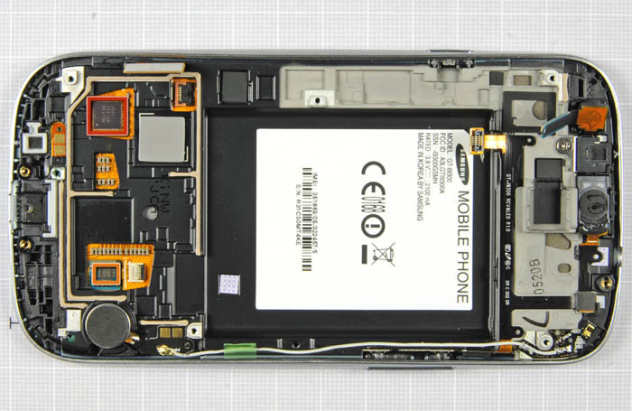
Layers of an Android Device
1: Physical Hardware
Samsung Galaxy S3(Open), techrepublic.com
Notes:
ASK: WHAT IS A PROCESS?
CLICK:
According to The Linux Information Project....
They also state:
“Processes are dynamic entities in that they are constantly changing as their machine code instructions are executed by the CPU.”
CLICK:
Each process on a system can be identified by a Process Identification number (PID).
ASK: WHAT IS A NON-NEGATIVE INTEGER?
The kernel will hold a list of active processes
WHAT IS THE KERNEL?
END: So how is a process run (executed)?

Slide 7
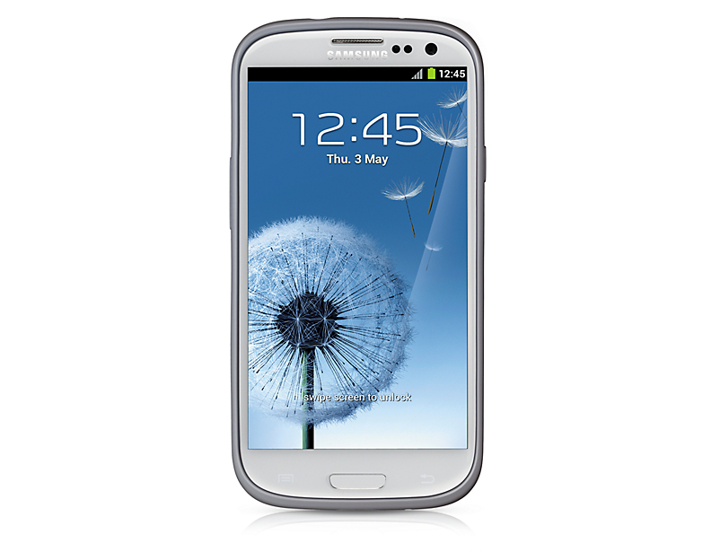
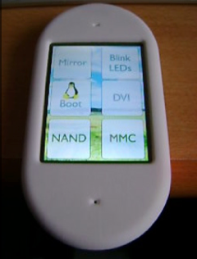
Layer 1: Physical Hardware
Proprietary Hardware Options
Majority of smartphones, tablets, and other mobile devices on the market
Manufacturers include:
Acer, Asus, HTC, Huawei, LG, Motorola, Samsung, Sony Ericsson, ZTE
Open Hardware Options
A few kickstarter/Indiegogo “pipe-dream” devices, inc. Root101, Neo900
Golden Delicious GTA04 board
(from Europe: 529 euros)
Raspberry Pi home-brew phone
Samsung Galaxy S3 I9300, GSM Arena
GTA04 board in Openmoko Neo freerunner case
Notes:
Proprietary = everything!
Concern in the security arena of isolation for each module (cellular radio, wifi radio, bluetooth, NFC radios)
Open source = Very limited! Hard to find, expensive to purchase, tricky to run
GTA04 = though board is open hardware, some of the modules/SOC chipsets are not
Fairphone in Europe could be possible option if they ever decide to release their PCB plans under an Open Hardware license!
Give a nod to Craig Comstock rolling his own old school GSM phone OS, but beyond my knowledge!
Raspberry Pi = I’m not a hardware guy, though gettinga cellular device onto a Pi is getting easier with skywire, plus RTAndroid for the Pi...but there’s a way to go yet!
Currently an open hardware mobile device is not a feasible option

Slide 8
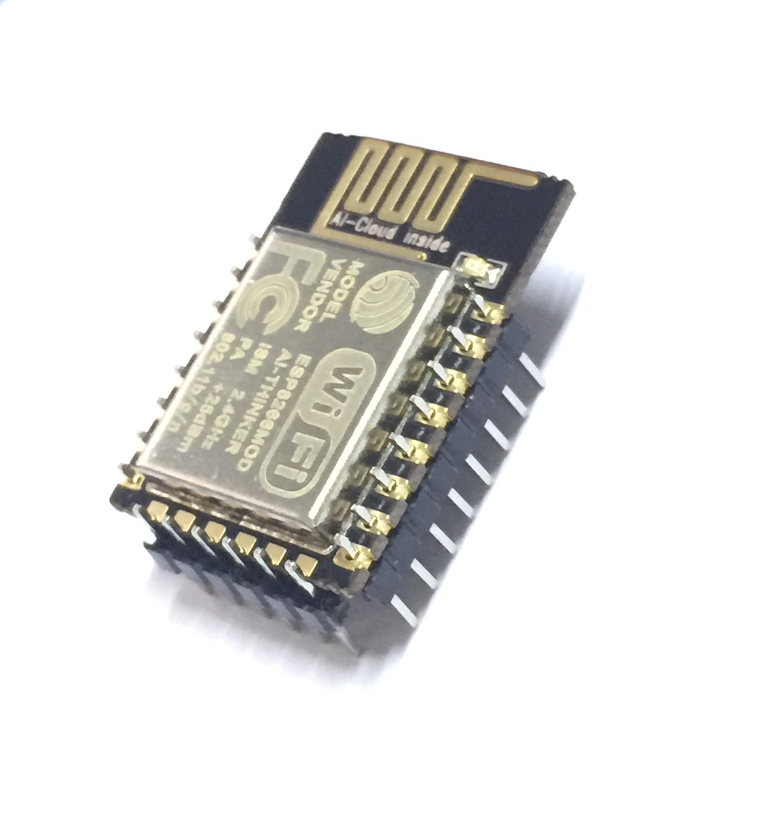
Layers of an Android Device
1: Physical Hardware
2: Hardware Drivers
ESP8266 SMD Wireless module
cvrelectonics.com
Notes:
ASK: WHAT IS A PROCESS?
CLICK:
According to The Linux Information Project....
They also state:
“Processes are dynamic entities in that they are constantly changing as their machine code instructions are executed by the CPU.”
CLICK:
Each process on a system can be identified by a Process Identification number (PID).
ASK: WHAT IS A NON-NEGATIVE INTEGER?
The kernel will hold a list of active processes
WHAT IS THE KERNEL?
END: So how is a process run (executed)?

Slide 9
Layer 2: Hardware Drivers
Proprietary Driver Options
Most manufacturers release hardware module drivers as binary blobs under closed source licensing
Module drivers (firmware) added on top of Linux OS
Similar to the historical M$ Windows ecosystem
Open Source Options
Open source drivers/firmware may be available but it depends on the module chipset
Older devices from certain manufacturers have some open source firmware
To run a fully working device, we have to mix-n-match open and proprietary firmware
Notes:
Proprietary = most modules
Open source = Limited but there are some components for older models. The Samsung Galaxy S3 I9300 (international model) has open firmware for cellular modem, SD Card, main camera, but proprietary drivers only for front facing camera, wireless, bluetooth, and GPS

Slide 10

Layers of an Android Device
1: Physical Hardware
2: Hardware Drivers
3: Operating System
Notes:
ASK: WHAT IS A PROCESS?
CLICK:
According to The Linux Information Project....
They also state:
“Processes are dynamic entities in that they are constantly changing as their machine code instructions are executed by the CPU.”
CLICK:
Each process on a system can be identified by a Process Identification number (PID).
ASK: WHAT IS A NON-NEGATIVE INTEGER?
The kernel will hold a list of active processes
WHAT IS THE KERNEL?
END: So how is a process run (executed)?

Slide 11


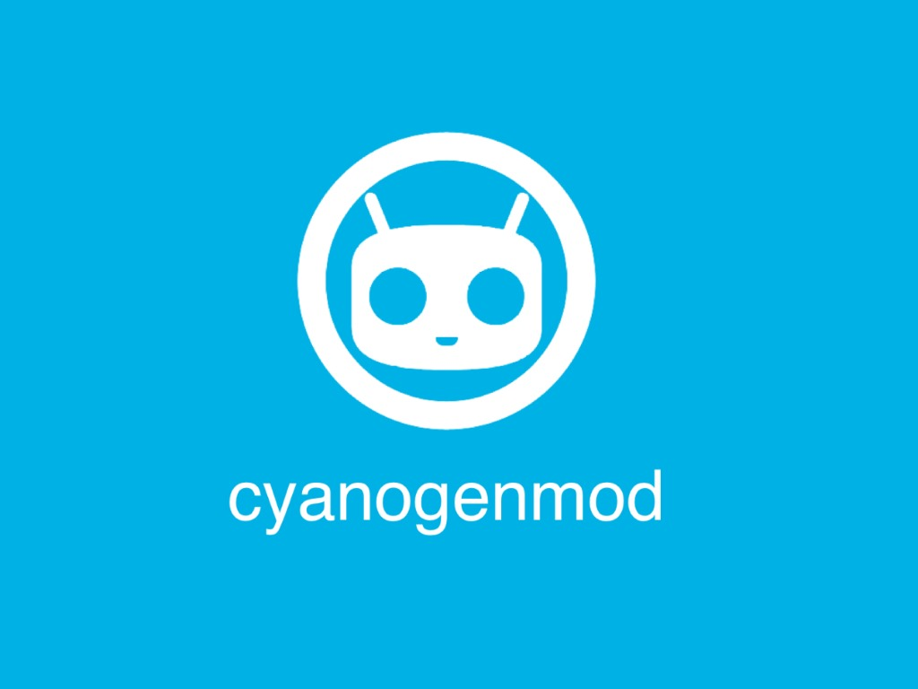
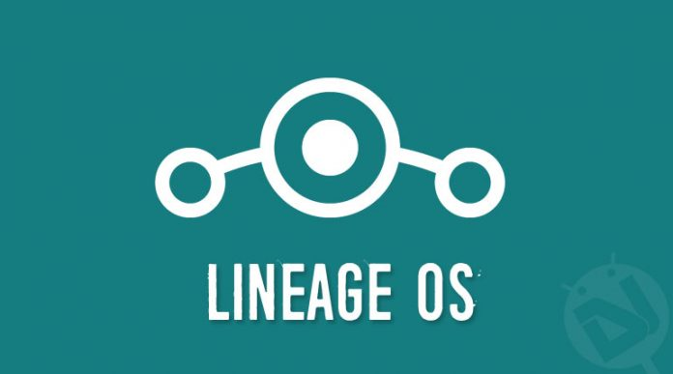
Layer 3: Operating System
Android OS using proprietary firmware and apps
“Stock” Google Android
Carrier built Android
Android OS using only Open Source firmware and apps
Replicant OS
  Security/privacy focused
Omni-The Open ROM
Cyanogenmod → Lineage OS
  User customization focused
Notes:
This is where people get confused over whether Android is open or proprietary. The OS is open source, but it is the repos and apps which are so often closed source
Proprietary = stock Android from Google if you buy a Nexus or if you buy a new phone from AT&T or Verizon
Open Source = Replicant OS comes with no proprietary firmware/drivers or apps ...but you have to install it yourself and only a few specific devices can run it!
Cyanogenmod/Lineage OS (political change) = stands between the two sides. Comes with proprietary firmware for multiple devices, but comes only with open source apps by default.

Slide 12

Layers of an Android Device
1: Physical Hardware
2: Hardware Drivers
3: Operating System
4: App Repository
Notes:
ASK: WHAT IS A PROCESS?
CLICK:
According to The Linux Information Project....
They also state:
“Processes are dynamic entities in that they are constantly changing as their machine code instructions are executed by the CPU.”
CLICK:
Each process on a system can be identified by a Process Identification number (PID).
ASK: WHAT IS A NON-NEGATIVE INTEGER?
The kernel will hold a list of active processes
WHAT IS THE KERNEL?
END: So how is a process run (executed)?

Slide 13


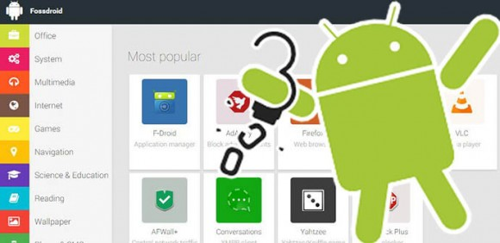


Layer 4: App Repository (Marketplace)
Proprietary Repo Options
Google Play
  The core of Google apps
  Part of “stock” Android
Third party commercial repos
  Amazon Appstore
  Aptoide
  AppBrain
Open Source Repo Options
Free and Open Source (FOSS) only Adroid app repositories
  F-Droid
  Fossdroid
Notes:
Proprietary = again so much!
Open source = Limited options but not impossible

Slide 14
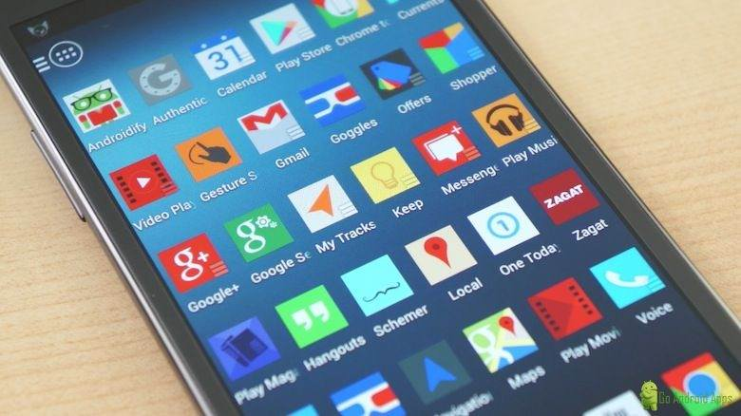
Layers of an Android Device
1: Physical Hardware
2: Hardware Drivers
3: Operating System
4: App Repository
5: User Apps
Notes:
ASK: WHAT IS A PROCESS?
CLICK:
According to The Linux Information Project....
They also state:
“Processes are dynamic entities in that they are constantly changing as their machine code instructions are executed by the CPU.”
CLICK:
Each process on a system can be identified by a Process Identification number (PID).
ASK: WHAT IS A NON-NEGATIVE INTEGER?
The kernel will hold a list of active processes
WHAT IS THE KERNEL?
END: So how is a process run (executed)?

Slide 15




Layer 5: User Apps
Proprietary App Options
Google Mobile Services (GMS)
  Often known as GApps
Most popular apps and games available on commercial repos
  Examples inc. Angry Birds, Facebook Messenger, FitBit, Uber, Whatsapp
EULAs = “Signing over your private data to highest bidder”
Open Source App Options
Base apps on vanilla Android
  Browser, Calendar, Phone
FOSS apps on F-Droid/fossdroid
  Examples inc. Blockinger, ConnectBot, Face Slim, K-9 mail, QKSMS, Xabber
Apps in development on GitHub
  Harder to find/install and may not fully work
Notes:
Proprietary = so many apps!
Watch for those EULAs
Open source = most core smartphone functionality can now be covered by an open source app...yay!!
Missing some features, usually when attempting to connect to proprietary cloud-based services, such as Uber or Google ...and don’t even think about getting your fitness bracelet to talk to your open source smart phone (though there are a few pure Linux tools for syncing some devices such as FitBit)

Slide 16

Layers of an Android Device
1: Physical Hardware
2: Hardware Drivers
3: Operating System
4: App Repository
5: User Apps
6: Cloud Storage & Sync
Notes:
ASK: WHAT IS A PROCESS?
CLICK:
According to The Linux Information Project....
They also state:
“Processes are dynamic entities in that they are constantly changing as their machine code instructions are executed by the CPU.”
CLICK:
Each process on a system can be identified by a Process Identification number (PID).
ASK: WHAT IS A NON-NEGATIVE INTEGER?
The kernel will hold a list of active processes
WHAT IS THE KERNEL?
END: So how is a process run (executed)?

Slide 17


Layer 6: Cloud Storage & Synchronization
Proprietary Cloud Options
Google Ecosystem
  Calendar, Contacts, Drive, Email, Hangouts, Voice
Facebook Messenger
Microsoft Outlook/Exchange
Any Others?
Open Source Cloud Options
POP/IMAP mail server
  Postfix, Dovecot
Calendar and contact sync
Radicale, Bedework, DCSIRC/XMPP chat server
  UnrealIRCd, ejabberd
Fully featured private cloud
  Owncloud / Nextcloud,
  Seafile, git-annex
Notes:
Proprietary = so many apps!
Watch for those EULAs
Open source = most core smartphone functionality can now be covered by an open source app...yay!!
Missing some features, usually when attempting to connect to proprietary cloud-based services, such as Uber or Google ...and don’t even think about getting your fitness bracelet to talk to your open source smart phone (though there are a few pure Linux tools for syncing some devices such as FitBit)

Slide 18
Terms and Tools used by “modders”
Terms used on the forums
‘Rooting (Jailbreaking)’
  gaining root access
‘Unlocked’
  Use on any cellular carrier
‘Custom ROM’
  Android OS image file
‘Flashing’
  low-level copying of custom ROM onto phone
‘Porting’
  Building a custom ROM for device from source code
Tools to flash Android ROMs
Android Debug Bridge (ADB)
  Remote command-line/shell via USB connection
Heimdall
  Remote flashing of ROM to phone via USB connection
ClockworkMod (CWM) and Team Win (TWRP)
  Recovery ROMs with copying/debugging options
Recovery and boot partitions are flashed separately
Notes:
Jailbreaking term is more often used for Apple devices
Sometimes “unlocking” will refer to unlocking the bootloader so you can install a custom OS
Though there are sometimes hacks to root and unlock a phone brought from a carrier, it is often easiest to just buy an already rooted and unlocked older phone

Slide 19
6 Months: Lessons Learned
Ask your carrier to switch to phone after you are ready to switch!
Replicant OS is not for the faint of heart
  Purchase the exact device model for the custom ROM
    Samsung Galaxy S3 alone has GT-I9300, GT-I9305, SGH-T999,
    SGH-I747, SCH-R530, SCH-I535, and SPH-L710
    Replicant OS only works with the GT-I9300 (intl) model!
  Unless proprietary firmware is installed by user via ADB,
  some hardware modules will not work
  Current build runs Android 4.2. Replicant 6.0 in development
Lineage OS is a good “intermediate” level custom ROM
  All hardware modules work as part of ROM, but are not FOSS
  Current build (14.1) runs Android 7.1.1 Nougat
Notes:
Though there are sometimes hacks to root and unlock a phone brought from a carrier, it is easiest to just buy an already rooted and unlocked older phone

Slide 20
Open Source within Google Ecosystem
FOSS webDAV apps have limited access into Google cloud services
Google uses CardDAV (contacts) & CalDAV (calendar) protocols
  DAVdroid can access CardDAV with following URL:
    https://apidata.googleusercontent.com/caldav/v2/calid/user
      where calid is gmail address, i.e.
    https://apidata.googleusercontent.com/caldav/v2/ben%40gmail.com/user
  Caldav Sync Adapter can access CalDAV with following URL:
    https://www.google.com/calendar/dav/calid/events
      where calid is gmail address or shared calendar ID, i.e.
    https://www.google.com/calendar/dav/ben%40gmail.com/events
  Further information can be found at
    https://developers.google.com/google-apps/calendar/caldav/v2/guide
Notes:
In the old days of flip-phones, people were happy to save their contacts on the SIM card. Now we want full synchronization with online web contacts and calendars!
Google Contacts and Calendars can be accessed via WebDAV, but requires clients to now authenticate with OAuth 2.0. I think DAVdroid does not use currently use Oauth 2.0, but seems it can access Google’s CardDAV. Perhaps if they implement Oauth, then we’ll get CalDAV too!
For now CalDAV Sync Adapter can access Google Calendars via the older calendar/dav/ link, but it is depreciated, flaky, and may be switched off sometime.
Further info!

Slide 21
Accessing Other Google Services
GApps Browser can access Google cloud services inside a sandbox
IMAP can be turned on in Gmail settings for FOSS email clients
Google Voice calls and texts can be forwarded to a cellular phone
  Reply to unique Google # using standard SMS text messages
If you cannot live without Google Mobile Services (GMS/Gapps)
  Open GApps project offer add-on ROMs for the GMS set of proprietary Google apps
Notes:
Oh, and there are three Facebook clients to choose from, so you won’t feel lost without your daily feed of random family vacation photos, humorous cartoons, and the occasional cat video!
Sadly, both Google and Facebook have recently dropped XMPP support from their realtime chat services, even though there are a number of FOSS XMPP clients in F-Droid

Slide 22
Goodbye Google: Roll your own cloud
Run a private Calendar and Contacts server?
  Radicale
    Simple CalDAV/CardDAV private hosting and management service
Or an entire private cloud on your private server?
  Owncloud / Nextcloud
    WebDAV secure file and photo storage, CalDAV calendar and CardDAV contacts management, Ampache streaming media, and video conferencing
IRC chat client to talk on Facebook Messenger or Google Hangouts?
  BitlBee: running on IRC server of your choice, i.e. UnrealIRCd
    IRC to chat networks gateway, inc. MQTT (Facebook), Google Hangouts, Twitter, Torchat, and XMPP (jabber)
Notes:
Simple coa
Though Google and Facebook are using protocols that have

Slide 23
Example on the Terminal:
Live Demonstration
by Ben if time allows!
Notes:
Make sure we have job_mon in home directory
Talk about the process and group IDs as we walk through demo!
Ben list the commands here:
echo $$
./job_mon | ./job_mon &
./job_mon | ./job_mon | ./job_mon &
fg
TYPE CTRL+C (SIGINT)
TYPE CTRL+Z (SIGTSTP)
jobs (NOTE: talk about job numbers vs. PIDs)
bg
jobs
kill %1 %2

Slide 24

Thank You!
Ben Roose: ben.roose@wichita.edu
These slides can be found at:https://github.com/benroose/presentations/tree/master/open_source_android
Any Questions?

Slide 25



Please attribute WuLUG with a link to orgsync.com/84973/chapter
This work is licensed under the Creative Commons
Attribution-ShareAlike 4.0 International License.
To view a copy of this license, visit http://creativecommons.org/licenses/by-sa/4.0/.
WuLUG is a student organization of
Wichita State University

