Slide 1
Cryptocurrency Myths:
Public perception and understanding in the Bitcoin era
Ben C. Roose
CS 898AT: Bitcoins and Cryptocurrencies
Instructor: Dr. Murtuza Jadliwala
Notes:
We’ve had some great presentations over very technical aspects of cryptocurrency, but I’d like to look at it from a different angle. I wanted to get into how Bitcoins and cryptocurrencies fit within the general public’s world view and the larger issue of using these currencies for cyber-attacks and ransomware
First a quick overview!

Slide 2

What are we talking about?
We will look at:
How Bitcoin has been portrayed in the public media
How ransomware attacks have increased in the era of Bitcoins
How there is a lack of understanding within the general public
How we can give better understanding by finding different ways to explain technology!
Notes:
Really quick run down of what we will talk about over the next 15 minutes!
CLICK
This should make us all happy kitties!

Slide 3
Portrayal of Bitcoin by the media
Bitcoin associated with hackers and ransomware:
  “Hackers Have Stolen Millions Of Dollars In Bitcoin -- Using Only Phone Numbers” - Shin, L. Forbes. Dec. 20, 2016
  “What you need to know about bitcoin after the WannaCry ransomware attack” - Fung, B. The Washington Post. May 15, 2017
  “Hackers have cashed out on $143,000 of bitcoin from the massive WannaCry ransomware attack” - Browne, R. CNBC Special Report. Aug 3, 2017
Bitcoin associated with large financial gain/loss or a lack of security:
  “Will bitcoin ever be a safe investment or always a gamble?” - Hickey, S. The Guardian. Oct. 1, 2017
  “I Forgot My PIN’: An Epic Tale of Losing $30,000 in Bitcoin” - Frauenfelder, M. Wired. Nov. 29, 2017
Notes:
The general public find out about technology through major news and media outlets.
Conflict makes a good story in the news
Bitcoin and cryptocurrencies have often been demonized by the general media as an immoral currency to hide hackers identities or as a bad investment which can destroy a person’s life savings, as seen in these examples.
Oh, that last article: the author wrote down his private key on a pink post-it note and hid the note under his daughter’s bed for safe keeping without telling his daughter it was there! Umm, can we say DOH? (BEN: Slap Forehead)
talk about poor data security!

Slide 4
Rebuttal?
Anonymity and psuedo-anonymity in Bitcoin is only useful for nefarious activities?
Notes:
F-Secure State of Cyber Security 2017 report:
“one ransomware “variant” in 2012. This increased to 35 in 2015 and 193 in 2016.”

Slide 5
Cryptocurrencies on the Rise
Bitcoin is close to the $10,000 mark!
  Current exchange rate: 1 BTC = $???
  Cryptocurrencies becoming part of the global economy
Cyber-attacks involving financial extortion are also on the rise!
  Cryptocurrencies used as tools by ransomware and extortionists
  WannaCry infected computers in 150 countries and made attackers about $120,000 in BTC during May 2017
How much will a global ransomware attack next year net for
cyber-attackers?
Notes:
Over the last couple of years we have seen an explosion in the exchange value of Bitcoins.
However, we are also seeing an explosion of cyber-attacks involving extortion of money, i.e. ransomware
F-Secure State of Cyber Security 2017 report:
“one ransomware “variant” in 2012. This increased to 35 in 2015 and 193 in 2016.”
This is likely due to the anonymity properties and popularity of cryptocurrencies
According to Kshetri and Voas in their IEEE IT Professional article “Do CryptoCurrencies Fuel Ransomware?” WannaCry infected … (READ IT)

Slide 6
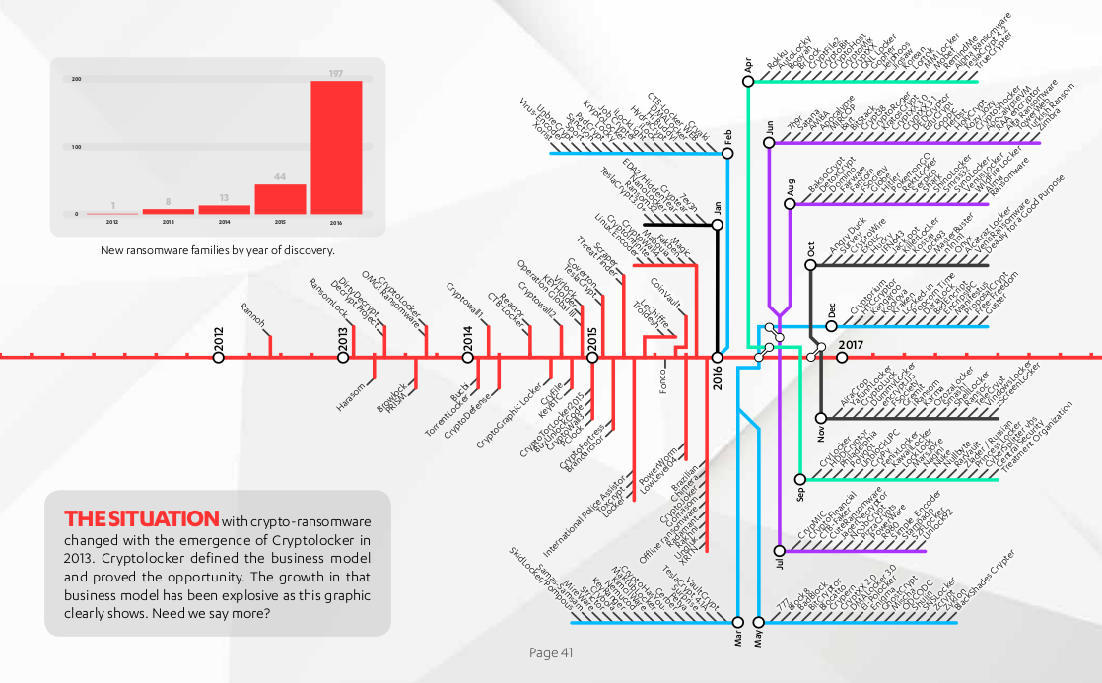
The Ransomware Tube Map
Sullivan, S. “The Ransomware Tube Map” F-Secure State of Cyber Security 2017.
Notes:
F-Secure State of Cyber Security 2017 report:
“one ransomware “variant” in 2012. This increased to 35 in 2015 and 193 in 2016.”
Note that this map is looking at 2016 statistics. We’ll have to wait a few more months to gain a better understanding of how this increased over 2017!
Companies having been investing in Bitcoins to pay ransoms in the future. Wouldn’t it be better to invest in good security and backup methods instead?

Slide 7
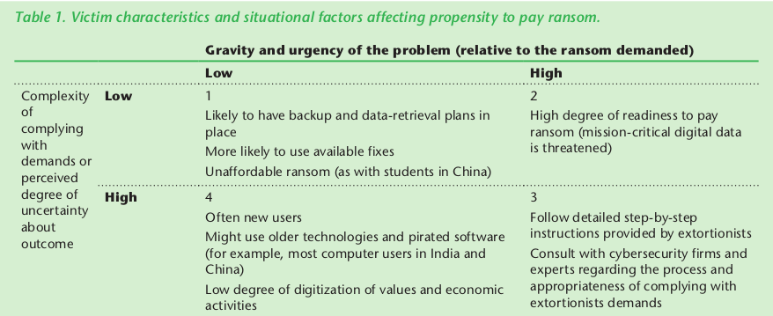
Paying the Ransom in Bitcoins?
Kshetri, N. Voas, J. “Do CryptoCurrencies Fuel Ransomware?” IT Trends, IEEE IT Professional ( Vol. 19, Issue. 5, 2017 ).
Notes:
Walk through this table briefly
Remember that just because you pay the ransom, doesn’t mean they’ll unencrypt your data!
Note the F-Secure reported that many ransomware attacks treat victims as customers, including a helpdesk call center, one-on-one help to exchange the ransom money into Bitcoins, and even a negotiation (or bartering) of the “price” to unencrypt” a user’s data!
Wouldn’t it be better to invest in good security and backup systems?
Even though there are now Cyber-Liability Insurance policies available, some companies have have purchased bitcoins to pay the ransom

Slide 8
Attacked at the weakest point
Weakness is not within Bitcoins or cryptocurrency technology!
Weakness is within users’ UNDERSTANDING of the technology!
Majority of successful attacks initiated by social engineering attacks
  Phishing/spear-phishing
  Drive-by-downloads
  Physical infiltration
Many data and financial loss events are caused by human error
  Lack of good planning and back up procedures
  Lack of good security practices and continued vigilance
Notes:
Many initial breaches into a company or government network were caused by successful breaches in the human side of the equation: phishing attacks, drive-by-downloads, and even physical penetrations of company or government offices
Data loss is also caused by lack of understanding of technology (and that it fails). Look at the article where the only access to Bitcoins was on a slip of pink paper under the bed
According to F-Secure’s report, “Keeping regular backups is a good and important thing do to, as is making sure your software is always patched. Removing unnecessary software and plugins helps a great deal, and of course the usual advice about clicking links and opening attachments applies too.”

Slide 9
Skype with My Mother, Ann
Ann: You should have got into Bitcoins early. You’d be rich now!
Ben: Maybe. I would have needed to get in very early before many people knew about it. As Dr. Jadliwala told us, the early days of Bitcoin mining was similar to the gold rush mining era in America.
Ann: Yes, but gold miners found precious metal. Bitcoins are virtual in a computer, so they’re not really mined. Aren’t they just created from nothing in a computer?
Ben: Mining Bitcoins gives them value with a Proof-of-Work by using computation. Miners compete by expending energy to run mathematical hashing computations over and over until one of them….
Ann: Oh, you know I never liked maths. I don’t think it is the same since you’re not creating anything real. I guess someone just decided creating Bitcoins is equal to creating real money.
Notes:
Skype sessions with my parents on Saturdays. Got talking about Bitcoins a few weeks ago.
This isn’t verbatim, but it is similar to the real conversation.
– Read through it comically!
So you can see that, even though my mother knows about Bitcoins and that they are valuable now, she finds it very hard to understand how a digital currency can have read world value, since it is not attached to a physical object.
How do I bring the explanation of foundational concepts of cryptocurrencies, such as value through Proof-of-Work, down to a physical level that she can more easily grasp that Bitcoins do hold value just like any other currency?

Slide 10

Star Trek Technobabble
“The Enterprise computer system is controlled by three primary main processing cores cross linked with a redundant melacortz ramistat and fourteen kiloquad interface modules. The core element is based on an FTL nanoprocessor with twenty-five bilateral kelilactirals with twenty of those being slaved into the primary heisenfram terminal. You do know what a bilateral kelilactiral is?”
- Star Trek: The Next Generation (S06-E07: “Rascals”)
Notes:
Though Bitcoin is a buzz word and know by many, in reality when we as experts talk about technology, about security, about cryptocurrencies what this sounds like to normal people is a lot of Technobabble
DON’T READ IT, LET THEM READ IT WHILE YOU TALK ABOUT TECHNOBABBLE!
We need to use alternative documentation styles, analogies and practical demonstrations to better inform the general public about new technologies and securing our investment of these technologies

Slide 11
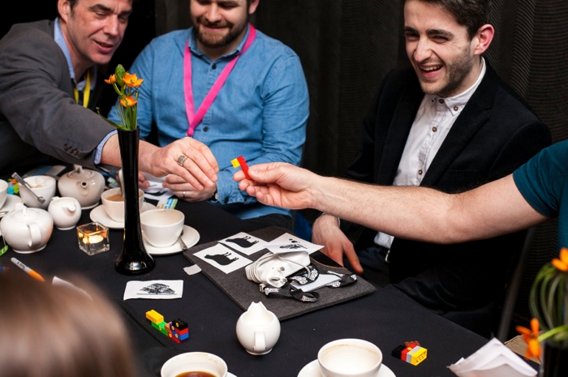
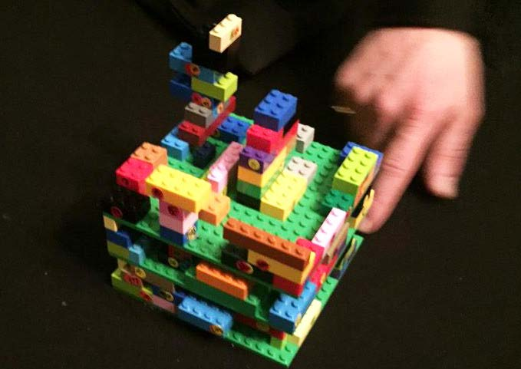
Effing the Ineffable
Using Lego to explain Blockchain technology to techs and non-techs
Beginning a transaction
The completed blockchain
(3 blocks high)
Maxwell, D. Speed, C. Campbell, D. “’Effing’ the Ineffable: Opening up Understandings of the Blockchain.” British HCI '15 Proceedings of the 2015 British HCI Conference. 2015.
Notes:
A good example of this is Maxwell, Speed, and Campbell’s 2015 paper “’Effing’ the Ineffable: Opening up Understandings of the Blockchain.”
Effable is the ability of something to be described in words
Group of business people
Lego bricks represent a transaction, and once the transaction is made, the brick is placed onto the Lego blockchain
This example did not delve into the math or the cryptography, but it gave these people an understanding of the fundamentals of blockchain technology.

Slide 12
Analogical Reasoning
Defined by Stanford Encyclopedia of Philosophy:
  An analogy is a comparison between two objects, or systems of objects, that highlights respects in which they are thought to be similar. Analogical reasoning is any type of thinking that relies upon an analogy.
Can we use analogies to help us explain these complex cryptographic technologies to the general public?
Notes:
This is a use of anology. QUOTE THE DEFINITION
So can we use analogies to explain other fundamental concepts of security or cryptocurrencies, much like the paper used lego bricks?

Slide 13

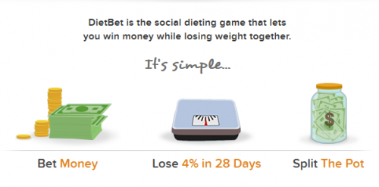
Analogy for Proof-of-Work:
Fitness for points or profit
WSU Heskett Center:
F45 Team Training
- work out in a team for points
- whichever team has the highest points wins that round
dietbet.com
Notes:
Let’s revisit the idea of how to perhaps explain Proof-of-Work with a more understandable analogy than stating “miners compete by calculating hash functions within a target space”
Talk through F45 as a means to explain proof-of-work

Slide 14
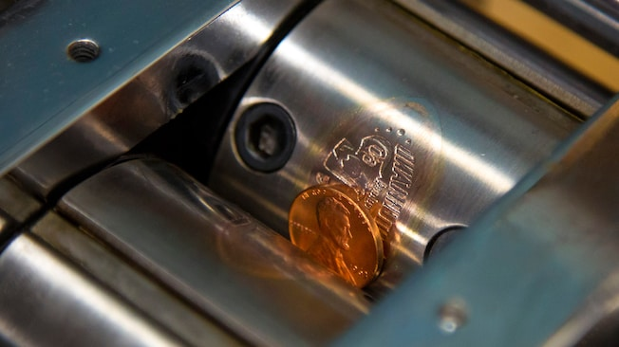
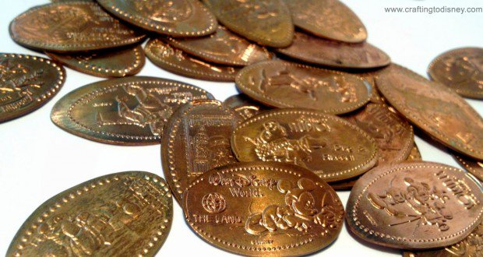
Analogy for Proof-of-Burn:
Memento Coin Presses
A penny press at Disneyland
Pressed Disney “memento” pennies
- no longer legal tender, but sometimes worth a lot more!
From: disneyland.disney.go.com
Notes:
Talk through memento penny presses
Like burning a small amount of bitcoins to place data onto the blockchain, we can use a penny press at a tourist resort/attraction and “burn” 1 cent fiat currency (a penny) to turn it into a memento from the tourist attraction
Like paying transaction fees for the transaction to be placed on the blockchain, we have to “pay” extra money for the penny to be pressed!
DON”T USE THIS: Side-note: mention my father used to place pennies on train tracks and watch the train “flatten” the penny as a kid!

Slide 15
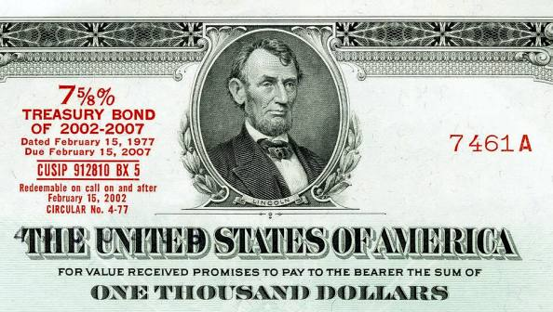
Analogy for Proof-of-Stake:
Treasury Bonds
Proof of Stake (PoS) concept:
  “… a form of proof of ownership of the currency. … Philosophically speaking, money is a form of ‘proof-of-work’ in the past thus should be able to substitute proof-of-work all by itself.” - King, S. & Nadal, S. “PPCoin: Peer-to-Peer Crypto-Currency with Proof-of-Stake.” 2012.
Treasury Bonds:
“...pay a fixed rate of interest every six months until they mature. They are issued in a term of 30 years.” - treasurydirect.gov
Notes:
OPTIONAL – ONLY DISCUSS IF TIME ALLOWS!
We did not directly cover Proof of Stake in class
Shown is a definition from the paper on peercoin which originated the implementation of proof-of-stake in cryptocurrency
Investopedia defines it more concisely as “a person can mine or validate block transactions according to how many coins he or she holds. This means that the more Bitcoin or altcoin owned by a miner, the more mining power he or she has.”
CLICK
Is this not similar to owning a Treasury Note or Bond.
These are U.S. government debt securities that pay the holder an interest payment twice a year for as long as the note/bond is held or until maturity

Slide 16
To Conclude
Cryptocurrencies will become more complex yet more mainstream
Ransomware and cyber-extortion will continue to rise
Security of user data will continue to be very important
Developing understandable ways to explain technology as important as developing the technology itself
  Heuristic: use simple models to give meaning to complexity
  Analogical: explain fundamentals with real world comparisons
  Association: relate explanations to the user’s world view
Above all, pretend to not have a degree in Computer Science and use less of the Star Trek technobabble!
Notes:
Heurisic::using Lego to understand blockchains
Analogical: using fitness to understand proof-of-work
Association: using non-technical examples to help explain technology

Slide 17

Thank You!
Ben Roose: ben.roose@wichita.edu
These slides can be found at: https://github.com/benroose/presentations
Any Questions?

Slide 18



Please attribute Ben Roose with a link to https://github.com/benroose/presentations
This work is licensed under the Creative Commons
Attribution-ShareAlike 4.0 International License.
To view a copy of this license, visit http://creativecommons.org/licenses/by-sa/4.0/.
Ben Roose is an employee of
Wichita State University

