Slide 1

Can an Android device be useful yet Open Source?
Ben C. Roose
Electrical Engineering & Computer Science
Systems Administrator, Wichita State University
Maintains Debian, Ubuntu, LTSP, and OpenStack with CFEngine
Notes:
My personal journey of six months with an almost fully open source phone (in software)
First a quick overview of what we are going to talk about!

Slide 2

What are we talking about?
We will look at:
Drilling down: 6 layers of an Android mobile device
Picking your battles: Open Source options for each layer
Practical application: Terms and tools for installing an Android OS
Hard lessons learned: Experiences with an Open Source smartphone
Tips and tricks: Staying open inside the Google ecosystem
Goodbye Google: Rolling your own cloud synchronization
Notes:
Quick run down of what we will talk about over the next 40 minutes!

Slide 3
Why I Decided to Rebuild my Smartphone
Carriers are reducing a user’s ability to manage their own device
Carriers are installing non-removable bloatware and tracking apps
Carriers are limiting support/upgrades for older device models
I promote Open Source technologies, so ethically shouldn’t I be using Open Source devices?
Can a smartphone still be a productive mobile device if we limit the installation to only Open Source apps?
Notes:
I might be egotistical, but as a sysadmin, I feel I am in a better position to manage my own device than a bunch of companies primarily interested in turning a profit
Is it just me or are we seeing more and more bloatware and spyware on smartphones sold by carriers like AT&T or Verizon?
I bought a cheap ZTE Z992 from AT&T about 4 years ago. AT&T would not upgrade it beyond Android 4.1.1 (Linux 3.4.0?)
I push for Open Source, but the system in my pocket is running a lot of closed source software. Can I do better ethically?
Now there’s the 64000 dollar question!

Slide 4
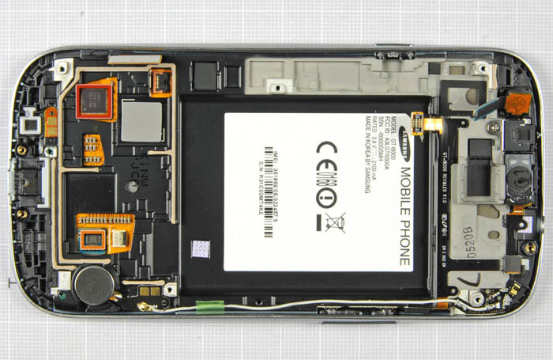
Layers of an Android Device (Template)
1: Physical Hardware
2: Hardware Drivers
3: Operating System
4: App Repository
5: User Apps
6: Cloud Storage & Sync
Notes:
ASK: WHAT IS A PROCESS?
CLICK:
According to The Linux Information Project....
They also state:
“Processes are dynamic entities in that they are constantly changing as their machine code instructions are executed by the CPU.”
CLICK:
Each process on a system can be identified by a Process Identification number (PID).
ASK: WHAT IS A NON-NEGATIVE INTEGER?
The kernel will hold a list of active processes
WHAT IS THE KERNEL?
END: So how is a process run (executed)?

Slide 5
Layers of an Android Device
Notes:
ASK: WHAT IS A PROCESS?
CLICK:
According to The Linux Information Project....
They also state:
“Processes are dynamic entities in that they are constantly changing as their machine code instructions are executed by the CPU.”
CLICK:
Each process on a system can be identified by a Process Identification number (PID).
ASK: WHAT IS A NON-NEGATIVE INTEGER?
The kernel will hold a list of active processes
WHAT IS THE KERNEL?
END: So how is a process run (executed)?

Slide 6
Layers of an Android Device
1: Physical Hardware
Notes:
ASK: WHAT IS A PROCESS?
CLICK:
According to The Linux Information Project....
They also state:
“Processes are dynamic entities in that they are constantly changing as their machine code instructions are executed by the CPU.”
CLICK:
Each process on a system can be identified by a Process Identification number (PID).
ASK: WHAT IS A NON-NEGATIVE INTEGER?
The kernel will hold a list of active processes
WHAT IS THE KERNEL?
END: So how is a process run (executed)?

Slide 7
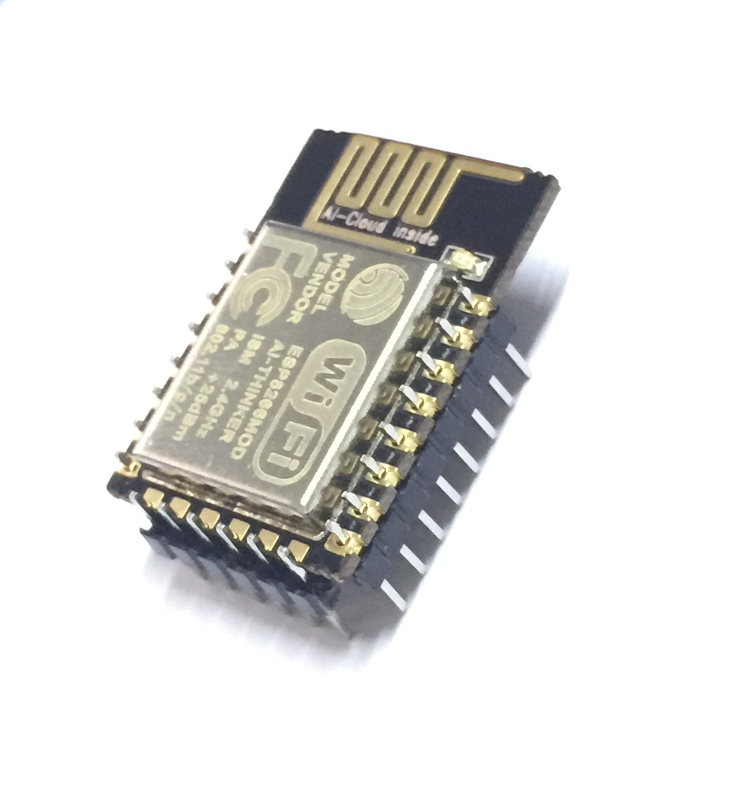
Layers of an Android Device
1: Physical Hardware
2: Hardware Drivers
Notes:
ASK: WHAT IS A PROCESS?
CLICK:
According to The Linux Information Project....
They also state:
“Processes are dynamic entities in that they are constantly changing as their machine code instructions are executed by the CPU.”
CLICK:
Each process on a system can be identified by a Process Identification number (PID).
ASK: WHAT IS A NON-NEGATIVE INTEGER?
The kernel will hold a list of active processes
WHAT IS THE KERNEL?
END: So how is a process run (executed)?

Slide 8

Layers of an Android Device
1: Physical Hardware
2: Hardware Drivers
3: Operating System
Notes:
ASK: WHAT IS A PROCESS?
CLICK:
According to The Linux Information Project....
They also state:
“Processes are dynamic entities in that they are constantly changing as their machine code instructions are executed by the CPU.”
CLICK:
Each process on a system can be identified by a Process Identification number (PID).
ASK: WHAT IS A NON-NEGATIVE INTEGER?
The kernel will hold a list of active processes
WHAT IS THE KERNEL?
END: So how is a process run (executed)?

Slide 9

Layers of an Android Device
1: Physical Hardware
2: Hardware Drivers
3: Operating System
4: App Repository
Notes:
ASK: WHAT IS A PROCESS?
CLICK:
According to The Linux Information Project....
They also state:
“Processes are dynamic entities in that they are constantly changing as their machine code instructions are executed by the CPU.”
CLICK:
Each process on a system can be identified by a Process Identification number (PID).
ASK: WHAT IS A NON-NEGATIVE INTEGER?
The kernel will hold a list of active processes
WHAT IS THE KERNEL?
END: So how is a process run (executed)?

Slide 10

Layers of an Android Device
1: Physical Hardware
2: Hardware Drivers
3: Operating System
4: App Repository
5: User Apps
Notes:
ASK: WHAT IS A PROCESS?
CLICK:
According to The Linux Information Project....
They also state:
“Processes are dynamic entities in that they are constantly changing as their machine code instructions are executed by the CPU.”
CLICK:
Each process on a system can be identified by a Process Identification number (PID).
ASK: WHAT IS A NON-NEGATIVE INTEGER?
The kernel will hold a list of active processes
WHAT IS THE KERNEL?
END: So how is a process run (executed)?

Slide 11

Layers of an Android Device
1: Physical Hardware
2: Hardware Drivers
3: Operating System
4: App Repository
5: User Apps
6: Cloud Storage & Sync
Notes:
ASK: WHAT IS A PROCESS?
CLICK:
According to The Linux Information Project....
They also state:
“Processes are dynamic entities in that they are constantly changing as their machine code instructions are executed by the CPU.”
CLICK:
Each process on a system can be identified by a Process Identification number (PID).
ASK: WHAT IS A NON-NEGATIVE INTEGER?
The kernel will hold a list of active processes
WHAT IS THE KERNEL?
END: So how is a process run (executed)?

Slide 12

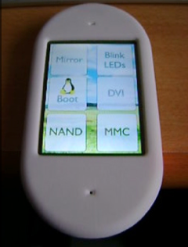
Layer 1: Physical Hardware
Proprietary Hardware Options
Majority of smartphones, tablets, and other mobile devices on the market
Manufacturers include:
Acer, Asus, HTC, Huawei, LG, Motorola, Samsung, Sony Ericsson, ZTE, etc.
Open Hardware Options
A few kickstarter/Indiegogo “pipe-dream” devices, inc. Root101, Neo900
Golden Delicious GTA04
(from Europe: 529 euros)
Raspberry Pi home-brew phone
Notes:
Proprietary = everything! Concern in the security arena of isolation for each module (cellular radio, wifi radio, bluetooth, NFC radios)
Open source = Very limited! Hard to find, expensive to purchase, tricky to run
Raspberry Pi = I’m not a hardware guy, though gettinga cellular device onto a Pi is getting easier with skywire, plus RTAndroid for the Pi...but there’s a way to go yet!
Currently an open hardware mobile device is not a feasible option

Slide 13
Layer 2: Hardware Drivers
Proprietary Driver Options
Most manufacturers release hardware module drivers as binary blobs under closed source licensing
Module drivers (firmware) added on top of Linux OS
Similar to the historical M$ Windows ecosystem
Open Source Options
Some modules have open source drivers available depending on chipsets used
Some modules in older Samsung devices have open source firmware
Can mix-n-match open and proprietary firmware
Notes:
Proprietary = again everything!
Open source = Very limited! Hard to find, expensive to purchase, tricky to run
Raspberry Pi = I’m not a hardware guy, though gettinga cellular device onto a Pi is getting easier with skywire, plus RTAndroid for the Pi...but there’s a way to go yet!
Currently an open hardware mobile device is not a feasible option

Slide 14
Layer 3: Operating System
Android OS allowing for proprietary firmware and apps
“Stock” Google Android
Carrier built Android
Cyanogenmod/Lineage OS
Android OS allowing only Open Source firmware and apps
Replicant OS
Notes:
Proprietary = again everything!
Open source = Very limited! Hard to find, expensive to purchase, tricky to run
Raspberry Pi = I’m not a hardware guy, though gettinga cellular device onto a Pi is getting easier with skywire, plus RTAndroid for the Pi...but there’s a way to go yet!
Currently an open hardware mobile device is not a feasible option

Slide 15
Layers of an Android Device
1: Physical Hardware
2: Hardware Drivers
3: Operating System
4: App Repository
5: User Apps
6: Cloud Storage & Sync
Notes:
ASK: WHAT IS A PROCESS?
CLICK:
According to The Linux Information Project....
They also state:
“Processes are dynamic entities in that they are constantly changing as their machine code instructions are executed by the CPU.”
CLICK:
Each process on a system can be identified by a Process Identification number (PID).
ASK: WHAT IS A NON-NEGATIVE INTEGER?
The kernel will hold a list of active processes
WHAT IS THE KERNEL?
END: So how is a process run (executed)?

Slide 16

Example: The Shell as a Process
A child process is given a unique process number (PID)
A child process inherits from its parent:
  Parent Process number (PPID)
A child process inherits from its parent (or sets its own):
  Process Group Identification number (PGID)
  Session Identification number (SID)
Notes:
The command ps (like top or htop) displays process information by probing/reading the /proc directory (pseudo-filesystem).
ASK: WHAT IS THE /PROC DIRECTORY?
MENTION: pgrep uses grep to find a process in ps
Breakdown ps command
-o = option to display custom output for ps
$$ = PID of the current process (i.e. the bash shell) an environment variable!
CLICK:
Review on example bash process, TTY PID, PPID
ASK: SO WHAT IS PGID AND SID?
CLICK:
PGID is the Process Group Identification number.
SID is the Session Identification number.
Each child process (spawned) inherits its process group ID and session ID from its parents.
NOTICE how the shell's PGID and SID are the same as its own PID!

Slide 17
Sessions and Groups
Process Session (SID)
  A process is a member of a session
  Specific processes, such as the shell, can become session leaders
  (where SID = PID)
  A session may have a maximum of one controlling terminal
Process Group (PGID)
  A group is a collection of one or more processes
  Shell will execute a command with the first process in the command as group leader (where PGID = PID)
  Within a session, only one process group can be in the foreground at any time and have access to the terminal
  All other process groups in a session are in the background
Notes:
Process Session
For example a shell can become a session leader and then open a controlling terminal (tty)
A session may have one or none controlling terminal
CLICK:
Process Group
When a new command line is executed/run in the shell, the first process (command) is made the group leader.
At any time, only one process group in a session can be in the FOREGROUND and have direct read/write access to the controlling terminal.
All other process groups are running in the background.
When a command is run, the shell process will become a background group and hand over access to the controlling terminal to the newly run process group (i.e. in the foreground).
When the foreground process group terminates, the shell will automatically move itself into the foreground and take back access to the controlling terminal.

Slide 18
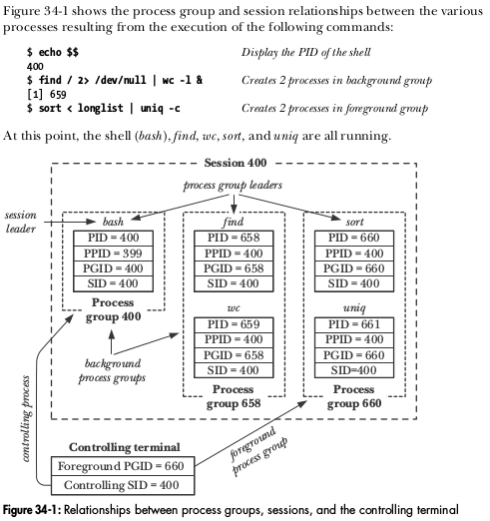
Example: Process Relationships
From: Kerrisk, M. (2010). The Linux Programming Interface (pp. 701)
Notes:
Walk through Kerrisk's example

Slide 19
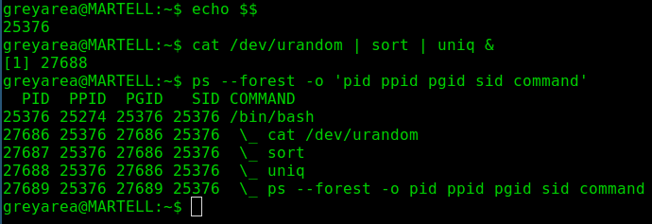
Example: Process Relationships
Notes:
I like green on black, reminds me of childhood with dad's Amstrad word processor in '80s!
Build a diagram something similar to Kerrisk pp. 701 fig. 34-1
Need to mention that & = places command as a background process group (otherwise command will become the foreground process group)
END: To understand more about process control, we need to look into software signals!

Slide 20

Signals
A software signal is a notification to process or process group
  Similar to hardware interrupts
  Denoted by a unique number and a symbolic name
Software signals are sent by the system (kernel):
  to a specific process
  to the foreground process group within a session
  to one or more background process groups within a session
Notes:
Talk about a software signal being similar to a hardware interrupt!
ASK: WHAT ARE SOME HARDWARE INTERRUPTS? (keyboard, serial port, hard drive, clock, watchdog timer)
Singals are idetified by a unique non-negative integer and by a symbolic name
CLICK:
Though processes can send signals to each other (one form of inter-process communication) ,we are interested in the signals sent by the kernel to process groups.
Remember: there can be only one foreground process group in any specific session (and only one controlling terminal connected to that session).

Slide 21
Sending and Receiving Signals
Signals are sent by the system:
  using specific processes, i.e. kill command
  using terminal keybindings, i.e. CTRL+C
When a signal is received by a process, it can:
  default to a standard behaviour: terminate, stop, or continue
  ignore the signal (not all signals can be ignored)
  run custom signal handler code, i.e. ping command
Notes:
Talk about a software signal is sent by processes (KILL) or terminal keybindings (keyboard shortcuts) (CTRL+C = SIGINT
CLICK:
Upon receiving a signal, a process can default behaviour (TALK about terminate, stop, and continue)
Ignore the signal (but some signals such as SIGKILL, SIGSTOP, can't be ignored)
Run custom signal handler code, such as the ping command when it receives SIGINT, it displays a summary of ping data before terminating

Slide 22
Common Signals
Sig Name | Sig # | Signal Description | Default Process Behaviour | Keybinding or command
SIGHUP | 1 | Terminal hangup | Process terminate | CTRL + D (EOL)
SIGINT | 2 | Terminal interrupt | Process terminate | CTRL + C
SIGQUIT | 3 | Terminal quit | Process core dump | CTRL + \
SIGTSTP | 20 | Terminal stop | Process stop | CTRL + Z
SIGTTIN | 21 | Term read from BG | Process stop | (sent by terminal)
SIGTTOU | 22 | Term write from BG | Process stop | (sent by terminal)
SIGTERM | 15 | Terminate process | Process terminate | kill <pid>
SIGKILL | 9 | Sure kill | Process terminate | kill -KILL <pid>
SIGSTOP | 19 | Sure stop | Process stop | kill -STOP -<pgid>
SIGCONT | 18 | Continue if stopped | Process continue | fg / bg / kill -CONT
Notes:
Walk through the common signals
Talk through the signals sent via a terminal
NOTE: EOL (end of line) sent when user types exit, CTRL+D or signal sent when terminal hangsup another way (i.e. SSH remote connection disconnects)
Signals such as SIGHUP or SIGINT are passed down from a parent process to its children (so all processes in a session or process group will terminate)
NOTE: Process stop means pause the process (but don't terminate it)
MENTION: core dump (used for debugging programs)
Talk through what happens when a process in a backgroup process group attempts to read from or write to the terminal (but mention that by default a shell will allow a process in the background to write to the terminal via the shell, i.e. display output from the process)
Talk through SIGCONT
Talk through process terminate and sure kill/stop using the kill command! (should try to use SIGTERM first, default in kill)!
MENTION: pkill uses grep to find a parocess and kill it

Slide 23
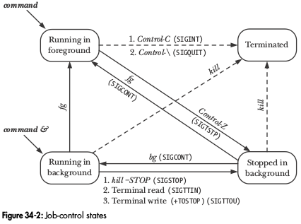
Putting it together to control processes
From: Kerrisk, M. (2010). The Linux Programming Interface (pp. 717)
Notes:
Talk through the control states of a process group
Move from running a command in foreground to stopped to running in background to terminate
Talk about using keybindings and fg / bg to shift between states
NOTICE: we can also use the ampasand to start a process in the background
Talk about the kill command sending different signals, including terminate, sure kill, sure stop, and continue
MENTION: with kill if you use a dash before the pid number, then it will send signal to entire process group (pgid)!
REMEMBER: we are controlling process groups, not single processes

Slide 24
Example on the Terminal: Job Control
Live Demonstration
by Ben if time allows!
Notes:
Make sure we have job_mon in home directory
Talk about the process and group IDs as we walk through demo!
Ben list the commands here:
echo $$
./job_mon | ./job_mon &
./job_mon | ./job_mon | ./job_mon &
fg
TYPE CTRL+C (SIGINT)
TYPE CTRL+Z (SIGTSTP)
jobs (NOTE: talk about job numbers vs. PIDs)
bg
jobs
kill %1 %2

Slide 25
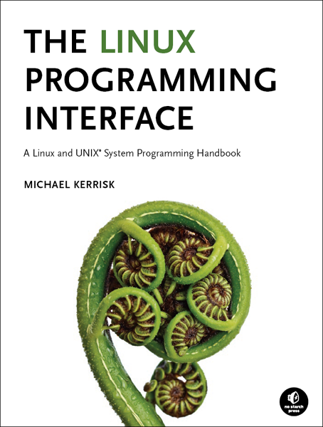
Kerrisk, Michael. (2010). The Linux Programming Interface. No Starch Press
Credit and plug...
A must read for Linux systems administrators, programmers, and enthusiasts looking for an in-depth discussion on the internal workings of UNIX.
For 30% sale discount and free ebook with the printed edition,
go to:
http://man7.org/tlpi/
Notes:
Shameless plug, but I get no money from this. I just think this is a great textbook for Linux gurus!
Michael Kerrisk wrote many of the man and info pages that we all take for granted

Slide 26

Thank You!
Ben Roose: ben.roose@wichita.edu
Any Questions?

Slide 27



Please attribute WuLUG with a link to orgsync.com/84973/chapter
This work is licensed under the Creative Commons
Attribution-ShareAlike 4.0 International License.
To view a copy of this license, visit http://creativecommons.org/licenses/by-sa/4.0/.
WuLUG is a student organization of
Wichita State University

