Slide 1
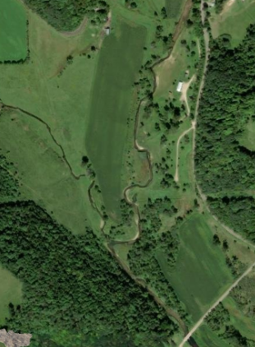
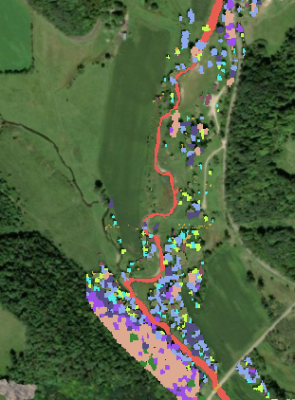

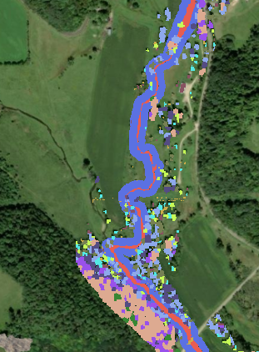
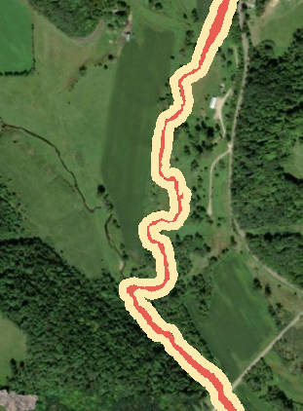

Land Cover Scenarios
Used for Shade Modeling
Satellite
Image
Observed (2023) Vegetation
Uniformly Forested Riparian Zone
Uniform Grassed Riparian Zone
0
.1
.2 miles

Slide 2
