Slide 1
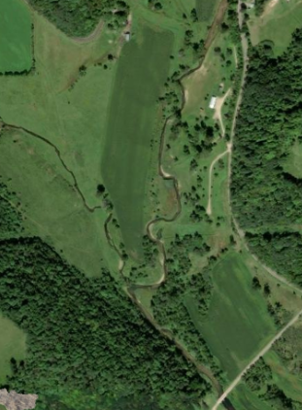
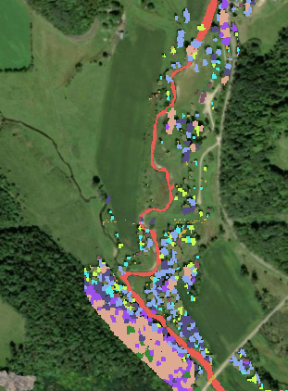

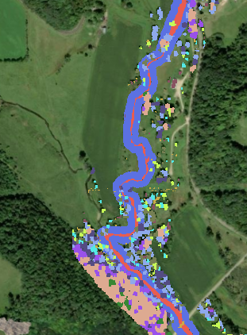
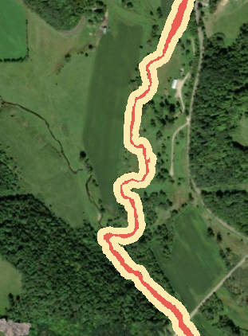

Land Cover Scenarios
Used for Shade Modeling
Satellite
Image
Observed (2023) Vegetation
Forest buffer
Grass buffer
River Channel
1.5 – 3.0 m
3.0 - 4.5 m
4.5 – 7.0 m
Forested Baseline
Non-forested Baseline
7.0 – 8.5 m
8.5 – 10.0 m
10.0 – 13.0 m
13.0 – 16.0 m
16.0 – 19.0 m
19.0 – 25.0 m
25.0 – 31.0 m
150 m
300 m

Slide 2
