Slide 1
Data Forwarding

Slide 2


What is Data Forwarding?
Data forwarding allows you to forwards cases and forms to an external server for your own processing
Docs: http://bit.ly/1NjRZLm
CommCareHQ
EXI

Slide 3
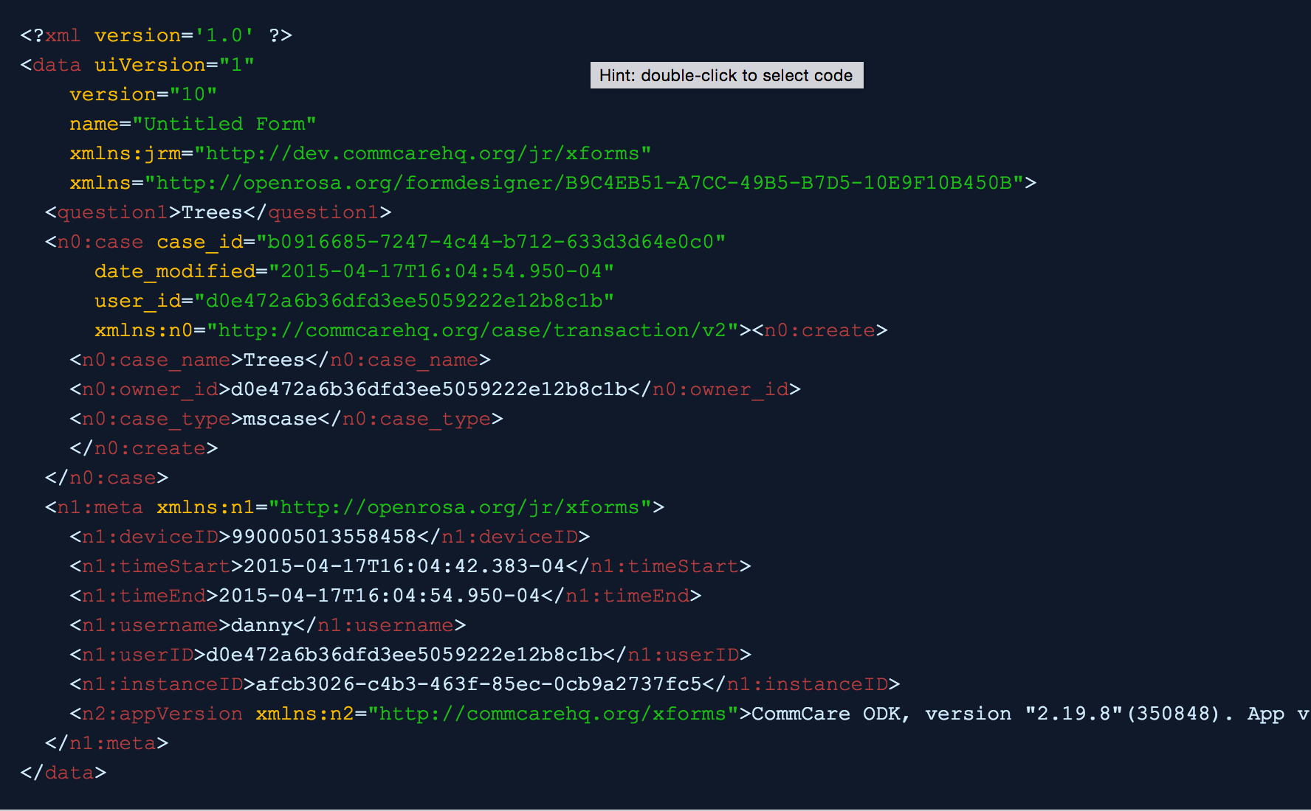
Form Forwarding
Sends you the entire form (XML or JSON)

Slide 4
Case Forwarding
Sends you the entire case(XML or JSON)

Slide 5
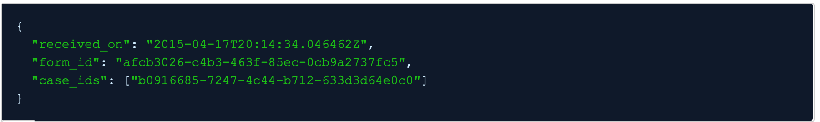
Forward Form Stub
This sends you a timestamp (GMT), the form's id, and the ids of any affected cases
Why is this useful?
When you get the ids, you can use the data APIs to read the corresponding cases (at a different time or immediately)

Slide 6
Forward App Schema Changes
Sends an app_id whenever the app has been saved
Sends a build_id whenever there’s a new build

Slide 7
Let’s look at HQ https://www.commcarehq.org/a/exi-training/settings/project/forwarding/
Notes:
Replace milk type question with lookup table

Slide 8
Notes
Forwarding will happen every five minutes

