Slide 1
CommCare Overview

Slide 2


What is CommCareHQ
A tool to build phone applications online
Notes:
Build phone applications
CommCare is the phone application
CommCareHQ is where the binary for the application is built
All data is sent to CommCareHQ

Slide 3
What we will do
Notes:
Go over commcarehq
There is a _lot_ of capability in HQ, even some I’m not sure of, but we can always figure it out

Slide 4

Designing smart applications

Slide 5


Case Management Review
101110101000101
101110101000101
101110101000101

Slide 6
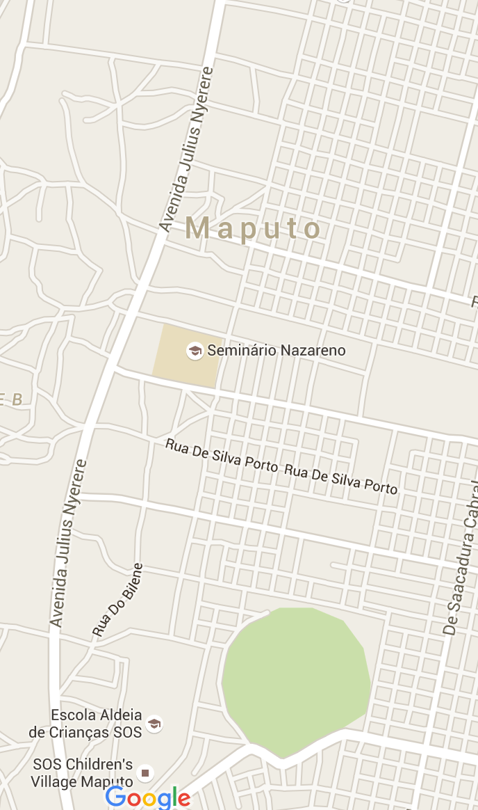

GPS capture in CommCareHQ
Notes:
CommCareHQ has multiple ways to capture GPS we’ll go over each of the ways

Slide 7
Data exporting and forwarding
CommCareHQ
EXI

Slide 8


Reporting
Notes:
Custom reports

Slide 9
The Tech

Slide 10
XForms
Xforms is a w3 spec: http://www.w3.org/TR/xforms/
CommCare can play any xform spec
Notes:
Breaks up form into MVC, a large improvement over web forms. Makes it easier to display on multiple devices

Slide 11
Essence of an application
Download the CommCare application
Build a ccz file on HQ (consists of forms and modules)
The CommCare application plays that CCZ file
Each time a form is submitted HQ processes that data
“restores” are sent back to the phone to update the case database

