Slide 1
Case Management

Slide 2

What is a case
Notes:
Ask audience

Slide 3
What is case
A way to collect data over time
A way to share data between applications
A way to send information to other users
A way to share data between mobile workers
Notes:
Explain each of the concepts with drawings. Bring up case closures`

Slide 4
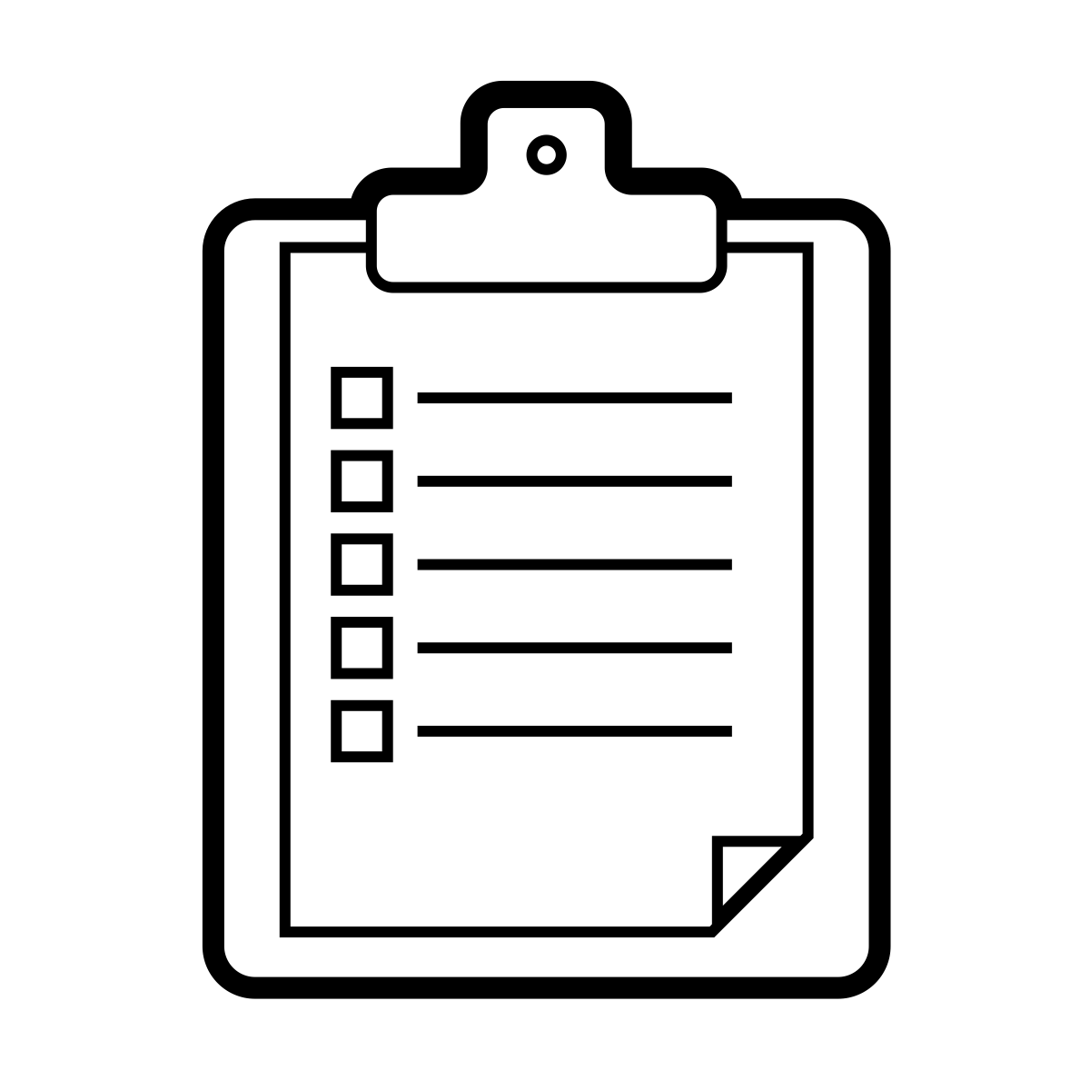
Theory behind cases
Cases are built from forms and can always be “rebuilt”
101110101000101
101110101000101
101110101000101
Notes:
Discuss how cases actually work
Setup cases on HQ
Submit and view the data

Slide 5
Case Activity
Module: Register Mother
Form: Register Mother
Name
Age

Slide 6
Case Activity: Edit Mother
Module: Register Mother
Form: Register Mother
Name
Age
Form: Edit Mother
Name (preload the data)
Age (preload the data)
Favorite Color

Slide 7
Case List and Case Detail
Case list is the list of cases to be shown before selecting a case
Only has one or two case properties
Can be filtered or sorted based on an Xpath Expression
Case Detail is the information of the case after clicking on it in the case list
Often shows more properties
Docs: http://bit.ly/1NX8sWv

Slide 8
Child Cases
Can be used to refer cases
Avoid creating multiple registrations (mother and child, for example)
Can use a repeat group to create child cases

Slide 9
Case Activity: Child Case
Module: Register Mother
Form: Register Mother
Name
Age
Has child? (Y/N)
Name
Age
Gender (M/F)
Form: Edit Mother
Name (preload the data)
Age (preload the data)
Module: Child
Form: Update Child

Slide 10
View the Case Data
https://www.commcarehq.org/a/exi-training/reports/case_list/

Slide 11


Case Sharing
Normal case workflow:
Susy’s cases
Susy
Bob’s cases
Bob

Slide 12
Case Sharing
Case sharing case workflow:
Bob and Susy’s cases
Susy
Bob and Susy’s cases
Bob

Slide 13
Case Sharing Caveats
All users must be in exactly one case sharing group
Users not in a case sharing group will cause errors
Users in more than one group will cause errors if they ever create a case

Slide 14
Case Activity: Case Sharing
Make two mobile workers
Open phone with new mobile worker. See that there are no cases
Create a case sharing group
Log out of new mobile worker, and log into the old one.
Submit some cases
Log back into the new user and see that the data should be shared
Note: Remember to Sync with Server after you’ve updated the groups!

Slide 15
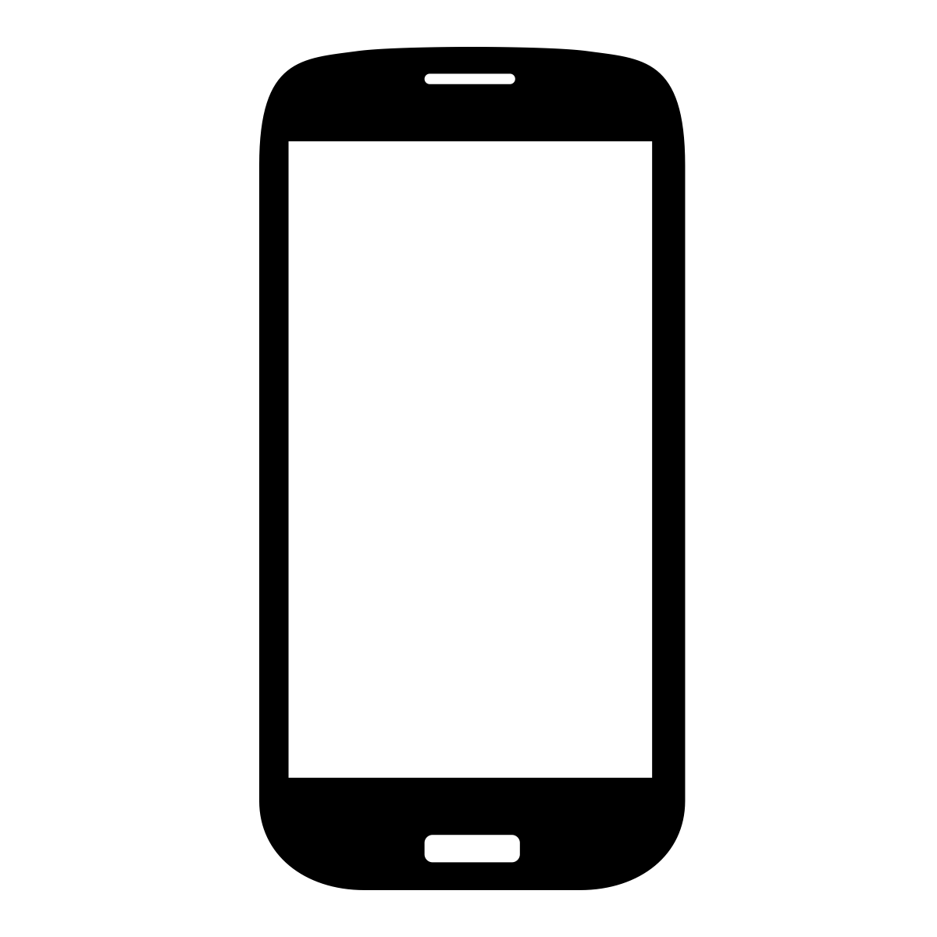
Multiple Apps
Case Types can be shared across a _domain_. That means case types case be shared in different applications
One case many apps

Slide 16
Case Activity: Multiple apps
Make a second app with the same case type
See how the other cases get loaded
See that the cases show up in the other application
New App: Humans of Mozambique
Module: Register Human
Form: Register a human
Name
Age

