Slide 1
Case Management

Slide 2

What is a case
Notes:
Ask audience

Slide 3
What is case
A way to collect data over time
A way to share data between applications
A way to send information to other users
A way to share data between mobile workers
Notes:
Explain each of the concepts with drawings. Bring up case closures`

Slide 4
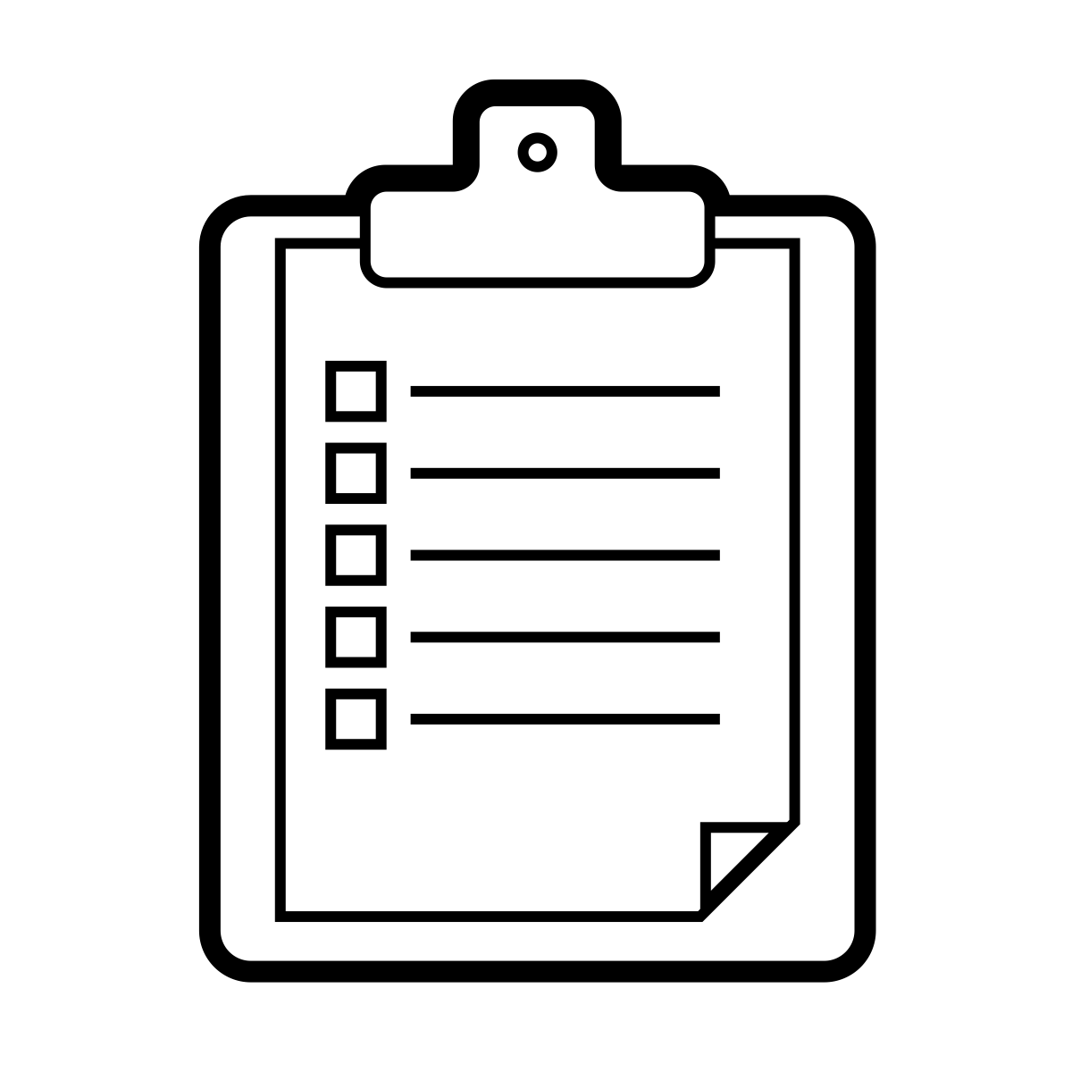
Theory behind cases
Cases are built from forms and can always be “rebuilt”
101110101000101
101110101000101
101110101000101
Notes:
Discuss how cases actually work

Slide 5


Case Sharing
Normal case workflow:
Susy’s cases
Susy
Bob’s cases
Bob

Slide 6
Case Sharing
Case sharing case workflow:
Bob and Susy’s cases
Susy
Bob and Susy’s cases
Bob

Slide 7
Child Cases
Can be used to refer cases
Avoid creating multiple registrations (mother and child, for example)
Can use a repeat group to create child cases

Slide 8
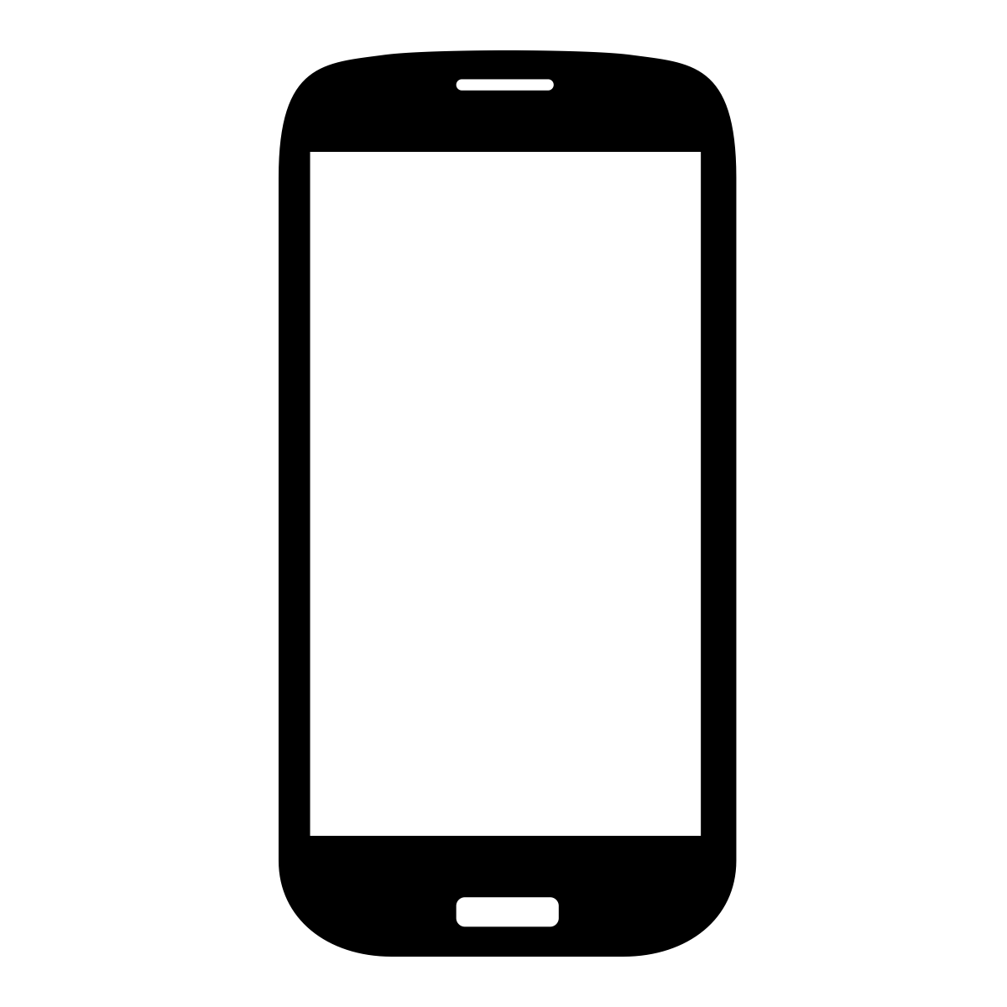
Multiple Apps
Case Types can be shared across a _domain_. That means case types case be shared in different applications
One case many apps

Slide 9
Case List and Case Detail
Case list is the list of cases to be shown before selecting a case
Only has one or two case properties
Can be filtered or sorted based on an Xpath Expression
Case Detail is the information of the case after clicking on it in the case list
Often shows more properties
Docs: http://bit.ly/1NX8sWv

Slide 10
Let’s look at HQ https://www.commcarehq.org/a/exi-training/apps/view/841cb462e89c6bd0e4d0038b4a97367c/modules-0/
Notes:
Setup basic case management

Slide 11
Activity: Complex case management
A community health worker needs to create a case for a mother and her baby, create a form that creates both those cases in a single form
Workers need to visit districts, but we do not want them to overlap. Build a case sharing application that ensures that workers see where other workers have visited.
Create your own!
Incorporate a nice case list and case detail!
Docs: http://bit.ly/1lnZhr1

