Slide 1
Exports

Slide 2
So, you wanna see your data?

Slide 3
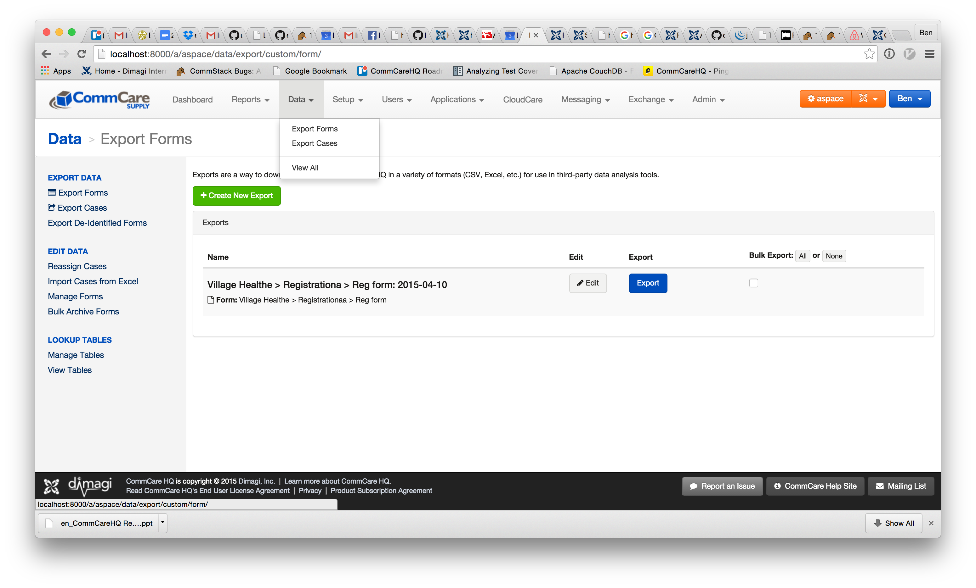
Export Forms: Create New Export

Slide 4
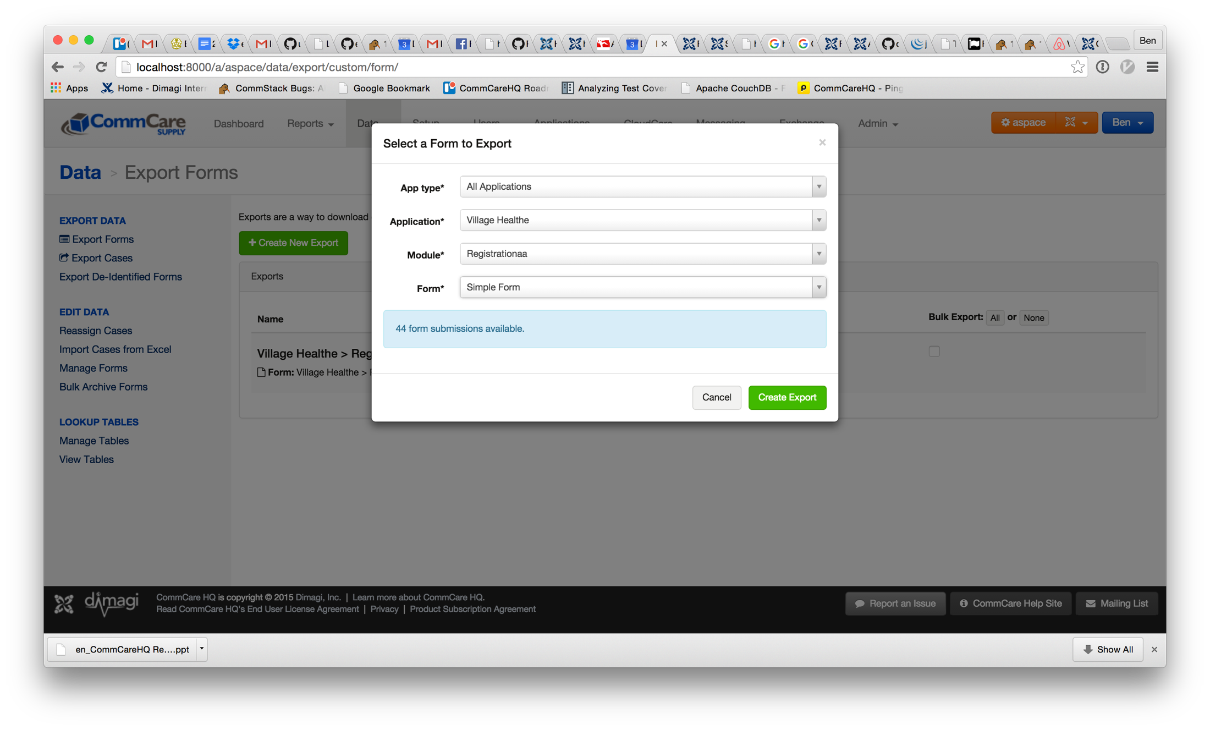
Export Forms: Select the form

Slide 5
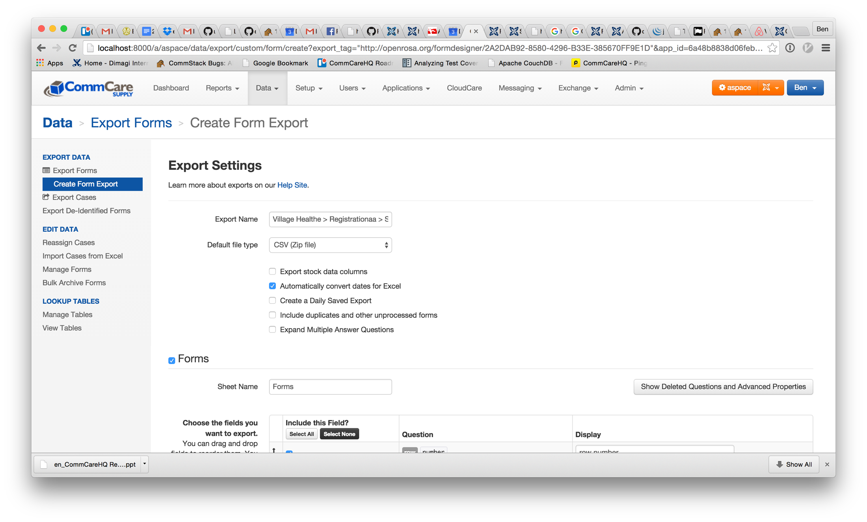
Export Forms: Select the data

Slide 6
Same process for cases except hit Export Cases

