Slide 1
Magnetometer array for Mirror Neutron Oscillation Experiment
Ben Rybolt, Ben Chance
3/16/2017

Slide 2
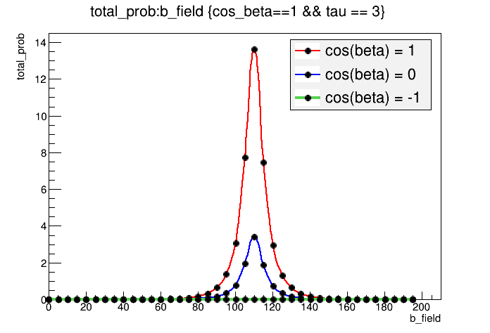
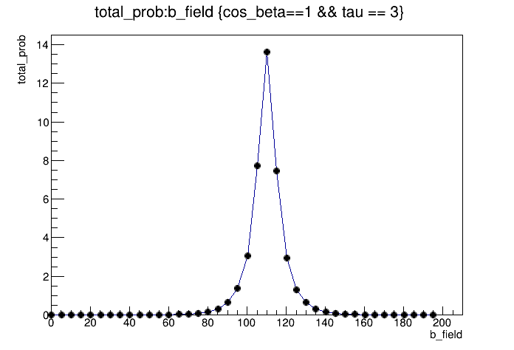
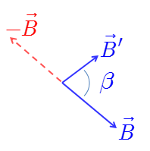


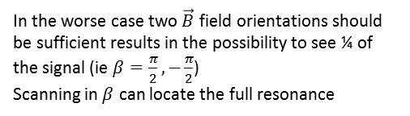


Overview
Mirror Neutron oscillation experiment requires controlling the magnetic field in 3d along the flight path of neutrons (see schematic to the right)
The Probability of oscillation is sensitive to changes (~10mG) of magnetic field strength and direction[see below for example].
For this reason there should be an independent measurement system to determine the magnetic field along the neutron beam.
Our goal is to build such a system.
$$N→N′$$
$$N^{′}→N$$
Neutron source
B-Field Control
B-Field Control
Low Background High Eff. N Detector
Beam Dump
Low Efficiency
N Detector
High Eff. N Detector
High Eff. N Detector
Effect of unknown angle $β (\vec{B}′,\vec{B}$)
Assumes: SNS neutron beam w/ 2x 15 m pipe; cos(beta)=1 ; ΔB = 5 mGauss
Example scan in B with $τ=3$
Neutrons/MWs
Neutrons/MWs
Examples at SNS
In the worse case two $\vec{B}$ field orientations should be sufficient results in the possibility to see ¼ of the signal (ie $β=\frac{π}{2},−\frac{π}{2}$)
Scanning in $β$ can locate the full resonance
B Field (mG)

Slide 3
Hardware
We plan to accomplish this goal by installing a prototype magnetometer array along the neutron guide.
1) The immediate goal will be to build a 6 channel working prototype that can be installed in May 2017.
2) Following completion of 1) we will examine the time varying magnetic fields within a 1m region
3) By the design the prototype will be modular so that replication will allow coverage of the entire 14 m “disappearance” region.
Multi-channel
Arduino
Raspberry pi
Power Outlet
I²C Multiplex
Useful links:
Arduino:
Magnetometer chip: datasheet
SD card read/write
I2C Multiplexer breakout:
3 axis Magnetometer
3 axis Magnetometer
3 axis Magnetometer
3 axis Magnetometer
3 axis Magnetometer
3 axis Magnetometer

Slide 4
Software
Magnetometers communicate through I²C protocol with Arduino. Raspberry Pi reads and saves data from Arduino with time stamp.
A measurement session can be started in person and left to collect data indefinitely.
Ideally we can have remote access to this raspberry Pi through its Wi-Fi connection for data retrieval/operation control.
We can also explore automatic uploads of data files onto our server.
Have communicated this with :Senesac, Larry R. <senesaclr@ornl.gov>
Ben,
Currently our IT guy is looking into how we can set up this communications and stay within the ORNL internet rules, so we will have to get back to you regarding when we will be ready for you to bring the device and setup the initial communications. I’m sure that the setup cannot be done remotely.
Larry

Slide 5
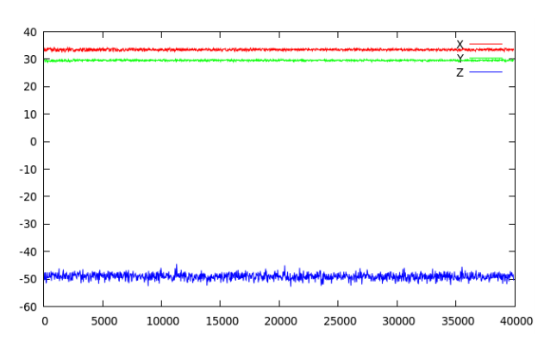
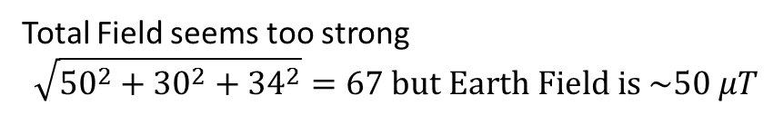
Performance of Single Magnetometer
Overnight Magnetometer Run
Total Field seems too strong
$$\sqrt{{50}^{2}+{30}^{2}+{34}^{2}}=67 but Earth Field is \sim 50 μT$$
Also we should make a plot where we bring a magnet nearby
or
maybe use Helmholtz coils to calibrate
Self Calibrate magnetometers?

Slide 6
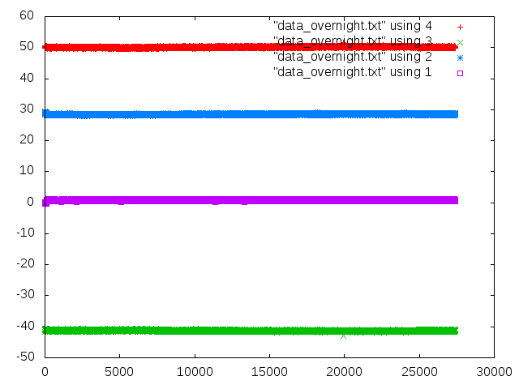
Overnight Magnetometer Run
Magnitude
Y
B-Field (uT)
X
Z

Slide 7
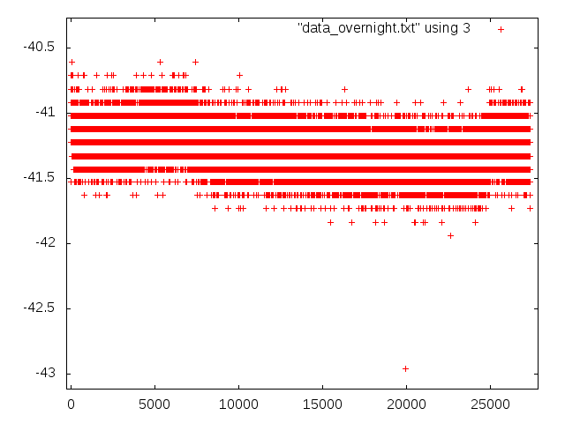
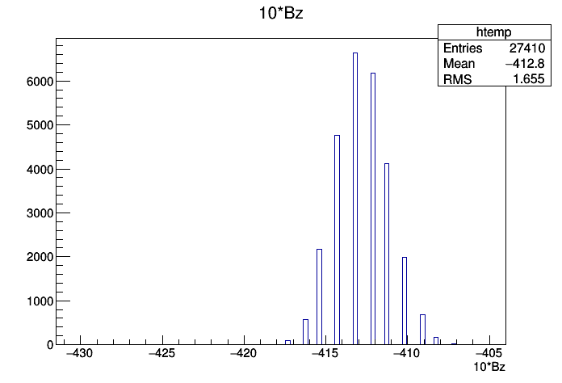
Magnetometer Sensitivity
1uT=10 mG
Z channel stability
B-Field (uT)
Bz (mG)
Digitizer LSB = 1 mG
RMS = 1.65 mG

Slide 8
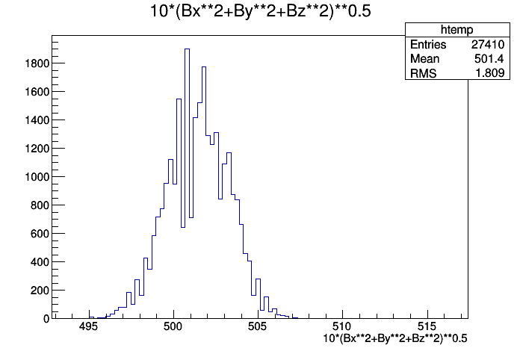
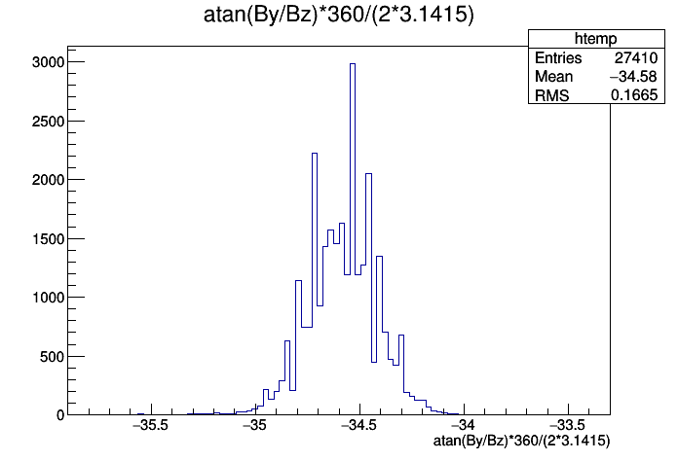
Magnetometer Sensitivity
We want to know the magnitude and direction. What is sensitivity on these measurements?
B Magnitude (mG)
Direction in Y-Z plane (°)
Magnitude 501 mG
RMS +/- 1.8 mG
Spec sheet says noise floor is 2 mG
Direction: -34.6°
RMS= 0.67°
Spec sheet quotes 1-2° accuracy

Slide 9
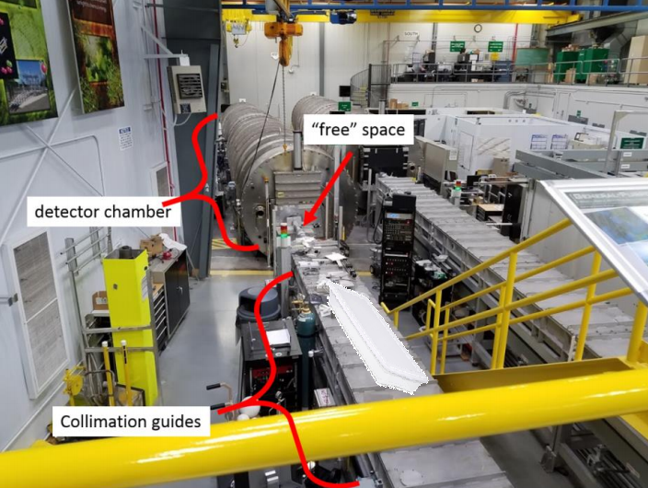
Prototype Magnetometer Array Design
Self contained system can be placed where it is near collimation guide and will not be disturbed
Picture here
0.5 m
0.5 m
0.5 m
HMC5883L – triple axis magnetometer
TCA9548A I²C multiplexer
Arduino
Power cord
Raspberry Pi

Slide 10
To Do:
Approval of Prototype design
Who can give us feedback?
Build Prototype
Install at HFIR
Analyze 1 week of data with Beam Off

Slide 11
Hardware summary
Raspberry Pi 3
Arduino Uno
Magnetometer –HMC5883L : datasheet
I²C Multiplexer- I2C Multiplexer breakout:
2.5 A Power supply: link here

