Slide 1
Efficient Solar Panels for Hot Water
Team 21
Stanley Nguyen, Hal Levin, Yuri Zhang, Moises Bensadon
21
Prof Robert Kotiuga

Slide 2
Efficient Solar Panels for Hot Water
21
Prof Robert Kotiuga
Problem Statement
Solar panels are 15%-22% efficient in optimal conditions and decrease in efficiency as temperature increases
How can circulated water be used to increase efficiency?
Design and build an efficient, low maintenance solar panel hot water heating system

Slide 3
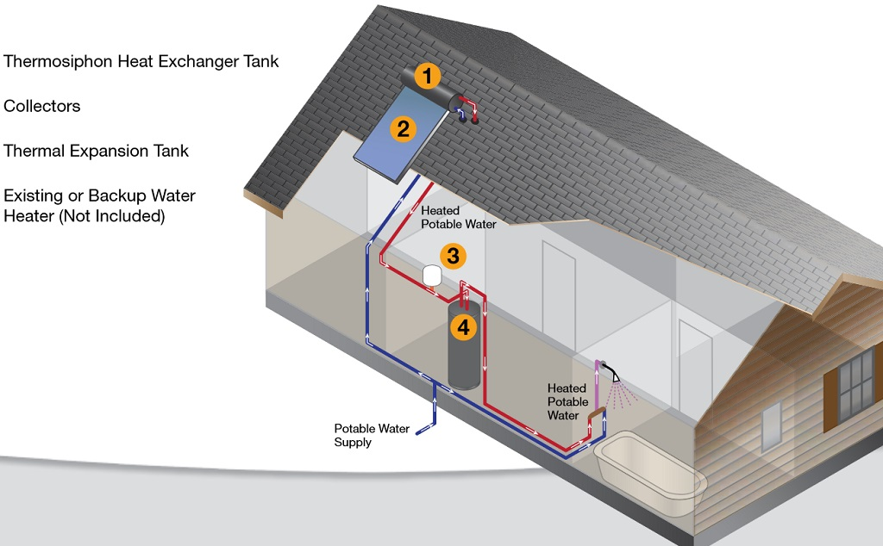
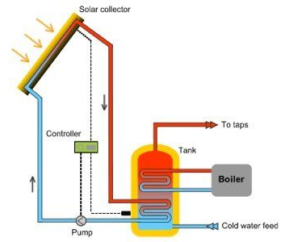
Efficient Solar Panels for Hot Water
21
Prof Robert Kotiuga
Visualization

Slide 4
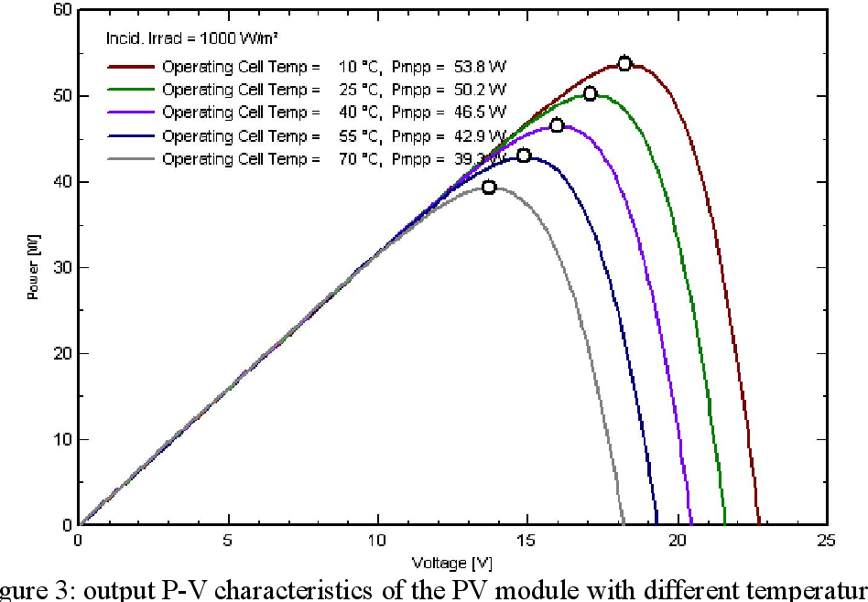
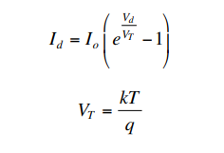
Efficient Solar Panels for Hot Water
21
Prof Robert Kotiuga
Visualization (continued)
Solar Cell Temperature Dependence

Slide 5
21
Prof Robert Kotiuga
Deliverables
Model energy production against temperature using collected data from our solar panels
Build physical system that drives cool water from heat pump to cool the solar panels while storing hot water in tank
Compare and model different designs of this system using data collected on energy use and production by this system

Slide 6
21
Prof Robert Kotiuga
Functions and Objectives
Monitoring system must record temperature of solar panels and temperature of water storage tanks
Be able to record water levels and energy production vs. consumption
Be able to remotely control pumps
Hybrid system must have net energy savings and be able to pay for itself within a reasonable timeframe

Slide 7
21
Prof Robert Kotiuga
Constraints
Currently we only have access to Boston’s Autumn climate to test our system
Must take up a small enough area and mass to fit on a customer’s roof or possibly their backyard
Total Budget of $1000

Slide 8
21
Prof Robert Kotiuga
Reach Goals
Model systems of different climates such as those that reach freezing temperatures
Use infrastructure to raise the temperature of solar panels in the winter to increase efficiency or to melt snow off of panels
Build customer friendly monitoring system

Slide 9
21
Prof Robert Kotiuga
Competing Technologies / Patents / Other Products
Solar panels solely for water heating
Everything Solar®
RevoluSun®
Hybrid electricity and heat production
DualSun®
Heat exchange patent only in France

Slide 10
21
Prof Robert Kotiuga
Thank you!
Questions/Comments?

