Slide 1
RFPIS Team Training
Find, screen and decide on funding opportunities — together, every week.
RFPIS · RFP Intelligence System
Notes:
Welcome. This session takes about 45 minutes. By the end everyone should be able to run the Eligibility Scan, update a decision, search, submit an RFP the scan missed, and capture meeting notes and actions. The full user manual is under Help in the app.

Slide 2
What we'll cover today
1
2
3
How RFPIS works
Getting started
Screening & decisions
Where opportunities come from, and your part in it
Sign in, find your way around, read the alerts
Run the Eligibility Scan, review, update a decision
4
5
6
Finding more
Team meetings
Reports & help
Search inside RFPIS and the web; submit what the scan missed
Meeting notes, actions, engagements and follow-ups
Generate a report; where the manual lives
Notes:
Six parts. The two the team will use most are Screening & decisions, and Team meetings.

Slide 3
How RFPIS works
Where opportunities come from, and where you come in

Slide 4
From the web to a team decision
SUPER USER
AUTOMATIC
YOU ARE ALERTED
YOU
THE TEAM
Extraction
Friday scan
Raw records ready
Eligibility Scan
Review & decide
A separate crawl of every donor source, run by the platform owner
›
Every Friday 06:00 UTC the sources are crawled again
›
The bell shows “Scan completed”
›
Screens the raw records against your organisation
›
Proceed, Park or Decline — then track it
Raw records vs. your pipeline
Raw records are every call the crawl found — all countries, all themes, before any screening. They sit in one shared pool. The Eligibility Scan reads that pool against YOUR organisation's rules and adds only what fits to your pipeline.
Notes:
Two separate jobs. Collecting is done for us: the Super User runs a separate extraction elsewhere, and the Friday cron at 06:00 UTC crawls again. When raw records are ready you get alerted in the bell (and the admin may email). Then it's on us to run the Eligibility Scan.

Slide 5
The weekly rhythm
FRIDAY
FRIDAY – SUNDAY
MONDAY CALL
MID-WEEK
Scan runs
Screen & submit
Team meeting
Follow through
The automatic scan refreshes the store. Watch the bell for “Scan completed”.
Run the Eligibility Scan. Submit any RFP you found outside the scan.
Walk through Screen, agree decisions, capture notes and actions.
Work the Track tab, log donor engagements, close pending actions.
The Monday call is where most of us work in RFPIS — decisions, notes and actions.
Notes:
Anchor the week: Friday scan, weekend screening and submissions, Monday team call, mid-week follow-through.

Slide 6
Roles: what you can and can't do
What you want to do | Contributor | Reviewer | Admin | Super User
Run the Eligibility Scan, search, read the pipeline | ✓ | ✓ | ✓ | ✓
Submit an RFP, update a decision, edit an RFP | ✓ | ✓ | ✓ | ✓
Log engagements, resolve pending actions, reports | ✓ | ✓ | ✓ | ✓
Add meeting notes and mark them resolved | — | ✓ | ✓ | ✓
Delete an RFP; edit the organisation profile | — | — | ✓ | ✓
Open Settings: users, scan preferences, records | — | — | ✓ | ✓
Run the full Extraction; manage organisations | — | — | — | ✓
See a greyed-out button?
Your role doesn't allow it. Ask your administrator — Settings → Accounts → Users.
Notes:
Most of the team are Contributors or Reviewers. Important: adding meeting notes needs Reviewer or above. If you are the note-taker and the Add a note button is grey, ask an admin.

Slide 7
Getting started
Sign in, find your way around, read the alerts

Slide 8
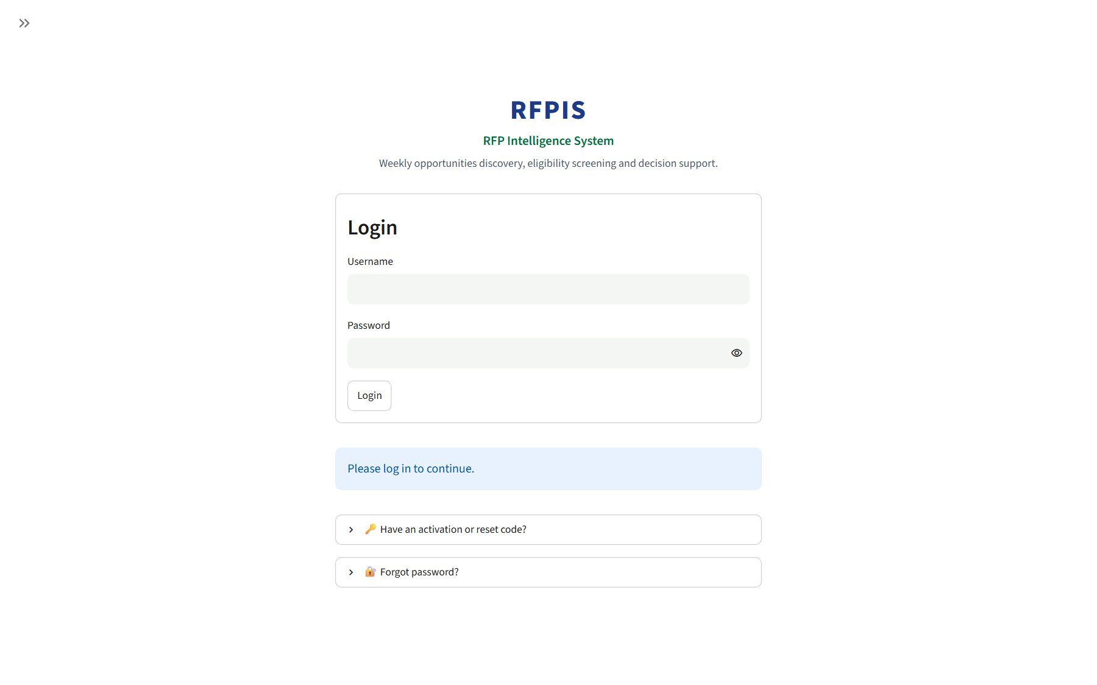
Activate your account, then sign in
1
Open the “Activate your RFPIS APP account” email (sent to e.g. user@example.com)
2
Click Activate my account — the link works for 7 days
3
Choose your password twice → Save password → Go to sign in
4
Sign in: Username = your email, then your password → Login
5
Forgot it? Forgot password? → Request password reset (an admin approves it)
The sign-in screen
Notes:
Nobody signs themselves up — admins create accounts and RFPIS emails the invitation. A session lasts about 8 hours.

Slide 9
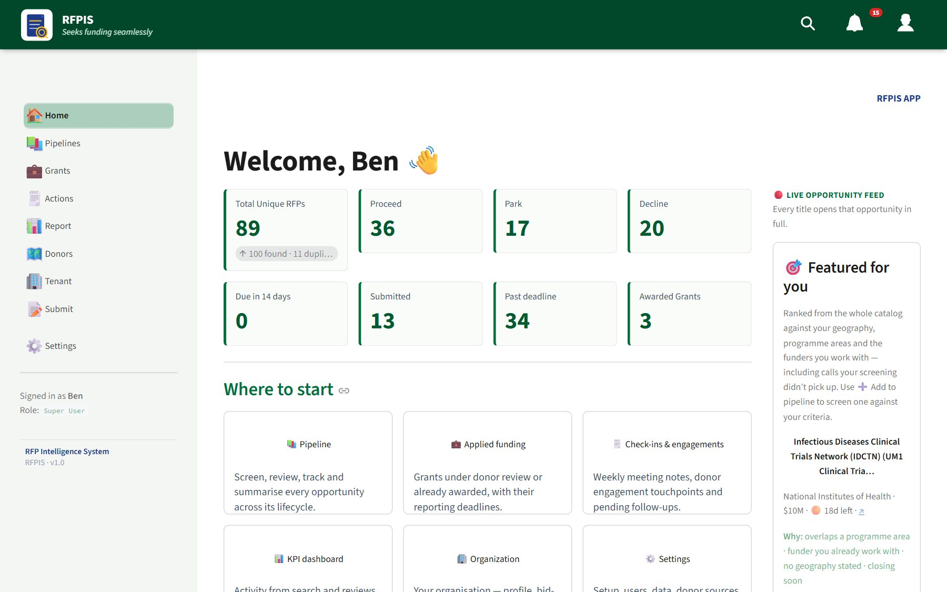
Finding your way around
Left sidebar
Home · Pipelines · Grants · Actions · Report · Donors · Tenant · Submit. Your role is at the bottom.
Top bar
Search · Notifications bell · Person menu (Help, Tenant, Profile, Sign Out).
Admins only
Settings appears in the sidebar and person menu for administrators only.
Notes:
Click the double-arrow at the top of the sidebar to expand labels. Most pages have tabs along the top — that's where the detail lives.

Slide 10
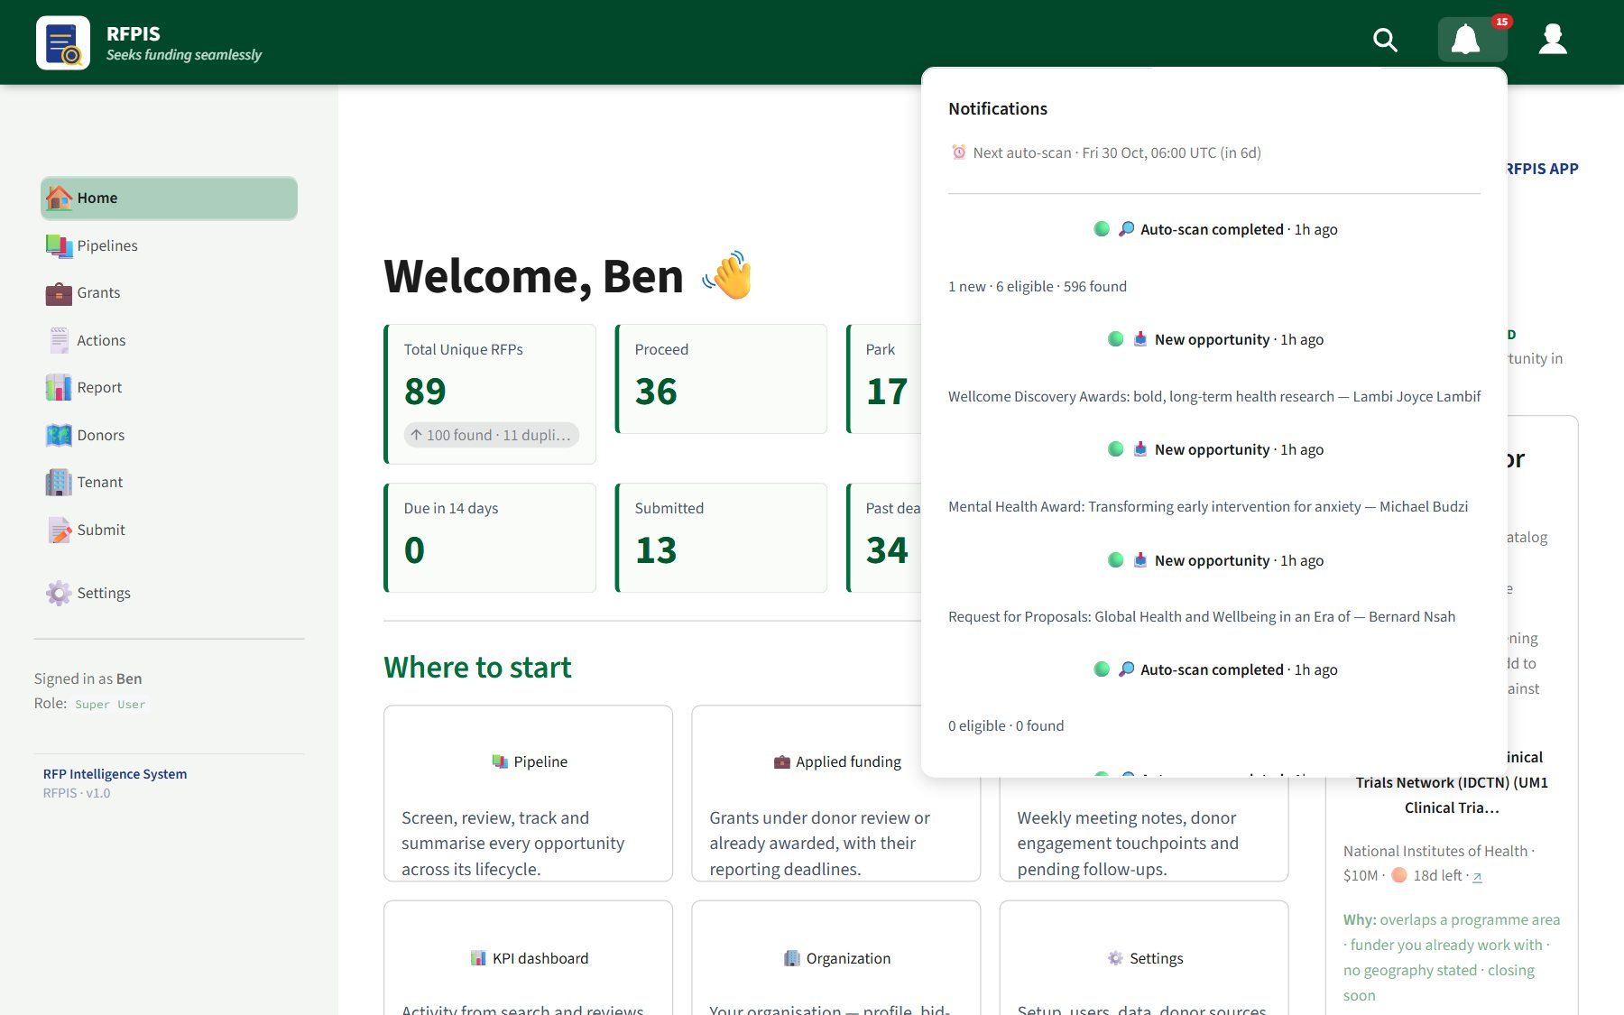
The bell is your alert
1
A red number = new items since you last looked
2
Next auto-scan: Friday 06:00 UTC; Next call: this week's rota
3
“Scan completed” → raw records are ready: go and run the Eligibility Scan
4
“New opportunity” → a teammate submitted an RFP
5
Mark all as read clears the count
Notes:
This is how you know raw records are ready. Your administrator may also email the team.

Slide 11
Screening & decisions
Run the Eligibility Scan, review, update a decision

Slide 12
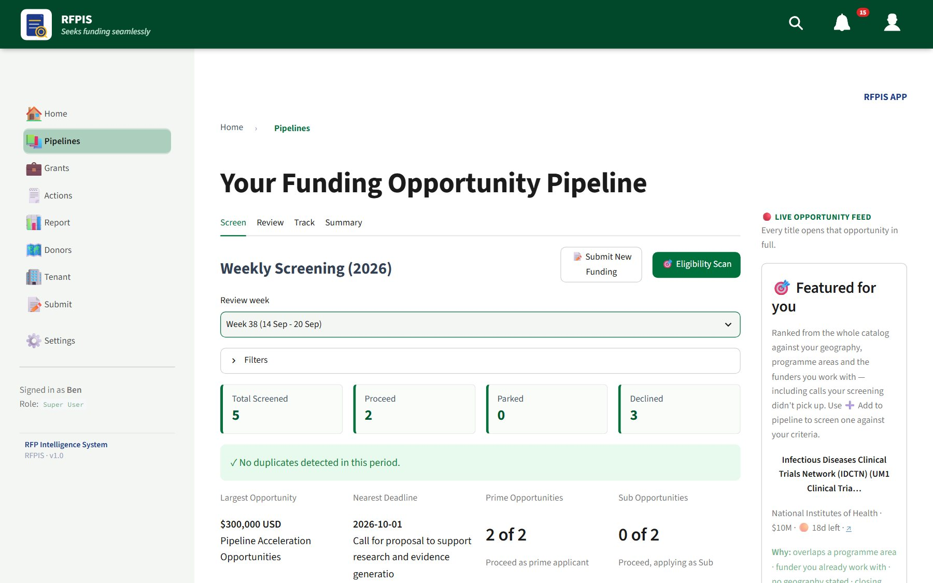
Run the Eligibility Scan
KEY TASK
1
Open Pipelines — stay on the Screen tab
2
Click 🎯 Eligibility Scan (top right, beside Submit New Funding)
3
Wait while it shows ⏳ Scanning… — seconds, no web crawl
4
Read the banner: “… → 8 eligible for your org (5 newly added …)”
5
Scroll down: the new opportunities are in this review week
Pipelines → Screen
Run it as often as you like
Calls already in your pipeline are never added twice.
Notes:
Any team member can run this. It doesn't crawl the web — it screens the shared store of raw records against our organisation's eligibility rules. The full Extraction is different: it takes 20-40 minutes and only the Super User runs it.

Slide 13
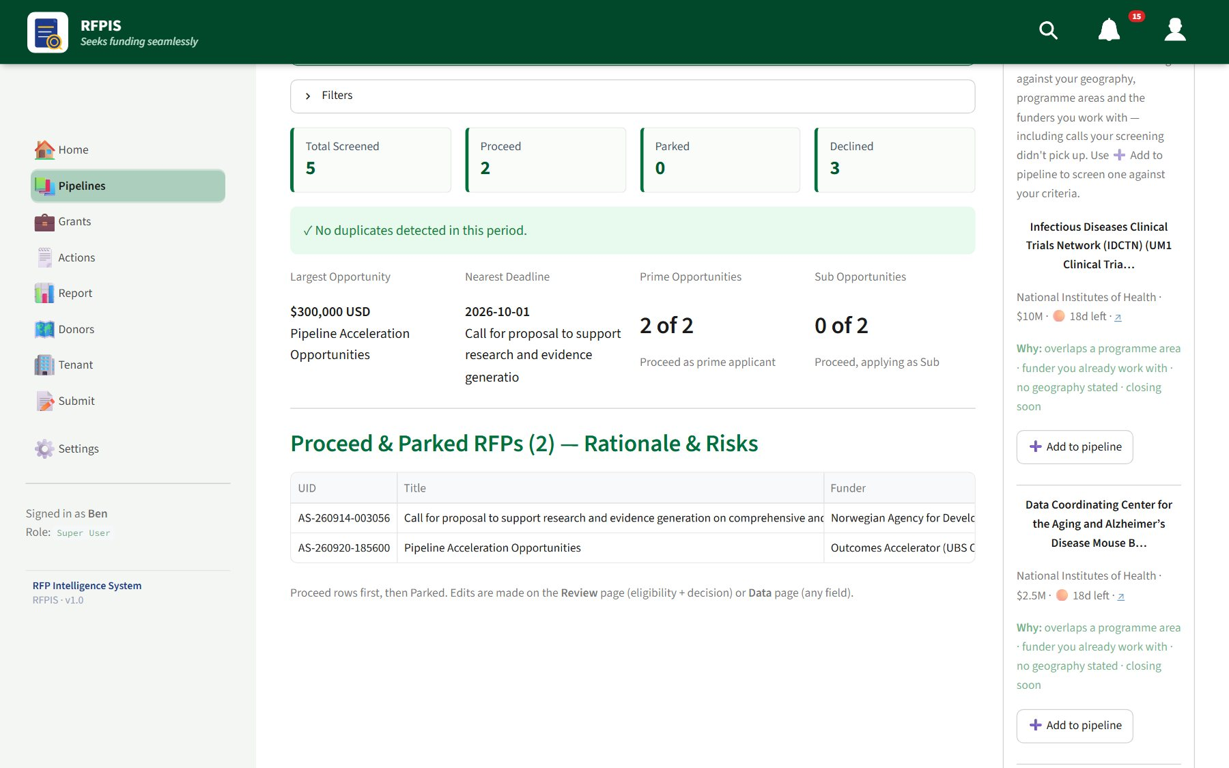
Read the Screen tab
1
Pick the Review week (defaults to this week)
2
Optional: Filters — decision, feasibility, geography, program area
3
Counters: Total Screened, Proceed, Parked, Declined
4
Table: score, Auto-rec (system) vs Decision (team), key risks
Notes:
This is what the chair puts on screen at the start of the Monday call.

Slide 14
How an opportunity is scored
Nine criteria. Five MUSTs carry 65% of the score; four PREFERs carry 35%.
90+
70–89
<70
Proceed
Park
Decline
Pursue it
Worth a human look
Or a fatal eligibility gate
MUSTs: legal status · strategic fit · implementation capacity · geographic fit · co-financing & compliance
PREFERs: funding quality · donor relationship · competitiveness · bid effort
People outrank the system
Correct any criterion in Update Decision and the score follows. A human who has read the call knows best.
Notes:
“Not scored” means the call said nothing — it takes the Park midpoint instead of counting against us. A fatal gate is a structural ineligibility that can't be fixed before the deadline.

Slide 15
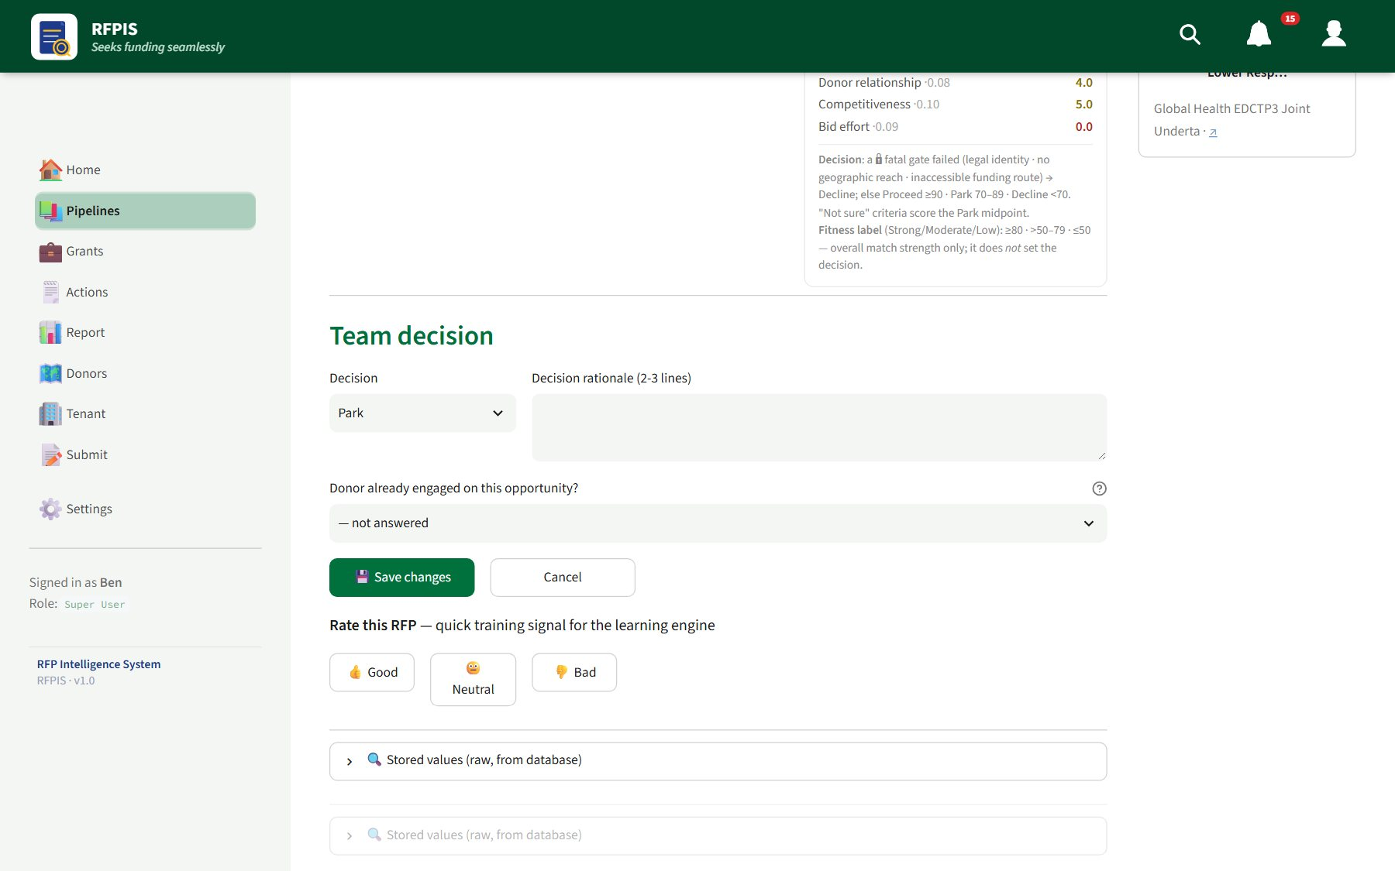
Update a decision
KEY TASK
1
Pipelines → Review: pick the week, then the RFP
2
Read Key details, Bid Strength and the Eligibility criteria
3
Click ✏ Update Decision; fix any criterion the system got wrong
4
Set Decline flags, Key risks, the Decision: Proceed / Park / Decline
5
Write the rationale (2–3 lines); answer Donor already engaged?
6
Click 💾 Save changes
Review → Update Decision
Proposal lead, next action, deadline?
Use ✏️ Edit RFP beside Update Decision.
Notes:
Every team member can update a decision. Deleting an RFP is admin-only — decline it instead.

Slide 16
Finding more
Search inside RFPIS and the web; submit what the scan missed

Slide 17
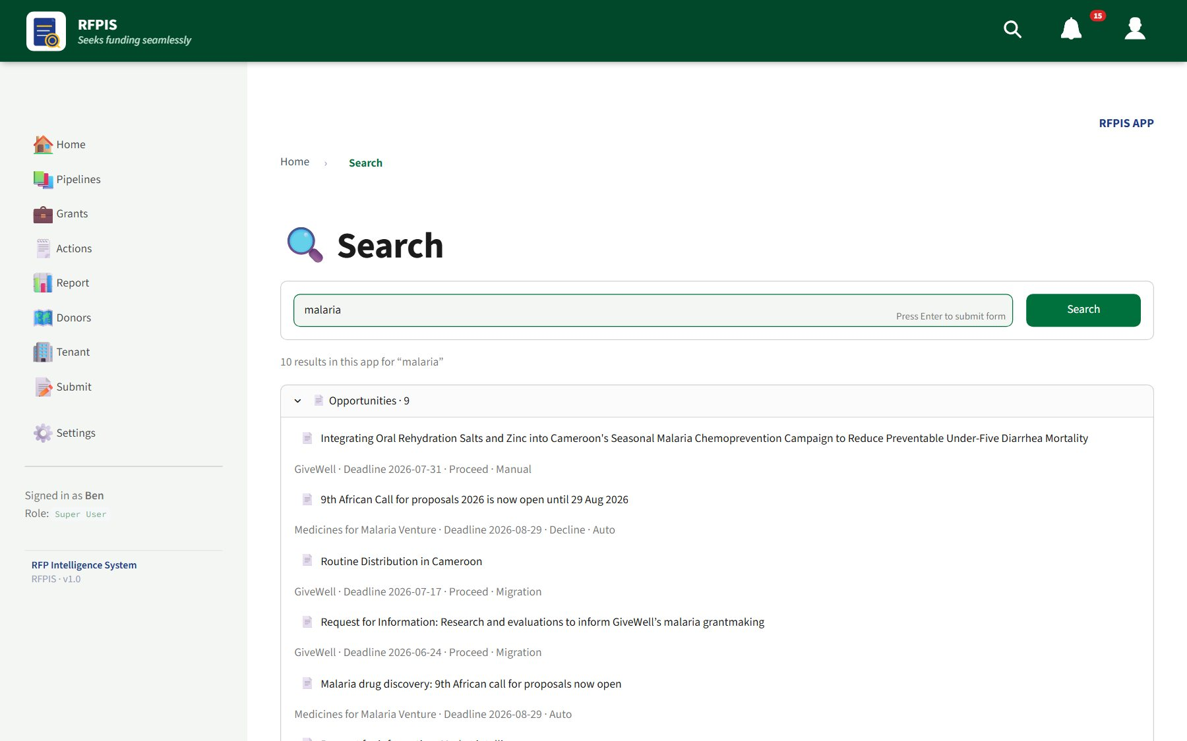
Search: inside RFPIS and on the web
KEY TASK
Inside RFPIS
1
Click 🔍 in the top bar, type 2+ characters, Search
2
Results: Pages & tabs · Opportunities · Donors
On the web
1
Full search page → 🌐 Search the web for “…”
2
Rate results 👍 😐 👎 to sharpen future searches
3
Real call? ➕ Track adds and scores it
Notes:
Search first before submitting anything — it may already be in RFPIS.

Slide 18
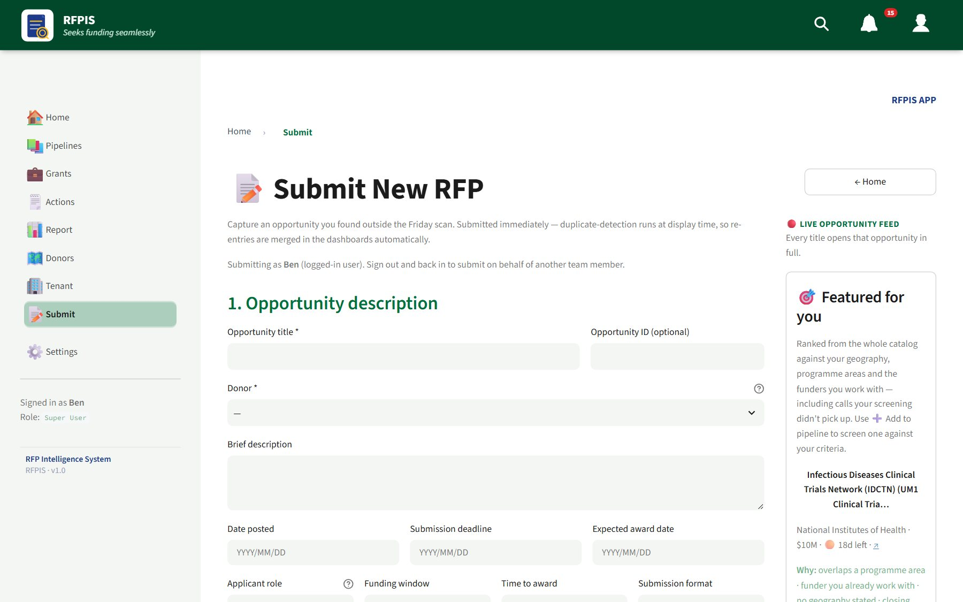
Submit an RFP you found elsewhere
KEY TASK
1
Pipelines → Screen → 📝 Submit New Funding
2
1 · Title*, Donor*, deadline, link (URL), value, Lead applicant*
3
2 · Nine eligibility questions — “Not sure” is fine
4
3 · Decline flags* · 4 · Bid decision* · 5 · Proposal lead*
5
Click Submit RFP → “Submitted as UID — alignment score X/100”
📝 Submit New RFP
Always paste the link
It lets RFPIS share the call with other organisations and recheck it.
Notes:
For calls forwarded by colleagues or published on a partner's microsite. It goes straight into our pipeline, tagged to this review week, and joins the shared pool for everyone else.

Slide 19
Team meetings
Where most of us work in RFPIS: notes, actions and follow-ups

Slide 20
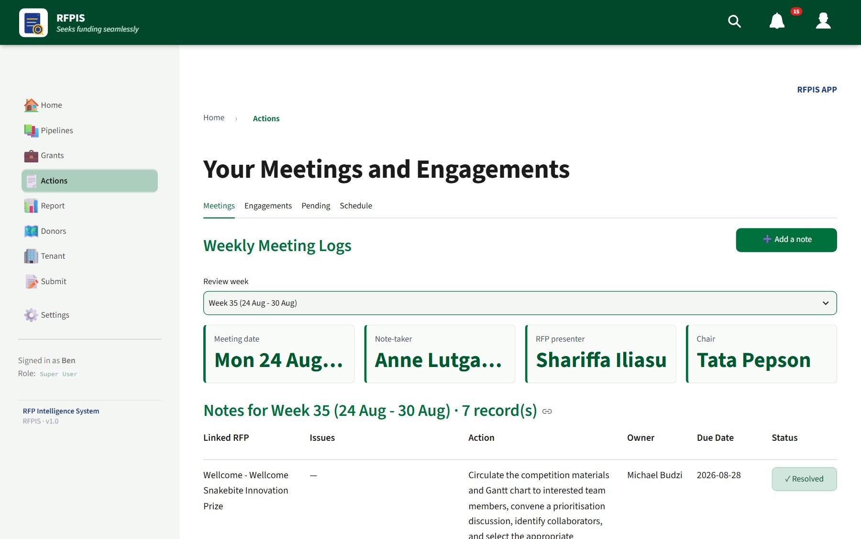
A good Monday-call routine
Chair
Opens Pipelines → Screen for this week
Presenter
Walks through each RFP on the Review tab
Team
Agrees the decision → ✏ Update Decision
Note-taker
➕ Add a note for every agreed action
Actions → Meetings: this week's rota and notes
Everyone
Before closing: Actions → Pending, resolve what's done
Notes:
The rota (note-taker, presenter, chair) is set in Actions → Schedule and shows in the bell.

Slide 21
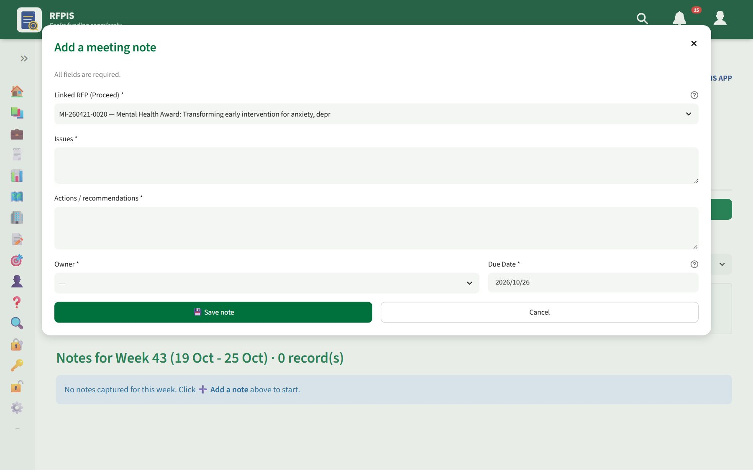
Capture a meeting note
REVIEWER+
1
Actions → Meetings; check the Review week
2
Click ➕ Add a note
3
Linked RFP (Proceed only), Issues, Actions / recommendations
4
Owner and Due Date (defaults to next Monday)
5
💾 Save note — then Not Resolved → ✓ Resolved when done
6
⬇ Download the week's notes as CSV for the minutes
➕ Add a note
Contributor?
Adding notes needs Reviewer or above — ask your admin.
Notes:
Saved notes can't be edited here; an admin can fix them under Settings → Records → Data → Meeting Logs.

Slide 22
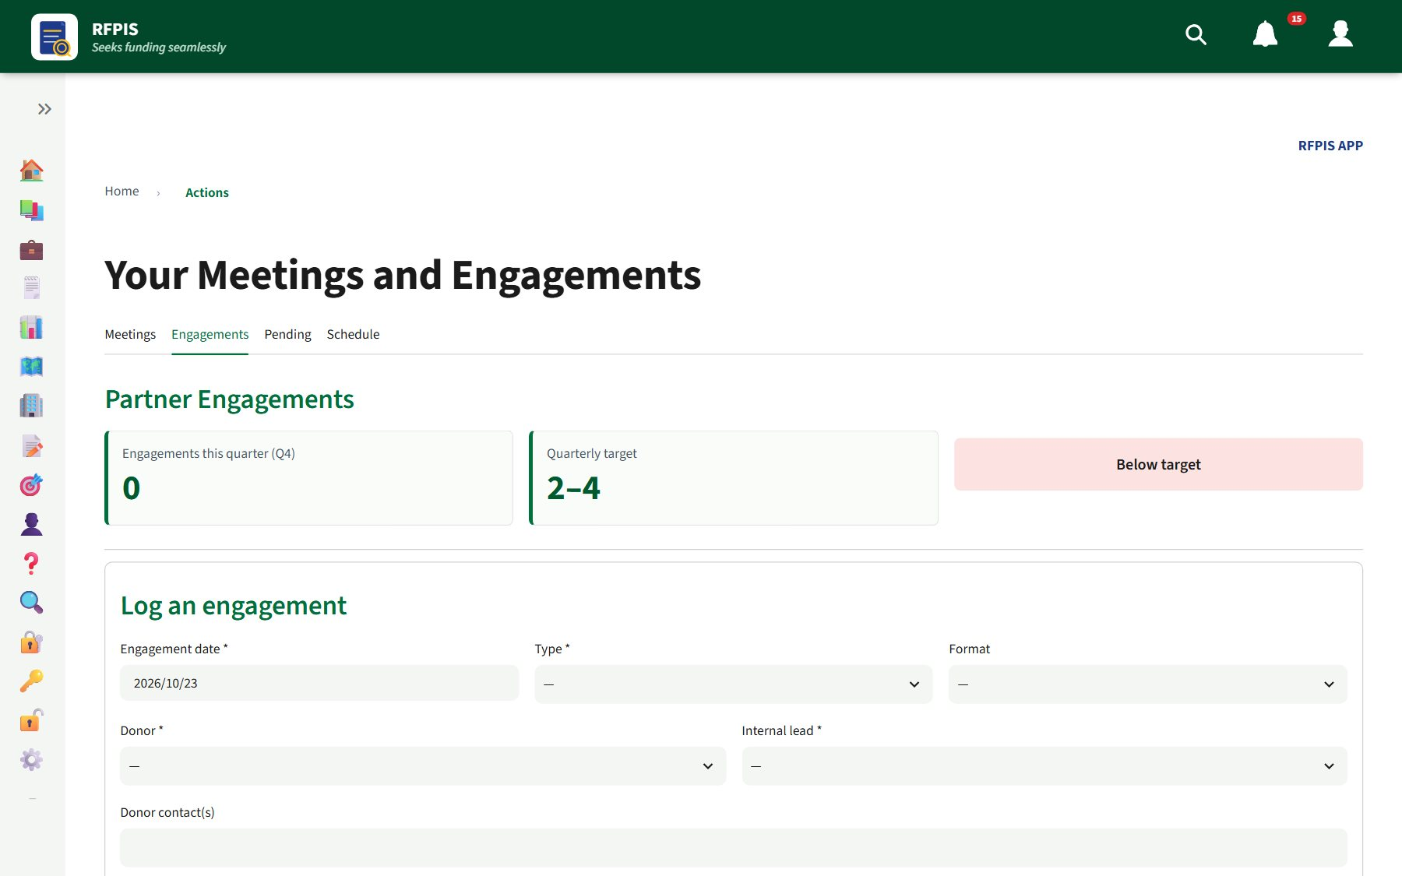
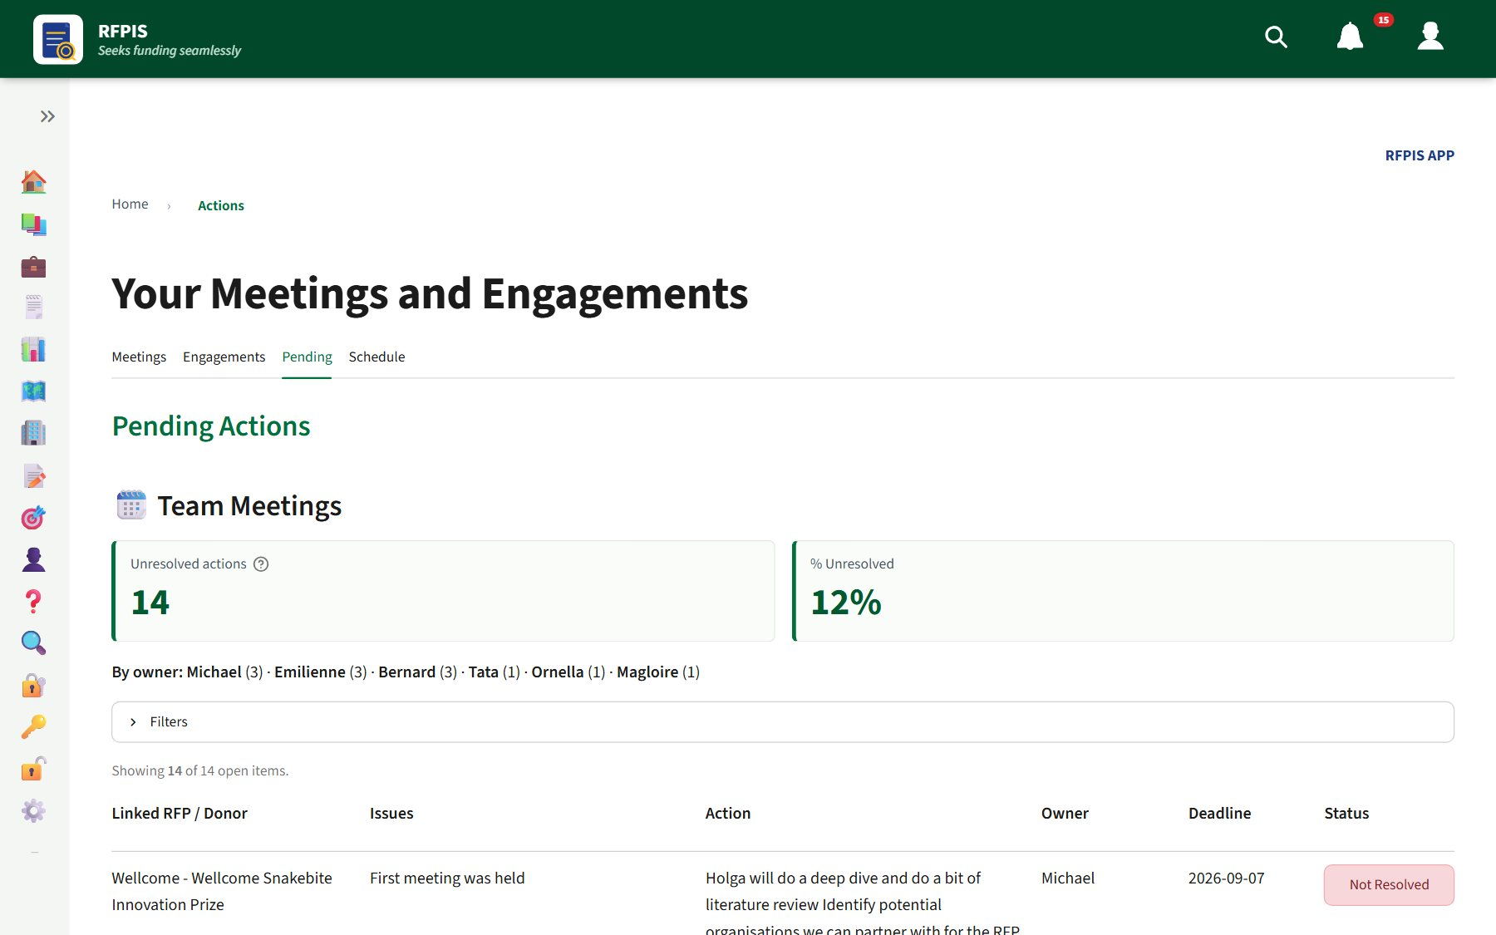
Engagements and pending actions
Engagements — log every donor touchpoint
Pending — everything still open
Engagements: date, type, donor, internal lead, purpose, outcome → 💾 Save engagement. Target: 2–4 a quarter.
Pending: Filters → your name under Owner; click Not Resolved when an item is done.
Notes:
Anyone can log engagements and resolve pending items.

Slide 23
Reports & help
Generate a report; where the manual lives

Slide 24
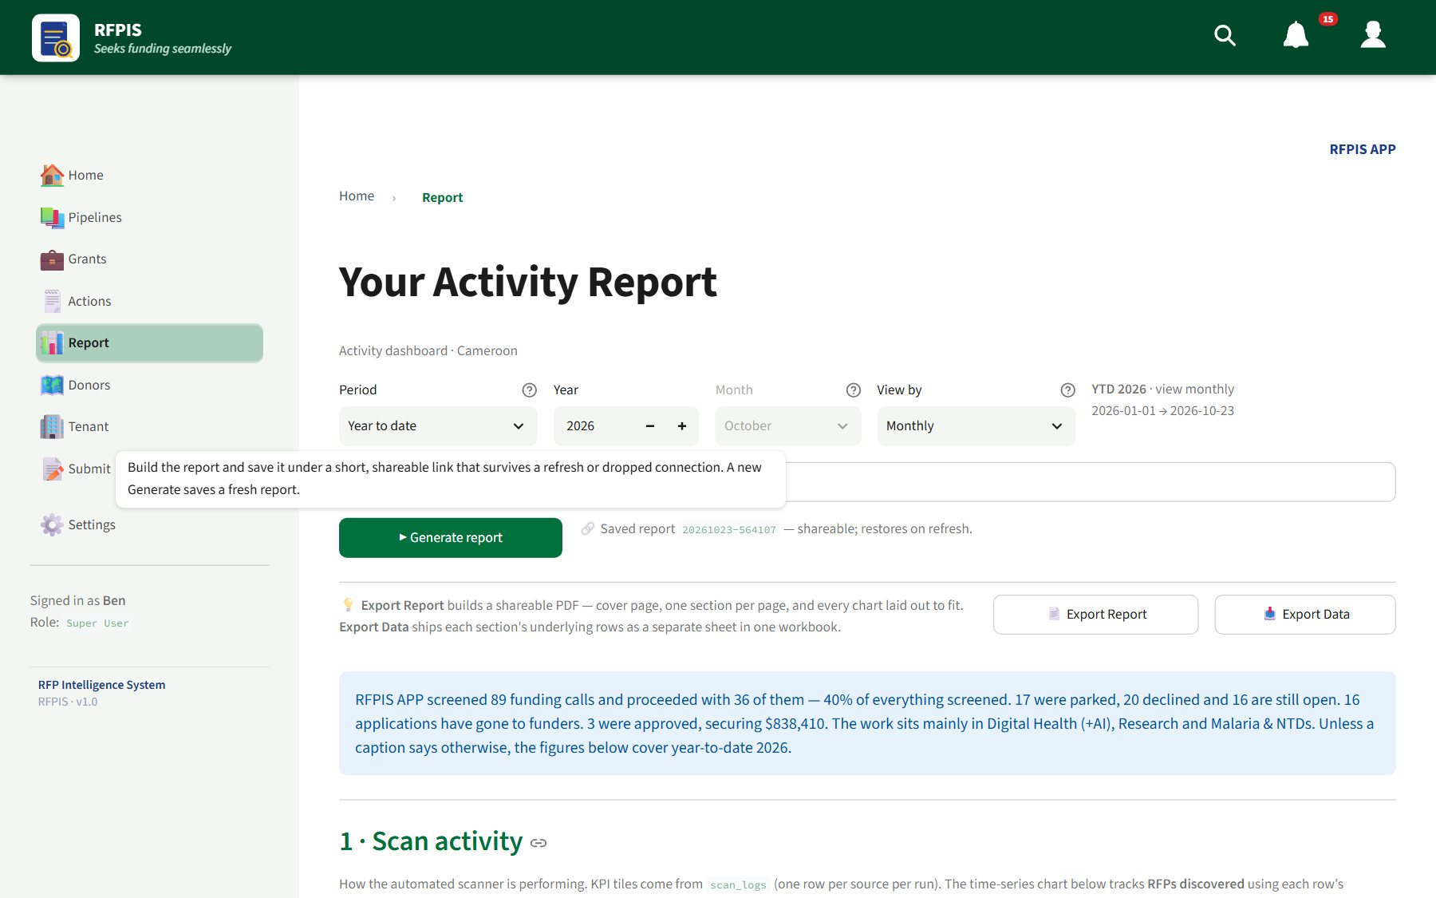
Generate a report
1
Sidebar → 📊 Report
2
Choose the Period, Year and View by
3
Optional: ⚙️ Advanced filter — sections and metrics
4
Click ▶ Generate report (nothing loads before this)
5
📄 Export Report → ⬇ Download PDF; 📥 Export Data for Excel
📊 Your Activity Report
Notes:
The address bar holds a shareable link after Generate report. The first PDF after a restart can take a couple of minutes.

Slide 25
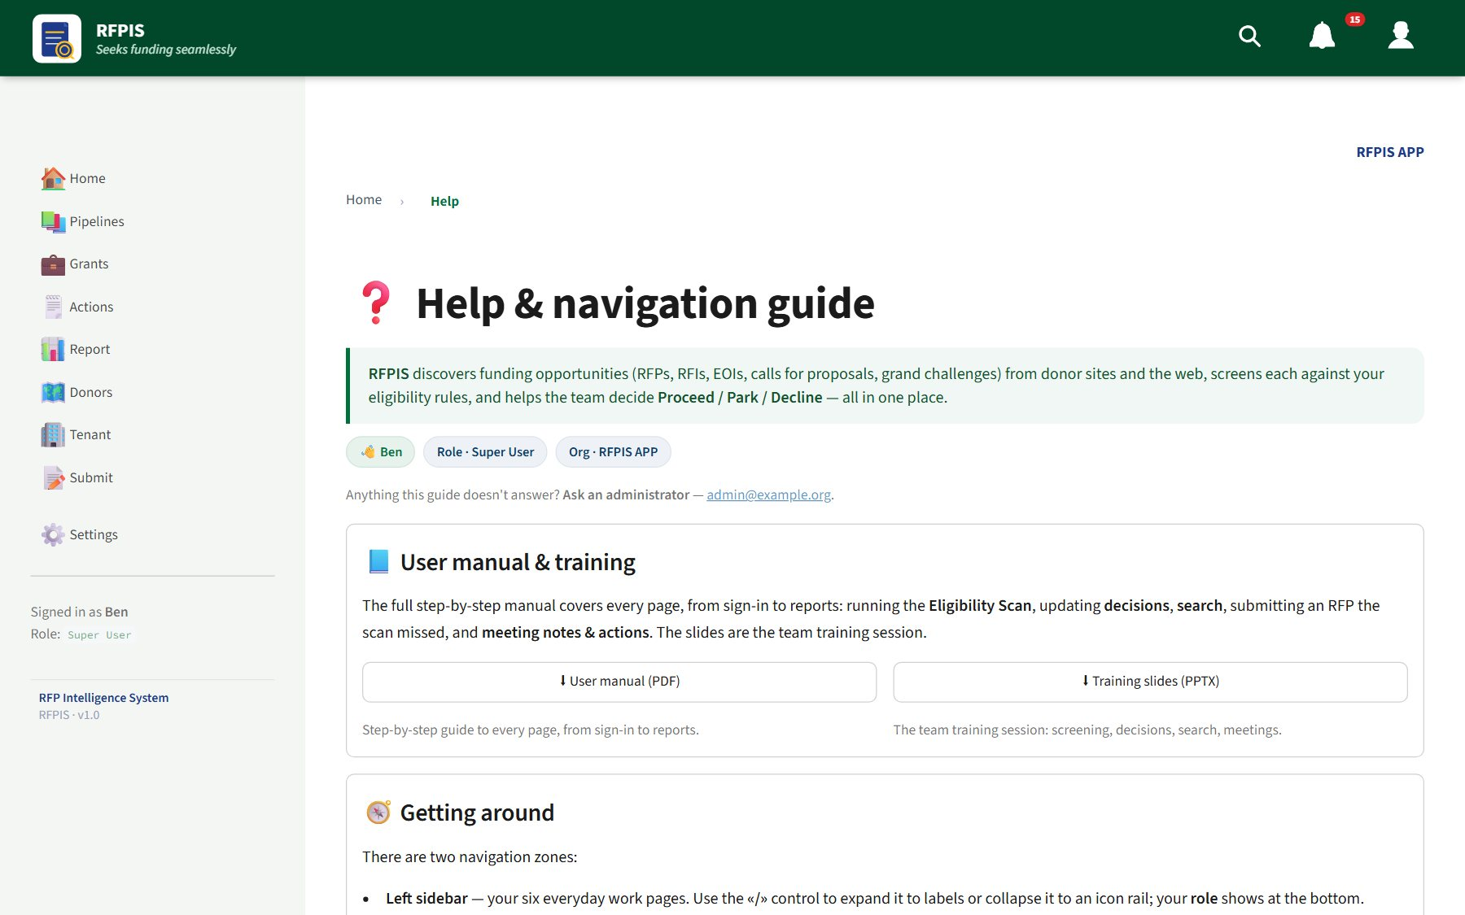
Where to get help
The user manual
👤 → Help → ⬇ User manual (PDF). Also on the Home page.
These slides
👤 → Help → ⬇ Training slides (PPTX).
Still stuck?
Ask your administrator — the Help page shows who to contact.
👤 → Help
Notes:
Point everyone at Help. The manual covers every page step by step.

Slide 26
Try it now: 10-minute exercise
Open the bell. When is the next auto-scan?
Run the Eligibility Scan. How many were newly added?
1
2
Open one RFP on Review. What is its Bid Strength?
Search for a donor you know. Is it in RFPIS?
3
4
Open Actions → Pending and filter to your name
Generate this year's report and export the PDF
5
6
Notes:
Hands-on. Walk the room. Don't save decisions on real RFPs unless the team agreed them.

Slide 27
Thank you
Scan on Friday · Screen & submit at the weekend · Decide and take notes on Monday · Follow through mid-week.
User manual & these slides: 👤 → Help
Notes:
Questions. Remind everyone where the manual is.

