Slide 1











binary classification
multi-class classification

Slide 2
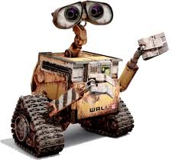
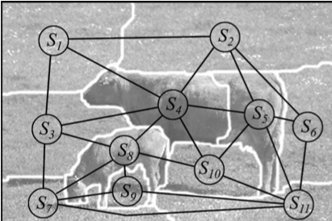



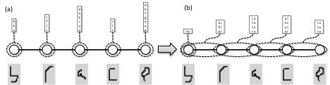


(a)
(b)
(d)
(1,1)
head
laser range
sensor
luarm
ruarm
N
S
E
W
torso
llarm
rlarm
(c)
(e)
(10,10)
Liu et al. PAMI11

