Slide 1
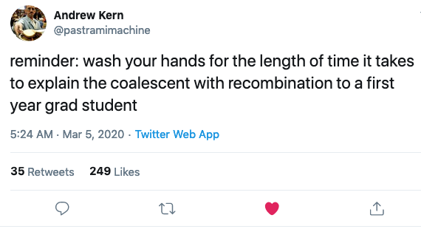

Slide 2


Slide 3
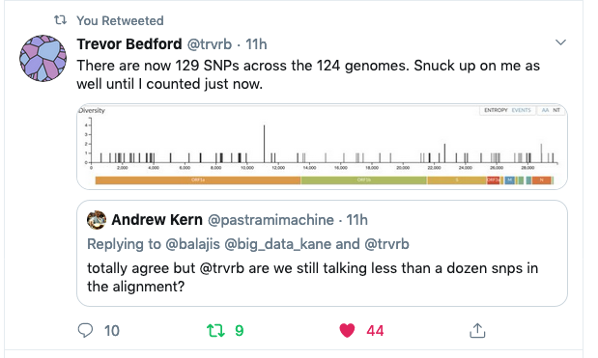
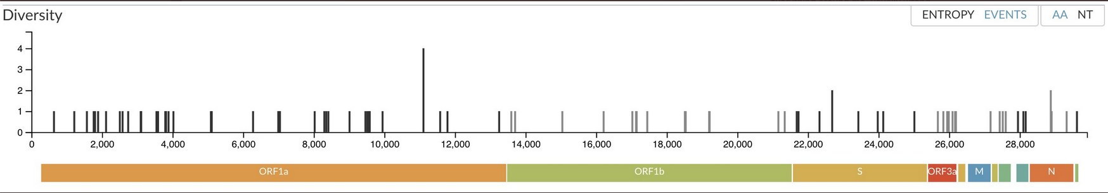
N_{e} from nucleotide diversity
Last minute question 3!
Notes:
http://www.stats.ox.ac.uk/~mcvean/notes3.pdf
Infinite sites model: poisson process .. E(pi) = t*u
T=2N (coalescence time) * 2 because diploid
For example, in a population of 10^6 diploids, with a mutation rate of 10^-9 per site per generation, the
expected number of pairwise differences in a gene of 1500bp would be 6.
You will be doing this in the lab
Questions so far ..

Slide 4
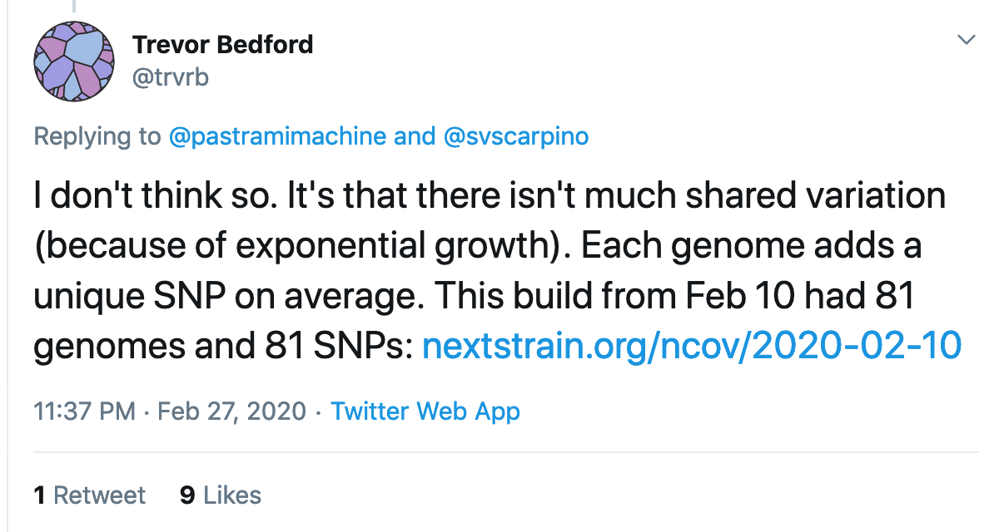
N_{e} from nucleotide diversity
From the same Twitter thread:
Notes:
http://www.stats.ox.ac.uk/~mcvean/notes3.pdf
Infinite sites model: poisson process .. E(pi) = t*u
T=2N (coalescence time) * 2 because diploid
For example, in a population of 10^6 diploids, with a mutation rate of 10^-9 per site per generation, the
expected number of pairwise differences in a gene of 1500bp would be 6.
You will be doing this in the lab
Questions so far ..

Slide 5
Notes:
http://www.stats.ox.ac.uk/~mcvean/notes3.pdf
Infinite sites model: poisson process .. E(pi) = t*u
T=2N (coalescence time) * 2 because diploid
For example, in a population of 10^6 diploids, with a mutation rate of 10^-9 per site per generation, the
expected number of pairwise differences in a gene of 1500bp would be 6.
You will be doing this in the lab
Questions so far ..

Slide 6
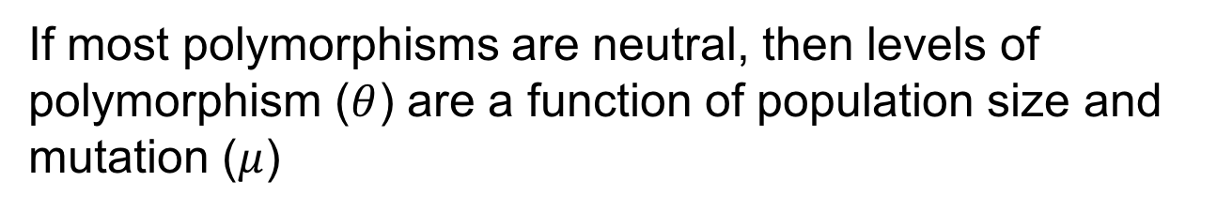

The Neutral Theory of Molecular Evolution
Most polymorphisms or fixed differences between species are selectively neutral
If most polymorphisms are neutral, then levels of polymorphism ($θ$) are a function of population size and mutation ($μ$)
$$θ=4N_{e}μ$$
And where does MRCA = $4N_{e}τ$ come from?

Slide 7
The Neutral Theory of Molecular Evolution
Most polymorphisms or fixed differences between species are selectively neutral
If most polymorphisms are neutral, then levels of polymorphism ($θ$) are a function of population size and mutation ($μ$)
$$θ=4N_{e}μ$$
And where does MRCA = $4N_{e}τ$ come from?

Slide 8
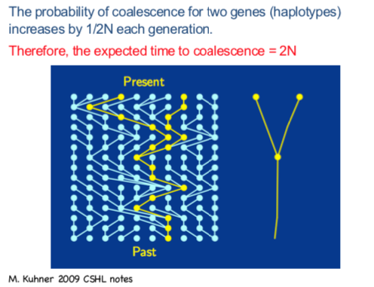
Remember this?

Slide 9
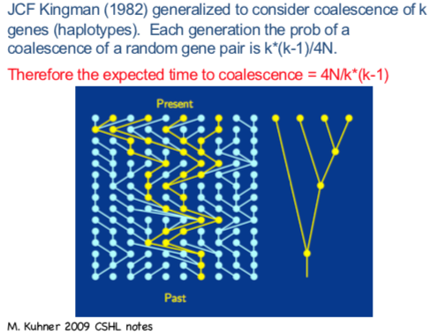
.. and this?
Notes:
d

Slide 10
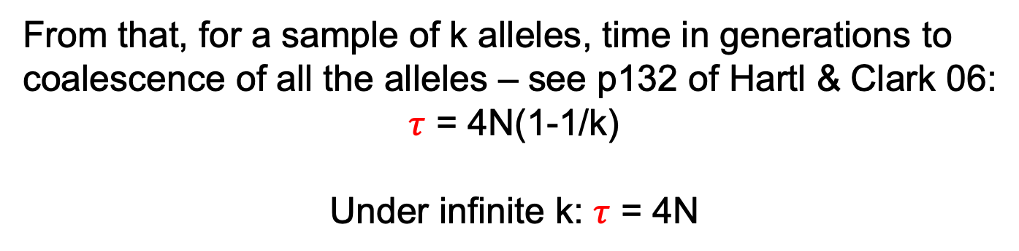
.. and this?
From that, for a sample of k alleles, time in generations to coalescence of all the alleles – see p132 of Hartl & Clark 06:
$τ$ = 4N(1-1/k)
Under infinite k: $τ$ = 4N
Notes:
d

Slide 11
The McDonald Kreitman Test: extensions
Advantage of the McDonald Kreitman test :
synonymous & non-synonymous diffs are close, so demographic effects are the same for both
Non-neutral vs neutral sites or differences could be any type of interspersed sequences e.g.
non-coding regulatory regions vs synonymous sites
Introns vs synonymous sites
Casillas & Barbadilla 2017

Slide 12
Molecular Population Genetics
The Neutral Theory of Molecular Evolution
Detecting signatures of natural selection in populations:
McDonald-Kreitman test, HKA test
Tajima’s D
Coalescent simulations
Notes:
In the lab:
Nucleotide diversity, Tajima’s D, coalescent sims, McD-K

Slide 13

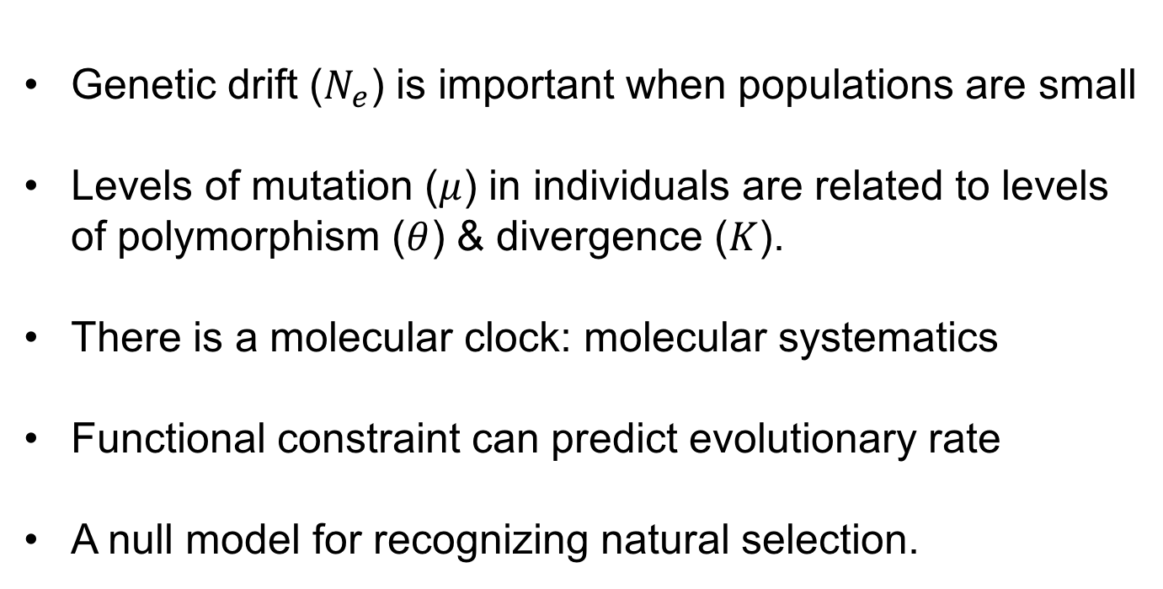

The (nearly) Neutral Theory : implications
Genetic drift ($N_{e}$) is important when populations are small
Levels of mutation ($μ$) in individuals are related to levels of polymorphism ($θ$) & divergence ($K$).
There is a molecular clock: molecular systematics
Functional constraint can predict evolutionary rate
A null model for recognizing natural selection.
$$θ≈4N_{e}μ$$
$$K≈μ$$

Slide 14
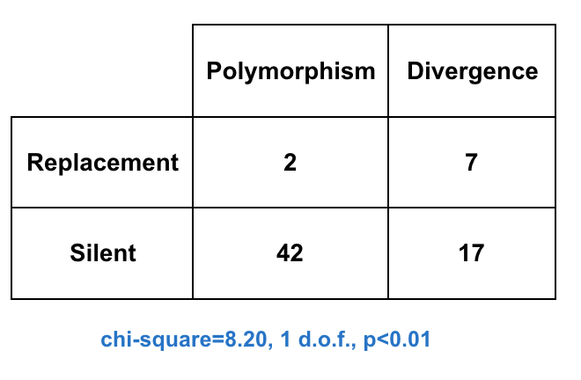
The McDonald Kreitman Test
(Nonsynonymous)
(Synonymous)

Slide 15
The McDonald Kreitman Test
(Nonsynonymous)
(Synonymous)

Slide 16
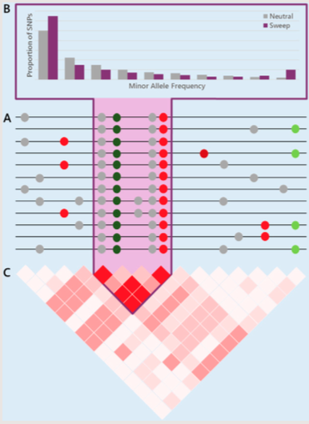
Molecular Signatures of Natural Selection
Reduction in genetic diversity
Notes:
Other signatures we’ll discuss after spring break

Slide 17
Molecular Signatures of Natural Selection
Skew toward rare derived alleles
Reduction in genetic diversity

Slide 18
Molecular Signatures of Natural Selection
Skew toward rare derived alleles
Reduction in genetic diversity
An increase in linkage disequilibrium

Slide 19
Molecular Signatures of Natural Selection
Skew toward rare derived alleles
Reduction in genetic diversity
e.g. Tajima’s D

Slide 20
Nucleotide diversity
Nucleotide diversity (π) of sequences in a population is the average pairwise distance.
Number of segregating sites = S = 2
Number of alleles = 3
Length = 20
In a diploid population, π ~ θ = 4N_{e}μ
Seq1 ACCGTTAGTGTGTACGTGTA
Seq2 ACCGTCAGTGTGTACGTGTA
Seq3 ACTGTTAGTGTGTACGTGTA
Nei & Li 1979
Notes:
At a site which is not under selective constraint ..

Slide 21
Nucleotide diversity
Nucleotide diversity (π) of sequences in a population is the average pairwise distance.
Number of segregating sites = S = 2
Number of alleles = 3
Length = 20
In a diploid population, π ~ θ = 4N_{e}μ
Seq1 ACCGTTAGTGTGTACGTGTA
Seq2 ACCGTCAGTGTGTACGTGTA
Seq3 ACTGTTAGTGTGTACGTGTA
Seq1/Seq2: 1
Seq1/Seq3: 1
Seq2/Seq3: 1
Average: 1
π = 1/20 = 0.05
Nei & Li 1979
Notes:
At a site which is not under selective constraint ..

Slide 22
Nucleotide polymorphism
Nucleotide polymorphism (θ_{W}) is estimated from the number of segregating sites.
Number of segregating sites = S = 2
Number of alleles = 3
Length = 20
In a diploid population, θ_{W} ~ θ = 4N_{e}μ
Seq1 ACCGTTAGTGTGTACGTGTA
Seq2 ACCGTCAGTGTGTACGTGTA
Seq3 ACTGTTAGTGTGTACGTGTA
Nei & Li 1979
Notes:
At a site which is not under selective constraint ..

Slide 23
𝑁_{e} is important when populations are small
The Origins of Genome Complexity
Mutations that increase genome size and complexity are slightly deleterious (e.g. transposable elements, duplications, introns)
These mutations will only reach fixation in organisms with small population size
Could explain the C-value paradox
This leads to opportunities for increased organismal complexity
Lynch & Conery 2003 PMID: 14631042
Notes:
Ie why some organisms have large genomes (e.g. grasshoppers have larger genome sizes maybe because they live in tiny populations?)

Slide 24
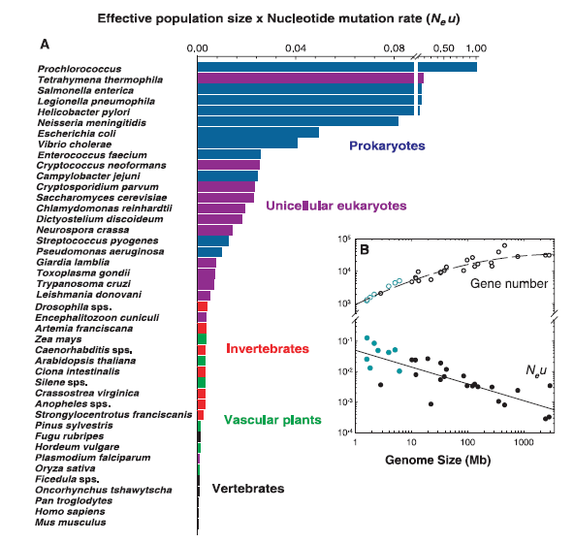
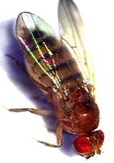

N_{e} from within-species DNA sequence diversity
π
The DNA sequences of less complex organisms show high nucleotide diversity (π_{S})
π_{S} ~ θ = 4N_{e}μ
Lynch & Conery 2003 PMID: 14631042
Notes:
What’s the evidence? Used DNA seq to estimate Ne .. Bacteria .. Large pi therefore large Ne .. Small simple genomes.
NB mutation also included .. But crazy thing is the mutation rate doesn’t differ very much .. And usually bacteria have lower mutation rates .. Bias is in the opposite direction to explain

Slide 25
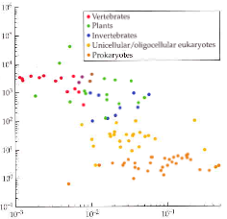
The Origins of Genome Complexity
Explains correlations with genome size without invoking natural selection
No need to invoke “macroevolutionary” processes
Genome size (Mbp)
Silent-site diversity (π_{S})
Lynch & Conery 2003
Notes:
Good because it’s a null – no natural selection *on bulk DNA phenotypes* invoked except for the immediate deleterious effects of new mutations that we already know about

Slide 26
Criticism
Mutation included in π estimates
Correlation does not show cause
Phylogenetic effects
Genome size (Mbp)
Silent-site diversity (π_{S})
Lynch & Conery 2003
Notes:
Phylogenetic effects: although he has lots of points in his scatter plots, they are not all independent, because everything is related to everything else,
most of the signal is coming from a small number of major evolutionary changes or transitions.

Slide 27
Criticism
Mutation included in π estimates
Correlation does not show cause
Phylogenetic effects
Genome size (Mbp)
A good null hypothesis
Silent-site diversity (π_{S})
Lynch & Conery 2003
Notes:
Phylogenetic effects: although he has lots of points in his scatter plots, they are not all independent, because everything is related to everything else,
most of the signal is coming from a small number of major evolutionary changes or transitions.

Slide 28
HKA
Introduce the molecular signatures of selection
Box 2 image from Casillas

Slide 29
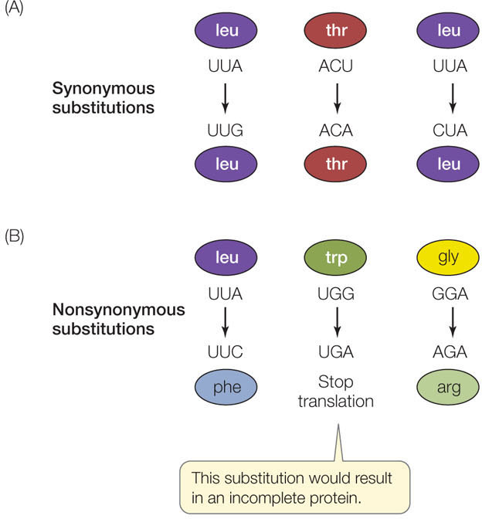
ms
Coalescence

