Slide 1
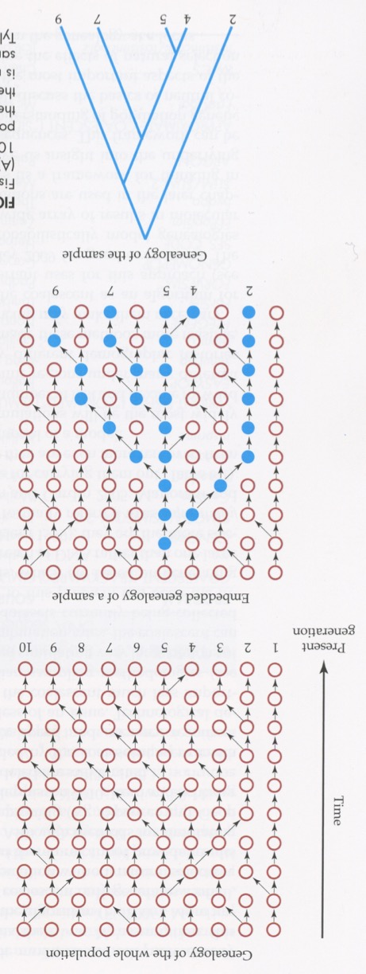
More Molecular Population Genetics
PBIO/BINF 8350
Instructor: Douda Bensasson
Notes:
I’m also adding more (explanations for coalescence) so you can see more how they fit into theory and practice ..
I realize there’s overlap with Jim, and people on other courses .. But it’s a challenging concept, very relevant to our material ..

Slide 2
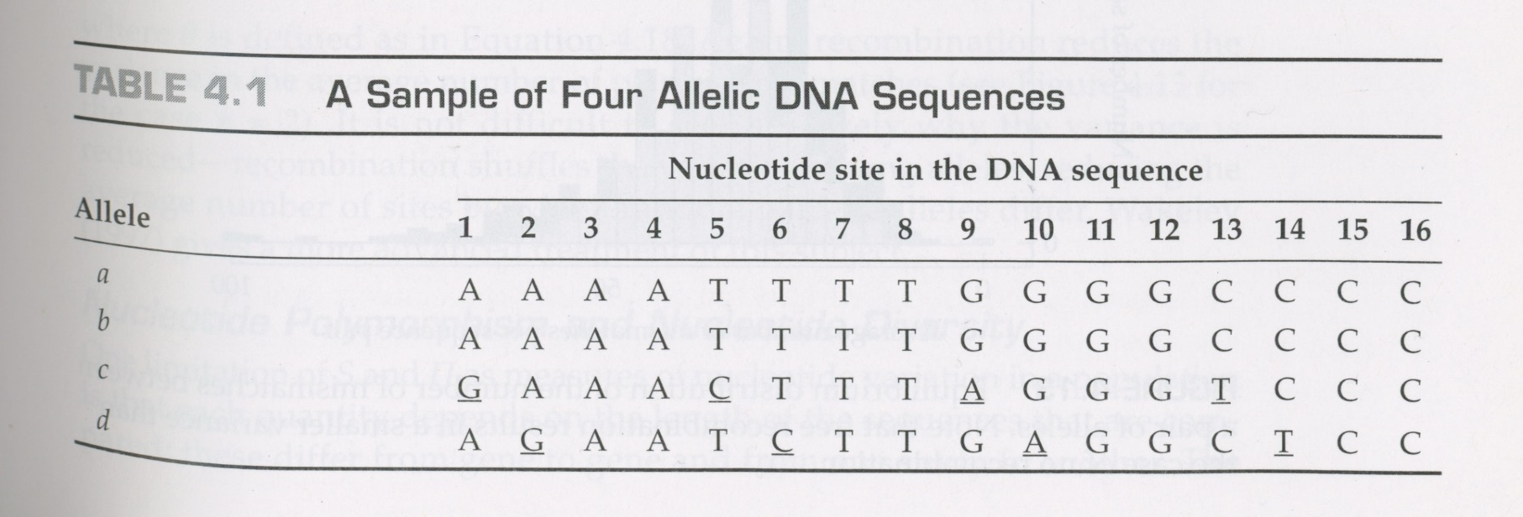
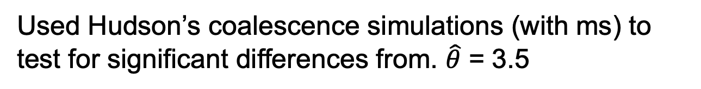
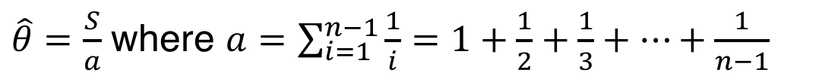
Levels of polymorphism
From the lab
Levels of DNA polymorphism can be measured multiple ways.
$\hat{θ}=\frac{S}{a}$ where $a=\sum_{i=1}^{n−1}{\frac{1}{i}}=1+\frac{1}{2}+\frac{1}{3}+…+\frac{1}{n−1}$
$Π$, which is the average number of pairwise differences
Used Hudson’s coalescence simulations (with ms) to test for significant differences from. $\hat{θ}$ = 3.5
Notes:
You did this on Friday .. Let’s think more carefully about what you did .. I’ll need to repeat some of what Jim and I have gone over already

Slide 3
From before
Simulating DNA sequences
(a) Wright-Fisher model Assumes constant population size, no gene flow, no selection
(b) Coalescent process. A backward simulation. The process of lineage joining when tracing the genealogical history of a sample backwards in time.
LongAgo
Time
Coalescence event
Independently proposed by Kingman (1982), Tajima (1983) & Hudson
Now
5 seq
Genealogy of the sample
Notes:
Forward = down, back = up

Slide 4
Simulating DNA sequences
Wright-Fisher model Assumes constant population size, no gene flow, no selection
Discrete generations
(b) Coalescent process. A backward simulation.
Continuous approximation.
(c) The resulting simulated genealogy of the sample
Time
Now
5 seq
5 seq
Genealogy of the sample

Slide 5
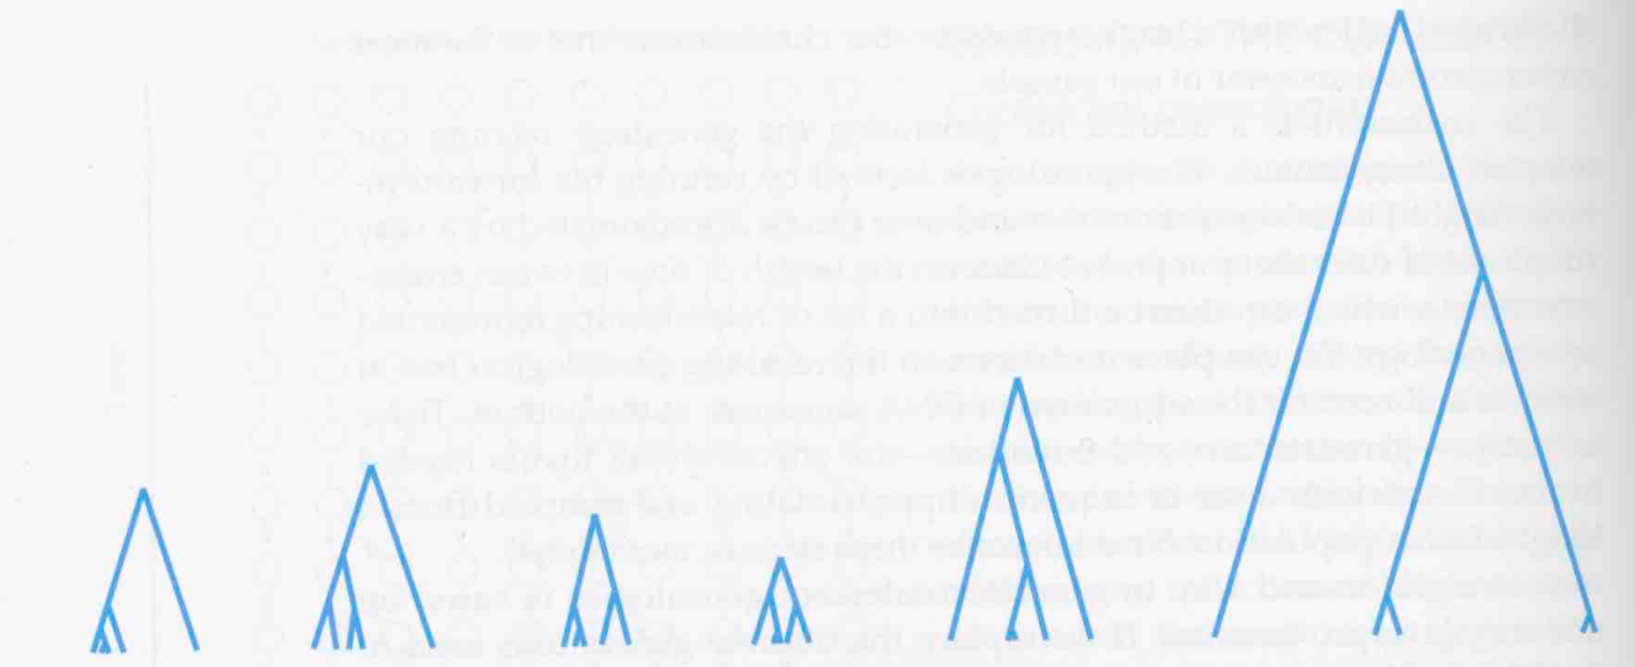
Simulating DNA sequences
Simulating genealogies
Use a continuous approximation of a Wright-Fisher model.
Randomly sample a time until the next coalescent from an exponential distribution
Merge randomly chosen lineages
Repeat until all lineages merge
Notes:
Classic approximation for rare events accumulating through time
Rate parameter is a function of the number of lineages (I’ll explain those probabilities more soon)
Note: branch lengths and topologies will vary in the simulated topology and will depend on the number of sequences or lineages sampled

Slide 6
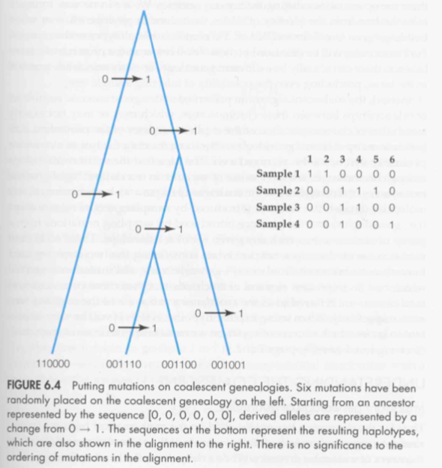
Simulating DNA sequences
Simulating genealogies
Use a continuous approximation of a Wright-Fisher model.
Randomly sample a time until the next coalescent from an exponential distribution
Merge randomly chosen lineages
Repeat until all lineages merge
Add mutations to genealogy
Randomly place mutations with probability proportional to branch length
Assume rare mutation: no back mutations or multiple hits
Notes:
Q: If a mutation is common to many lineages then did it arise near the top or bottom of the genealogy?
Think/pair/Share

Slide 7
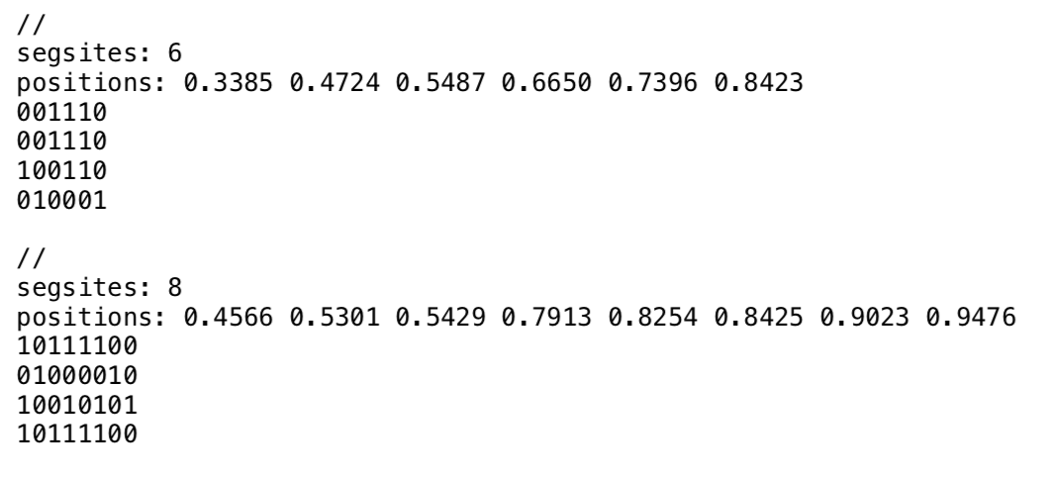
Levels of polymorphism
From the lab
Output from Hudson’s ms coalescence simulator. Note that some sequences are a lot more similar than others because the mutations were added to a genealogy:
Notes:
Remember you did this ..
Each one of these entries is a summary of a single genealogy
Some of the simulated SNPs will be high allele frequency and other
- Could also have output the simulated genealogy for each simulation.

Slide 8
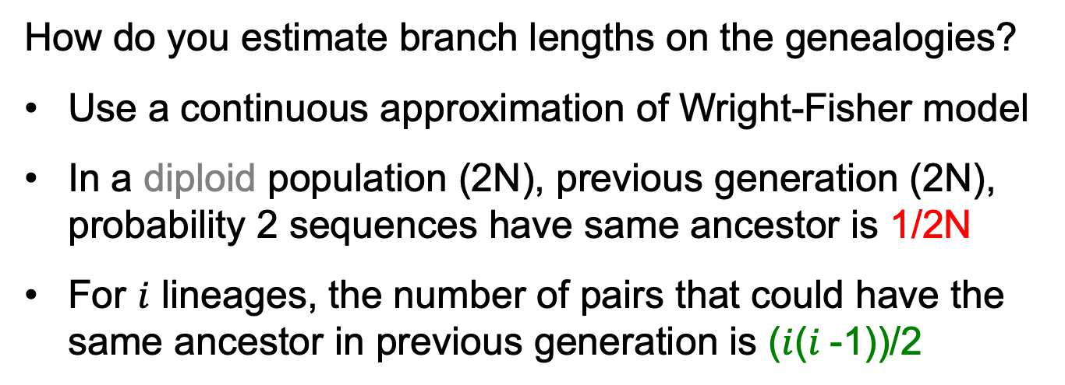
Probability of a coalescence event
diploid
How do you estimate branch lengths on the genealogies?
Use a continuous approximation of Wright-Fisher model
In a diploid population (2N), previous generation (2N), probability 2 sequences have same ancestor is 1/2N
For $i$ lineages, the number of pairs that could have the same ancestor in previous generation is ($i$($i$-1))/2
Notes:
1/2N because you choose 1 ancestor for seq1 then the chances that seq2 had that exact parent is 1/2N (because all seqs in the previous generation have the same parent. .. But that’s just one pair .. How many possible pairs are there?

Slide 9
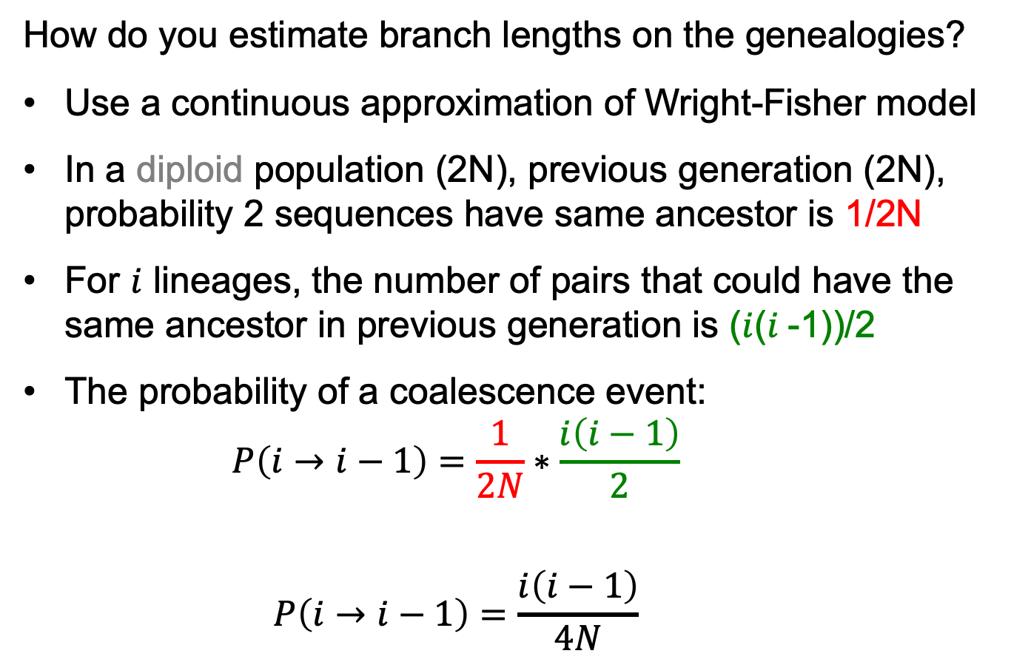
Probability of a coalescence event
diploid
How do you estimate branch lengths on the genealogies?
Use a continuous approximation of Wright-Fisher model
In a diploid population (2N), previous generation (2N), probability 2 sequences have same ancestor is 1/2N
For $i$ lineages, the number of pairs that could have the same ancestor in previous generation is ($i$($i$-1))/2
The probability of a coalescence event:
$$P\left(i→i−1\right)=\frac{1}{2N}∗\frac{i\left(i−1\right)}{2}$$
$$P\left(i→i−1\right)=\frac{i\left(i−1\right)}{4N}$$
Notes:
The larger the number of lineages, the higher the probability of a coalescence event in the previous generation

Slide 10
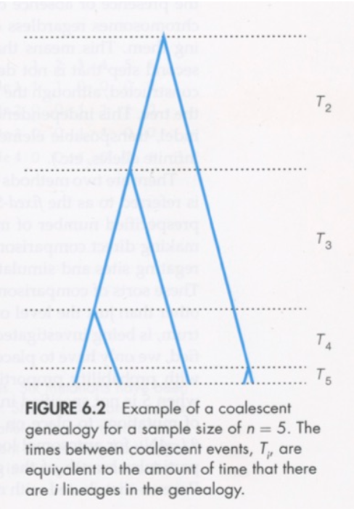
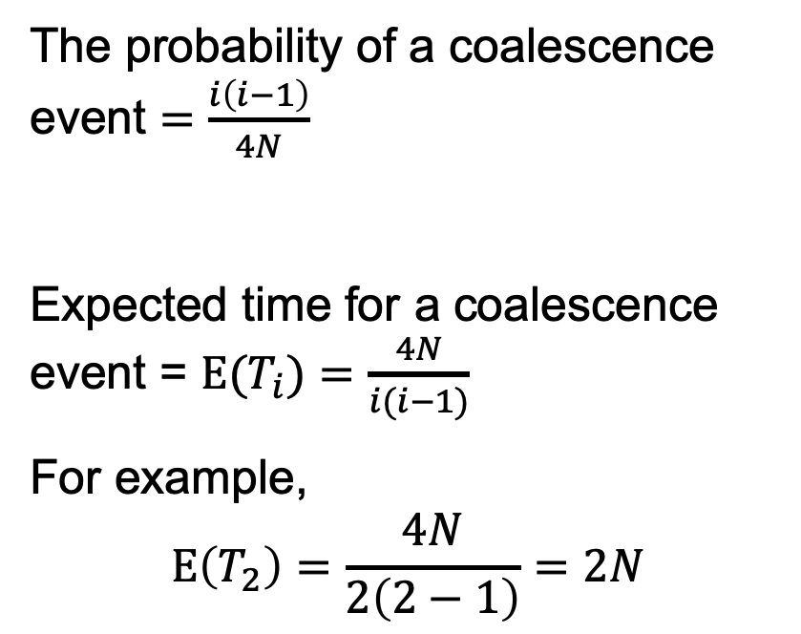
Time to coalescence events
diploid
The probability of a coalescence event $=\frac{i\left(i−1\right)}{4N}$
Expected time for a coalescence event = $E(T_{i})=\frac{4N}{i(i−1)}$
For example,
$$E\left(T_{2}\right)=\frac{4N}{2\left(2−1\right)}=2N$$
Expected time to event: $E\left(X\right)=\frac{1}{λ}$ where $λ$ is the rate parameter

Slide 11


Time to coalescence events
diploid
The probability of a coalescence event $=\frac{i\left(i−1\right)}{4N}$
Expected time for a coalescence event = $E(T_{i})=\frac{4N}{i(i−1)}$
For example,
$$E\left(T_{2}\right)=\frac{4N}{2\left(2−1\right)}=2N$$
$$E\left(T_{3}\right)=?$$
$$E\left(T_{4}\right)=?$$

Slide 12


Time to coalescence events
diploid
Most Recent Common Ancestor (MRCA)
The probability of a coalescence event $=\frac{i\left(i−1\right)}{4N}$
Expected time for a coalescence event = $E(T_{i})=\frac{4N}{i(i−1)}$
For example,
$$E\left(T_{2}\right)=\frac{4N}{2\left(2−1\right)}=2N$$
2N
2N/3
N/3
$$E\left(T_{3}\right)=2N/3$$
$$E\left(T_{4}\right)=N/3$$
When sample size is large, time to MRCA sums to 4N

Slide 13
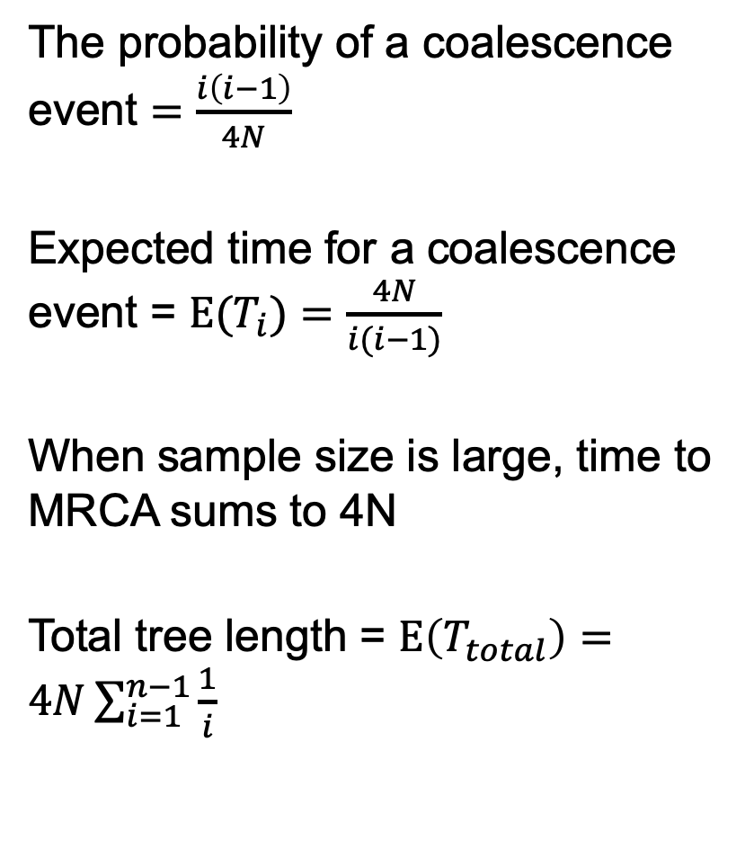
Time to MRCA and total tree length
diploid
Most Recent Common Ancestor (MRCA)
The probability of a coalescence event $=\frac{i\left(i−1\right)}{4N}$
Expected time for a coalescence event = $E(T_{i})=\frac{4N}{i(i−1)}$
When sample size is large, time to MRCA sums to 4N
Total tree length = $E\left(T_{total}\right)=4N\sum_{i=1}^{n−1}{\frac{1}{i}}$

Slide 14
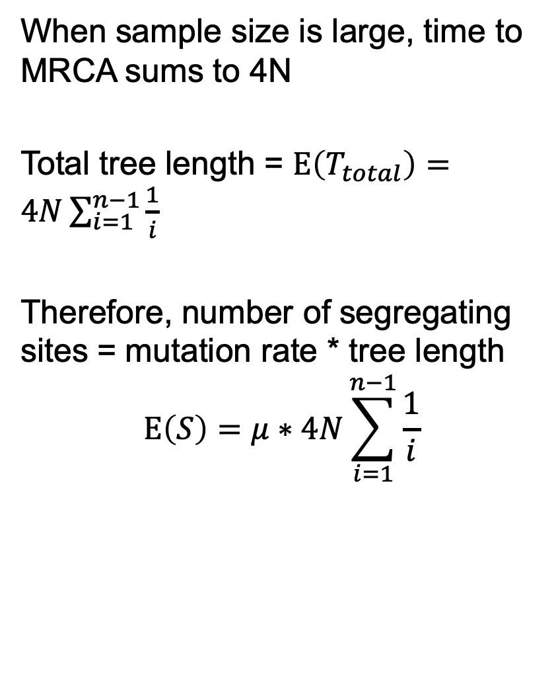
Time to MRCA and total tree length
diploid
Most Recent Common Ancestor (MRCA)
When sample size is large, time to MRCA sums to 4N
Total tree length = $E\left(T_{total}\right)=4N\sum_{i=1}^{n−1}{\frac{1}{i}}$
Therefore, number of segregating sites = mutation rate * tree length
$$E\left(S\right)=μ∗4N\sum_{i=1}^{n−1}{\frac{1}{i}}$$
Does this look familiar?

Slide 15
From last time
Molecular Population Genetics
The Neutral Theory of Molecular Evolution
Detecting signatures of natural selection in populations:
McDonald-Kreitman test
Tajima’s D
Coalescent simulations
Population Genomics
Notes:
Review

Slide 16
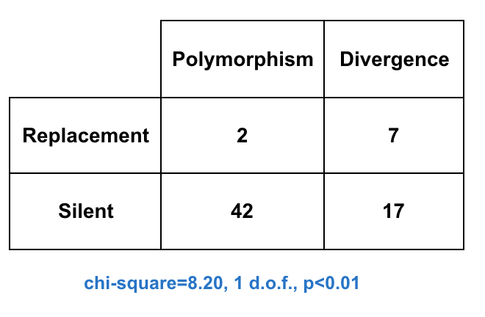
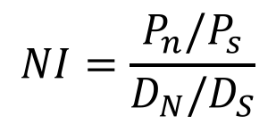

From last time
The McDonald Kreitman Test
Positive selection
P_{n}
5.8
D_{N}
3.2
9
(Nonsynonymous)
P_{s}
38.2
D_{S}
20.8
59
(Synonymous)
What if replacement polymorphism had been higher than expected?
44
24
68
$$NI=\frac{P_{n}/P_{s}}{D_{N}/D_{S}}$$
Neutrality Index:
Proportion of adaptive substitutions:
$$α=1−NI$$
Notes:
What if replacement had been higher than expected?

Slide 17
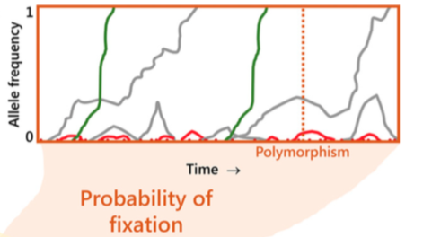
The Neutral Theory of Molecular Evolution
Most polymorphisms or fixed differences between species are selectively neutral
High P_{n} if slightly deleterious
Notes:
Under neutrality most ..
If the ratio of synonymous and nonsynonymous changes was different for polymorphisms than divergence it would imply there’s a break from the null model of neutrality.

Slide 18
From last time
The McDonald Kreitman Test: extensions
Advantage of the McDonald Kreitman test :
synonymous & non-synonymous diffs are close, so demographic effects are the same for both
Non-neutral vs neutral differences could be any type of interspersed sequences e.g.
non-coding regulatory regions vs synonymous sites
Introns vs synonymous sites
Casillas & Barbadilla 2017
Casillas & Barbadilla 2017

Slide 19
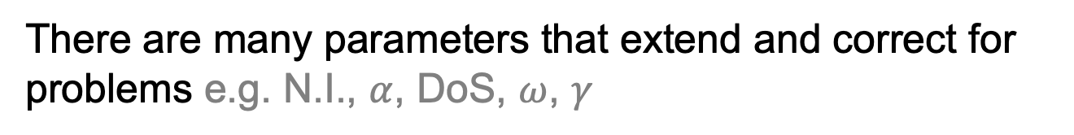
The McDonald Kreitman Test: extensions
Advantage of the McDonald Kreitman test :
synonymous & non-synonymous diffs are close, so demographic effects are the same for both
Non-neutral vs neutral differences could be any type of interspersed sequences e.g.
non-coding regulatory regions vs synonymous sites
Introns vs synonymous sites
There are many parameters that extend and correct for problems e.g. N.I., $α$, DoS, $ω$, $γ$
Can use whole-genome data in a single analysis to identify outlier loci that may be under selection
Casillas & Barbadilla 2017
Casillas & Barbadilla 2017
Notes:
Omega corrects for mutation rates
Correction for small population size
Questions?

Slide 20
Molecular Population Genetics
The Neutral Theory of Molecular Evolution
Detecting signatures of natural selection in populations:
McDonald-Kreitman test
Tajima’s D
Coalescent simulations
Population Genomics
Notes:
Introduce Tajima’s D .. It’s a bit crude and other tests are much better now .. But there’s a common empirical result that it describes that is just as important as it ever was

Slide 21
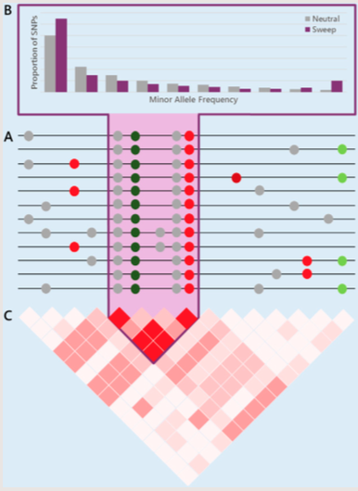
Other Molecular Signatures of Natural Selection
Reduction in genetic diversity
Slightly advantageous
Slightly deleterious
Notes:
Natural selection on non-neutral mutations
Other signatures .. E.g. green mutation here v. advantageous .. Sweeps to fixation (selective sweep)

Slide 22
Other Molecular Signatures of Natural Selection
Reduction in genetic diversity
Slightly advantageous
Slightly deleterious
Advantageous
e.g. Selective sweep
Notes:
Natural selection on non-neutral mutations
Other signatures .. E.g. green mutation here v. advantageous .. Sweeps to fixation (selective sweep)

Slide 23
Molecular Signatures of Natural Selection
Skew toward rare derived alleles
Reduction in genetic diversity
Tajima’s D tests for skew toward rare alleles (negative Tajima’s D)

Slide 24
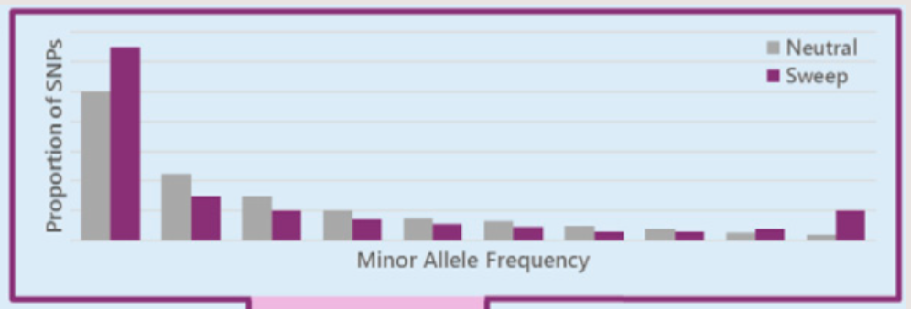
Skew toward rare derived alleles
Site Frequency Spectrum, or Allele Frequency Spectrum
neutral
Notes:
What are the derived alleles?

Slide 25
Skew toward rare derived alleles
Site Frequency Spectrum, or Allele Frequency Spectrum
Skew toward rare derived alleles
after sweep or low N_{e}
neutral
100% of SNPs w/ MAF<0.1
Notes:
MAF = 2nd most common allele

Slide 26
Skew toward rare derived alleles
Site Frequency Spectrum, or Allele Frequency Spectrum
Skew toward rare derived alleles
after sweep or low N_{e}
neutral
100% of SNPs w/ MAF<0.1

Slide 27
Skew toward rare derived alleles
Site Frequency Spectrum, or Allele Frequency Spectrum
Tajima’s D
Skew toward rare derived alleles
after sweep or low N_{e}
100% of SNPs w/ MAF<0.1
neutral
soft sweep
hard sweep
Notes:
The high frequency allele is because of genetic hitchhiking (it sweeps along with the advantageous mutation)
A test for that = Fay & Wu’s H 2000

Slide 28
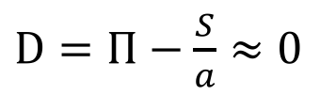
Levels of polymorphism
From the lab
Levels of DNA polymorphism can be measured multiple ways.
$\hat{θ}=\frac{S}{a}$ where $a=\sum_{i=1}^{n−1}{\frac{1}{i}}=1+\frac{1}{2}+\frac{1}{3}+…+\frac{1}{n−1}$
$Π$, which is the average number of pairwise differences
Under neutrality, these 2 estimates will be the same, Tajima’s D ~ 0:
$D=Π−\frac{S}{a}$ $≈0$
Skew toward rare alleles?
Notes:
.. So how do you test for this with Tajima’s D ..
From the lab .. 2 different ways to measure levels of polymorphism
.. Hopefully you noticed that they are affected differently by
How would D look if there was a skew toward rare alleles

Slide 29
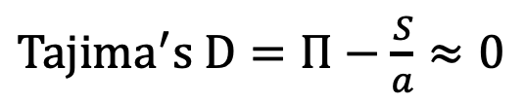
Levels of polymorphism
From the lab
Levels of DNA polymorphism can be measured multiple ways.
$\hat{θ}=\frac{S}{a}$ where $a=\sum_{i=1}^{n−1}{\frac{1}{i}}=1+\frac{1}{2}+\frac{1}{3}+…+\frac{1}{n−1}$
$Π$, which is the average number of pairwise differences
Under neutrality, these 2 estimates will be the same:
${Tajima}^{′}s D=Π−\frac{S}{a}$ $≈0$
Estimate p value with coalescent simulation (e.g. ms)
Notes:
From the lab

Slide 30
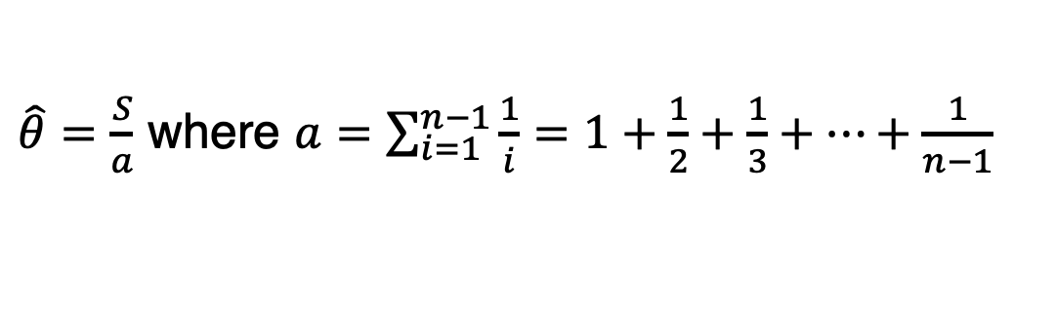
Levels of polymorphism
From the lab
$\hat{θ}=\frac{S}{a}$ where $a=\sum_{i=1}^{n−1}{\frac{1}{i}}=1+\frac{1}{2}+\frac{1}{3}+…+\frac{1}{n−1}$
$Π$, which is the average number of pairwise differences
Under neutrality, these 2 estimates will be the same:
${Tajima}^{′}s D=Π−\frac{S}{a}$ $≈0$
Estimate p value with coalescent simulation (e.g. ms)
Notes:
From the lab
Could use those 0s and 1s to estimate pi (average pairwise diffs), and seg sites to estimate waterson’s theta, then estimate Tajima’s D for every one of these simultions .. How often is the difference bigger than -0.39?

Slide 31
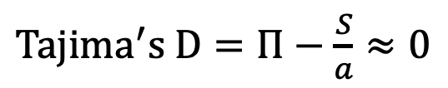
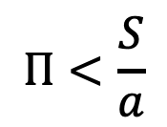
Interpreting Tajima’s D
Skew toward rare alleles:
low freq. sites less important
low freq. sites important
$$Π<\frac{S}{a}$$
${Tajima}^{′}s D=Π−\frac{S}{a}$ $≈0$
Tajima’s D < 0
-ve
after sweep or recent low N_{e}
100% of SNPs w/ MAF<0.1

Slide 32
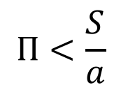
Interpreting Tajima’s D
Skew toward rare derived alleles:
Fu and Li’s D 1993
$$Π<\frac{S}{a}$$
${Tajima}^{′}s D=Π−\frac{S}{a}$ $≈0$
Tajima’s D < 0
-ve
after sweep or recent low N_{e}
100% of SNPs w/ MAF<0.1

Slide 33
Interpreting Tajima’s D
Skew toward rare derived alleles:
$$Π<\frac{S}{a}$$
${Tajima}^{′}s D=Π−\frac{S}{a}$ $≈0$
Tajima’s D < 0
-ve
after sweep or recent low N_{e}
How can you tell the difference between a sweep and a population bottleneck?
100% of SNPs w/ MAF<0.1
Notes:
How can you tell the difference between sweep and low Ne?

Slide 34
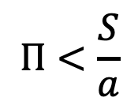
Interpreting Tajima’s D
Skew toward rare derived alleles:
More high freq. pws diffs
$$Π<\frac{S}{a}$$
${Tajima}^{′}s D=Π−\frac{S}{a}$ $≈0$
Tajima’s D > 0
+ve
after sweep or recent low N_{e}
What if Tajima’s D is +ive?
100% of SNPs w/ MAF<0.1
Notes:
How can you tell the difference between sweep and low Ne?

Slide 35
Molecular Signatures of Natural Selection
Skew toward rare derived alleles
Reduction in genetic diversity
An increase in linkage disequilibrium
Correlated inheritance
Notes:
We can use coalescence theory and neutral theory to come up with a null model for each of these
There are pop genetic and pop genomic tests that look for non-neutral patterns in each of these
Questions?

Slide 36
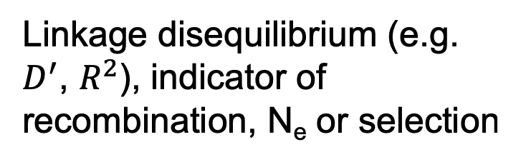
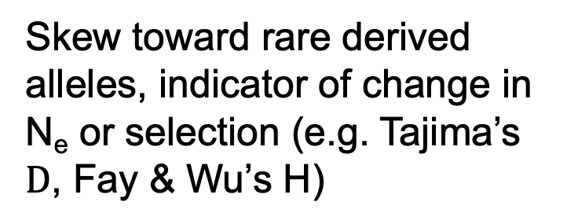
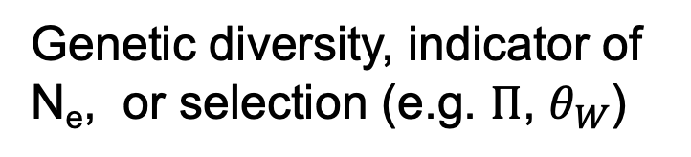

Parameters for population genomics
Skew toward rare derived alleles, indicator of change in N_{e} or selection (e.g. Tajima’s $D$, Fay & Wu’s H)
Genetic diversity, indicator of N_{e}, or selection (e.g. $Π$, $θ_{W}$)
Linkage disequilibrium (e.g. $D^{′}$, $R^{2}$), indicator of recombination, N_{e} or selection
$$D^{′}=P_{AB}P_{ab}−P_{Ab}P_{aB}$$
Hartl & Clark 2007,
Casillas & Barbadilla 2017
Notes:
Often population genomic studies will estimate parameters in sliding windows and compare these to genome-wide averages
.. Havent learnt about LD yet, but an understanding of that is especially important ..
.. Define .. Explain its use.
Frequency of AB together and ab together compared with the recombined versions

