Slide 1
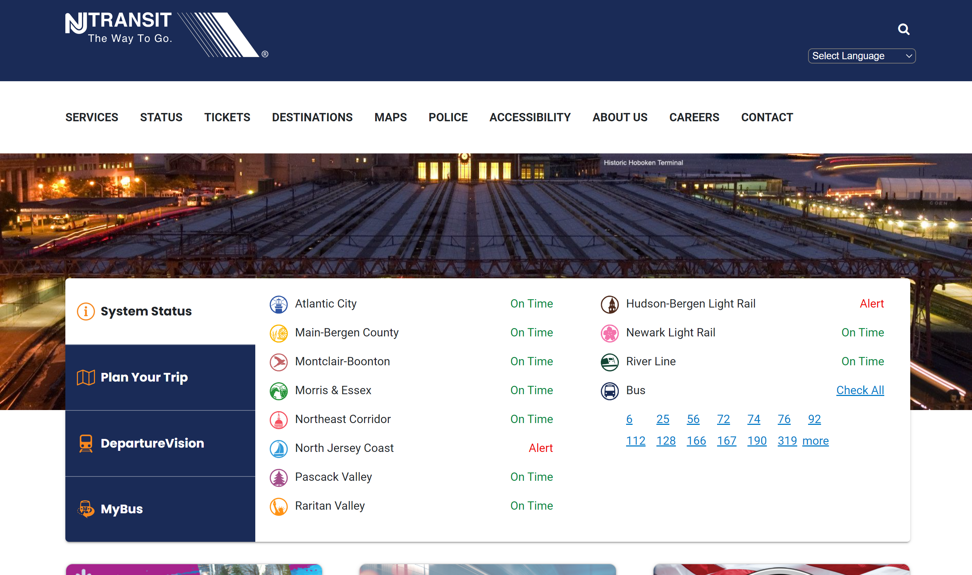

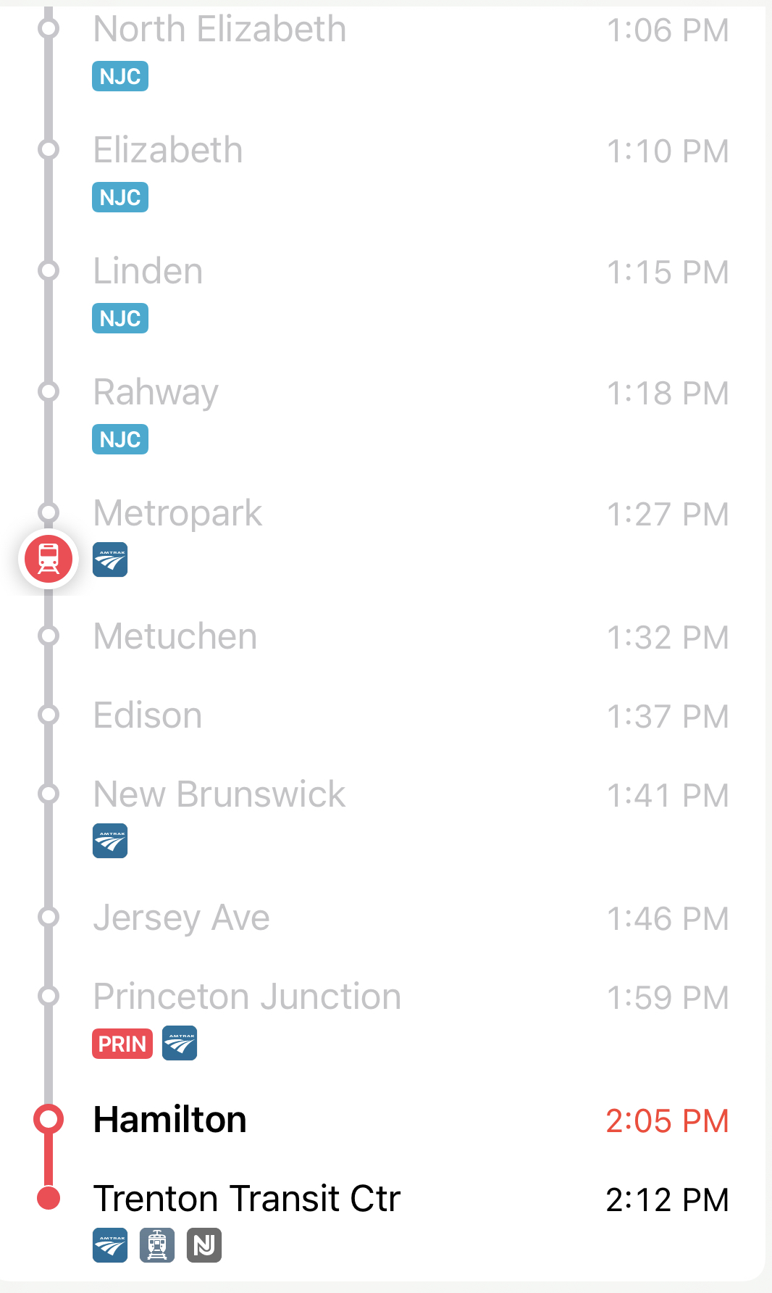
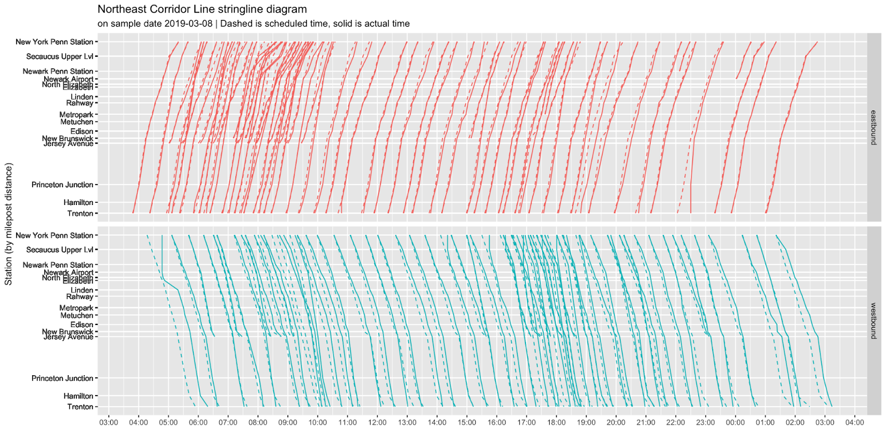
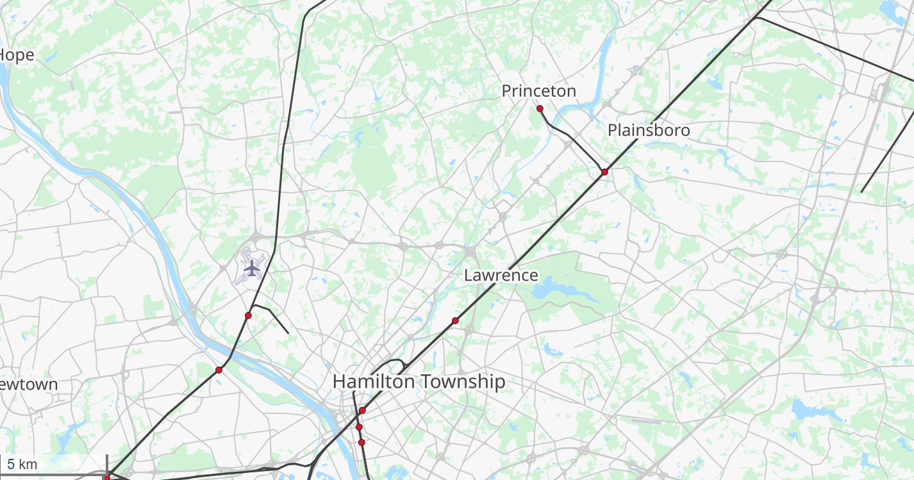

Real-time Service Stringline
Selected
Historical
Train NEC 3321 - Trenton
12-09-2021 | Arrived Trenton x mins late
12-08-2021 | Arrived Trenton x mins late
12-07-2021 | Arrived Trenton x mins late
12-06-2021 | Arrived Trenton x mins late
12-05-2021 | Arrived Trenton x mins late
12-04-2021 | Canceled
12-03-2021 | Arrived Trenton x mins late
12-02-2021 | Arrived Trenton x mins late
12-01-2021 | Arrived Trenton x mins late
11-30-2021 | Arrived Trenton x mins late
11-29-2021 | Arrived Trenton x mins late
11-28-2021 | Arrived Trenton x mins late
11-27-2021 | Arrived Trenton On-time
NEC 3321 to Trenton
Type: Arrow III
Next Stop: Trenton
Status: 4-min late
Service Recommendations

