Slide 1
Machine Learning
CS 5830/6830
John Edwards
john.edwards@usu.edu
Slides loosely based on “Data Science from Scratch” by Joel Grus and Andrew Ng’s Machine Learning Coursera course

Slide 2
Topics
What is machine learning?
Supervised learning
Regression
Classification
Unsupervised learning
Overfitting
Correctness
Bias-variance trade-off
Feature extraction and selection

Slide 3
Data science
“Data science is mostly turning business problems into data problems and collecting data and understanding data and cleaning data and formatting data, after which machine learning is almost an afterthought.”
-Joel Grus

Slide 4
Machine learning - models
Model - a specification of a mathematical relationship that exists between different variables. Examples:
Social networking site:
get_profit(num_users, ad_revenue_per_user, employee_salaries)
Cooking recipe webpage:
bread_cups_flour(number_of_eaters, hungriness)
Poker:
win_probability(revealed_cards)

Slide 5
Machine learning - models
Model - a specification of a mathematical relationship that exists between different variables. Examples:
Social networking site:
get_profit(num_users, ad_revenue_per_user, employee_salaries)
return num_users * ad_revenue_per_user - employee_salaries
Cooking recipe webpage:
bread_cups_flour(number_of_eaters, hungriness)
return number_of_eaters * hungriness * factor
Poker:
win_probability(revealed_cards)
return [some statistical analysis of cards plus player statistics]

Slide 6
What is machine learning?
Machine learning is creating and using models that are learned from data.
(Also called predictive modeling and data mining.)
What are some things we might want to predict?

Slide 7
What is machine learning?
Machine learning is creating and using models that are learned from data.
(Also called predictive modeling and data mining.)
What are some things we might want to predict?
Is an email message spam?
Is a credit card transaction fraudulent?
Which advertisement will a shopper click on?
Who will win the Super Bowl?

Slide 8
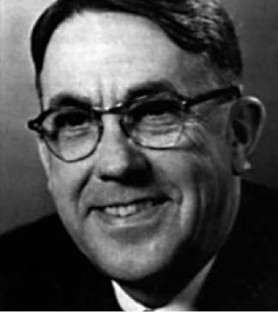
Early machine learning
Arthur Samuel – 1959
Not a great checkers player
Taught computer to play checkers better than him

Slide 9
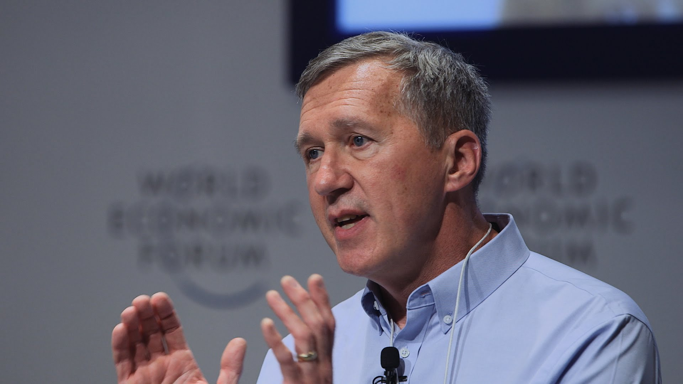
Definition of machine learning
Tom Mitchell (Carnegie Mellon):
A computer program is said to learn from experience ‘E’, with respect to some class of tasks ‘T’ and performance measure ‘P’ if its performance at tasks in ‘T’ as measured by ‘P’ improves with experience ‘E’.

Slide 10
Two main types of ML algorithms
Supervised
Unsupervised
(Also semi-supervised and online)

Slide 11
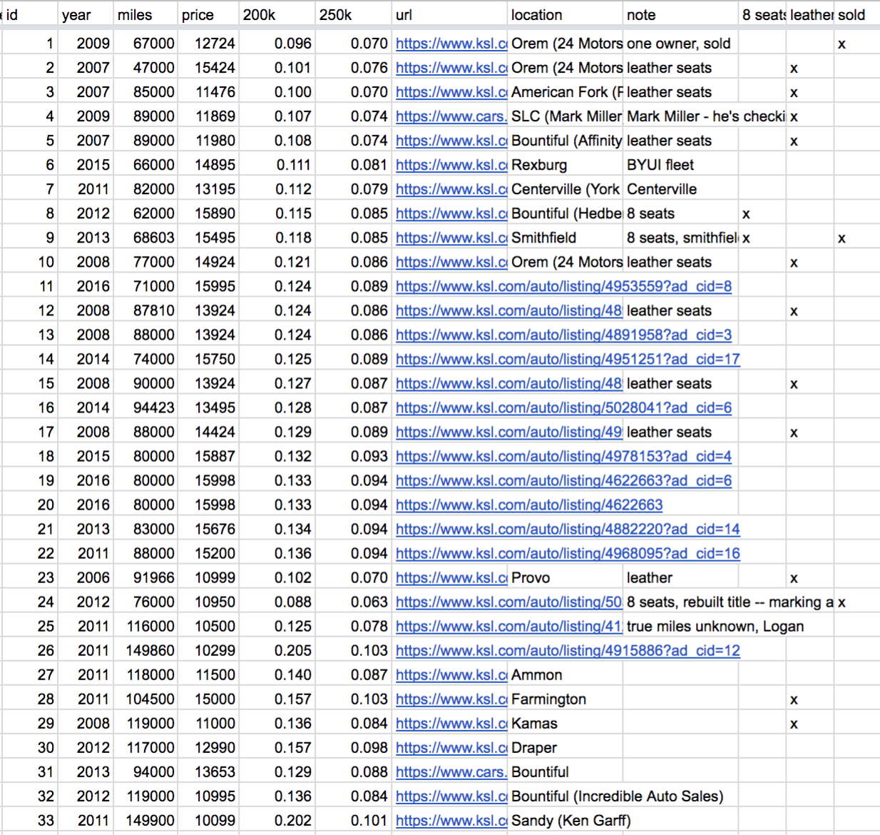
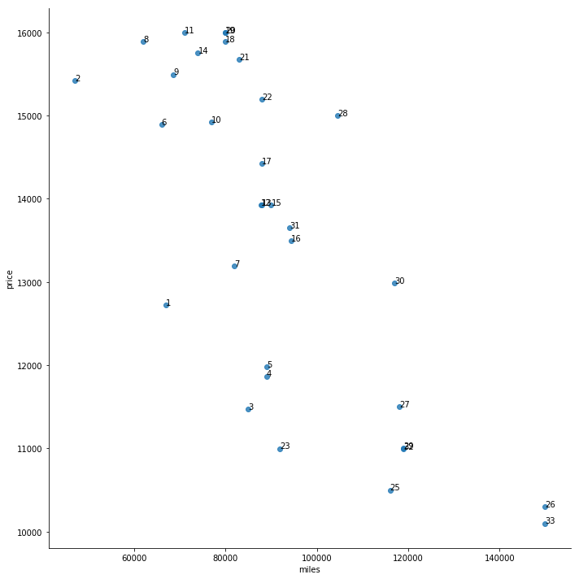
Supervised learning - van shopping
Notes:
When shopping for a new van I made a spreadsheet and plot

Slide 12
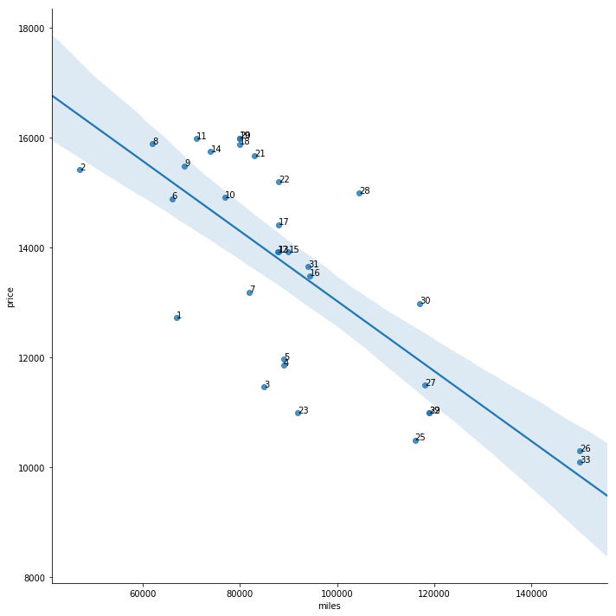
Supervised learning - van shopping
Notes:
Not only helps me know what is a good deal but also how to predict how much I might be able to sell my car for. I can fit a line and predict the cost based on the number of miles.

Slide 13
Supervised learning - breast cancer
Malignant
Benign
Unknown
Age
Lump size

Slide 14
Supervised learning - breast cancer
Malignant
Benign
Unknown
Age
Lump size

Slide 15
Supervised learning
A dataset with the “right answers” is given
Two types of supervised learning
Regression - predict continuous valued output (price)
Classification - predict discrete valued output (malignant or benign)
Regression or classification?
I have data on Chick-Fil-A restaurants and data on Logan. I want to predict how many customers I’ll get each month if I build another Chick-Fil-A in Logan.
I have crime data. I want to predict the crime rate in Logan.
I have crime data. I want to predict if John Doe is a criminal based on his attributes.
I have electronic medical records. I want to decide if a person has type I or type II diabetes.

Slide 16
Unsupervised learning - data isn’t labeled
Can you find structure in this dataset?
Clustering!
Tissue density
Tissue color

Slide 17
Unsupervised learning - data isn’t labeled
malignant
Tissue density
benign
Tissue color

Slide 18
Unsupervised learning - data isn’t labeled
Tissue density
Tissue color

Slide 19
Unsupervised learning - data isn’t labeled
Malignant type I
Tissue density
benign
Malignant type II
Tissue color

Slide 20
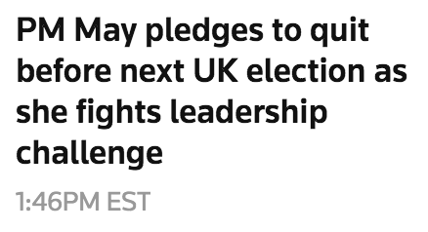
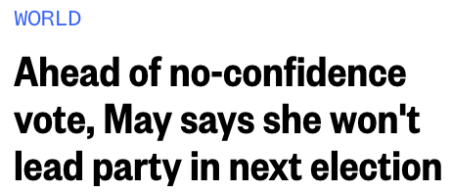
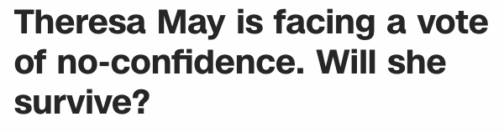
Unsupervised learning - data isn’t labeled
News aggregation website might cluster similar articles:
Theresa May

Slide 21
Unsupervised learning - applications
Social network analysis
Gene expression
Market segmentation

Slide 22
Unsupervised learning
Supervised or unsupervised?
Given email labeled as spam/not spam, learn a spam filter.
Given customer data, group customers into different market segments.
Given a dataset of patients with and without diabetes, learn to classify new patients as having/not having diabetes
Given a dataset of humans and their genes, group humans into classes based on their genes.

Slide 23
Supervised learning - overfitting
Known price
Unknown
Predicted
Car price
Number of miles

Slide 24
Supervised learning - overfitting
Known price
Unknown
Predicted
Car price
Number of miles

Slide 25
Supervised learning - overfitting
Known price
Unknown
Predicted
Car price
Number of miles

Slide 26
Supervised learning - overfitting
Known price
Unknown
Predicted
Car price
Number of miles

Slide 27
Unsupervised learning - overfitting
Malignant
Benign
Unknown
Age
Lump size

Slide 28
Unsupervised learning - overfitting
Malignant
Benign
Unknown
Age
Lump size

Slide 29
Unsupervised learning - overfitting
Malignant
Benign
Unknown
Age
Lump size

Slide 30
Bias/variance tradeoff
Degree 0 model:
High bias - poor performance for pretty much any training dataset
Low variance - pretty much same model for every training dataset
Underfit
Car price
Car price
Number of miles
Number of miles

Slide 31
Bias/variance tradeoff
Degree 7 model:
Low bias - high performance for pretty much any training dataset
High variance - very different models depending on training dataset
Overfit
Car price
Car price
Number of miles
Number of miles

Slide 32
Bias/variance tradeoff
Degree 1 model:
Low bias - good performance for pretty much any training dataset
Low variance - similar model for every training dataset
Car price
Car price
Number of miles
Number of miles

Slide 33
Bias/variance tradeoff solutions
High bias, low variance:
Increase model complexity
Add features (attributes)
Low bias, high variance
Decrease model complexity
Remove features (attributes)
Obtain more data
Car price
Car price
Number of miles
Number of miles

Slide 34
Supervised learning - regression
Notation
m - number of training examples
x - input variables / features
y - output variable / target variable
(x,y) - one training example
(x_i, y_i) - ith training example
Age
Lump size

Slide 35
Measuring how good our predictions are

Slide 36
Correctness
What is accuracy?

Slide 37
Correctness
What is accuracy?
The percentage of time you get it right.
successes/(successes+failures)
Examples:
Joe Burrow, quarterback for Cincinnati Bengals: 70.4% completion average in 2021
Concert pianist hits, say, 99.9% of notes correctly

Slide 38
Correctness
What is accuracy?
The percentage of time you get it right.
In prediction, accuracy is (tp+tn)/(tp+tn+fp+fn)
Suppose we have a spam filter that predicts spam messages
tp = “true positive” or “you correctly guessed the email is spam”
fp = “false positive” or “you wrongly guess the email is spam”
tn = “true negative” or “you correctly guessed the email is not spam”
fn = “false negative” or “you incorrectly guessed the email is not spam”
Confusion matrix:
 | spam | not spam
predict “spam” | tp | fp (type 1 error)
predict “not spam” | fn (type 2 error) | tn

Slide 39
Leukemia
I have a cheap non-invasive test that can be given to a newborn baby that will test if the baby will ever develop Leukemia with 98% accuracy.
Leukemia test credit: Joel Grus

Slide 40
Leukemia
I have a cheap non-invasive test that can be given to a newborn baby that will test if the baby will ever develop Leukemia with 98% accuracy.
The test: if the child is named “Luke” then he will develop Leukemia.
Leukemia test credit: Joel Grus

Slide 41
Leukemia
I have a cheap non-invasive test that can be given to a newborn baby that will test if the baby will ever develop leukemia with 98% accuracy.
The test: if the child is named “Luke” then he will develop leukemia.
14 out of every 1,000 people will develop leukemia. 5 babies in 1,000 are named Luke.
 | leukemia | no leukemia | total
Luke |  |  | 5,000
not Luke |  |  | 995,000
total | 14,000 | 986,000 | 1,000,000
Leukemia test credit: Joel Grus

Slide 42
Leukemia
I have a cheap non-invasive test that can be given to a newborn baby that will test if the baby will ever develop leukemia with 98% accuracy.
The test: if the child is named “Luke” then he will develop leukemia.
14 out of every 1,000 people will develop leukemia. 5 babies in 1,000 are named Luke.
 | leukemia | no leukemia | total
Luke | 70 (tp) | 4,930 (fp) | 5,000
not Luke | 13,930 (fn) | 981,070 (tn) | 995,000
total | 14,000 | 986,000 | 1,000,000
(tp+tn)/(tp+tn+fp+fn) = (70+981070)/(70+981070+4930+13930) = 981140/1000000 = 0.98
Leukemia test credit: Joel Grus

Slide 43
Leukemia
Why does the Luke test “work” so well?

Slide 44
Leukemia
Why does the Luke test “work” so well? The intuition:
Just labeling all babies as not having leukemia gives 98% accuracy.
Any test that labels most babies as not having leukemia will have good accuracy.

Slide 45
Leukemia
So what is wrong with the Luke test?

Slide 46
Leukemia
So what is wrong with the Luke test?
If I label a baby as having leukemia, there’s a 98.6% chance I got it wrong.
I will identify only 0.5% of the babies who will have leukemia. In other words, 99.5% of the babies who will have leukemia will be mis-labeled.

Slide 47
Leukemia
Precision: how accurate are our positive predictions?
tp/(tp+fp) = 70/(70+4930) = 0.014
Recall: how many of the positives did we correctly identify?
tp/(tp+fn) = 70/(70+13930) = 0.005
 | leukemia | no leukemia | total
Luke | 70 | 4,930 | 5,000
not Luke | 13,930 | 981,070 | 995,000
total | 14,000 | 986,000 | 1,000,000
Leukemia test credit: Joel Grus

Slide 48
Correctness
Never use accuracy.
Use precision and recall.
You can also use the F1 score:
p = precision
r = recall
F1 score = 2 * p * r / (p + r)
F1 score is the harmonic mean, or “average”, of precision and recall

Slide 49
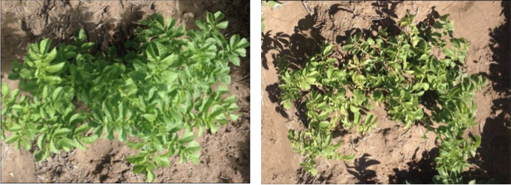
Precision/recall tradeoff - PVY
Potato Virus Y is a dangerous disease

Slide 50
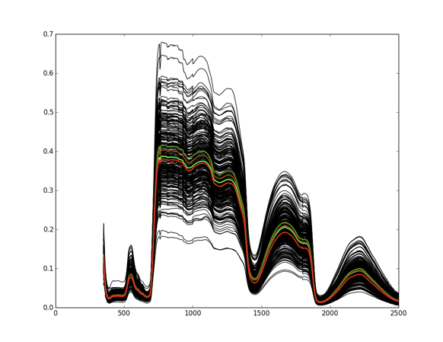
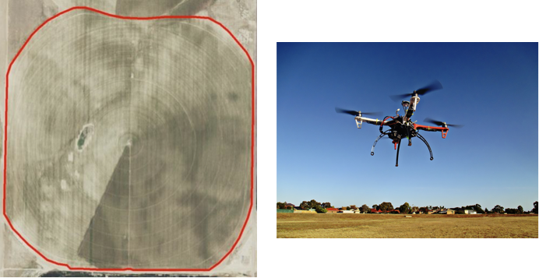
Precision/recall tradeoff - PVY
Can collect spectral signatures from drones

Slide 51
Precision/recall tradeoff - PVY
Can we use machine learning on the spectral signatures to predict if a plant has PVY?

Slide 52
Precision/recall tradeoff - PVY
Weight is a parameter for the SVM learning algorithm
Weight | Precision | Recall
1 | 89 | 85
0.8 | 87 | 88
0.6 | 85 | 91
0.4 | 83 | 95
0.2 | 73 | 99

Slide 53
Feature selection
Types of attributes (with examples)
Categorical (red, green, yellow)
Binary (veteran, not veteran)
Ordered
Ordinal (small, medium, large)
Quantitative (1.3, 8.2, 11.4)
Example: spam filter - features in an email
Does the email contain the word “Viagra”? (binary)
How many times does the letter d appear? (quantitative)
What was the domain of the sender? (categorical)

