Slide 1
Applications of Shape Data Analysis to Time Series Data and Manifold Learning
Ben Shaw

Slide 2
The Data
A set of distinct 2D points corresponding to points on an object (the boundary, usually).
Alternatively: a continuous curve in the plane.
The shape of an object is the geometric information, invariant under translations, rotations, scaling.
Example: the circle. The geometric shape doesn’t change under said transformations.

Slide 3
Similarity of Shape data
In one paper (Bharath and Kurtek, 2019), two methods are outlined:
  Landmark-based approach, or picking landmark points and comparing distances;
  Curve-based approach, or treating the shape as a continuous curve (discretized in implementation)
The curve-based approach may be messier, but picking landmarks requires domain expertise.
Curve similarity: distances in “shape space.”

Slide 4
Application to Time series
Shapes can be converted to time series, as we have seen in class.
Time series can be converted to shapes.
In this project, we convert time series to shapes and compare differences using tools from shape analysis.

Slide 5
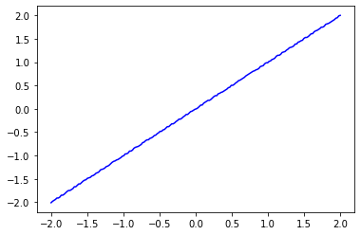
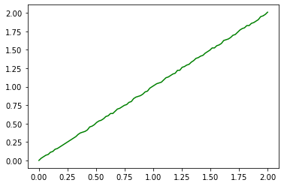
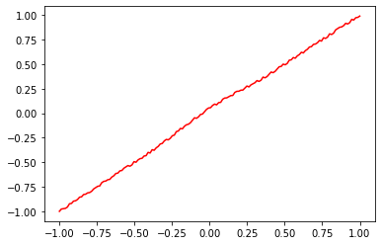
The Time series
Which time series is the green time series more similar to: Blue or Red? Different lengths.

Slide 6
Getting the shape
The temporal component encodes information about the angle theta: transform t to theta.
The remaining component of the ts data encodes information about the distance from the origin: transform y(t) to r.
Another transformation: u=r*cos(theta), v=r*sin(theta), a “Cartesian graph.”
Rotation invariance: apply PCA (if needed).

Slide 7
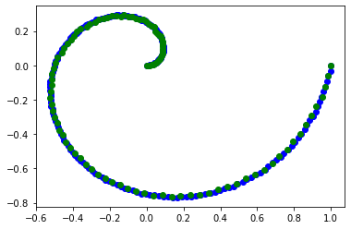
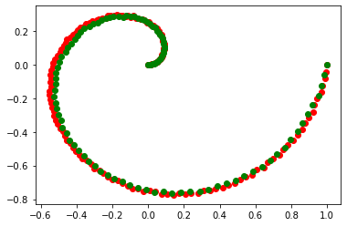
The Shape Data Representative
Visually, we see that the green curve is more similar to the blue curve than the red curve. A suitable distance metric in shape space will quantify this. One idea is theta-based euclidean comparison. “New” idea: fit to continuous curve and use integration (angle in function space).

Slide 8
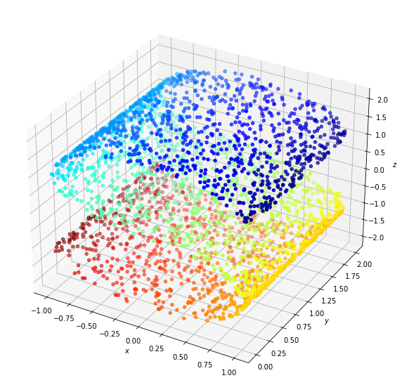
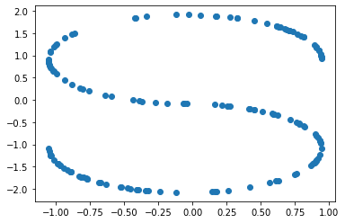
Application to Symmetry detection

Slide 9
Symmetry -> Manifold Learning
The s-curve dataset is (approximately) generated by translation of a 2D s-curve. The data may thus be represented as a point in the translated direction and a point on the 2D s-curve (dimensionality reduction)
Useful geometric information can be approximated, such as the “Riemannian Metric”
Other symmetries are useful and detectable (i.e. rotational).

Slide 10
Thank you
Questions?

