Slide 1

Microsoft Access 2000
AutoStart Setup

Slide 2
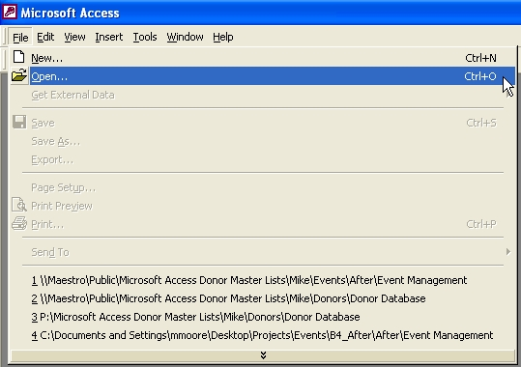
Open a Database - 1
Open a Database
Here
Here
or …

Slide 3
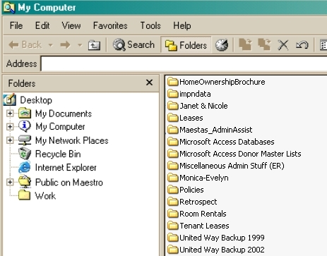
Open a Database - 2
Here

Slide 4
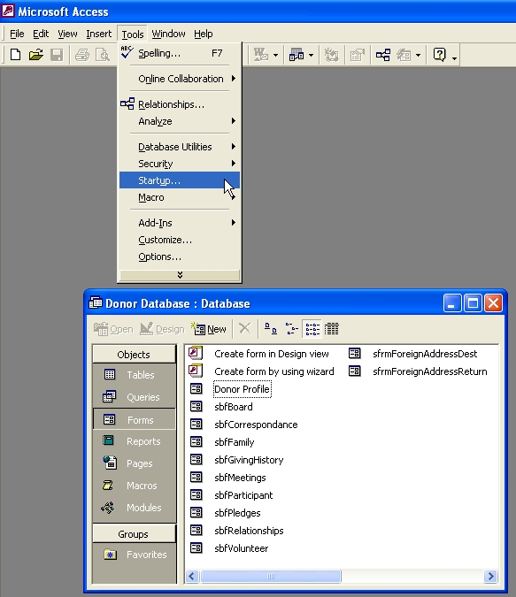
AutoStart Setup
Once you have a database opened…
Click here to open the Autostart Window.

Slide 5
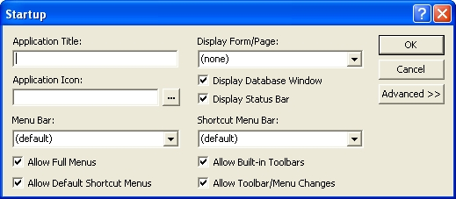
AutoStart Setup - 2
There are two main areas to be concerned
about:
Here
and here

Slide 6
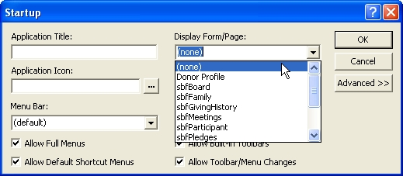
AutoStart Setup - 3
Here you select the Form/Page you’d like
to open:

Slide 7
AutoStart Setup - 4
Here you select what you would or would not like to display in addition to your form.

Slide 8
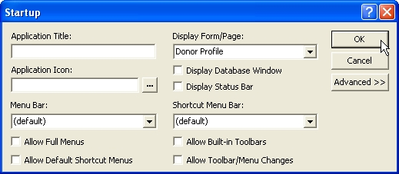
AutoStart Setup - 5
If you select Donor Profile as your form and uncheck ALL options…

Slide 9
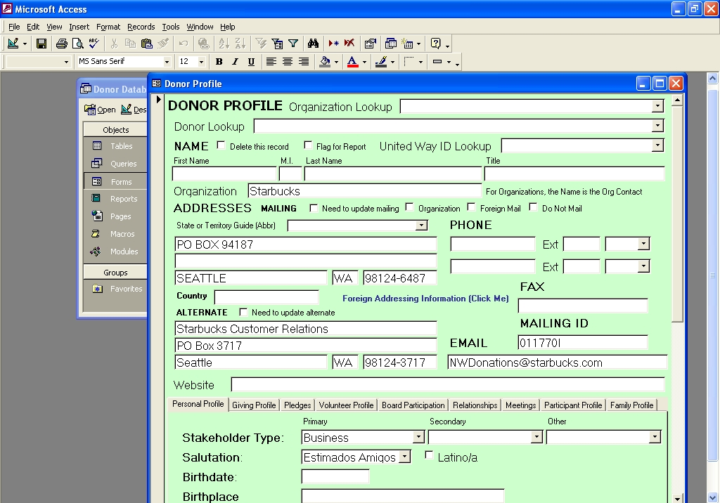
AutoStart Setup - 6
Here’s the Before Screen:

Slide 10
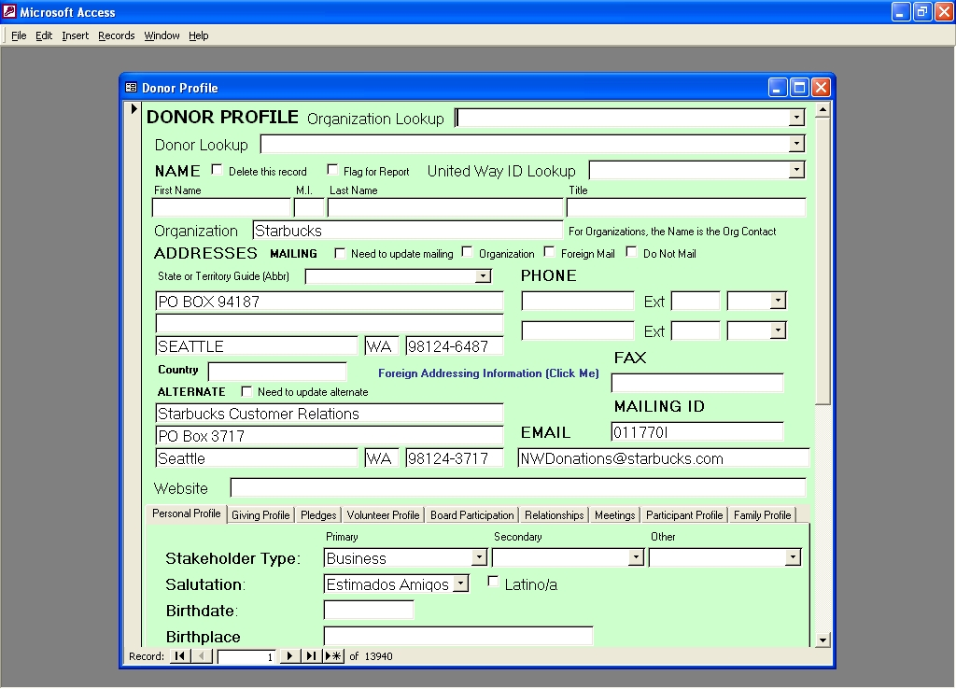
AutoStart Setup - 7
Here’s the After Screen:

Slide 11
AutoStart Setup - 8
Should you want to change AutoStart options after the fact, hold down the “Shift” key when opening the Database and that will bypass the AutoStart options.
You can then go back into AutoStart and
make your changes.

Slide 12
AutoStart Setup - 9
Fin.

