Slide 1
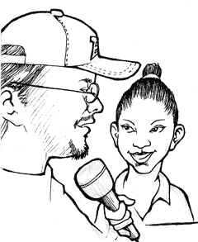
Welcome to Shires Media Citizen Press Corps
Recording and Interviewing Techniques

Slide 2
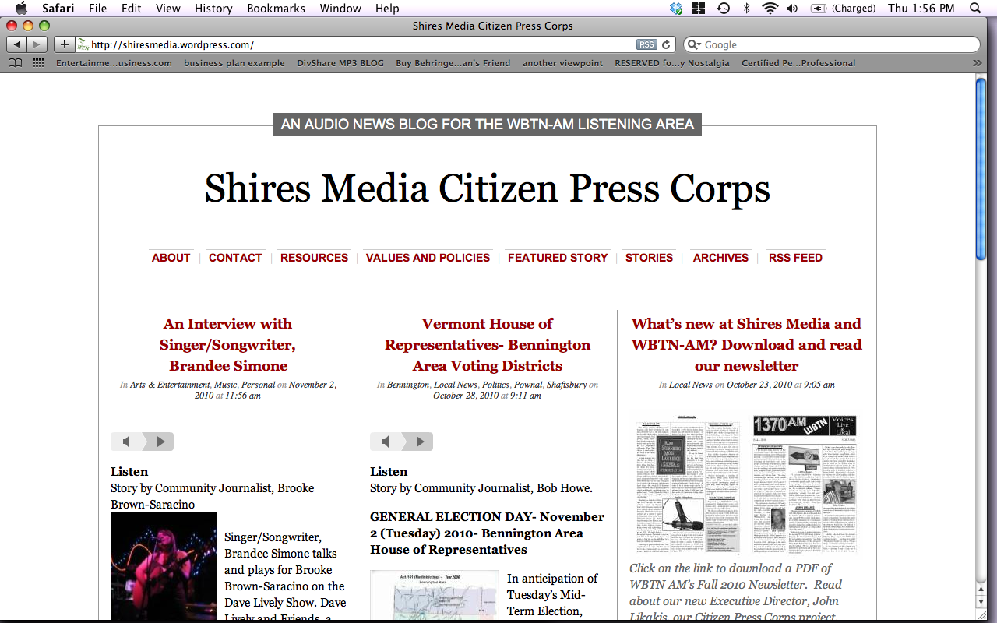
www.ShiresMedia.org
Our audio news site
Home for citizen journalists

Slide 3
Citizen Press Corps
Story Ideas and Guidelines:
What kind of story can I report on?
Shires Media Citizen Press Corps invites you to follow your interests and passions to create an audio story that both excites you and that you think others in your community will be excited to hear. You might ask yourself, what story would I like to share with my community? What story do I want to learn more about? What story might the Bennington area be interested in hearing?

Slide 4
How do I structure my story?
First Person: Either you tell your own life story or you interview someone else about their life story. Ex. Brooke’s interview with friend and Singer/Songwriter, Brandee Simone.
Slice of Life: Interview local business owner or community member. Ex. Chris Sobolowski discusses the new Bennington Cricket Club.
Something Happened: Report on an event that recently happened in your community: Ex. Seventy people participate in first Shires Media community event.
Something is going to happen: Report on a local, upcoming event. Ex. Empty Bowls fundraiser for the Bennington Free Clinic.
Issue Reporting: Report on why a local topic is an issue for the community revealing multiple perspectives. Ex. Pros and Cons of burning biomass for electricity in Pownal.
Spot News: On the spot reporting of live event. Ex. Local sports game coverage.
visit www.ShiresMedia.org/archives for more examples.

Slide 5
But I’ve never been a journalist before, how do I report?
Journalism is the art of telling a story so that the listener gets a complete and fair picture of the topic, event, person or place that is the subject of the story.

Slide 6
Journalism Ethics
Strive for:
Civility and Respect in the articulation of your ideas- We want this to be a fun and safe place where a diversity of ideas can be expressed. Remain open, honest and civil.
Thoroughness, Objectivity and Balance- Who? What? Where? When? Why? How? Ask these questions to ensure that your story is complete. Provide enough context and information so that the listener can form their own opinion around the subject matter regardless of your own opinion.
Fairness and Accuracy- Make sure to stay inquisitive and do background research to supplement interviews. You can’t always trust something someone said just because they said it. Always site your sources of information.
Open Identity and Transparency- Reveal who you are and where you’re coming from. Remember you are a part of the story and we encourage you to unveil any biases or interests you might have when reporting on an issue.
Creativity and originality- Have fun and report on things that interest you and you are passionate about.
Local- We want to make sure we are serving the information needs and interests of the Bennington area community. Often local stories go unheard. This is an opportunity for Bennington area community members to speak directly to one another.

Slide 7
How should I begin?
FIRST PERSON INTERVIEWS
We encourage you to start with a first-person story in order to become comfortable with recording and interviewing. We will focus on the first person narrative today as we grow more comfortable with using digital voice recorders and with interviewing. There are rich stories around us all the time, even from people we talk to everyday. Try interviewing a close friend or family member and you might be surprised by how much you learn about their life just by sitting down and asking them a few questions.

Slide 8
How long should my story be?
What matters most is the telling of your story
Clear audio
Human attention span under 15 minutes

Slide 9
Where can I get more ideas on Community Journalism?
www.ShiresMedia.org also functions as a home for community journalists. Please visit the Resources section of the website for more helpful tips and tutorials.
Feel free to contact Brooke at WBTN with any questions:
brooke@wbtnam.org or 802.442.6321

Slide 10
First Person Interviews- a great place to start
The Human Voice- single narrative
“Popcorn” and her father- two people interview each other
Saltcast Interview- Interview with narration

Slide 11

Olympus Recorders
Shires Media Recording Tutorial

Slide 12
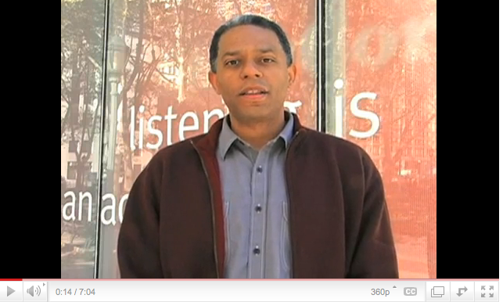
Introduction to Recording and Interviewing
Story Corps Do-It-Yourself Video

