Slide 1


PRIDE
Photocell Radiometry and Iron Deposit Experimentation
Chris Bodine
Elaine Chung
Charles Coello
Benjamin Shih

Slide 2
Problem Statement
What terrain types on Terrablair have viable iron ore deposits for use in Terrablair colonies?

Slide 3
Objectives
To determine which locations on Terrablair contain iron ore deposits
To determine the reflectance of Terrablair’s surface and ground truth orbiter reflectance data
To determine the type of terrain the iron will be found on

Slide 4
Questions
How can magnetic fields be used to detect iron deposits?
How accurate is the X-9000 radiometry data and how can it be ground truthed?
What is considered a viable iron ore deposit?
What types of values will be returned by the handyboard?
How will the handyboard values be converted to CBL values?

Slide 5
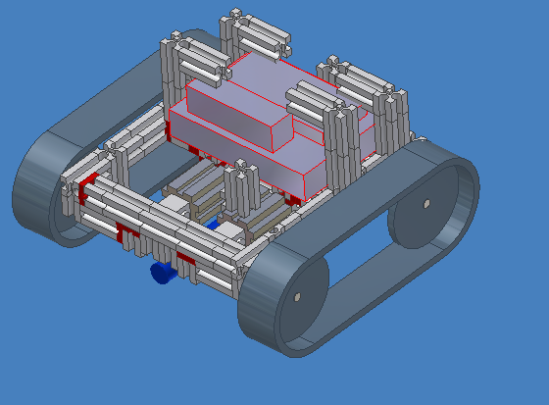
Diagram of Rover

Slide 6
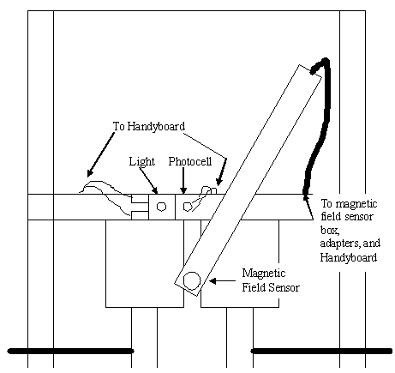
Diagram of Sensor Array
Needs to be in inventor

Slide 7
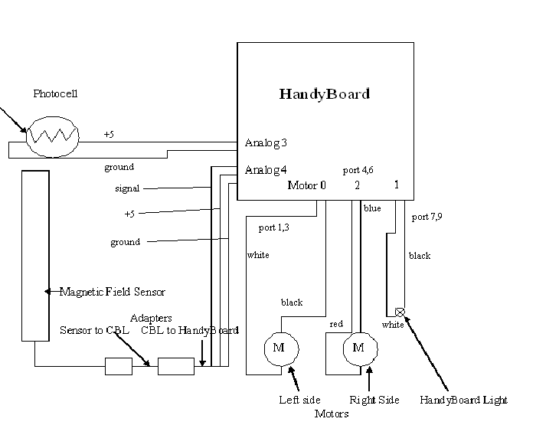
Diagram of Schematics
4
6
3

Slide 8
Sensor Capabilities
Magnetic Field Sensor
  Measures strength of magnetic fields
  Accurate to one hundredth of a Tesla
Photocell
  Measures reflected light
  Accurate to one hundredth w/cm²

Slide 9
Data Analysis Techniques
Find irregularities in magnetic field measurements to determine where iron is located
Plot such areas on a map using image processing software
Analyze radiometry
Determine radiometry correlation to terrain

Slide 10
Experimental Control
Bring experimental control to Terrablair
  Iron
    Actual value of magnetic field
    Range to determine if iron exists
  White paper
    [this isn’t in the program --Chris]Initial radiometry value
Control discarded after initial measurements

Slide 11
Experimental Control
Ground truthing
  Iron
    Initial range of viable magnetic field
  Radiometry
    Shades of gray
    Isolated box
    Controlled light

Slide 12
Expected Results
Iron ore
  Search for irregularities in measurements
    Iron located where irregularities exist
  [may want to change, does anybody have a better idea?--Chris] Iron will be found were it has been placed by Nature*
  Qualitative statement as to viability of iron deposits
* a.k.a Clarels Coello

Slide 13
Expected Results
Radiometry
  Ground truthing data similar to orbiter data
    Possible error - certain areas received more incidental light during orbiter data collection
  More even distribution of light
  More accurate radiometry values

Slide 14
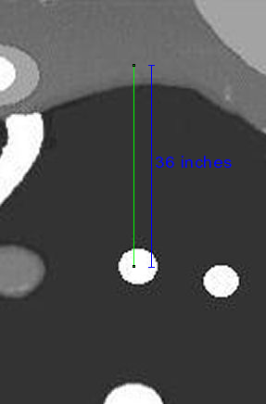
Rover Path
start
finish

