Slide 1
NAIL-IT
By Christopher Hsing
Benjamin Shih
Louis Teng
Nick Vujcic

Slide 2

Commercial

Slide 3
Injury Statistics
In 2005 – 2120 hammer related injuries at work reported
  3.8% wrists
  17.0% hands
  46.2% fingers
Source: Bureau of Labor Statistics

Slide 4
Project Description
Purpose
  Hammer Safety
  Lightweight and Portable
  Ease of Use

Slide 5
Marketability
Of the polled population:
  43.9% problems striking nail
  32.6% injure themselves
  42.4% expressed interest

Slide 6
Materials and Costs
Item | Approximate | Quantity/Dimensions
Spring | $0.15 | 3
Aluminum Dowel | $0.20 | 1
Plastic Wheels | $0.02 | 4
Steel Dowel | $0.25 | 1
Plastic | $1.00 | 7.825x.75x.125, 2.25x1x.125, .125x1.75x1.75
Copper Dowel | $0.25 | 1
Wood | $5.00 | 10x.5x2.5, 10x3x1
Nail/Screw/Washers | $0.15
Hot Glue | Negligible
Prototype Cost | $7.38 | All materials are provided by the R/E Lab
Actual Cost | $9.38 | Metal instead of wood to make the device last longer
We plan to sell the device for $12.00 |  | Actual Vendor: Home Depot

Slide 7
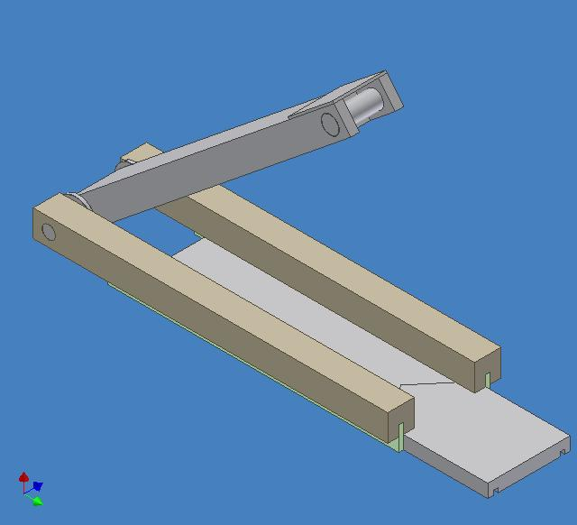
Diagram

Slide 8
Demonstration

Slide 9
Testing
Nail-It vs. Regular Hammer
  Accuracy of Strikes
  Angle of Nail

Slide 10
Data/Results
Accuracy of Driving in Finishing Nails with the Nail-It
Nail Size | Number of Accurate Strikes (out of 5) | Percentage
2D | 5 | 100%
4D | 5 | 100%
6D | 4 | 80%
8D | 4 | 80%
Average | 4.5 | 90%
Angle of Finishing Nails Parallel to Direction of Strikes Using Nail-It
Nail Size | Angle After 5 Strikes
2D | 90°
4D | 89°
6D | 89°
8D | 86°
Average | 88.5°

Slide 11
Data/Results Cont.
Accuracy of Driving in Finishing Nails with a Hammer
Nail Size | Number of Accurate Strikes (out of 5) |  |  |  | Percentage
2D | 5 | 3 | 5 | 5 | 90%
4D | 5 | 4 | 5 | 5 | 95%
6D | 5 | 3 | 5 | 5 | 90%
8D | 5 | 5 | 5 | 5 | 100%
Average | 5 | 3.75 | 5 | 5 | 93.75%
Angle of Finishing Nails Parallel to Direction of Strikes Using Hammer
Nail Size | Angle After 5 Strikes
2D | 87° | 80° | 88° | 87°
4D | 89° | 83° | 88° | 86°
6D | 87° | 83° | 86° | 89°
8D | 88° | 85° | 87° | 84°
Average | 87.75° | 82.75° | 87.25° | 86.50°

Slide 12
Discussion of Problems
Building
Hammer
Size
Portability
Accuracy and Driving Nail

Slide 13
Recommendations for Future
Heavier/Denser “Hammerhead”
Convenience of Device
Quality of Material

Slide 14
Credits
Many Thanks To:
Our parents
  For driving us around Rockville
Mr. Templin
  For approving our design
Mr. Kaluta
  For helping us resize our device
Dr. Witte
  For her continuous support and advice

Slide 15
Questions

