Slide 1
RUL prediction

Slide 2
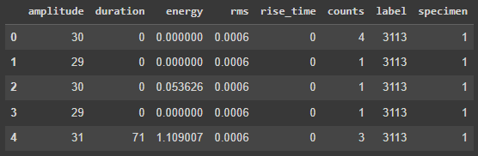


Data description and preprocessing
This dataset has 8 columns. Description of each column is as follows:
Column 1-6: 6 features extracted from sensor measurements
Column 7: Corresponds to cycle number.
Column 8: Corresponds to specimen number
How many specimens are there?
Number of unique values in column 8 gives us the total number of specimen that are under study in this dataset
After how many cycles does each specimen fail?

Slide 3
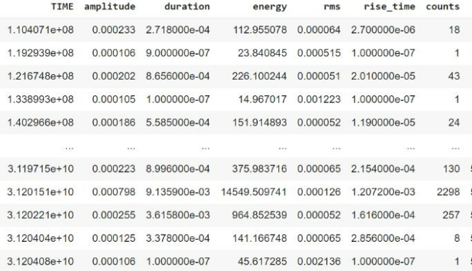
Target definition: RUL
RUL
cycle
1
N
2
N-1
3
N-3
N-1
2
N
1
1 cycle every 1 second

Slide 4
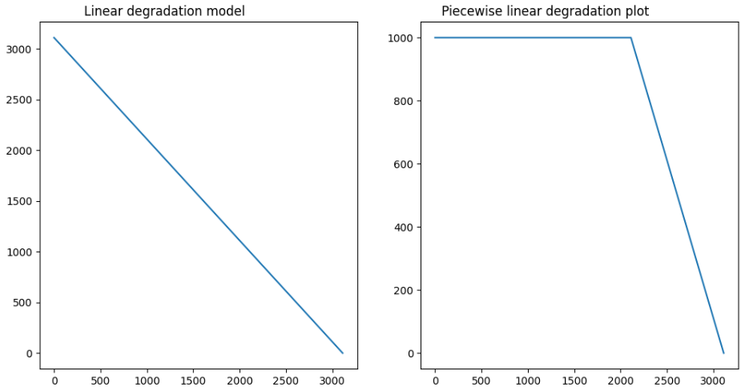
Training data
training data contains run to failure data of all specimens:
Specimen 1 fails after 3113 cycles. So, at the first cycle of specimen 1, its RUL is 3112. After cycle 2, its RUL is 3111 and so on. As it fails after 3113 cycles, at 3113rd cycle, its RUL is 0. This type of degradation model is called linear degradation model. From the start of the cycle, it decreases gradually to 0 at the last cycle.
Apart from linear degradation model, there is another degradation model called piecewise linear degradation model that is also widely used. In this model, at the beginning (for a number of cycles), RUL is assigned to a fixed number. The fixed number is called early RUL. When RUL value reaches early RUL, from there on RUL follows a linear degradation model
To illustrate both degradation model, we will plot RUL values for engine 1 using both models. RUL of specimen 1 is 3113. For piecewise linear degradation model, we take early RUL to be 1000 (It's just a choice. There is no definite rule for selecting this value).

Slide 5
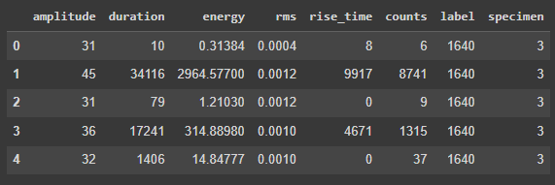


Testing data
Test data are similar to train data with only one difference. While for training data, data are available until failure for each specimen, for test data, it is available for an arbitrary number of cycles. Using the given test data, our goal is to predict RUL. For test data, true RUL values are also available so that we can compare the performance of our prediction algorithm.
How many specimens are there in test set?
True RUL for each specimen in test dataset

Slide 6
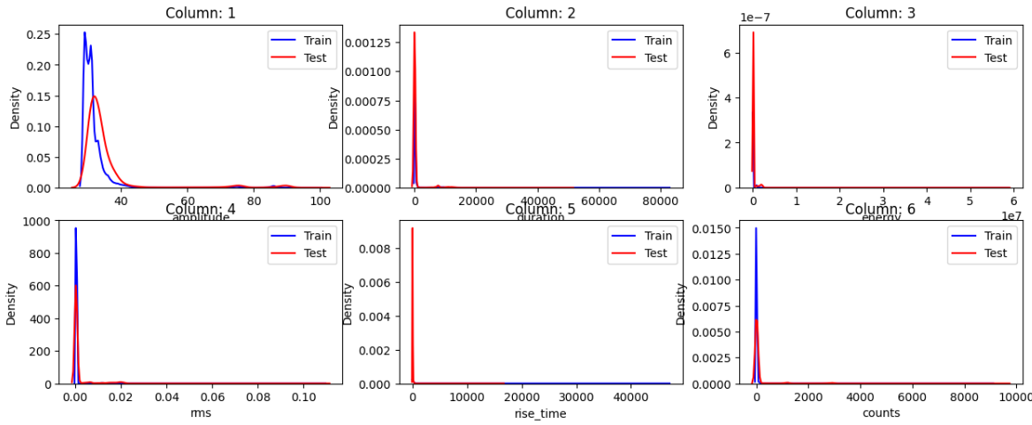
Preparing data for training algorithm
We will only use columns 1-6 values to train our algorithm as those are sensor measurements
An algorithm generalizes well (i.e., its performance on unseen data is good) if unseen data is similar in distribution to training data. Unseen data need not be exactly of same distribution as of training data, but it should not be very different from training data.
Here, we will just check the distribution of training and test data. It should be noted that test data should never be used while training an algorithm. Training an algorithm is an iterative process. With more parameters, it is very likely that training error reduces nearly zero. But its performance on new unseen data is not that good. In that case, we say that the model has overfit the training data (or memorized the training examples). Therefore, while training we have to devise some way to check whether the model is learning something or just memorizing the training data.
Here, we will only show the density plot of training as well as test data:

Slide 7
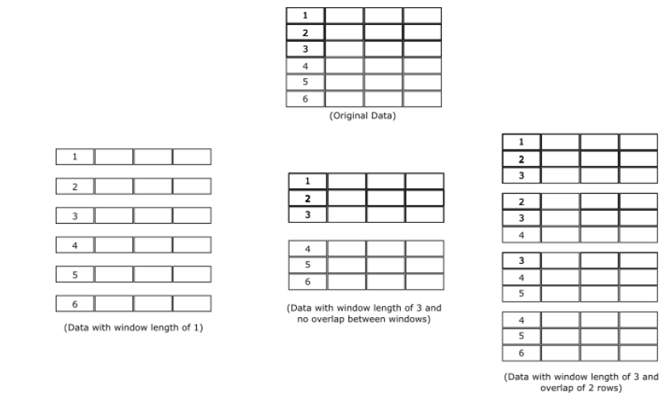
Preparing data for training algorithm
While preparing data for a training algorithm, we must consider several factors:
Should data be scaled? If data are scaled, should a single scaling be applied to all specimens or individual scaling be applied for every specimen?
Should linear degradation model or piecewise linear degradation model for RUL be used? If piecewise linear degradation model is used, what is the value of early RUL?
We choose to apply scaling individually to every specimen.
For some applications, we consider each row of the data matrix as a data point and our training model is trained accordingly. But for some other applications, we use a window of data. There may be overlap between windows.

Slide 8
example
f1 | f2 | f3 | f4
Window =3
Overlap =2
Model:
Train and then predict

Slide 9
Test data preprocessing
For each specimen in the test set, we need to predict one RUL value. To predict one RUL value, we need one example of test data for each specimen. So, the obvious choice is to use the last example of test data for each specimen. If an example consists of a window of data, for a given window length, we will take the last window of data that can be extracted from test set for a particular specimen.
The above approach, though technically correct, is prone to mistakes. What happens if the measurements of last example have some outliers? In that case our prediction would be way off. One approach to circumvent this issue is to take, say, last 5 examples instead of only the last example for each engine. Then we will get 5 RUL prediction values. We can average those to come up with our final estimate of RUL. In this way our RUL estimate will be a little conservative but robust against outliers in the last test example
In our case, the test dataset contains only one specimen, but we used it to create 3 ‘Specimens’ with decreasing RUL for better visualization and result analysis.

Slide 10
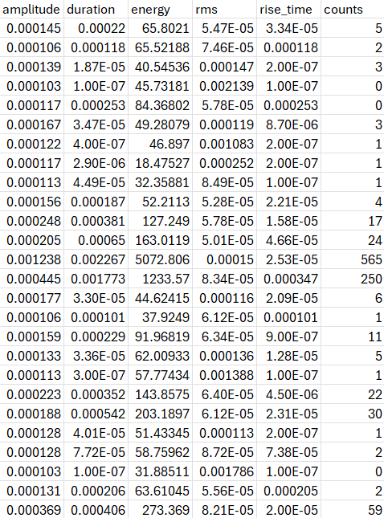
Our data
Data1 for prediction
Data2 for prediction
Data3 for prediction

Slide 11
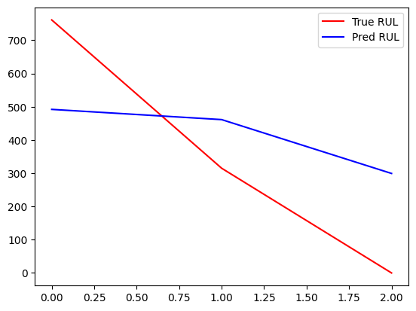
Results using 1D CNN
10 epocs
Rmse= 247

Slide 12
Next
Augment the data with the new specimens
Compare with different models
Real time implementation

Slide 13
Prediction Protocol

Slide 14
Monotonic data
Dog-bone: 5 tests (A2, A3, A5, A6, A7)
Cruciform: 4 tests (B1, B2, B3, B7)
Univariate: Force no need for normalization
1 AE feature predict outlier/peak (failure)
Multivariate: All AE features
All AE features + Force (target)
Combine the 2 datasets for potential results improvement if the 2 specimen have similar reactions/phases

Slide 15
Fatigue data
Dog-bone: 2 tests (A10, A11)
Cruciform: 5 tests (B8, B9, B10, B11, B12)
Univariate: _Number of hits collected each cycle
_the average of the amplitude divided by the duration of
a signal for all the hits collected for each cycle
Multivariate: All AE features
Combine the 2 datasets for potential results improvement if the 2 specimen have similar reactions/phases

Slide 16
models to deploy
RNNs : LSTM
GRU
CNNs: 1DCNN
TCNN

Slide 17
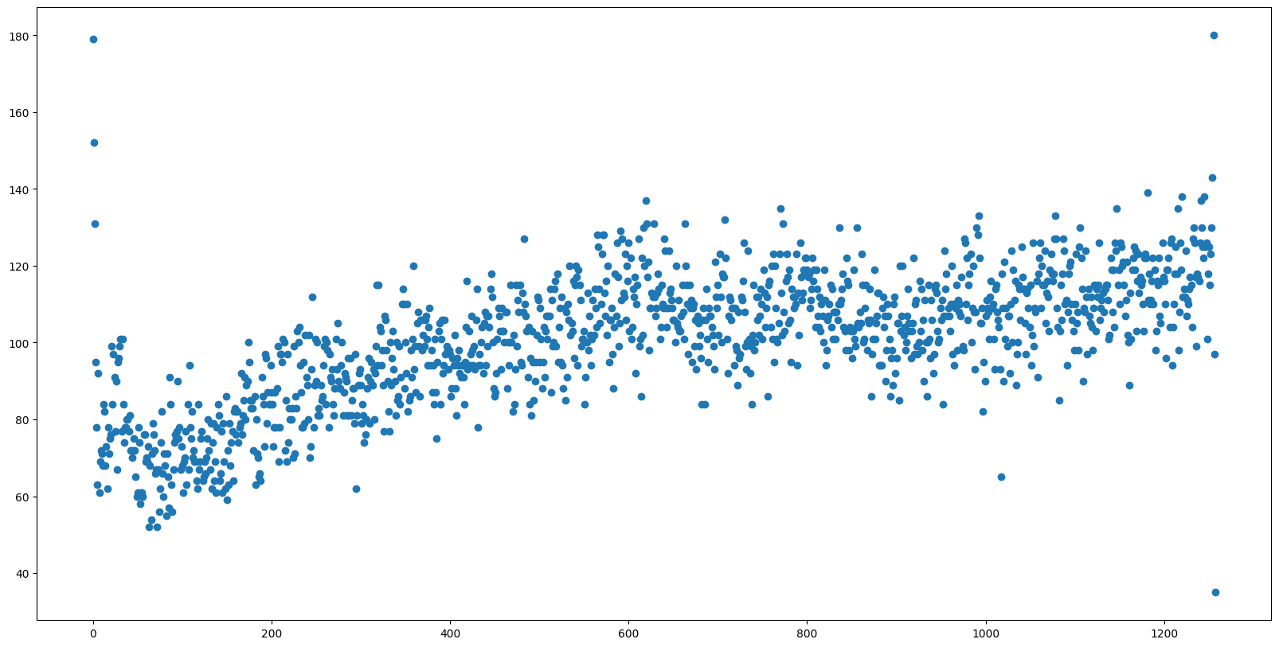
Univariate: Number of hits collected each cycle data presentation

Slide 18
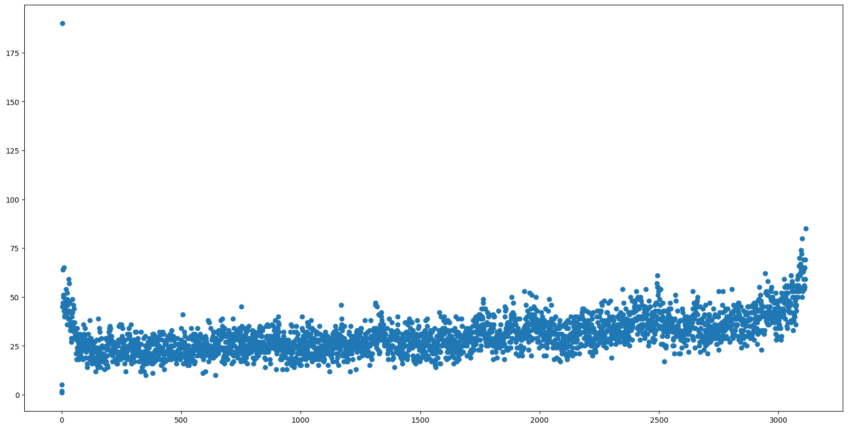

Slide 19
