Slide 1
DeapLearning appoach for acoustic signals classification
date
Ahmed Ben Sidhom
Electrical and Computer Engineering PhD candidate
Advisor: Dr. Antonios Kontsos
Director, Digital Engineering Hub (DEHub)​
Henry M. Rowan Foundation Professor ​
Dept. of Mechanical Engineering​
Dept. of Electrical Engineering (courtesy)​
Materials Science & Engineering (affiliated)​
Henry M. Rowan College of Engineering (HMRCOE)

Slide 2
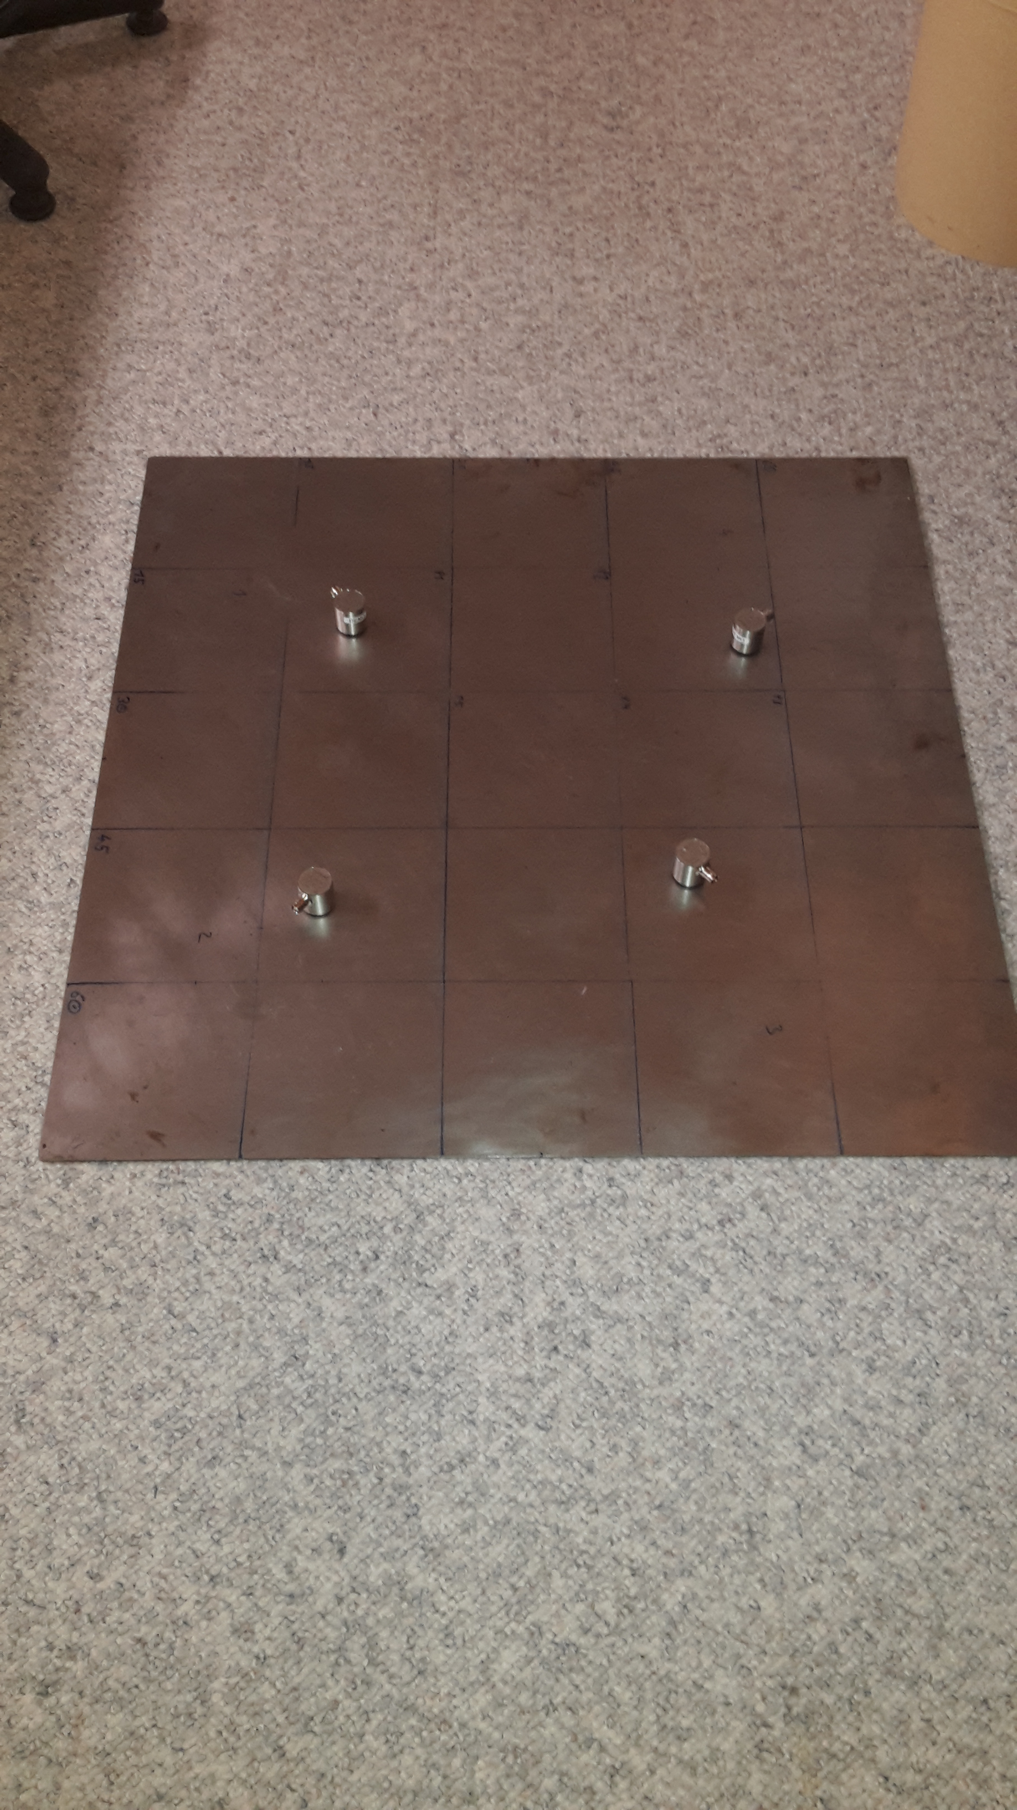
I. Problem Formulation
Setup:
- Steel plate (750 x 750 x 4) mm
- 4 sensors of type VS150-RIC (34 dB gain)
- Acquisition settings:
- Digital filter: bypass -> 85-2400 kHz (analog filter)
- Threshold: 40 dBAE
- Sample rate: 5 MHz
- Pretrigger samples: 2048
- Post-duration samples: 1024

Slide 3
II. Data Discovery data collection
Four different sources (source mechanisms):
1. Sherbet powder (cavitation): Sherbet powder was applied to the substrate surface (in small piles) and sprinkled with water until a visible reaction took place (bubble formation).
2. Fiber friction (soft on hard): The part with the barbs was used from a commercially available hook and loop fastener and the barbs were brought into contact with the substrate. The hook and loop fastener was then moved in circles over the substrate using variable pressure applied with fingers.
3. Sand (impacts): Sand with a maximum grain size of 1 mm was dropped onto the substrate surface from a height of approx. 20 cm.
4. Sand friction (hard on hard): A small metal plate was passed over the substrate surface. Grains of sand were placed between the metal plate and the substrate.
The data set if balanced with ~6900 records for each source.

Slide 4
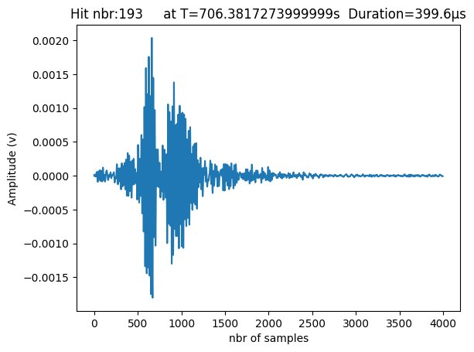
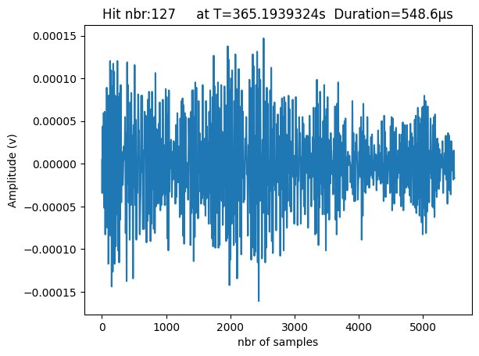
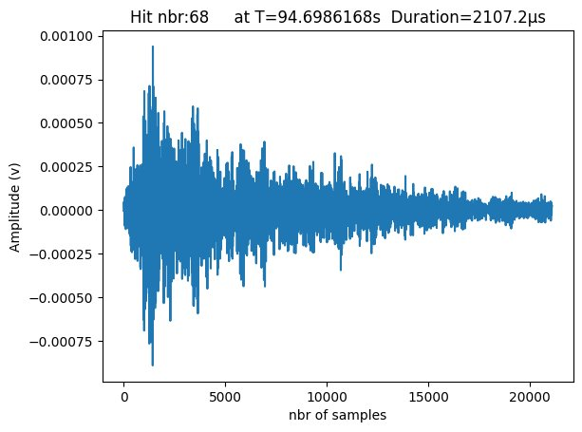
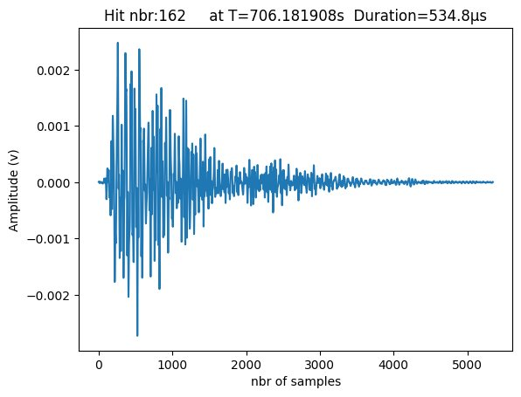
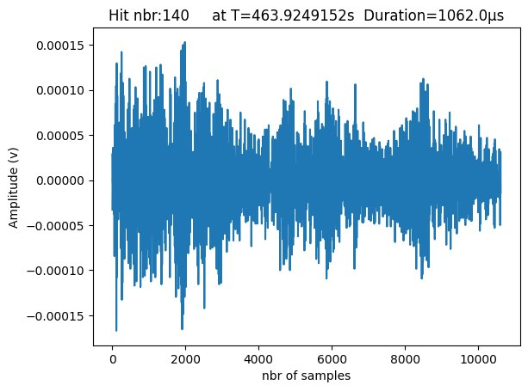
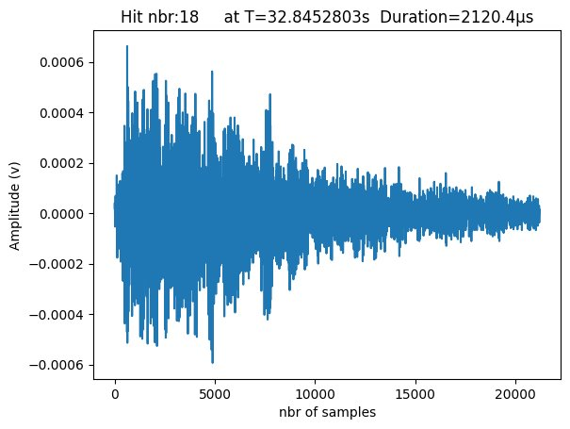
II. Data Discovery Visiualization
Different number of samples

Slide 5
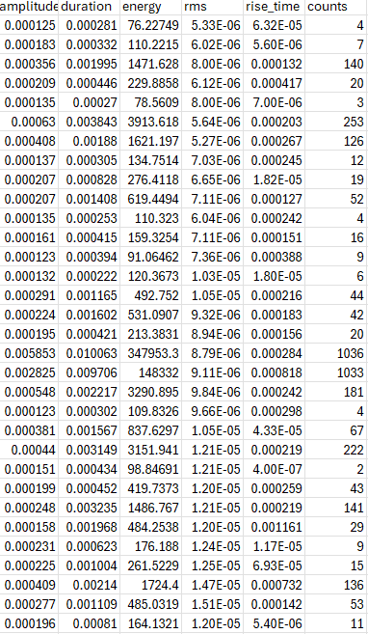
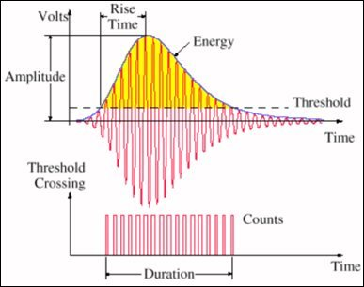
II. Data Discovery feature extracrion

Slide 6
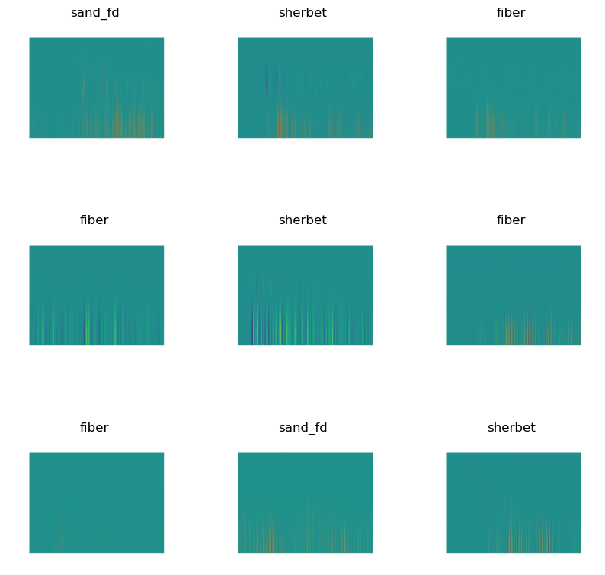
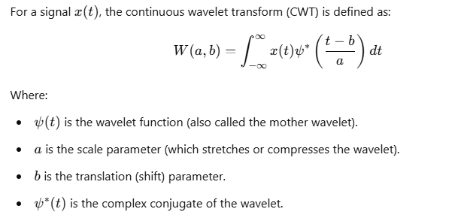
II. Data Discovery feature extracrion
Continuous Wavelet transformation:
Scaling: Wavelets can be stretched or compressed, changing their scale. A large scale corresponds to low frequency, capturing slower changes in the signal, while a small scale corresponds to high frequency, capturing quick changes.
Shifting: The wavelet is moved or shifted across the signal to analyze different parts. This shift allows you to study the signal both locally in time and at different resolutions

Slide 7
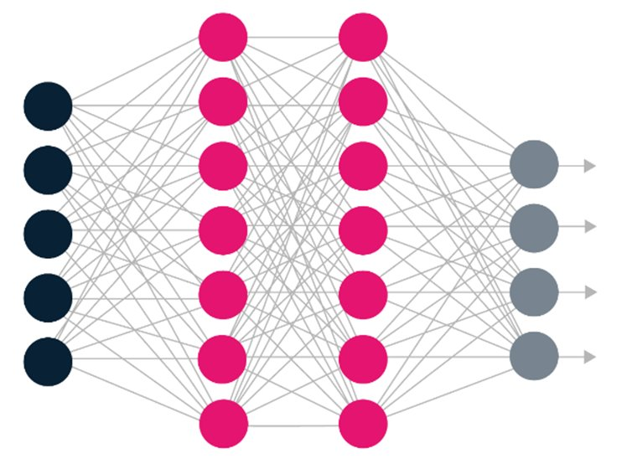

III. Approach tabulated data classification
Input
Model
Output
Amplitude
Duration
Sand
Energy
Sand friction
RMS
Sherbet
Rise Time
Counts
fiber

Slide 8
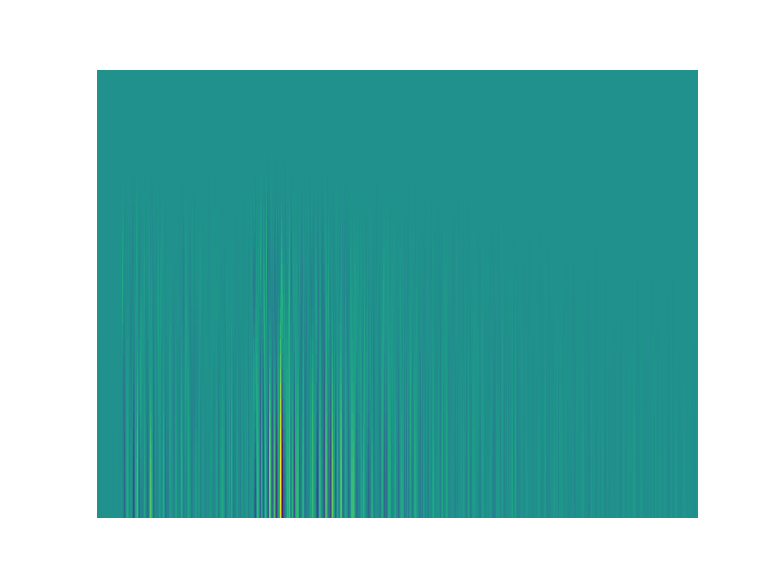
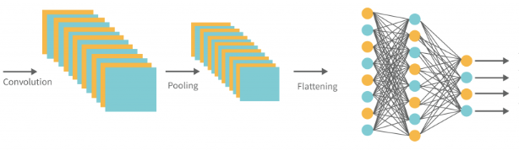
III. Approach image classification
Input
Model
Output
Sand
Sand friction
Sherbet
fiber

Slide 9
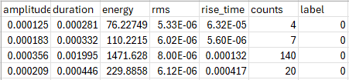
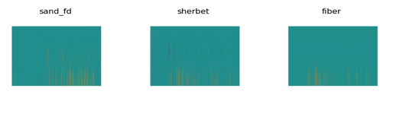
IV. Data preprocessing Data labeling and splitting
80% training
20% validation

Slide 10
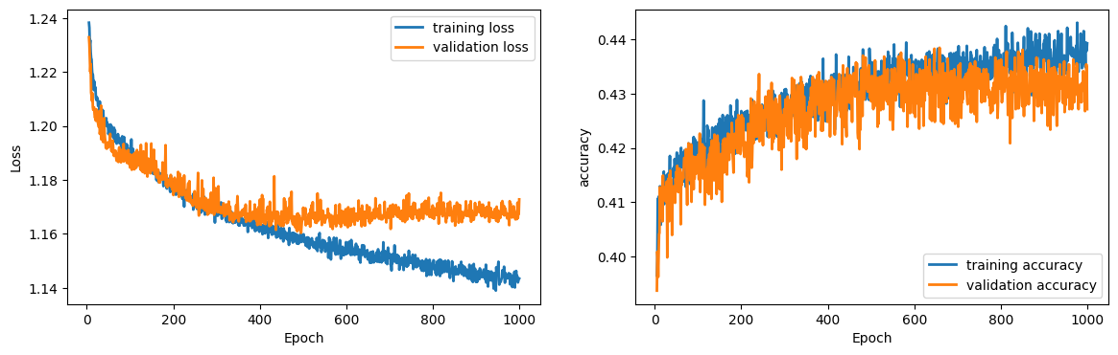
V. Traoining process tabulated: Hyperparameters finetuning and model evaluation

Slide 11
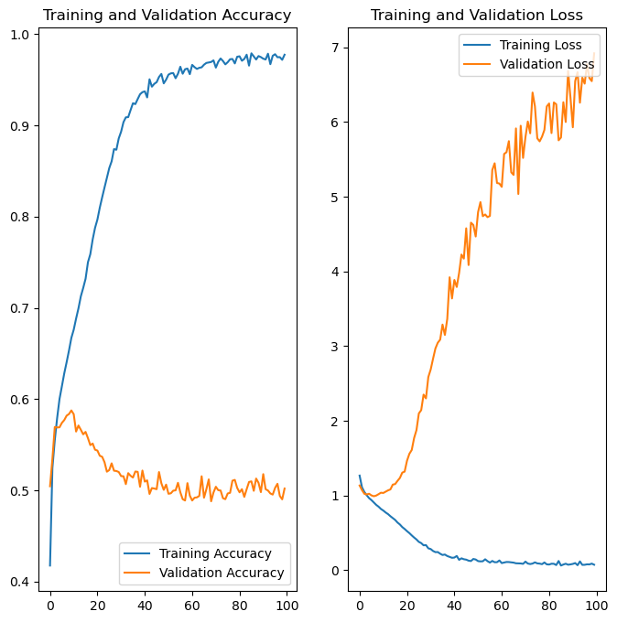
V. Training process images: Hyperparameters finetuning and model evaluation

Slide 12
V. Training process images: Hyperparameters finetuning and model evaluation
Transfer learning

Slide 13
V. Training process images: Hyperparameters finetuning and model evaluation
Finetuning pretraining model

Slide 14
VI. results tabulated:
Confusion matrix

Slide 15
VI. results tabulated:
deplyment
.keras
.onnx
linwave

Slide 16
V. Results images:
Confusion matrix

Slide 17
Thank you for your attention!
Questions?
kontsos@rowan.edu
bensid28@students.rowan.edu

