Slide 1
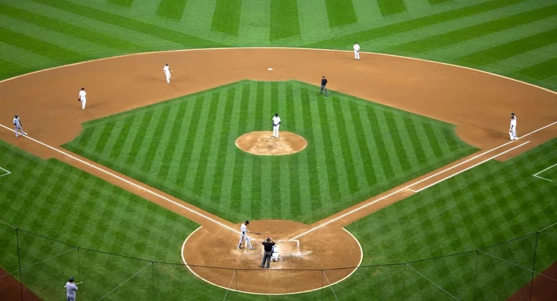
Baseball player selection in fantasy baseball leagues
Ben Lacar
Github: benslack19

Slide 2
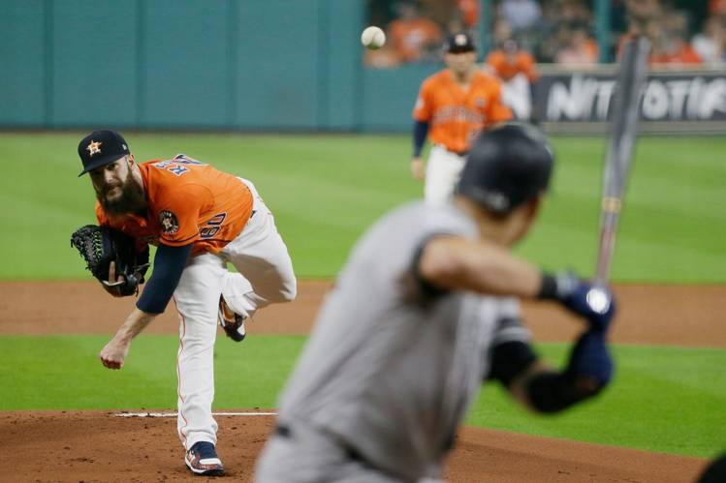
A baseball player’s contribution to winning depends heavily on the batter-pitcher matchup

Slide 3
Fantasy baseball represents a projected market of $8.6 billion for 2020
Fantasy baseball has over 11 million participants.
A participant's success depends in part on daily player selection.
Participants must rely on their own research or use a site's recommendation, which uses black-box algorithms behind pay walls.
I'm developing an alternative algorithm to assist in player selection to save participants time and expose the important features in player performance prediction.
Roster of 20 players
Select 9 to start
Notes:
The winners of leagues collecting entry fees and host platforms receiving a commission.

Slide 4
Participants often make choices among players of lesser skill
Star players would be inserted into a roster nearly all the time
What about deciding between average players?
Mike Trout stats – HR, etc.
Performance between Mike Trout

Slide 5
Features that can affect performance metrics of the batter on a given day
Batter’s historical performance
Metric itself (e.g. proportion of at-bats getting on base or proportion of at-bats hitting a home run)
Batted ball characteristics (how hard were batted balls, regardless of whether it resulted in a hit)
This can be segmented by metrics against all pitchers, left-handed pitchers, and right-handed pitchers
Pitcher’s historical performance
Metric itself (e.g. proportion of time getting on base)
Batted ball characteristics (how hard were batted balls, regardless of whether it resulted in a hit)
This can be segmented by metrics against all batters, left-handed batters, and right-handed batters
Historical performance of the batter-pitcher matchup for that metric (a subset of above)
Characteristics of the day/game
Whether game was played home or away
Whether game was played in the day or night
Other
Whether defense may utilize shifts
Look at pitch and batted ball characteristics that correlate with a hit
correlations
Show example visualizations

Slide 6
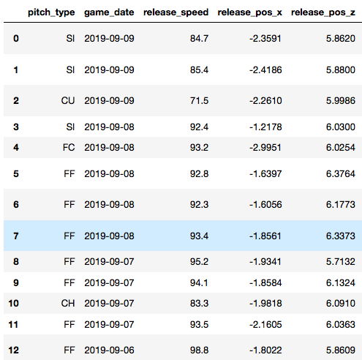
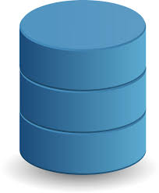
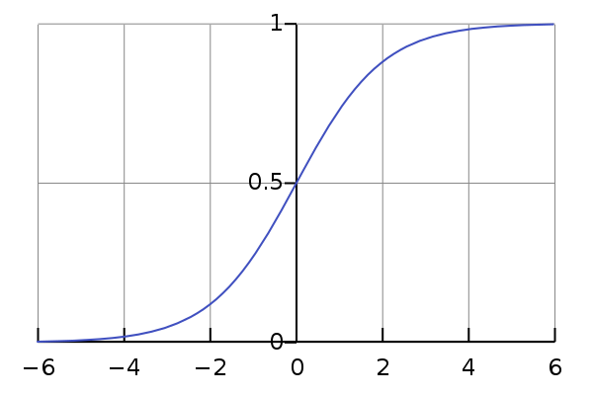
Methods
pybaseball API
2,174,906 pitch-by-pitch entries
(2017-2019 seasons)
SQL query for the two players being considered and given date
(e.g. May 9, 2019)
Stats MLB API
game conditions
Construct features of batter and pitcher performance, game conditions for each player
Verification
“Select Player B for May 9, 2019”
Statistics of Player A
Statistics of Player B
Build a model for each player and provide recommendation based on probability score of performing (getting on base)
Compare prediction with actual performance on given date

Slide 7

Webapp: Insight Baseball
Inputs:
Roster of your players
Day of the week / starting opposing pitcher
Selection of traditional vs. advanced stats for categories
Output:
Suggestions for waiver wire
Starting lineup with probability of them doing better than alternative

Slide 8
Model aims to predict player performance for a given day
Attempt | Data matrix segmentation | Time window of feature | Row granularity | Target | Model | Overall result
1 | Single matrix: All batter-pitcher matchups | 1 season (2018) | at-bat event | 0 or 1 of a hit, date agnostic (2019 season) | Log. regression | No pos. class prediction with threshold at 0.5; Will look at probabilities of positive class and set lower threshold
2 | Multiple matrices: Each batter with their own pitcher matchups | 1 season (2018) | at-bat event | 0 or 1 of a hit, date agnostic (2019 season) | Log. regression | No pos. class prediction with threshold at 0.5; Will look at probabilities of positive class and set lower threshold
3 | Multiple matrices: Each batter with their own pitcher matchups | Players historical at-bats against pitcher or similar pitchers since 2017 | game |  | TBD

Slide 9
Ben Lacar, PhD.
UCLA B.S. in Biochemistry
Yale University Ph.D. in Neuroscience
Salk Institute for Biological Studies
Fluidigm Corporation – PAS and Bioinformatics Scientist

Slide 10
Project checkpoints
Deliverable | Status | Deadline
Get statcast data from last 3 years | Done | 1/17 8 am
Determine fantasy baseball format | H2H, season long with waiver wire | 1/18 6 pm
Evaluate inputs/outputs | Start with roster of 12 people and date Find the position | 1/19 7 am
Make first web app | Done with Insight template | 1/23
Model trial and iteration | On-going!
Add other features (weather etc)

Slide 11
Output ideas 1/26/20
A vs. B
Input: for each, event rate in last 100 ab
Output: for each, predict 0 or 1 and probability of 1
Is this assumption valid?
yes it’s valid - Machado vs. Frankel test
Combine DFs of A and B
Just use A and B (with feature encoding) for the input with inputs
Is coefficient of player predictive? – might be too simple

Slide 12
Notes

Slide 13
Project score refinement
1/18/20
Read about fantasy baseball
Try to identify a truly novel idea
Fantasy baseball based on advanced stats? Or give the option of traditional or advanced
Incorporate statcast data so you can use SQL
Use player similarity with a linear mixture model
Other
Lineup constructor, bin by position
stars vs bench base on WAR , see Padres for separation by WAR
Randomly choose
Backup
What I proposed previously
Later today - get started on writing more code, define input and output

Slide 14
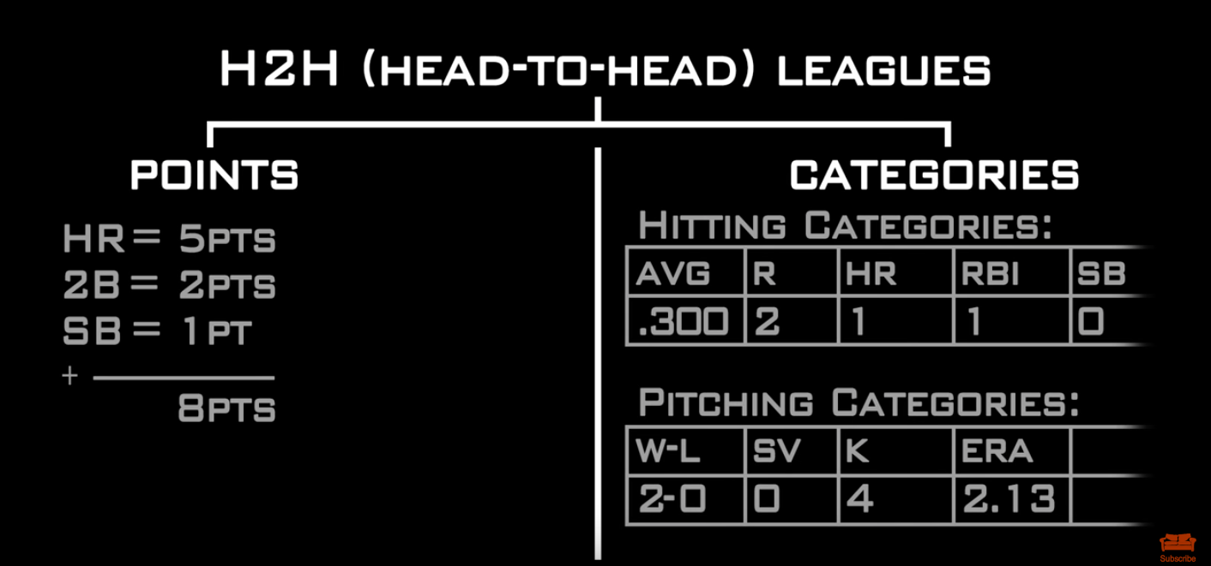
Learning about fantasy baseball - focuses on head-to-head format (1 win a week) (youtube)
1/18/20
https://www.youtube.com/watch?v=lUzcLnB6F18
Head-to-head leagues (don’t do rotisserie)
Points league: each different statistic has a point total attached to it
Add up points for the week
A gets 100 points, B gets 99 points
Thus far, A is 1-0 for the season; B is 0-1 for the season
Categories league:
Just based on how many categories you win, but it can be scored differently;
In week 1 if A wins 7 out of 10 categories; A is 7-3 for the season, B is 3-7
other ways of scoring is to just call it 1-0

Slide 15
Fantasy baseball - draft for the season
1/18/20
Preparing for draft
Category league - draft for overall well-rounded team
Hitting: want people for average, power (HR, RBI), speed (SB)
Pitching: closers, relief pitchers (lower ERA)
Points league
What are points settings?
If 5 points for HR, then draft a lot of power guys, but drawback in some leagues is that strikeouts can be negative points
Mock draft can be a way to prepare

Slide 16
Fantasy baseball - being competitive for season
1/18/20
Throughout season players can be inconsistent, get injured, suspended, possibly rainouts, or obviously the opposing team IRL (substitute a pitcher facing a monster lineup)
You have to set someone to start and someone to bench
Different ways to improve team - best way is waiver wire How often does this happen?
All players who weren’t drafted originally. An owner can pick people up but it depends on league format.
Usually an order of players to take, which is based on the inverse rank of the previous week
Another way is a bid auction; bid up on the players for waivers. Order doesn’t matter, just whoever is willing to bid the most (more in-depth but getting more popular)
Trading with other owners in the league
Generally trade strength in one for weakness in another
Or try to buy low and sell high; for example, someone on a hot streak outperforming expectations; someone out there might be the reverse
Generally want to find guys who are more consistent for the long haul
Trades could be hard cause you need to find someone who needs someone you can offer; sometimes a participant might have a player who just got injured
Check lineups every morning; but you can also check later in the day for injury updates, suspensions, etc. Rain outs are a big deal.
Should you trade?

Slide 17
Fantasy baseball - conclusion of league
1/18/20
It could have been a free league or an entry fee ($25 to thousands) - winner of league gets the lions share
League can also decide to have some people get some money

Slide 18
Fantasy 101: Intro to fantasy baseball (ESPN article)
1/18/20
https://www.espn.com/fantasy/baseball/flb/story?page=mlbdk2k12_fantasy101
Options for getting players - draft or auction format
10-12 teams is a good number for a league
Too few owners and you'll have nothing but superstars on each roster, while too many owners means you may end up needing to draft backup infielders and long relievers just to fill out a starting lineup.
Categories vs. points system

Slide 19
Daily fantasy baseball
1/18/20
https://en.wikipedia.org/wiki/Daily_fantasy_sports
Daily fantasy sports (DFS) are a subset of fantasy sport games. As with traditional fantasy sports games, players compete against others by building a team of professional athletes from a particular league or competition while remaining under a salary cap, and earn points based on the actual statistical performance of the players in real-world competitions. Daily fantasy sports are an accelerated variant of traditional fantasy sports that are conducted over short-term periods, such as a week or single day of competition, as opposed to those that are played across an entire season. Daily fantasy sports are typically structured in the form of paid competitions typically referred to as a "contest"; winners receive a share of a pre-determined pot funded by their entry fees. A portion of entry fee payments go to the provider as rake revenue

Slide 20
Daily fantasy baseball (It could be too much for me to tackle)
1/18/20
https://www.youtube.com/watch?v=7yn7TmolRSc
Have to think about money resources
Current suggestion is to pick a pitcher with a high strikeout rate against the team that gets struck out a lot
Pitching is more predictable than hitting, but less upside than hitters
Have to think about bullpens
https://www.dfsarmy.com/2017/04/top-10-ways-win-daily-fantasy-baseball.html

Slide 21
After research, decide to go with season format, H2H
1/18/20
From skill level, it will help me put more time into SQL queries and get to learning more ML

Slide 22
Other notes from Eric
1/18/20
when you set a roster, do you choose a subset of your team? -yes
Recent bias
Advanced stats
Or just do multiple categories
Points league. Strikeout on offensive side....
Could be a rate
Points based scoring... more categories
Advanced stats are getting more popular
Pitch by pitch....
Integrate audio, or text description from statcast data?
fantasy baseball based on advanced stats
Using advanced stats to construct your roster
what about a lineup constructor with order?

Slide 23
Other direction
1/18/20
Is pitcher unpredictability a real thing?
If not, then just use the good pitch
Does variability in pitching help them or not?
What is the best pitch to get a first strike?
Hitter-pitcher; called strike, swinging strike, zone
When does it matter to shift?
Which player to acquire or cut based on recent statcast data? Do some metrics predict a time to buy low or sell high?

Slide 24
Other direction - defensive shifts
1/18/20
Unique defenses
if_fielding_alignment | of_fielding_alignment
-----------------------+------------------------
Infield shift | Strategic
Standard | Standard
Strategic | Standard
|
Infield shift | 4th outfielder
Standard | Strategic
Infield shift | Standard
Strategic | Strategic
Standard | Extreme outfield shift
Strategic | 4th outfielder

Slide 25
Other direction
1/18/20
https://theathletic.com/1521278/2020/01/10/stark-realignment-robots-and-the-universal-dh-what-baseball-will-be-like-at-the-end-of-this-decade/
Use whiff and freeze rate - plate discipline
Predict HR based off launch angle, barrels, etc.
Be mindful of how sample size will decrease with train test split
Also hold out a validation set
# of at bats is limited

Slide 26
Main skills to demonstrate
1/20/20
From researching education jobs, make sure the project shows:
· Business sense
· SQL
· A/B testing
· Statistical analysis and modeling techniques
· Thoughtful, impactful visual and written communication
· Machine learning

Slide 27
Build a basic model of player selection
1/20/20
Given x set of features, can I predict what stats a RBP (real baseball player) will produce and therefore what “points” will be scored for the FBP (fantasy baseball participant).
Take all the stats from the previous 50 games

Slide 28
More notes from Eric
Here is my final roster from last year. It looks a little weird because we have a 4-week head-to-head playoff for draft order, so I dropped players/added players to re-shape the roster to maximize matchups in those final weeks. Plus, midway through the season, when I knew I wasn't going to be competitive, I traded some of my best guys (Verlander, Harper) for "keepers."
Our league is 10-team, 6x6 rotisserie (R, HR, RBI, SB, BA, OPS, W, QS, K, SV, ERA, WHIP). 29-man rosters (C, 1B, 2B, 3B, SS, CI, MI, OF, OF, OF, OF, U, 9 P, 8 Reserve). Since this is a keeper league, we have a large bench to stash minor leaguers/prospects. We keep 8 players each year with value based on draft position, and a 9th player who did not meet the major league minimum for PAs or IP (hence would still be considered a rookie the following season). Players can be kept a total of 3 times (so 4 years on the roster). No player drafted in the first 3 rounds can be kept.
How often do you fiddle with lineups? Like once a week?
As I mentioned, we have a H2H playoff in September. League split into 2 tiers based on roto standings: Bottom 5 teams play for top 5 draft picks, Top 5 teams play for picks 6-10. Roto points still accumulate during the playoffs. So, playoffs determine draft order for first 3 rounds, then round 4-29 are reverse-order of final roto rank. We do the playoff to try to avoid bottom teams totally tanking for top draft picks- if they tank too much, they risk losing in H2H playoff and still don't get a good draft pick.
You can fiddle with lineups DAILY.
Roster spot locks as soon as game with the player starts. So, if you have a SS that is out of the lineup in West Coast game, I can theoretically drop him at 9:50pm EST and pick up a different player who's game has not started yet.
Here is my roster from 2018. Now this is weird because there were those two 163rd game with LAD, COL, CUBS, and MIL to determine playoff seeding. So, you can see I stacked my roster with available players for that one day... and it is actually what won me the league (Roto- I still lost the H2H playoff in the first round)- Max Muncy hit a 3-R HR with Kike on base, so I ended up beating Rob Sears by 0.5 point because I took the lead in RBI and tied him in R (or something like that)! It literally came down to one play. Insane.

Slide 29
Approach iteration - use logistic regression to identify features associated with a home run for each plate appearance
1/21/20
I got some ideas from Zach
Initially I tried looking at home run output associated with features like launch angle, launch speed as a sanity check
This taught me about incorporating quadratics but I still have to carry this out
I’ll update by simply doing hit or no hit and then focusing on “conditions”
L/R handed pitcher
home/away
Pitcher average fastball velocity
Pitcher average fastball movement
Pitcher average fastball spin rate
Pitcher average curveball velocity
Pitcher average curveball movement
Pitcher average curveball spin rate

Slide 30
Audio detection
1/21/20
Home/away splits for Astros swinging/not swinging, broken down by pitch
ML on the audio track
https://www.baseballprospectus.com/news/article/55283/moonshot-the-astros-sign-stealing-left-a-fingerprint-in-the-audio-date/
Jomboy video
https://www.youtube.com/watch?v=M2XNW1qHN9w

Slide 31
Change approach from logistic to Bayesian framework
1/24/20
Logistic regression models don’t seem to be working
Focus more on a Bayesian approach - like Padres question?
Take the last 100 dates
https://community.fangraphs.com/the-outcome-machine-predicting-at-bats-before-they-happen/

Slide 32
Get pitcher features 1/27/20
Percent of events (on-base)
Historical matchup

Slide 33
Other 1/27/20
Get as many samples as possible
Output the size of the df4model with a warning if less than 200
Alise:
Perhaps you may want to start by writing out such problem statements where predictive analytics can be a solution. An example would be, “Based on your selection of Player X for daily baseball fantasy league, you are X% likely to win”.
Add histogram to show here players are
Add home/away
Day/night
Edit so that the statcast events aren’t getting the day-of data

