Slide 1
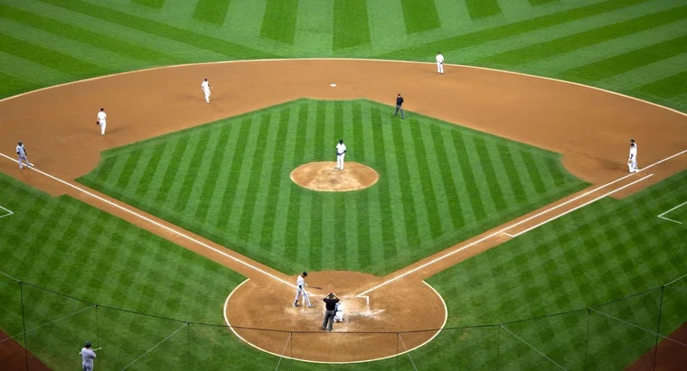
Baseball player selection in fantasy baseball leagues
Ben Lacar
Github: benslack19

Slide 2
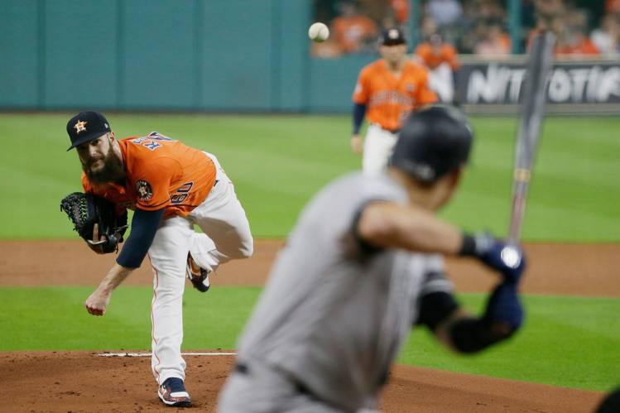
Introduction to baseball
Hitter-pitcher matchup is largely independent from other players

Slide 3
Fantasy baseball represents a projected market of $8.6 billion for 2020
Fantasy baseball has over 11 million participants with the winners of leagues collecting entry fees and host platforms receiving a commission.
A participant's success depends in part on daily player selection.
For player selection, participants must rely on their own research or use a site's recommendation, which uses black-box algorithms behind pay walls.
I'm developing an alternative algorithm to assist in player selection to save participants time and expose the important features in player performance prediction.

Slide 4
Participants must set their roster for a limited set of positions
Star players would be inserted into a roster nearly all the time
What about deciding between average players?

Slide 5
Methods
Use the pybaseball API to obtain pitch-by-pitch data and fill a database (from the last 3 years there are 2,174,906 entries)
Perform SQL queries to limit data to time window and players of interest and export to pandas
Construct features representing player performance (batting average, home runs, on-base + slugging percentage, etc.) or other factors (weather, ballpark)
Build a logistic regression model to predict with a probability score of expected performance (at-bat or game level)
Validation: choose a random day from the 2019 season where different players are being considered and see if prediction matches who actually played better that day

Slide 6
Build a model to predict which players should be on your roster for a given day
Order of investigation in increasing level of data segmentation
What is the player’s overall performance in the previous 50 games? (Or perhaps a more recent time window is more predictive).
Overall performance against pitchers of the same handedness (left versus right)
How well a player did against the opposing pitcher who is likely to start? (If the sample size is limited, use player similarity scores to increase n.)

Slide 7

Webapp: Insight Baseball
Inputs:
Roster of your players
Day of the week / starting opposing pitcher
Selection of traditional vs. advanced stats for categories
Output:
Suggestions for waiver wire
Starting lineup with probability of them doing better than alternative

Slide 8
Model aims to predict player performance for a given day
Attempt | Data matrix segmentation | Time window of feature | Row granularity | Target | Model | Overall result
1 | Single matrix: All batter-pitcher matchups | 1 season (2018) | at-bat event | 0 or 1 of a hit, date agnostic (2019 season) | Log. regression | No pos. class prediction with threshold at 0.5; Will look at probabilities of positive class and set lower threshold
2 | Multiple matrices: Each batter with their own pitcher matchups | 1 season (2018) | at-bat event | 0 or 1 of a hit, date agnostic (2019 season) | Log. regression | No pos. class prediction with threshold at 0.5; Will look at probabilities of positive class and set lower threshold
3 | Multiple matrices: Each batter with their own pitcher matchups | Players historical at-bats against pitcher or similar pitchers since 2017 | game |  | TBD

Slide 9
About me
Neuroscience PhD from Yale University
Postdoctoral associate at the Salk Institute for Biological Studies
Bioinformatics Scientist at Fluidigm Corporation
Data scientist interested in transitioning to the tech industry

Slide 10
Project checkpoints
Deliverable | Status | Deadline
Get statcast data from last 3 years | Done | 1/17 8 am
Determine fantasy baseball format | H2H, season long with waiver wire | 1/18 6 pm
Evaluate inputs/outputs | Start with roster of 12 people and date Find the position | 1/19 7 am
Make first web app | Done with Insight template | 1/23
Model trial and iteration | On-going!
Add other features (weather etc)

Slide 11
Output ideas 1/26/20
A vs. B
Input: for each, event rate in last 100 ab
Output: for each, predict 0 or 1 and probability of 1
Is this assumption valid?
Combine DFs of A and B
Just use A and B (with feature encoding) for the input with inputs
Is coefficient of player predictive?

