Slide 1
Baseball player selection in fantasy baseball leagues
Ben Lacar
Github: benslack19

Slide 2
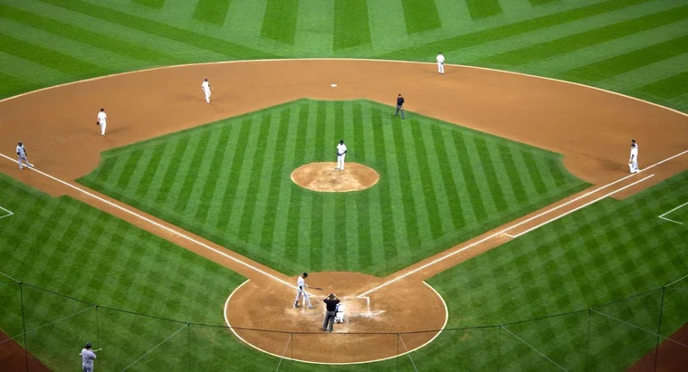
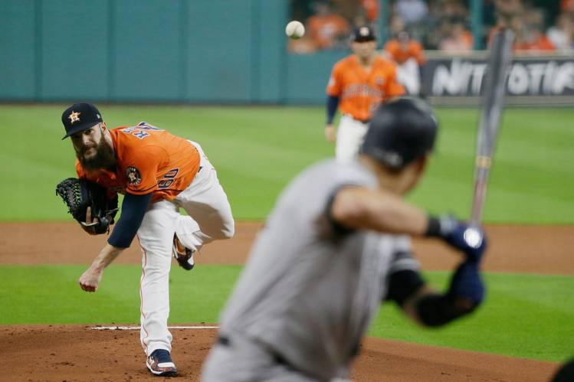
Introduction to baseball

Slide 3
Fantasy baseball represents a projected market of $8.6 billion for 2020
Fantasy baseball has over 11 million participants with the winners of leagues collecting entry fees and host platforms receiving a commission.
A participant's success depends in part on daily player selection.
For player selection, participants must rely on their own research or use a site's recommendation, which uses black-box algorithms behind pay walls.
I'm developing an alternative algorithm to assist in player selection to save participants time and expose the important features in player performance prediction.

Slide 4
Participants must set their roster for a limited set of positions
A roster can have 12-20 players but 9 must be chosen to start.
Star players would be inserted into a roster nearly all the time
What about deciding between average players?

Slide 5
Methods
Use the pybaseball API to obtain pitch-by-pitch data and fill a database (from the last 3 years there are 2,174,906 entries)
Perform SQL queries to limit data to time window and players of interest and export to pandas
Construct features representing player performance (batting average, home runs, on-base + slugging percentage, etc.) or other factors (weather, ballpark)
Build a logistic regression model to predict with a probability score which of the two players did better (try more sophisticated models)
Validation: choose a random day from the 2019 season where different players are being considered and see if prediction matches who actually played better that day

Slide 6
Build a model to predict which players should be on your roster for a given day
Order of investigation in increasing level of data segmentation
What is the player’s overall performance in the previous 50 games? (Or perhaps a more recent time window is more predictive).
Overall performance against pitchers of the same handedness (left versus right)
How well a player did against the opposing pitcher who is likely to start? (If the sample size is limited, use player similarity scores to increase n.)

Slide 7
Build a model to predict which players should be on your roster for a given day
Approaches attempted:
Single data matrix with all batter-pitcher matchups with rows showing each at-bat -> no positive class prediction
Each batter with own data matrix containing each pitcher they faced with rows showing each at-bat -> no positive class prediction

Slide 8
Build a model to predict which players should be on your roster for a given day
Model attempt | Data matrix segmentation | Time window of feature | Row granularity | Prediction model
1 | all batter-pitcher matchups | 1 season (2018) | at-bat | Log. regression
2 | Single batter with their own pitcher matchups | 1 season (2018) | at-bat | Log. regression
3 |  | 1 season (2018) | game
4 |  |  | game
5

Slide 9

Webapp: Insight Baseball
Inputs:
Roster of your players
Day of the week (starting opposing pitcher’s are known up to a week ahead of time)
Output:
Suggestions for waiver wire
Starting lineup with probability of them doing better than alternative

Slide 10
About me
Neuroscience PhD from Yale University
Postdoctoral associate at the Salk Institute for Biological Studies
Bioinformatics Scientist at Fluidigm Corporation
Data scientist interested in transitioning to the tech industry

Slide 11
Project checkpoints
Deliverable | Status | Next | Deadline
Get statcast data from last 3 years | Done | Potentially get longer history | 1/17 8 am
Determine fantasy baseball format | H2H, season long with waiver wire |  | 1/18 6 pm
Evaluate inputs/outputs | Start with roster of 12 people and date Find the position |  | 1/19 7 am
Make first web app | Successfully have insight |  | 1/20 9 pm
Add other features (weather etc)
Allow for other fantasy formats

