Slide 1
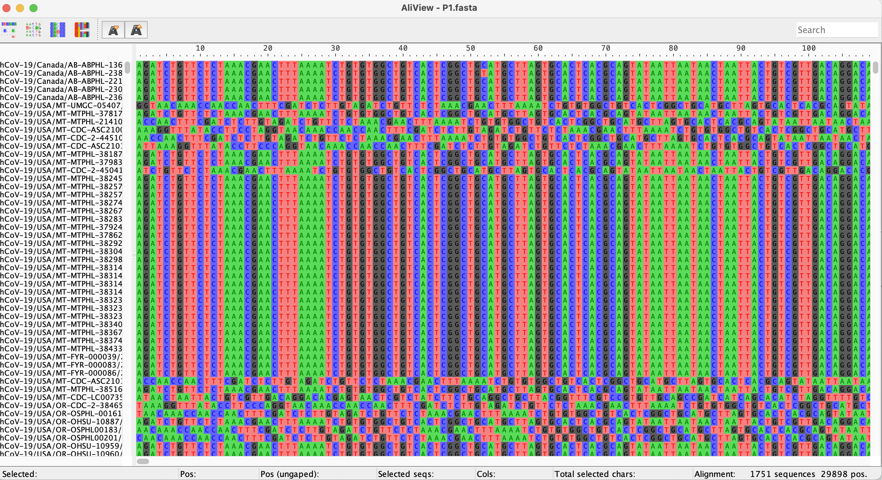
Site number
Sequence names
Nucleotides
Number of sequences and length of longest sequence

