Slide 1
Numerical Methods 5th Homework Report
Presenter: 陳昱憲
.

Slide 2
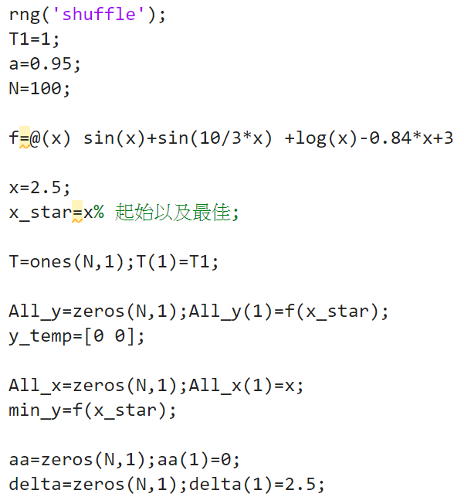
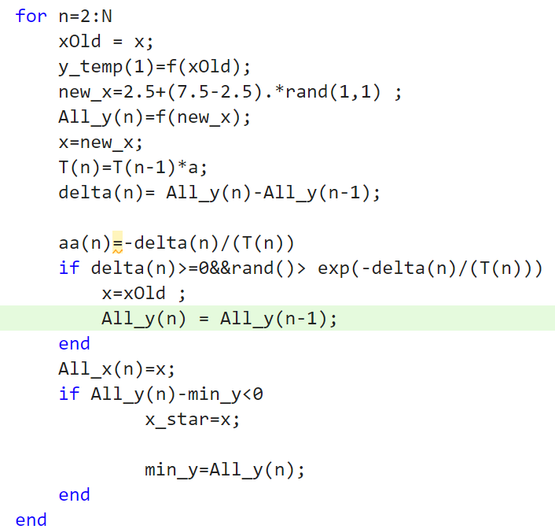
First Question’s Program
rng('shuffle') Initialize the random number generator based on the current time, it can make the “rand function” more random.
The T1 and a is the Parameters of simulated annealing ,and N is iteration times，It can be chosen arbitrarily, but may lead to worse or better results, details will be introduced later.
The All_x and All_y is Used to store the results of each iteration.
In each iteration, a randomly generated number x_new in the range [2.5 7.5] is compared with the previous result xOld, if f(x_new )<f(xOld ) it mean that we find the new number that small then previous one , then replace xOld by x_new and go to next iteration.
Else if f(x_new )<f(xOld ) , Generally speaking, because the found value becomes larger, it cannot replace the previous value, but based on the simulated annealing method, it has a certain probability(exp(-delta/T(n))) to replace the previous value, avoiding the dilemma of falling into a local minimum.
The variable aa and delta is used to observe the mode of the equation, and then find a more suitable the Parameters of simulated annealing .

Slide 3
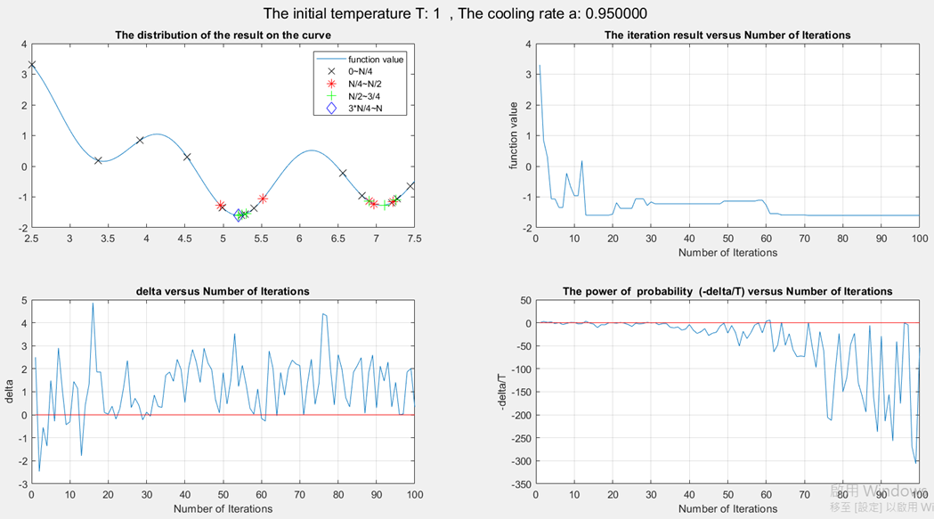
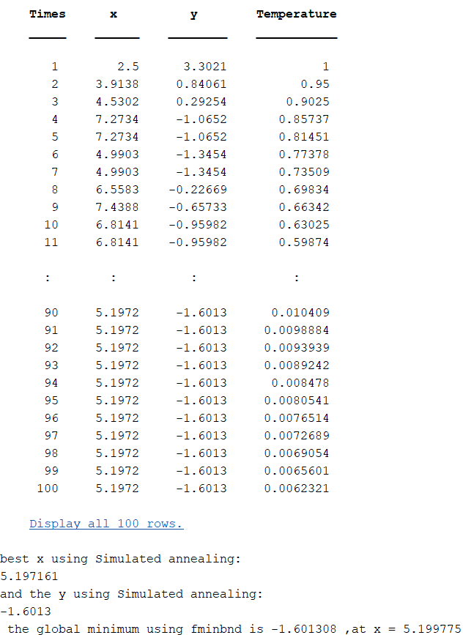
First Question’s Results
1
2
3
4
The right-hand side shows the results of each iteration and the best solution, and is verified by the fminbnd.
The picture above:
1. From this figure, we can know the distribution of the results obtained by the simulated annealing method in the iteration range .
2. The iteration result versus Number of Iterations.
3. The difference between the current result and the previous result: We can use the information obtained from this figure to adjust the parameters of the simulated annealing method
4. The power of probability (-delta/T) versus Number of Iterations

Slide 4
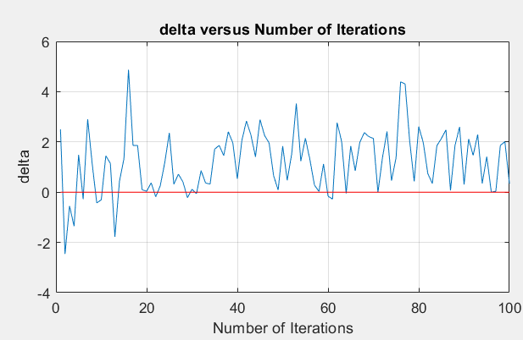

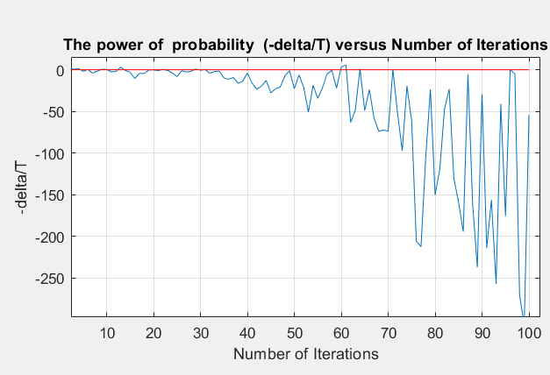
How to choose parameters T1
Because different problems produce different delta，So the first step is to know the range of delta ，like picture A.
Discuss the situation when delta is positive (When delta is negative, it must be a better solution, so there is no need to discuss it), When delta value is larger, the replacement probability of non-optimal solutions is smaller and vice versa.
As the temperature decays, the probability will become smaller and smaller(this also depends on delta), Since the delta in this experiment were small, So the value T1 we choose must also be small(Relative to the value of NM3), So the probability(Exp(-delta/T)) of this will get smaller and smaller over time.
A
Figure B express (-delta/T) change over time, The more negative the value, the lower the probability.
B
Why use (-delta/T) instead of Exp(-delta/T) to express，because Exp(-delta/T) varies too much, it is inconvenient to express . ex: 3~-512 Vs. exp(3)~ exp(-512)

Slide 5
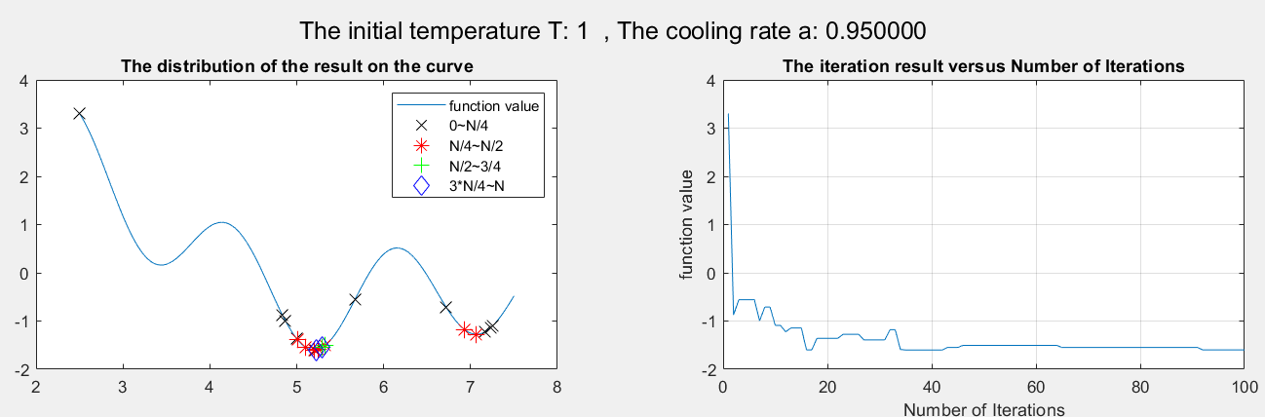
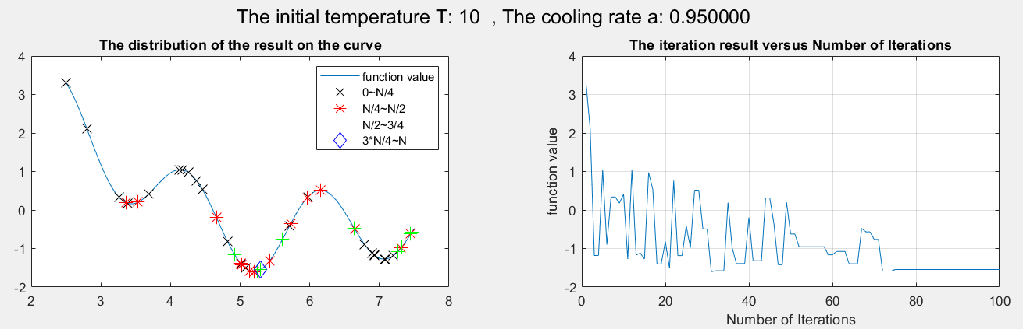
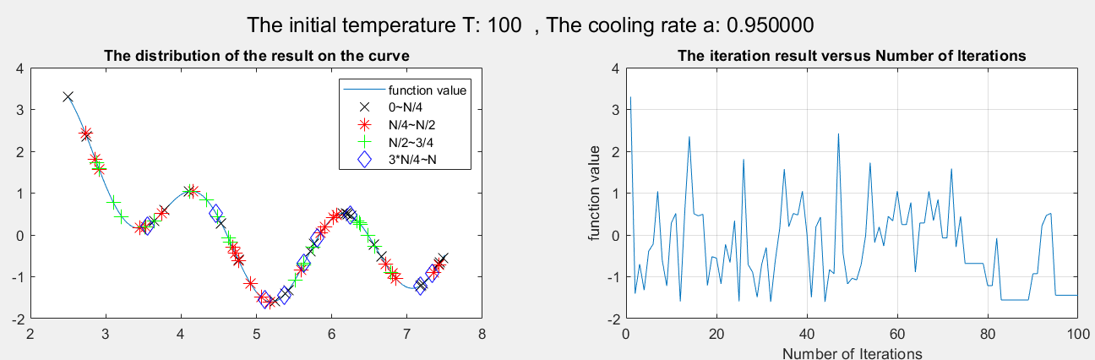
Result of different T1
Even though T will decrease with time, since T(1)=100 and T(1)=10 are slightly larger, the probability Exp(-delta/T) decreases slowly, and it is easier to accept poor solutions, resulting in more jitter in the curve (right hand side)
The left hand side figure shows the distribution when the number of iterations is fixed within a certain interval.
When the number of iterations is 1/4 of the total number of iterations, the solutions are more spread out on the curve(because probability Exp(-delta/T) is large ) no matter what T(1) is.
When the current number of iterations increases, the value of T(1)=1 on the curve gradually converges while the other T(1) is still divergent (T(1)=10 compared to T(1)=100 in the last few times It is more convergent when iterating).

Slide 6
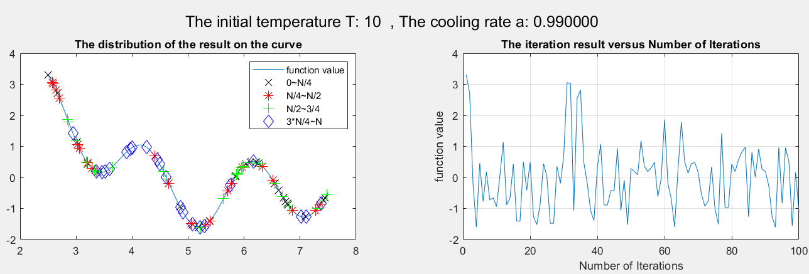

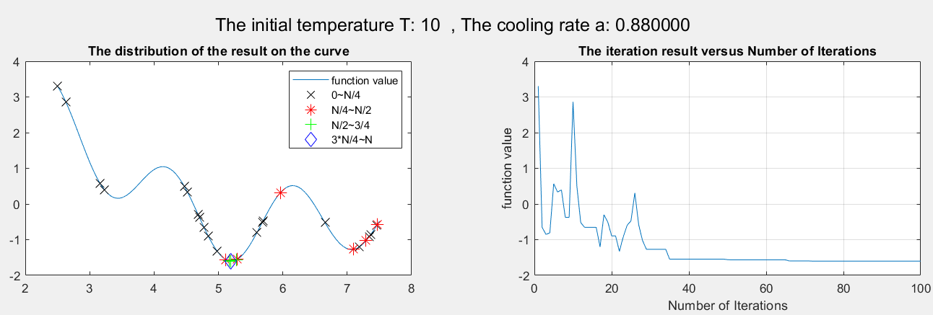
Result of different a
From these figures, it can be seen that the greater the cooling rate at a fixed initial temperature, the more poor solutions are accepted (because even with the increase in the number of iterations, the rate of decline in the probability is too slow).

Slide 7
Conclusion of the first question
Comparing the previous two pages, the choice of initial temperature affects the number of times a poor solution is accepted early in an iteration,the cooldown rate affects the behavior later in the iteration.
If you want to make the answer more accurate, then increasing the number of iterations(But the time consumed will increase) will be one of your considerations. In addition, the simulated annealing method also needs to know the details of the target problem before applying it, so that it is convenient to choose its parameters.
Advantages vs. Disadvantages of SA
Advantages:
1.Easy to implement and use
2.Provides optimal solutions to a wide range of problems(Not easy to get stuck in local minima)
Disadvantages:
1.Can take a long time to run if the annealing schedule is very long
2.There are a lot of tuneable parameters in this algorithm

Slide 8
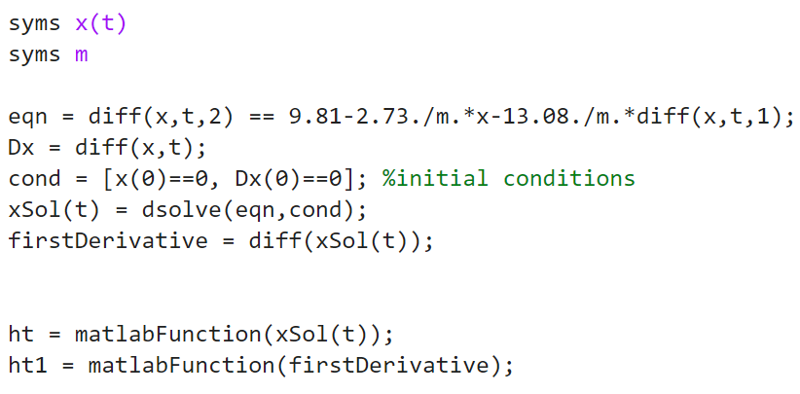
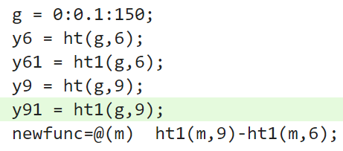
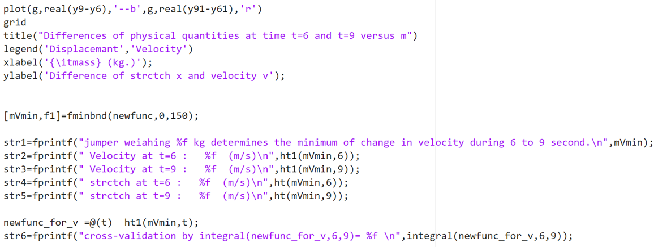
second question
Syms is used to define a variable as a symbol
According to the topic, establish a second-order differential equation in which x is the dependent variable and m and t are the independent variables(Differentiate x with respect to t)，set initial condition , and solve this differential equation to find expressions for x and its derivatives,.
matlabFunction() is used to convert symfun into function_handle, Due to Syms, the original function considers t, m as symbols, so it must be converted into function_handle.
Calculation and drawing according to the requirements of the topic

Slide 9
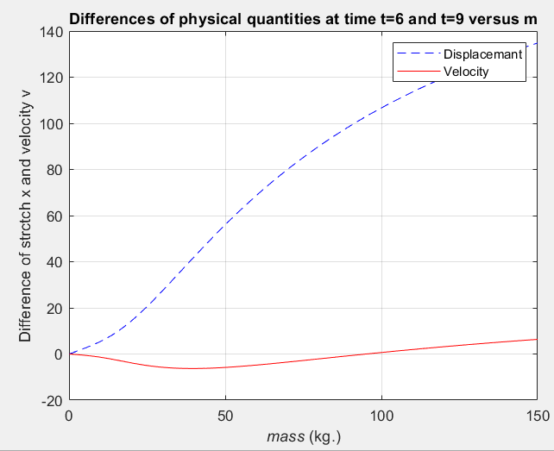
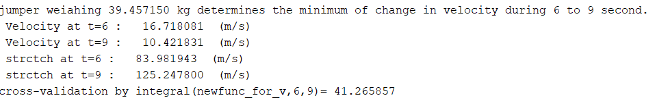
Result of second question
This picture expresses that Differences of physical quantities at time t=6 and t=9 versus mass.
The weight at the lowest point of the speed difference can be obtained through the calculation formula on the previous page.
Then bring this mass back to the formula on the previous page to obtain the Velocity and Displacemant at different times, and finally verify whether the Displacemant is correct by integrating the Velocity function.

