Slide 1


CAPSTONE PROJECT
TECHCRUSH CAPSTONE PROJECT
TOPIC:
BUILDING A SECURE SMALL NETWORK
MAIN TASK
Practically demonstrate how to design and secure a small network by creating a network layout, applying basic cybersecurity controls such as firewalls, port protection, and access control, analyzing network traffic with tools like Wireshark and Nmap, and showing how the network can detect or prevent simple cyber threats while documenting the process with explanations and screenshots.
Disclaimer: This training material belongs to techcrush and shouldn’t be shared

Slide 2
CAPSTONE PROJECT
Outline
Aim and Objective
Methodology
Concept of project
Tools Used
Conclusion
References
Disclaimer: This training material belongs to techcrush and shouldn’t be shared

Slide 3
CAPSTONE PROJECT
Aim and Objective
Aim of the Project
To design and implement a secure small network that demonstrates how basic cybersecurity measures can protect devices, data, and communication from common network threats.
Objectives of the Project
To create a basic network layout consisting of devices such as a router, workstation, server, and IoT device.
2. To apply network security controls such as firewalls, password protection, port hardening, and network segmentation.
3. To use Nmap to scan and identify open ports and improve network security by closing unnecessary ports.
4. To use Wireshark to capture and analyze network traffic such as HTTP, DNS, or ping packets.
5. To develop practical knowledge and confidence in basic networking and cybersecurity concepts
6. To document the setup process, configurations, screenshots, and results in a clear report and presentation
Disclaimer: This training material belongs to techcrush and shouldn’t be shared

Slide 4
CAPSTONE PROJECT
Methodology (Concept of Project)
Phase One: Architectural Design & Planning
2. Phase Two: Environment Deployment & Baseline Assessment
3. Phase Three: Security Control Implementation
4. Phase Four: Threat Simulation & Verification (Testing)
5. Phase Five: Documentation & Review

Slide 5
CAPSTONE PROJECT
Methodology (Tools Used)
1. Cisco packer tracer (Network Diagram and diagramming tool): it was used to create the network topology diagram
2. Vmware, Kali Linux: This is the primary environment for all terminal commands, tools execution and screenshots evidence
3. Native Firewall Implementation(Iptables): used to block incoming traffic in the linux against the custom security rules
4. Nmap: (Network scanner and port discovering tool), used to scan the target IP address, used to identify vulnerabilities
5. Wireshark: (Network Protocol Analyser and packet capture tool): live packet capture of eth0, ICMP traffic, verification of network behaviour and demonstration of passive traffic monitoring as a security monitoring technique.
Disclaimer: This training material belongs to techcrush and shouldn’t be shared

Slide 6
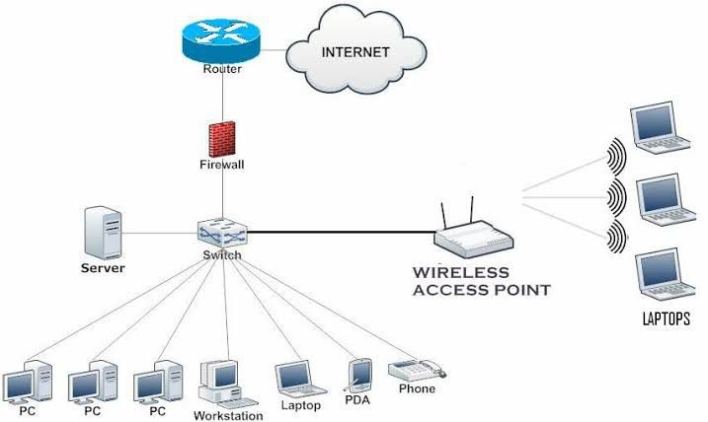
CAPSTONE PROJECT
Architectural Design and Planning
This phase involved designing the network architecture using Cisco Packet Tracer. The network layout included devices such as a router, firewall, server, workstation, and IoT device. The planning stage focused on proper device connection, IP addressing, and basic security measures like firewall placement and network segmentation to create a secure and efficient small network.
Disclaimer: This training material belongs to techcrush and shouldn’t be shared

Slide 7
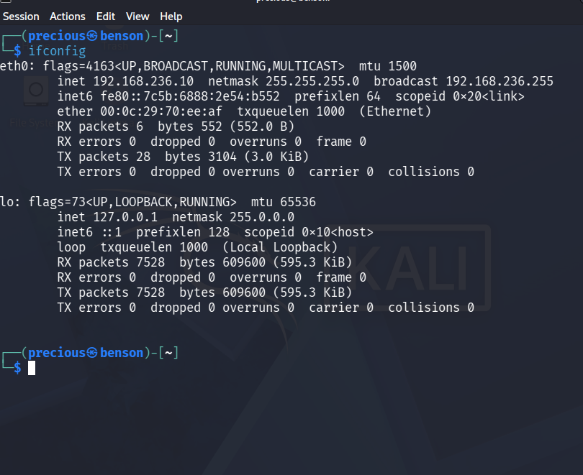
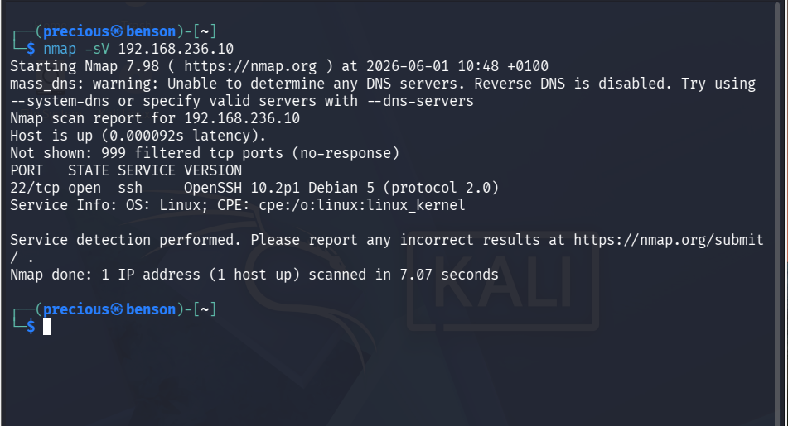
Environment Deployment & Baseline Assessment
CAPSTONE PROJECT
Verification of Host Network Interface Configuration via ifconfig:
This confirms the baseline network configuration on the Kali Linux host machine. We identified the active network interfaces and IP addresses that will be used during our scanning and optimization phases in this project.
Initial Baseline Nmap Reconnaissance Scan
An initial baseline Nmap scan (nmap –sV) we conducted the Nmap scan against the host IP address 192.168.236.10 to identify active services and open ports. As shown in this screenshot below, multiple ports are currently open and exposed, presenting a potential attack surface for malicious hackers.

Slide 8
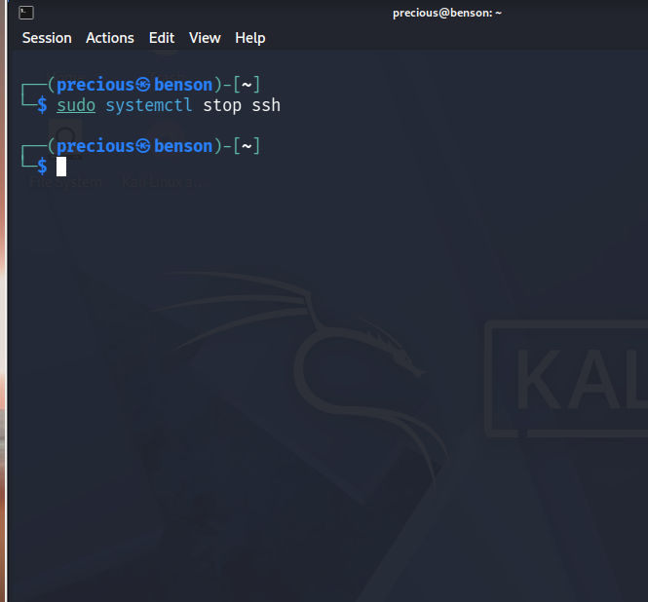
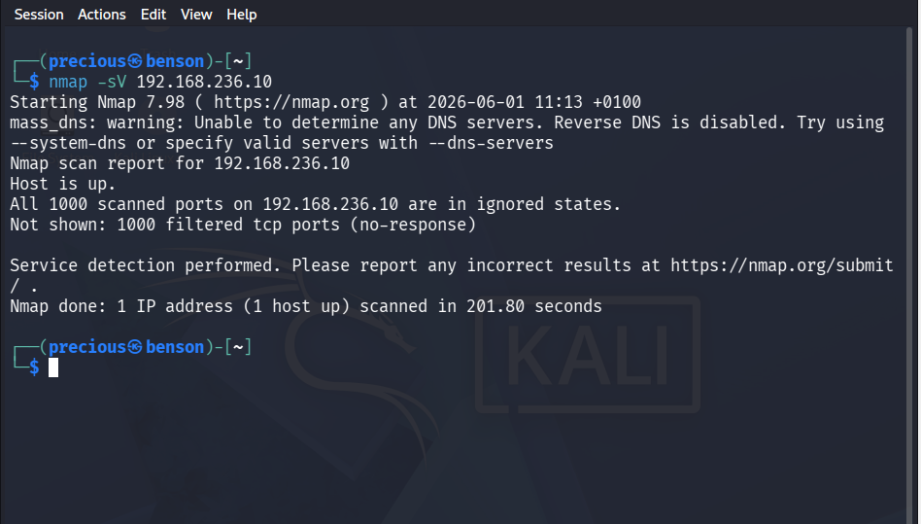
Port Hardening
CAPSTONE PROJECT
Disabling Unnecessary SSH Service
Hardened Port State Post-Incident Verification Scan
To reduce our attack surface, unnecessary services must be
disabled. Here, we shut down an unused system service,
directly applying the security principle of least functionality.
A follow-up verification scan was conducted using Nmap. We ran the command nmap –sV 192.168.236.10. The result showed 1000 filtered tcp ports are in ignored state because the system is secure by default

Slide 9
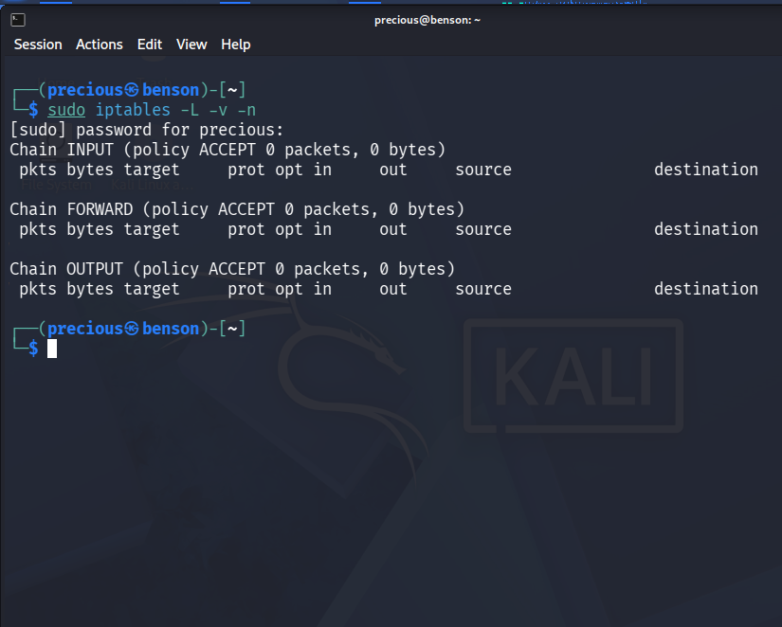
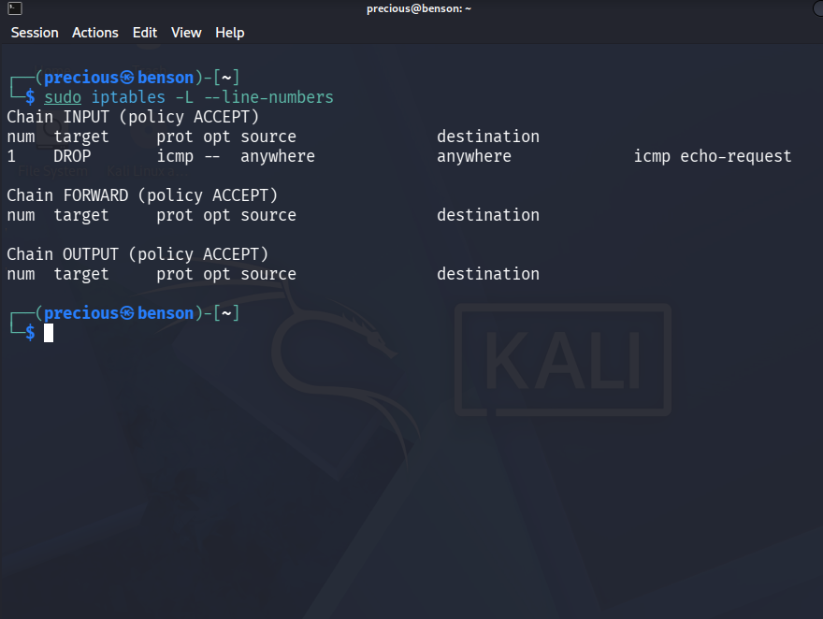
Security Control Implementation (Native Firewall Implementation)
CAPSTONE PROJECT
Administrative Baseline Audit of Native Kernel Policy via iptables
To satisfy the network security controls requirement using our system firewalls, an initial baseline audit was executed via the native kernel filtering command sudo iptables –L –v –n.
A final policy audit was performed using the index lookup L –line numbers to ensure implementation compliance. The terminal output confirms that rule index 1 under the input chain is successfully processing and enforcing the targeted drop policy against incoming ICMP traffic. This verifies the host based firewall configuration requirements has been successfully satisfied.

Slide 10
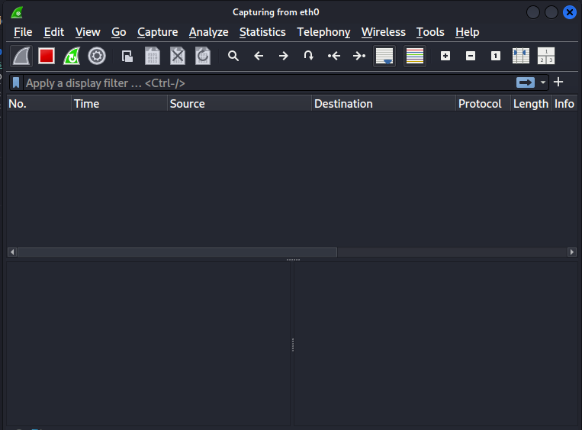
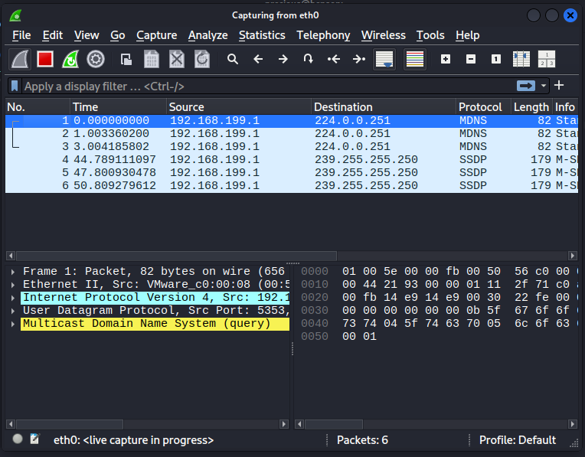
Threat Simulation & Verification (Testing)
CAPSTONE PROJECT
Wireshark Packet Capture:
Wireshark capturing on eth0, live capture of data packets moving across the local network. 192.168.199.1 is the IP address of the device sending out all the requests. 224.0.0.251 and 239.255.250 are the destination IP addresses
Wireshark capturing on eth0, live capture in progress, no packets yet (capture just started, status bar shows "eth0: live capture in progress"
and "No Packets")

Slide 11
CAPSTONE PROJECT
Interface Live Packet Capture
A live packet capture session was initialized on the primary interface eth0 using the Wireshark. The application layer panel verifies that the packet capture engine is successfully intercepting layer-2 data frames running on the local segment, recording background broadcast multicast domain name system query streams (MDNS) and simple service discovery protocol strings (SSDP) directly from the link layer traffic

Slide 12
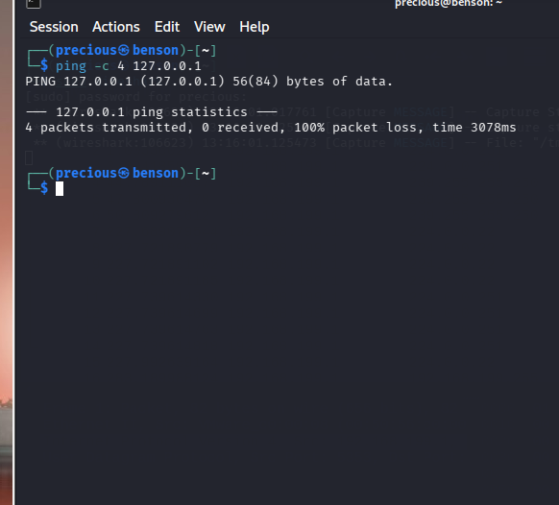
Empirical Testing and Performance Validation
CAPSTONE PROJECT
A host validation test was performed via the local command prompt by targeting the system interface with an ICMP data The output documents a metric of 100% packet loss, confirming that the newly deployed firewall rules are active, working, and successfully intercepting target data streams at the packet layer

Slide 13
CAPSTONE PROJECT
Conclusion
This project successfully achieved its aim of designing, implementing, and evaluating a secure small office network using free, industry-standard tools on Kali Linux. All three required security controls were implemented and evidenced: firewall rules using iptables firewall rules, port scanning and hardening using Nmap, and packet capture analysis using Wireshark. A port scanning threat scenario was simulated with before-and-after evidence demonstrating the measurable defensive effect of the controls.
Disclaimer: This training material belongs to techcrush and shouldn’t be shared

Slide 14
CAPSTONE PROJECT
References
Lyon, G. (2019). Nmap network scanning: The official Nmap project guide to network discovery and vulnerability scanning. Insecure.Org.
National Institute of Standards and Technology (NIST). (2011). Guide to enterprise telework, remote access, and bring your own device (BYOD) security (NIST Special Publication 800-114 Rev. 1). U.S. Department of Commerce. https://csrc.nist.gov/
Orebaugh, A., Ramirez, G., & Beale, J. (2006). Wireshark & Ethereal network packet sniffing. Syngress Publishing.
Saltzer, J. H., & Schroeder, M. D. (1975). The protection of information in computer systems. Proceedings of the IEEE, 63(9), 1278-1308. https://doi.org/10.1109/PROC.1975.9939 (Note: This is the seminal academic literature paper that established the Principles of Least Privilege and Least Functionality).
The Kali Linux Project. (2026). Kali Linux documentation. OffSec. https://www.kali.org/docs/
The Ubuntu Documentation Team. (2026). Uncomplicated Firewall (UFW) manual. Canonical Ltd. https://help.ubuntu.com/community/UFW
Wireshark Foundation. (2026). Wireshark user’s guide. Wireshark Project. https://www.wireshark.org/docs/wsug_html_chunked/
Disclaimer: This training material belongs to techcrush and shouldn’t be shared

Slide 15
CAPSTONE PROJECT
THANK YOU
Disclaimer: This training material belongs to techcrush and shouldn’t be shared

