Slide 1
Teach-It
By: Ben Douglas & Sandra Sung

Slide 2
What is Teach-It?
“
“
An interactive instant chat messaging system for teachers and students.
Allows teachers to create an instant chat messaging room to communicate with students

Slide 3
What Did We Use?
Client-Side:
HTML
CSS
JavaScript
Blade
API:
Socket IO
Server-Side:
PHP
MySQL
Laravel

Slide 4
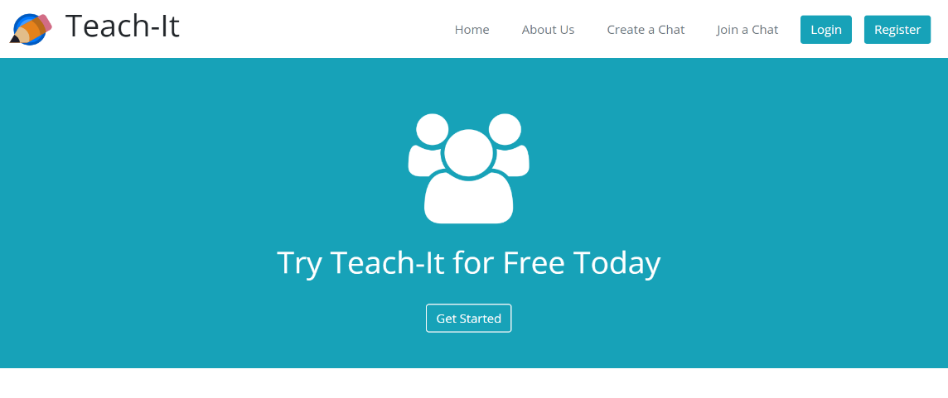
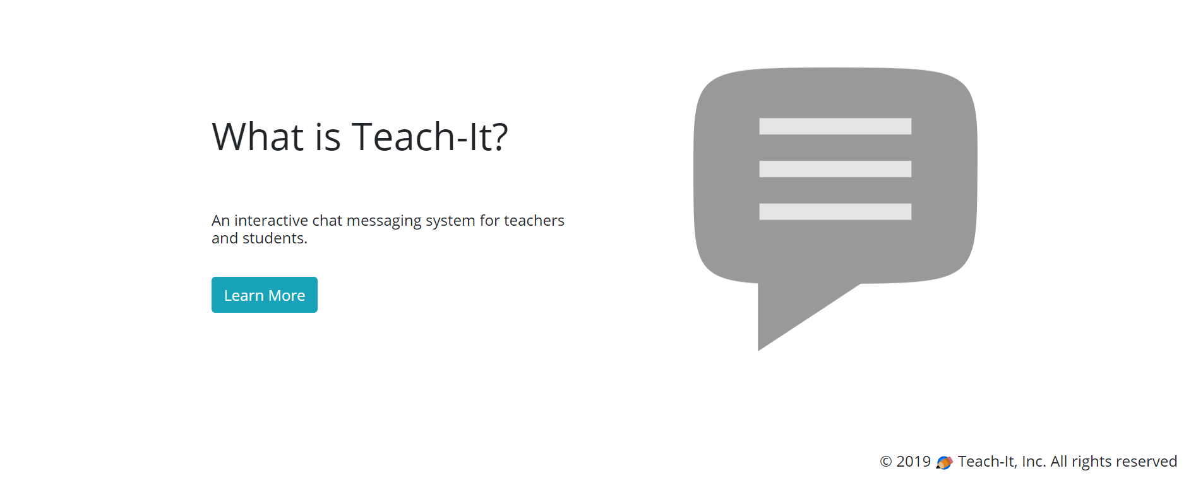
Design

Slide 5
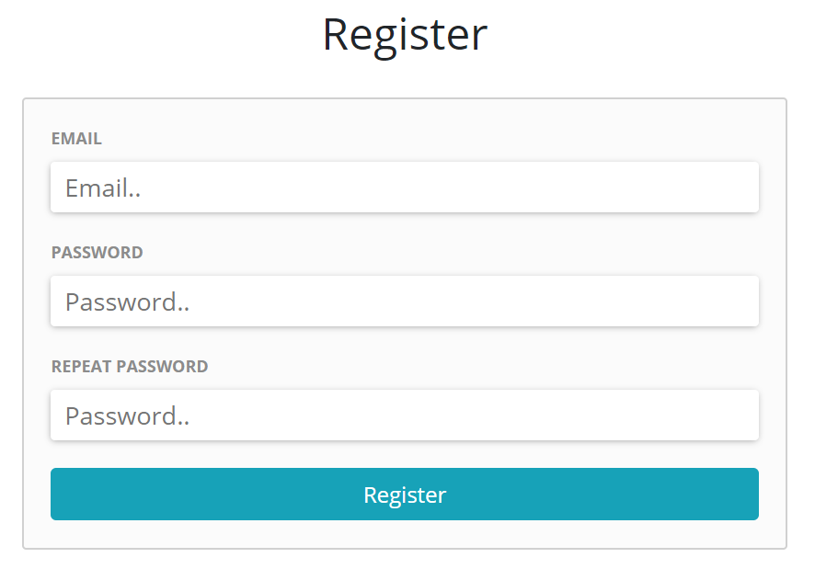
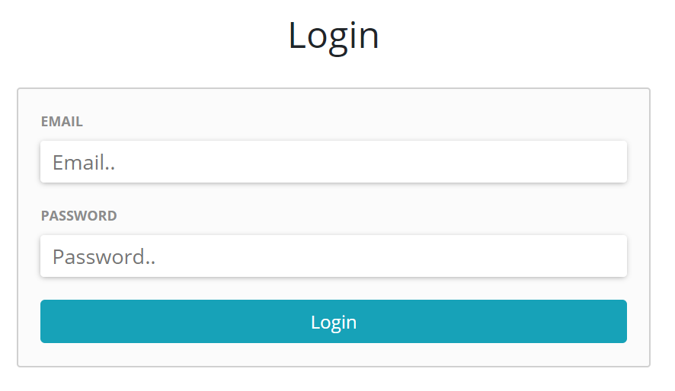
How does Teach-It Work?
Register/Login

Slide 6
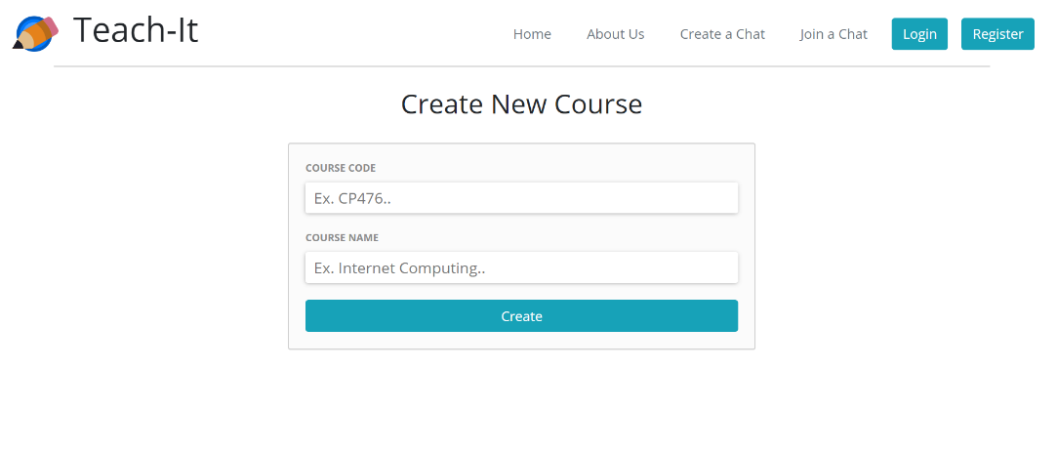
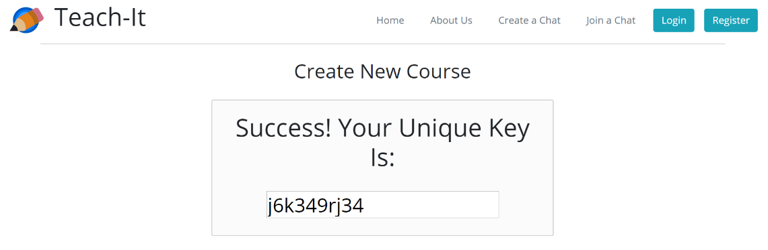
How does Teach-It Work?
x
Create a Course (if you’re a teacher) and get a unique key to give to students to access the course chat

Slide 7
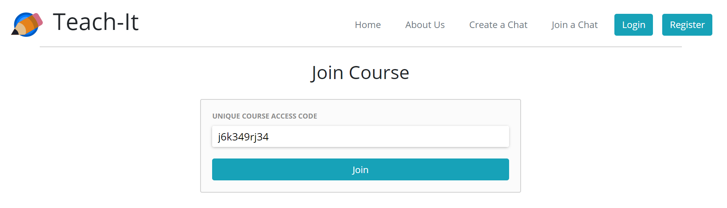
How does Teach-It Work?
Join a Chat (if you’re a student)
Join a Chat (if you’re a student)
Join a Chat (if you’re a student) using the unique access key given by the teacher

Slide 8
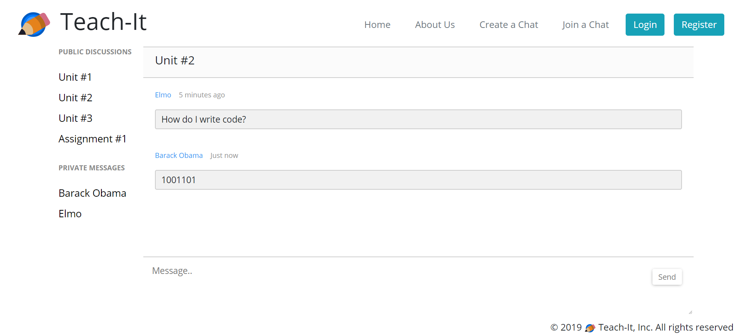
How does Teach-It Work?
Join a Chat (if you’re a student)
Join a Chat (if you’re a student)
Join a Chat (if you’re a student) using the unique access key given by the teacher
Chat!

Slide 9
Challenges
Implementing live-chat functionality
Figuring out how to divide up the work
Time Constraints

Slide 10
Thank You for Listening!
Any Questions?

