Slide 1
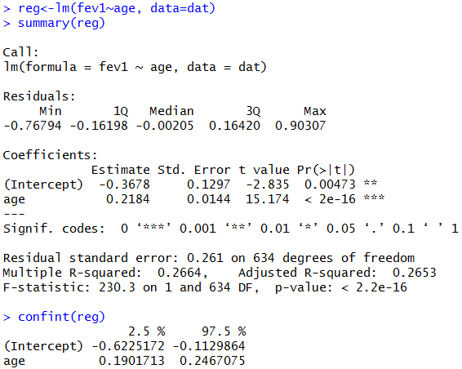
Regression equation
lm stands for linear model. The output of the model is stored in the object reg
Estimated parameters (Intercept, slope)
Standard errors,
t-values, and P-values
Residual standard deviation
(standard error is misnomer here)
Residual degrees of freedom
Coefficient of determination
95%-confidence intervals

