Slide 1
The Effects of Physical Activity on Quality of Life in People with Spinal Cord Injury: A Meta -Analysis
Ben Stear

Slide 2
Overview
Brief description of the studies included in the analysis
Data
Details of Statistical Methods used
Results

Slide 3
Physical Activity (PA) and Quality of Life (QOL) in persons with Spinal Cord Injury
Each of the studies compared the effect of PA regimens on QOL (depression) in the SCI community.
Studies varied on the type and duration of PA and on the type of QOL questionnaire
Different control populations

Slide 4
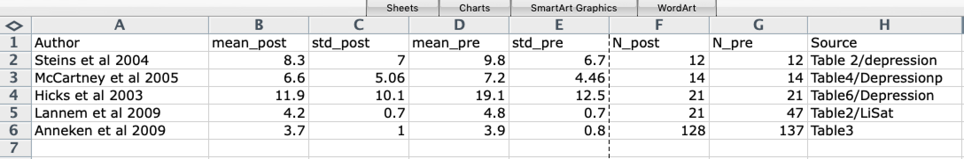
Data
Table 1. Data used in the meta-analysis. Post = post physical exercise, Pre = pre physical exercise, std = standard deviation, N = # of participants.

Slide 5
Details of Statistical Methods
Software
R version 3.6.0
Rstudio Version 1.1.45
Graph
Forest Plot
Followed an R tutorial: https://bookdown.org/MathiasHarrer/Doing_Meta_Analysis_in_R/

Slide 6
Details of Statistical Methods (cont.)
Effect Size for continuous variables: Hedges g (bias corrected Cohen’s d)
Pooling Effect Sizes: Random-effects-model
You can only use the fixed-effect-model when you can assume that all included studies come from the same population. The studies I chose come from different populations so I used the random-effects-model to pool the individual effect sizes.
Tau-squared estimator (estimation of variance of distribution of true effect sizes): Sidik-Jonkman

Slide 7
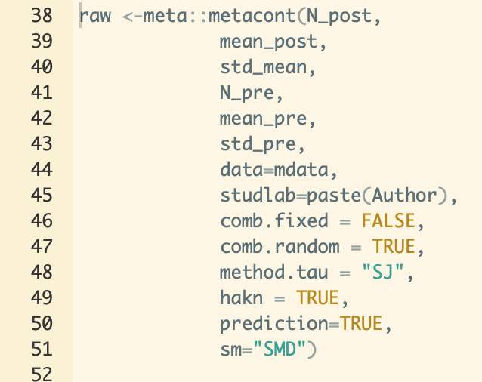
Details of Statistical Methods (cont.)

Slide 8
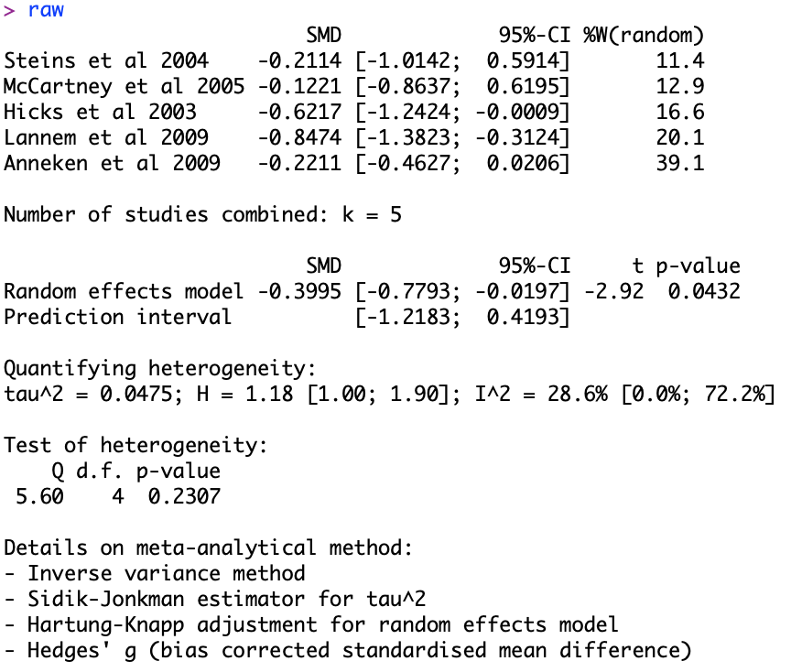
Results

Slide 9
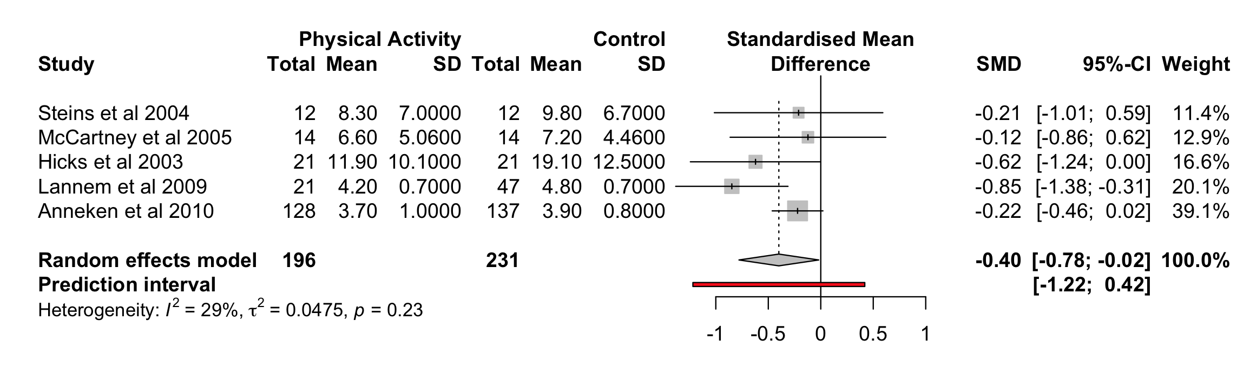
Results
Figure 1. Forest plot of the meta-analysis.
Notes:
Last 2 studies use actual control,,, last study, has lots of samples, effect is negative bc scale of depression went down.

Slide 10
References
Fernhall, B., Heffernan, K., Jae, S., & Hedrick, B. (2008). Health Implications of Physical Activity in Individuals with Spinal Cord Injury: A Literature Review . Journal of Health and Human Services Administration, 30(4), 468-502
Hicks, A.L., Martin, K.A., Ditor, D.S., Latimer, A.E., Craven, C., Bugaresti, J. & McCartney, N. (2003). Long-term exercise training in person with spinal cord injury: effects on strength, arm ergometry performance and psychological well-being. Spinal Cord, 41, 34–43 10.1038/sj.sc.3101389
Ditor, D. S., Latimer, A. E., Ginis, K. M., Arbour, K. P., McCartney, N., & Hicks, A. L. (2003). Maintenance of exercise participation in individuals with spinal cord injury: effects on quality of life, stress and pain. Spinal cord, 41(8), 446.
Lannem, A.M., Sorensen, M., Froslie, K.F., & Hjeltnes, N. (2009). Incomplete spinal cord injury, exercise and life satisfaction. Spinal Cord, 47(4), 295–300 10.1038/sc.2008.117
Anneken, V., Hanssen-Doose, A., Hirschfeld, S., Scheuer, T., & Thietje, R. (2010). Influence of physical exercise on quality of life in individuals with spinal cord injury. Spinal Cord, 48, 393–399 10.1038/sc.2009.137

