Slide 1
Bison and LALR
Bill Nicholson: nicholdw@ucmail.uc.edu
Ben Ward: benstopics@gmail.com

Slide 2

What is it?
Bison:
A general-purpose parser generator.
Converts a context-free grammar into a deterministic parser.
Bison is GNU
[1]

Slide 3
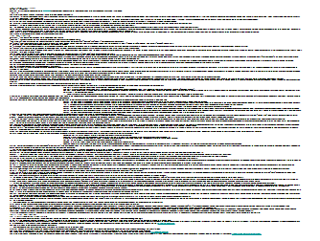
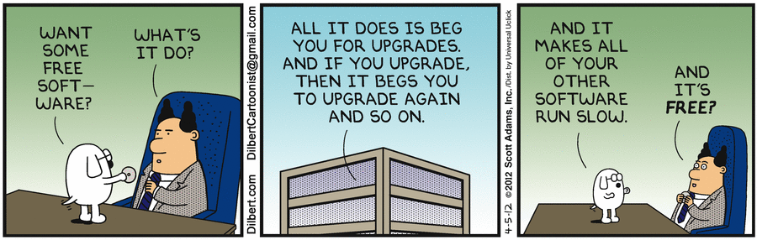
Free Bison ?
“The distribution terms for Bison-generated parsers permit using the parsers in nonfree programs.
Before Bison version 2.2, these extra permissions applied only when Bison was generating LALR(1) parsers in C.
And before Bison version 1.24, Bison-generated parsers could be used only in programs that were free software. “
The GNU GPL
[1]

Slide 4
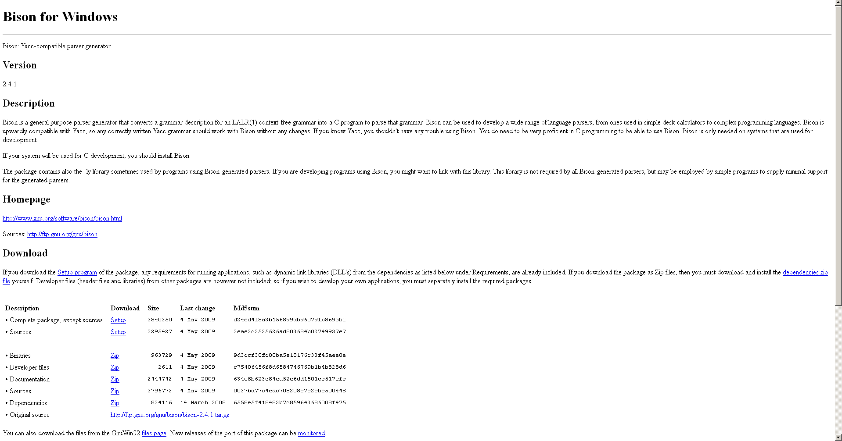
Bison for Windows
Notes:
http://gnuwin32.sourceforge.net/packages/bison.htm

Slide 5
Outline of a Bison Grammar
%{
Prologue
%}
Bison declarations
%%
Grammar rules
%%
Epilogue
[2]

Slide 6
Prologue
/* Reverse polish notation calculator. */
%{
#define YYSTYPE double
#include <math.h>
#include <stdio.h>
%}

Slide 7
Bison Declarations from rpCalc.y
%token NUM

Slide 8
Grammar Rules
A Bison grammar rule has the following general form:
result: components…;
Result is non-terminal
Component is terminal or non-terminal

Slide 9
Example Grammar
exp: exp '+' exp;

Slide 10
Grammar Rules from rpCalc.y
%% /* Grammar rules and actions follow */
input: /* empty */
| input line
;
line: '\n'
| exp '\n' { printf ("\t%.10g\n", $1); }
;
exp: NUM { $$ = $1; }
| exp exp '+' { $$ = $1 + $2; }
| exp exp '-' { $$ = $1 - $2; }
| exp exp '*' { $$ = $1 * $2; }
| exp exp '/' { $$ = $1 / $2; }
/* Exponentiation */
| exp exp '^' { $$ = pow ($1, $2); }
/* Unary minus */
| exp 'n' { $$ = -$1; }
;
%%

Slide 11
Epilogue fron rpcalc.y
/* Lexical analyzer returns a double floating point
number on the stack and the token NUM, or the ASCII
character read if not a number. Skips all blanks
and tabs, returns 0 for EOF. */
#include <ctype.h>
yylex ()
{
int c;
/* skip white space */
while ((c = getchar ()) == ' ' || c == '\t')
;
/* process numbers */
if (c == '.' || isdigit (c))
{
ungetc (c, stdin);
scanf ("%lf", &yylval);
return NUM;
}
/* return end-of-file */
if (c == EOF)
return 0;
/* return single chars */
return c;
}
int main (void) {return yyparse ();}
/* This function must be declared to return an int else Visual Studio will be unhappy. */
int yyerror (char const *s){
fprintf (stderr, "%s\n", s);
return 0;
}

Slide 12
/* Reverse polish notation calculator. */
%{
#define YYSTYPE double
#include <math.h>
#include <stdio.h>
%}
%token NUM
%% /* Grammar rules and actions follow */
input: /* empty */
| input line
;
line: '\n'
| exp '\n' { printf ("\t%.10g\n", $1); }
;
exp: NUM { $$ = $1; }
| exp exp '+' { $$ = $1 + $2; }
| exp exp '-' { $$ = $1 - $2; }
| exp exp '*' { $$ = $1 * $2; }
| exp exp '/' { $$ = $1 / $2; }
/* Exponentiation */
| exp exp '^' { $$ = pow ($1, $2); }
/* Unary minus */
| exp 'n' { $$ = -$1; }
;
%%
/* Lexical analyzer returns a double floating point
number on the stack and the token NUM, or the ASCII
character read if not a number. Skips all blanks
and tabs, returns 0 for EOF. */
#include <ctype.h>
yylex ()
{
int c;
/* skip white space */
while ((c = getchar ()) == ' ' || c == '\t')
;
/* process numbers */
if (c == '.' || isdigit (c))
{
ungetc (c, stdin);
scanf ("%lf", &yylval);
return NUM;
}
/* return end-of-file */
if (c == EOF)
return 0;
/* return single chars */
return c;
}
int main (void) {return yyparse ();}
/* This function must be declared to return an int else Visual Studio will be unhappy. */
int yyerror (char const *s){
fprintf (stderr, "%s\n", s);
return 0;
}
rpcalc.y

Slide 13
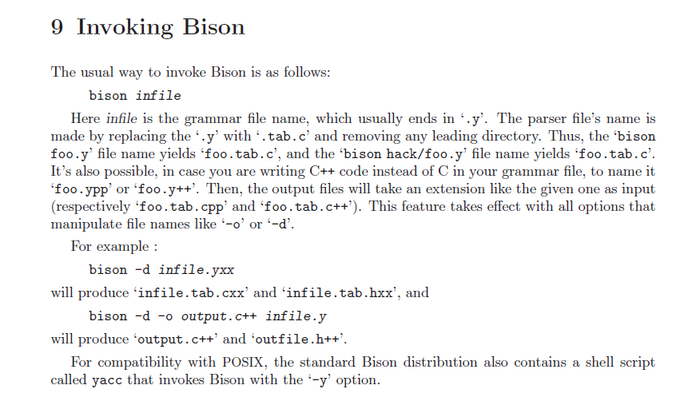
Command Line
Notes:
bison.pdf , Ch 9 p 105.

Slide 14
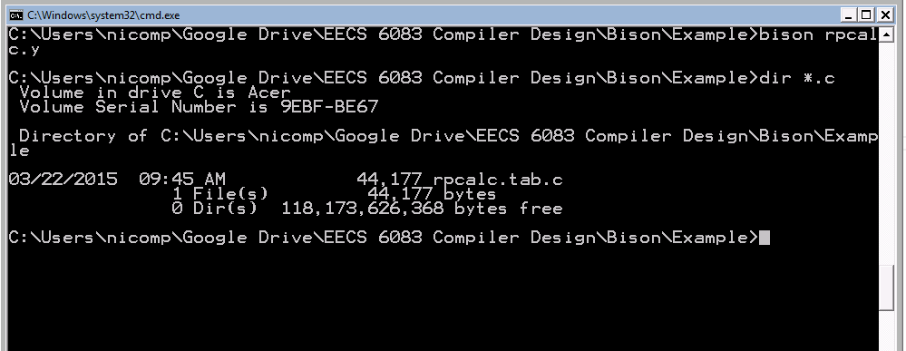
Bison generates rpCalc.Tab.c

Slide 15
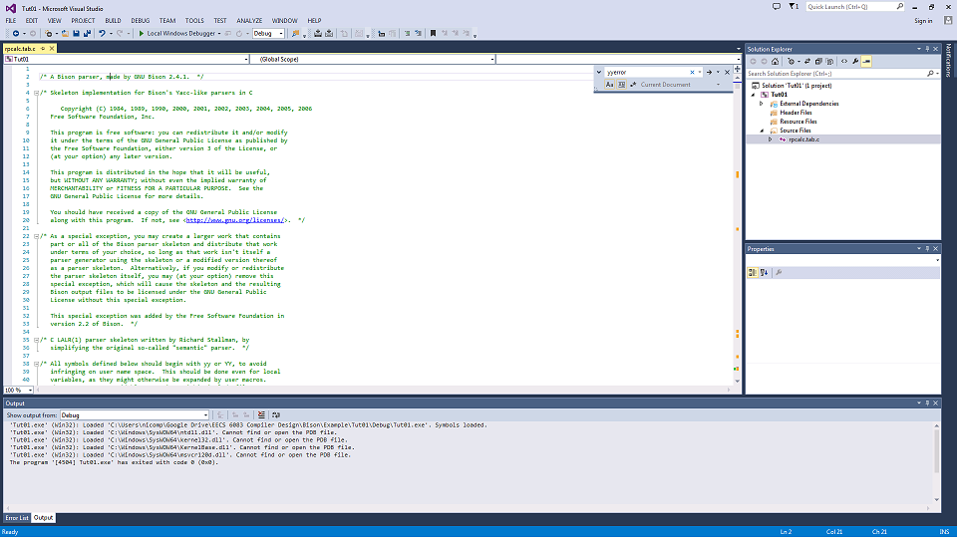
rpCalc.tab.c adapted to Visual Studio

Slide 16
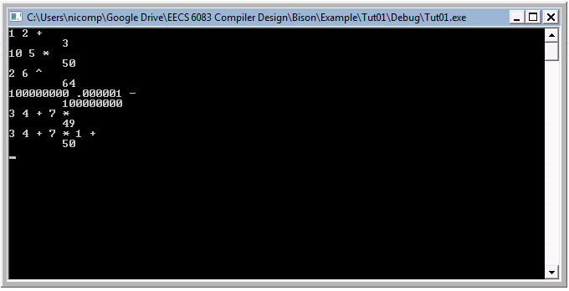
Compile and Execute the RPN Example

Slide 17
LALR
History
LR(0)
Example
Shift, Reduce, and Shift-Reduce Conflicts
LA(1) → LALR

Slide 18
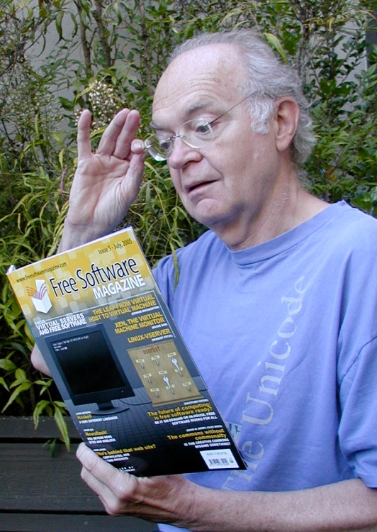

What is it?
LR
1965, Donald Knuth, “On the Transition of Languages from Left to Right” [3]
Large memory requirements, impractical in 1965
LALR
1969, Frank DeRemer, “Practical Translators for LR(k) Languages” [4]
1975, Stephen C. Johnson @ Bell Labs, YACC (Yet Another Compiler-Compiler) [5]
Later, GNU/Bison [6]
Donald Knuth
Stephen C. Johnson

Slide 19
LR(0) Example
Original Grammar
S → AB
A → a
B → b
Augmented Grammar
0. S’ → S
S → AB
A → a
B → b

Slide 20
I0
S’ → .S on S, s1
S → .AB on A, s2
A → .a on a, s3
I1
S’ → S. r1, accept
I2
S → A.B on B, s4
B → .b on b, s5
I3
A → a. r2
I4
S → AB. r1
I5
B → b. r3
Rules:
S → AB
A → a
B → b
Reduce S = Accept state

Slide 21
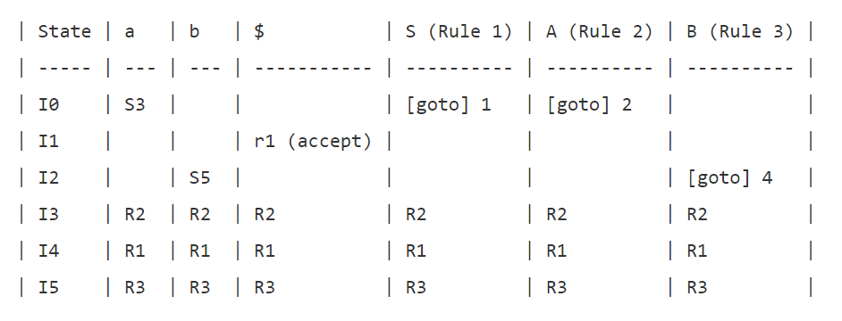
Parse Table
http://truben.no/table/

Slide 22
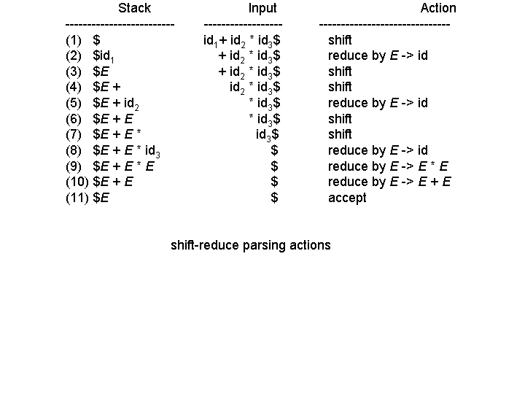
[8]
Rules:
E → id
E → E + E
E → E * E
Parsing Actions

Slide 23
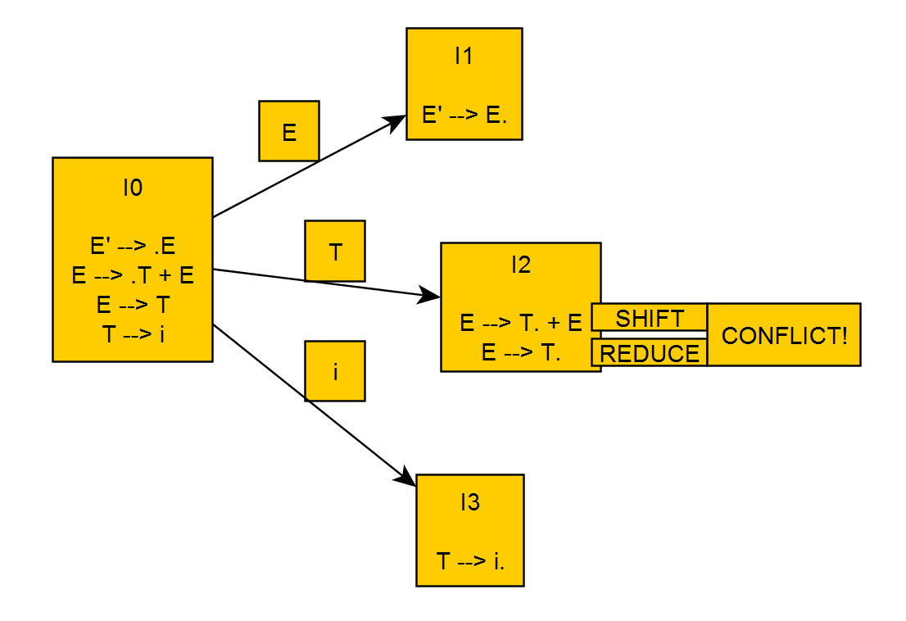
Shift-Reduce Conflict

Slide 24
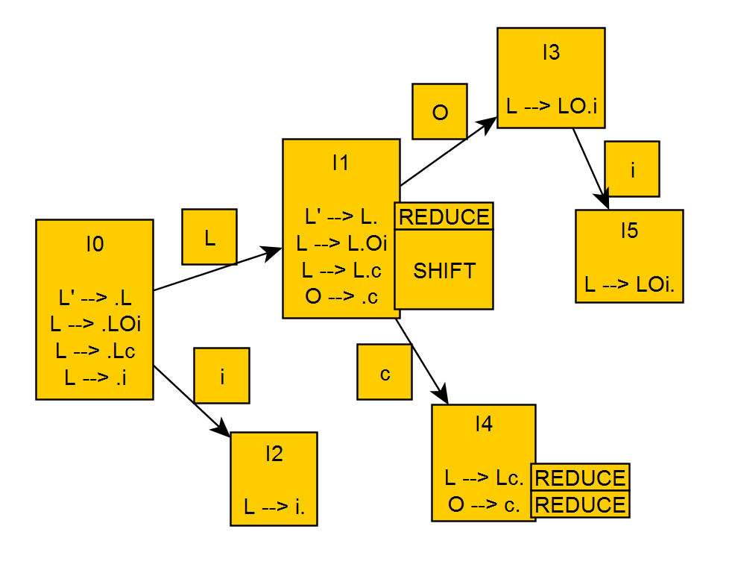
Reduce-Reduce

Slide 25
Generate LR(1) Parsing Table[9]
Original Grammar
S → .CC
C → .eC
C → .d
Augmented Grammar
0. S’ → .S$
S → .CC
C → .eC
C → .d

Slide 26
I0
S’ → .S$ , $ on S, s1
S → .CC , $ on C, s2
C → .eC , e | d on e, s3
C → .d , e | d on d, s4
I1
S’ → S.$ , $ accept
I2
S → C.C , $ on C, s5
C → .eC , $ on e, s6
C → .d , $ on d, s7
I3
C → e.C , e | d on C, s8
C → .eC , e | d on e, s3
C → .d , e | d on d, s4
I4
C → d. , e | d r3
I5
S → CC. , $ r1
I6
C → e.C , $ on C, s9
C → .eC , $ on e, s6
C → .d , $ on d, s7
I7
C → d. , $ r3
I8
S → eC. , e | d r2
I9
S – eC. , $ r2
S → CC
C → eC
C → d
Note: follow set of first C is first set of second C
Follow persists throughout derived states

Slide 27
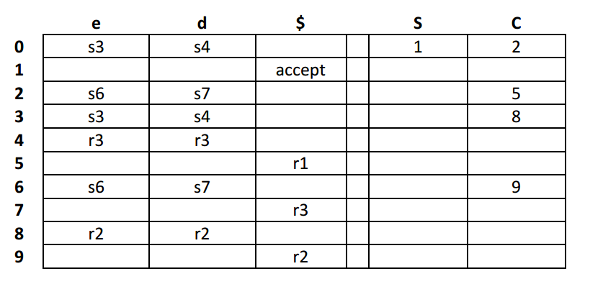
LR(1) Parsing Table [9]
Look-ahead good, number of states bad

Slide 28
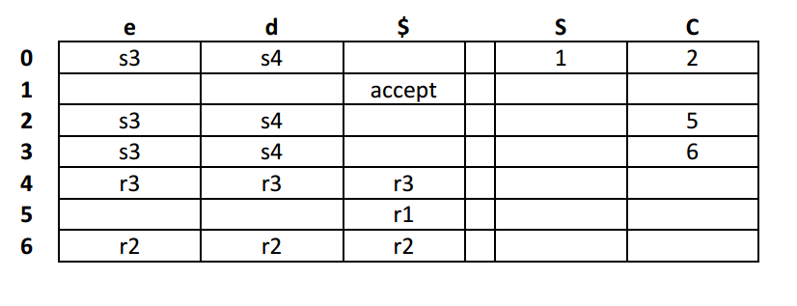
SLR(1) Parsing Table
Less states good, less parsing power bad

Slide 29
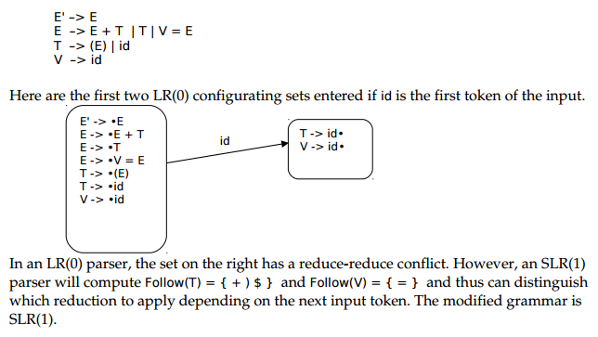
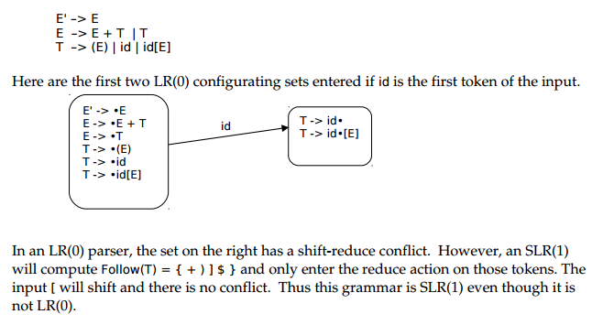

Brief Summary of SLR [10]
Question: Parsing power of LR in SLR states?

Slide 30
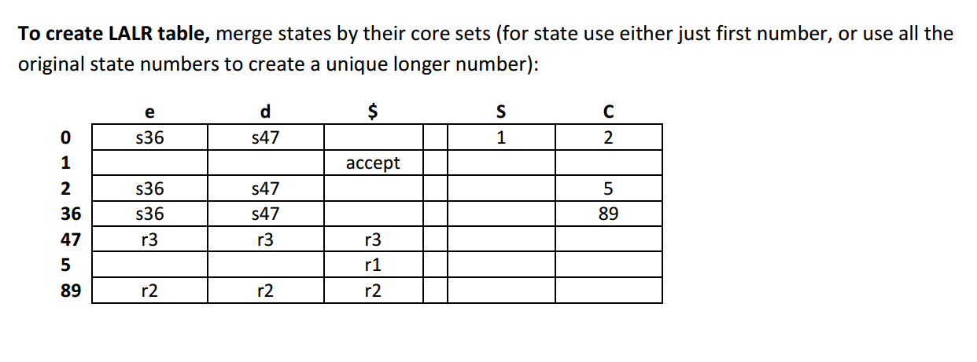
Answer: LALR [9]

Slide 31
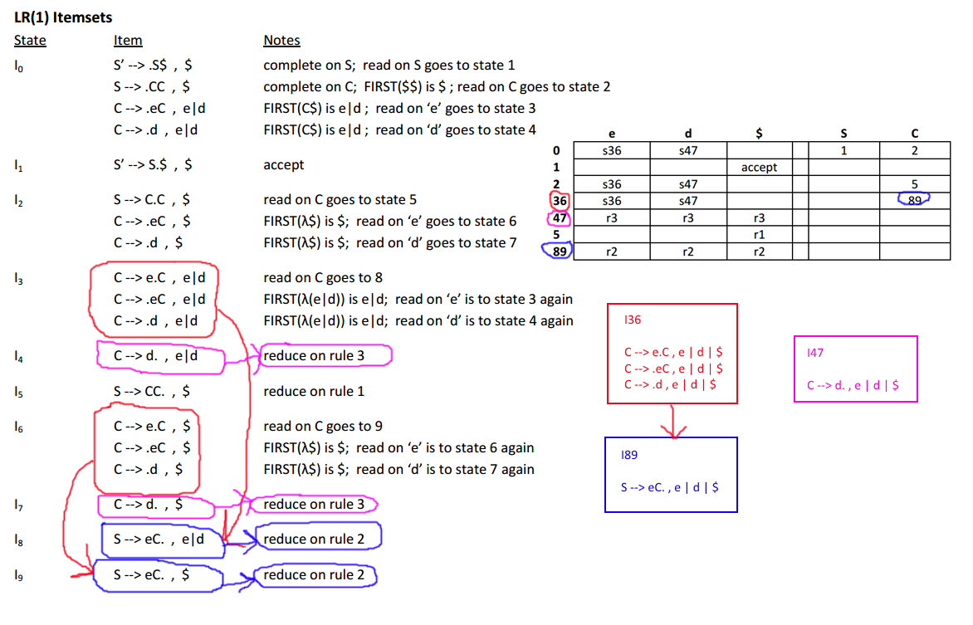
Merging Core Sets (Finite Automata)

Slide 32
References
[1] http://www.gnu.org/software/bison/manual/bison.html
[2] http://www.gnu.org/software/bison/manual/bison.html#Grammar-File
[3] http://www.cs.dartmouth.edu/~mckeeman/cs48/mxcom/doc/knuth65.pdf
[4] http://publications.csail.mit.edu/lcs/pubs/pdf/MIT-LCS-TR-065.pdf
[5] http://dinosaur.compilertools.net/yacc/
[6] https://www.gnu.org/software/bison/
[7] https://www.youtube.com/watch?v=fG1duL7tg3s
[8] http://tldp.org/LDP/LG/issue87/misc/ramankutty/figure1.png
[9] http://courses.washington.edu/css448/zander/Notes/LRandLALR.pdf
[10] http://web.stanford.edu/class/archive/cs/cs143/cs143.1128/handouts/110%20LR%20and%20SLR%20Parsing.pdf

Slide 33
Resources
Bison for Windows: http://gnuwin32.sourceforge.net/packages/bison.htm

Slide 34
Notes
The SourceForge installer puts bison into C:\Program Files (x86)\GnuWin32 but the path in bison.exe is hard-coded as c:\Progra~1\bison\. A solution is to copy all the files from C:\Program Files (x86)\GnuWin32 to c:\Progra~1\bison\.

