Slide 1
The More The Merrier - Resource Enhancement in Quantum Resource Theories
Universidade Federal de Pernambuco
9th April 2026
Benjamin Stratton
Visting Fellow, International Institute of Physics, Federal University of Rio Grande do Norte, Natal, Brazil
PhD Student, Quantum Information Theory Group, University of Bristol, UK.

Slide 2


Where I am from?

Slide 3

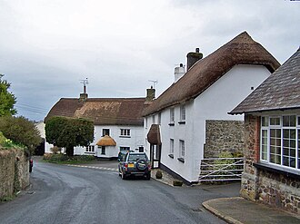


Where I am from?

Slide 4



Where I am from?

Slide 5
Overview
Quantum Resource Theory Overview
Conceptual Foundations
Mathematical Formalism
Resource Enhancement in Quantum Resource Theories
Resource Concentration
Unspeakable Coherence
Informational Non-equilibrium
able
My Results

Slide 6
Quantum Resource Theory Overview
Conceptual Foundations

Slide 7
References:
Quantum Resource Theories
Eric Chitambar and Gilad Gour
Reviews of Modern Physics, 2019
An Introductory Review of the Resource Theory Approach to Thermodynamics
Matteo Lostaglio
Reports on Progress in Physics, 2019

Slide 8

“Quantum computers can solve problems intractable on classical computers”
“Quantum sensors can offer a higher level of precision over the best classical sensors”
“Quantum states can exhibit non-local correlations, classical states cannot”
Quantum Enthusiast
“Quantum cryptography protocols offer a higher level of security then classical cryptography”
“Quantum States can be teleported over channels in which quantum information cannot be sent”

Slide 9
Quantum objects have value
Task with quantum object
Task without quantum object
>

Slide 10
What property gives quantum objects their value?
What is the property that without, quantum tasks can perform no better then classical tasks.

Slide 11
What property gives quantum objects their value?
Unital
Rank
Purity
Unitary
Dynamics
States
Entanglement
Purity Preserving
Non-local Correlations
Low Entropy
Entanglement Generating
Incompatible
Projective
Measurements
Degenerate

Slide 12
What property gives quantum objects their value?
As far as we know, no one property provides the value in all quantum information processing task.
Specific tasks require quantum objects with specific properties.

Slide 13
Focus the question:
Given a property of a quantum object, when is it “valuable”?
We want to rigorously defined the notion of “value”.
For what tasks is the property useful?
Would like to be able to quantify how much of this valuable property we have.
Answering such question is the goal of
quantum resource theories.

Slide 14
Basic premise behind a resource theory
Place an agent under a set of physical constraints
These constraints limit the agent’s ability to generate objects with the property of interest.
I say a property that cannot be generate is a resource.
Now ask: what can our agent not achieve under these constraints (i.e., without access to objects possessing this property)
If a given task cannot be achieved without objects possessing this property, that property is resource for that task (under this set of constraints).
Free objects – these are the objects the agent can reach under the allowed operations

Slide 15



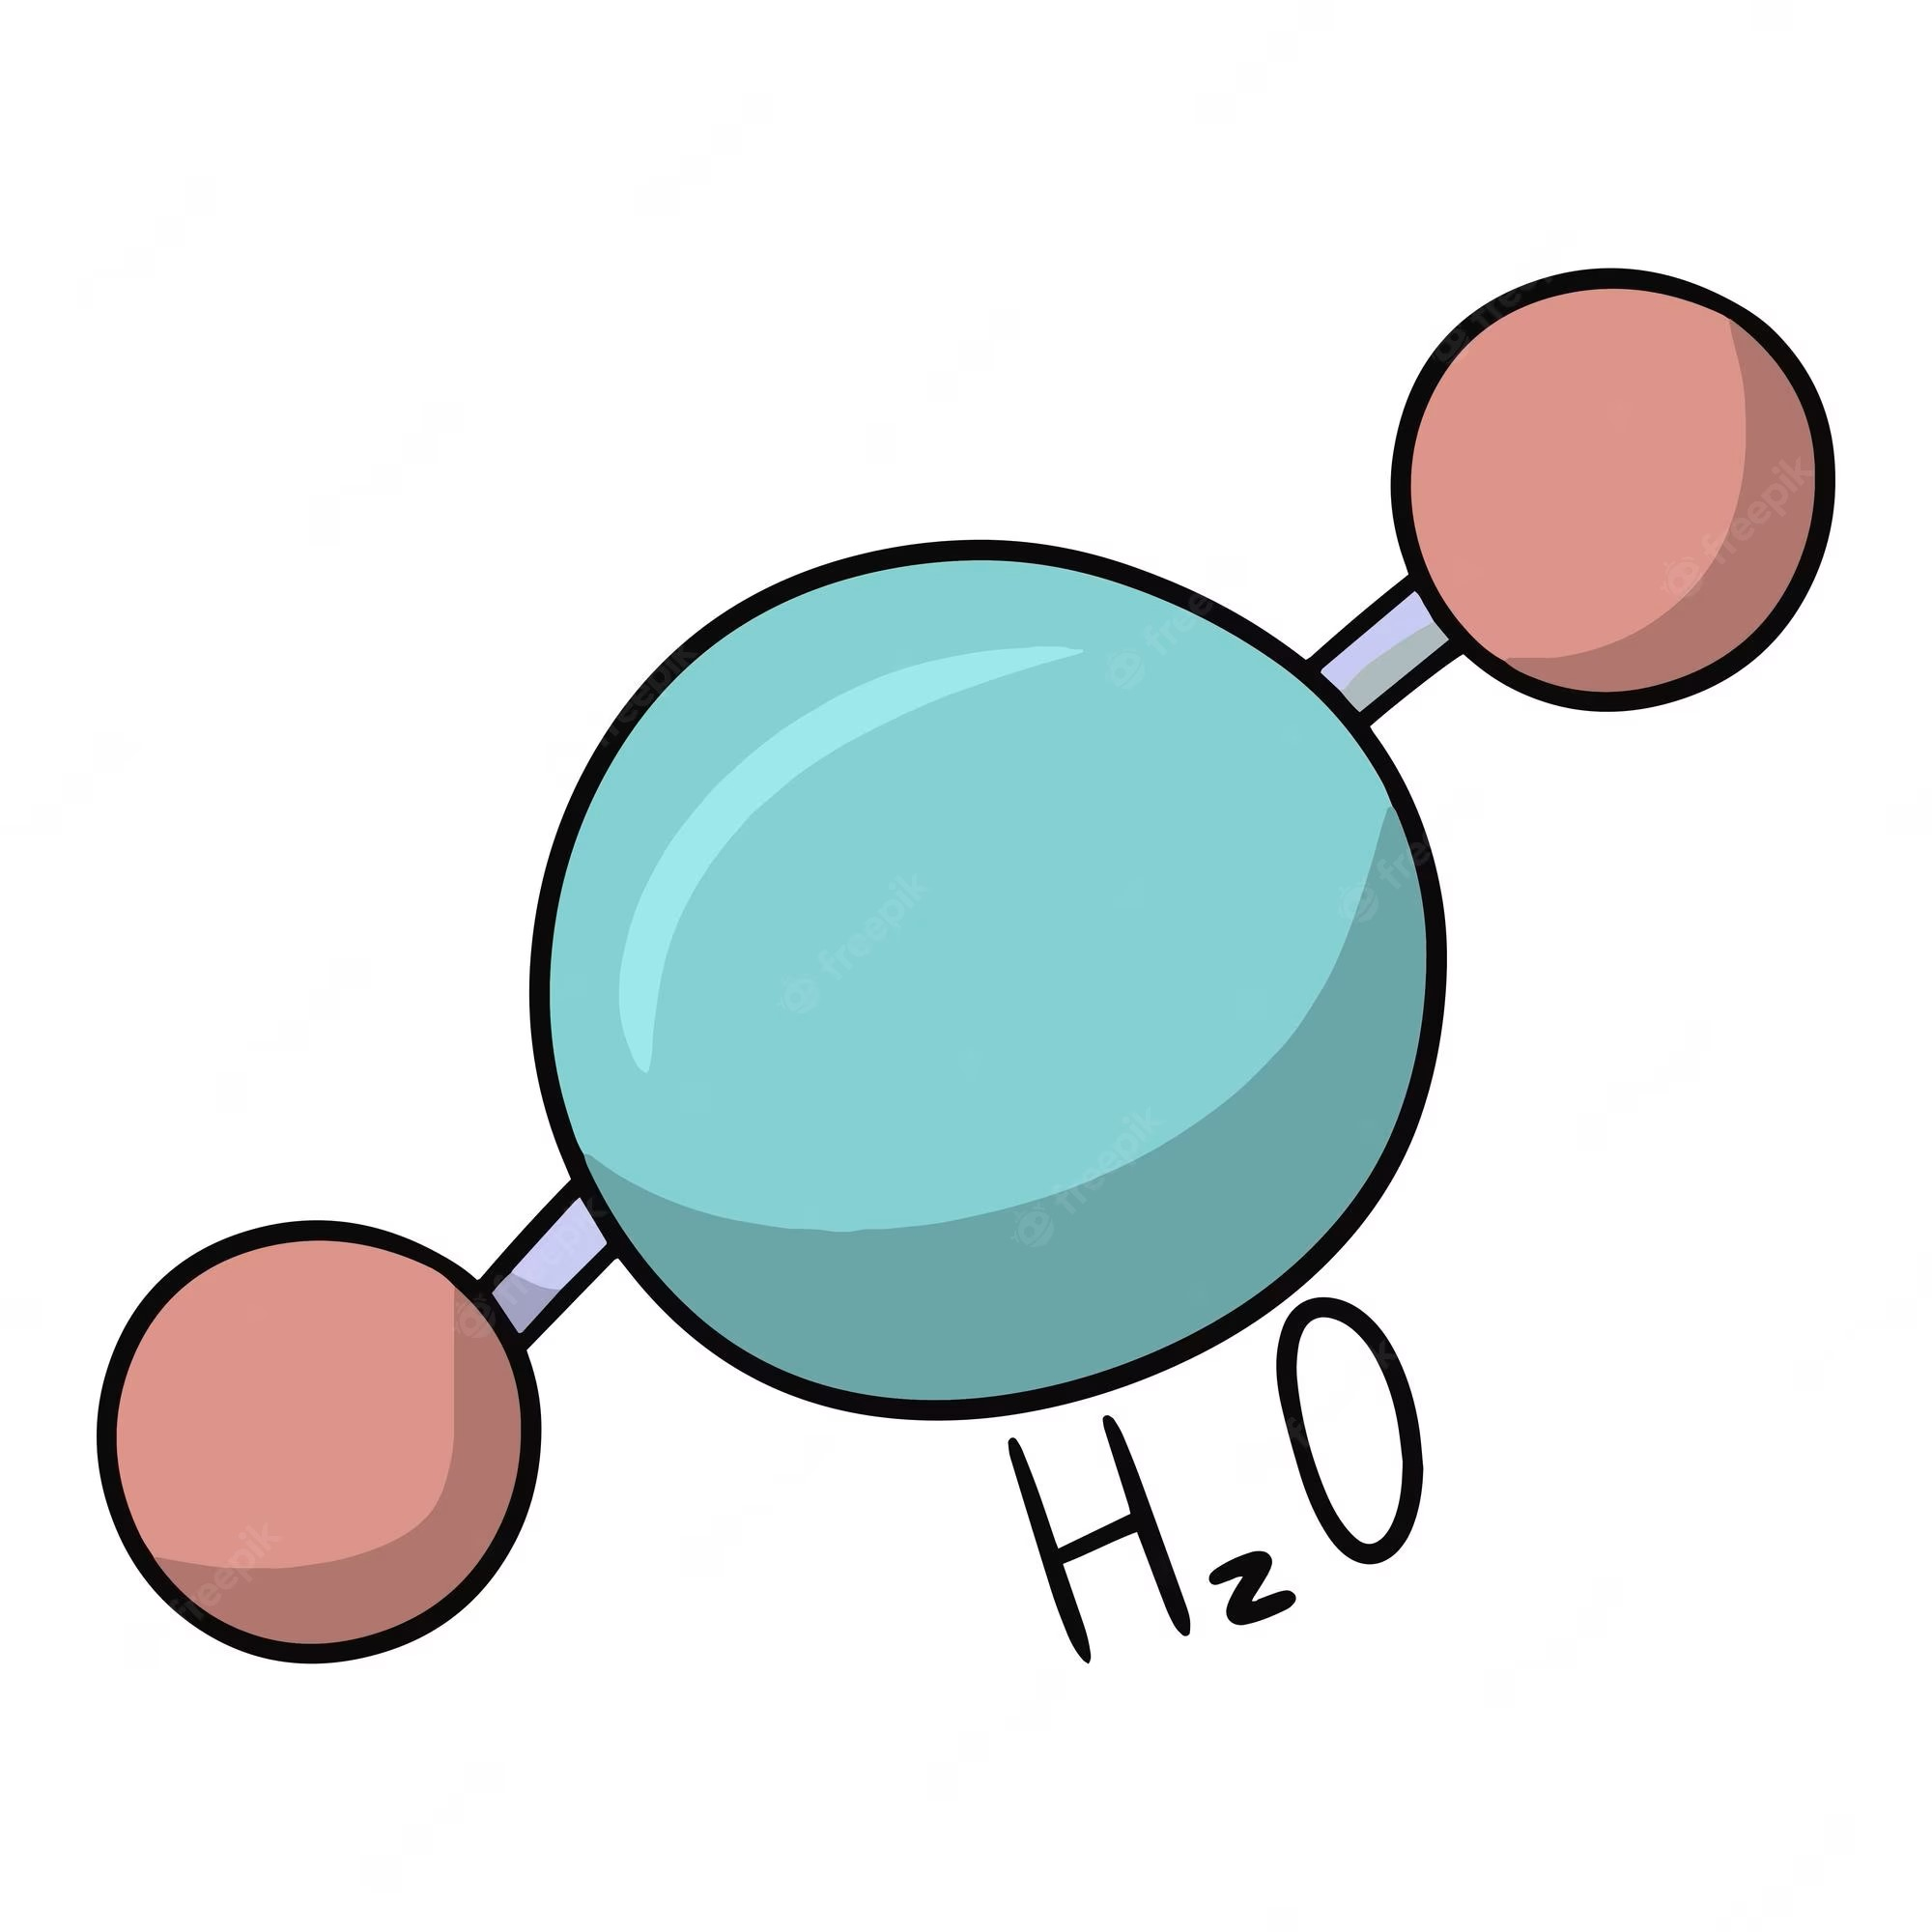

Value (resourcefulness) arises from limitation
Our Agent
Time
Nothing is a resource for an all powerful agent
Notes:
Initially define a resource as something useful or valuable
An all powerful agent can have any amount of anything of do anything

Slide 16
Value (resourcefulness) arises from limitation
Physical Constraints: The Laws of Physics
Therefore have limited access to:
Finite speed of light
Time
Energy Conservation
Quantum Mechanics
We now have a more concrete notion of value (via limitation)
And they are consumed to perform a useful task
Notes:
When considering these constraints things become limited
It is limited access to them that gives them value
If you could have an infinte amount of something, it has not value.

Slide 17
Set of all operations
Physically Constrained Universe
Allowed operations – operations the agent can performed in their constrained universe
Notes:
Restrict what it is the agent can do to isolate your property of interest

Slide 18
Set of all objects
Physically Constrained Universe
Free objects – objects upon which the allowed operations act invariantly

Slide 19
Physically Constrained Universe
Set of all objects
Agent can generate any object in the free set under the allowed operations.
Given a free object, the agent cannot leave the set of free objects under allowed operations
Free objects
Free Object
Free objects – these are the objects the agent can reach under the allowed operations

Slide 20
Physically Constrained Universe
Set of all objects
Agent cannot generate this object under allowed operations.
Free objects
Resourceful Object
Free objects – these are the objects the agent can reach under the allowed operations

Slide 21

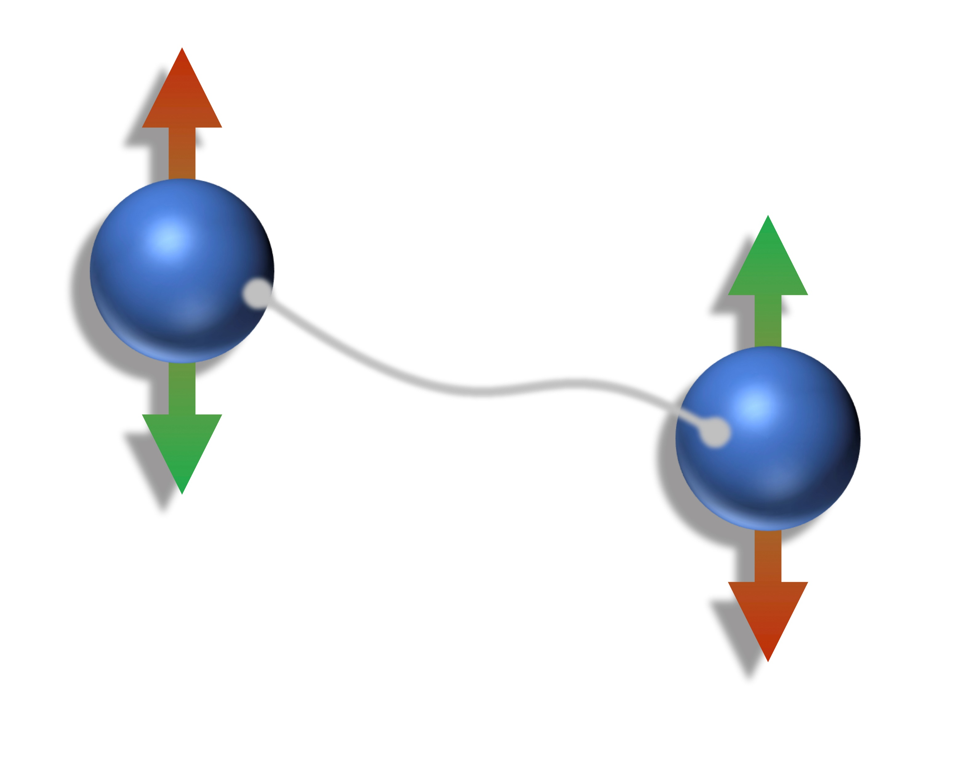
Example: Entanglement
Allowed Operations :
Local Operations
, Classical Communication (LOCC)
Given a separable state, LOCC cannot generate any entanglement.
Alice
Bob
Physical Constraints Allowed operations: LOCC Free Objects: Set of Separable States
Notes:
Cannot generate any entanglement through LOCC
LOCC is resource non-generating
Teleportation is the simulation of a noiseless quantum channel sending one qubit from Alice to bob

Slide 22
What task is entanglement a resource for?
Under allowed operations (LOCC):
Cannot perform quantum teleportation
Can perform quantum teleportation
Set of all quantum states
Entangled state
Separable
States

Slide 23
Entanglement is a resource for the task of quantum teleportation
Note, this is true under this set of physical constraints (LOCC).
Under a different set of physical constraints, entanglement might not be considered a resource.

Slide 24
In the resource theories framework, what is a valuable (resourceful) is dependent on the physical constraints of the system.
Start:
Set the physical constraints
Choose a property
What properties are valuable
Physical constraints

Slide 25
In Summary:
Quantum resource theories are a mathematical framework for quantifying what properties of quantum objects are valuable for performing certain quantum information processing tasks within a set of physical constraints.

Slide 26
Quantum Resource Theory Overview
Mathematical Formalism

Slide 27

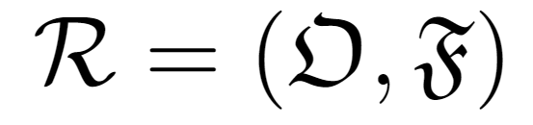

Resource Theories Structure
Allowed operations:
Resource non-generating maps of objects to objects
Free Objects:
Objects that contain no resource.
Quantum Channels:
Complete Positive Trace Preserving Map
Entanglement Example:
= LOCC
Quantum States:
Positive semi-definite, trace one, operators
= Separable States

Slide 28


Quantifying Resourcefulness
Resourceful
Not Resourceful
Currently Binary

Slide 29

Quantifying Resourcefulness
Resourceful
Resourceful
Is or more useful?

Slide 30

Quantifying Resourcefulness
“Useful”
is more resourceful than
such that

Slide 31


Operationally Motivated:
Quantum Register
Classical Register

Slide 32
Operationally Motivated:
Anything I can do with
I can also do with
Pre-processing allowed operation

Slide 33
Quantifying Resourcefulness
such that
Sets a partial order on the set of
free objects (free states) based on how resourceful they are.

Slide 34
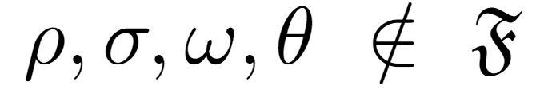

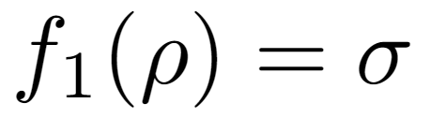
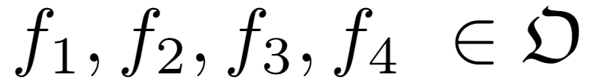


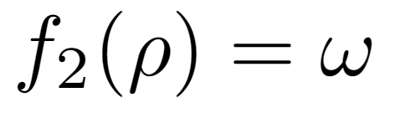
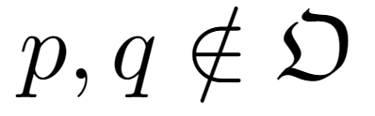
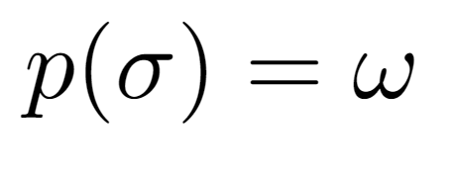
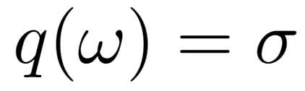

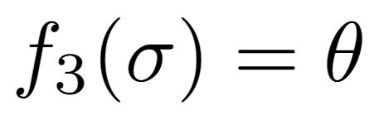
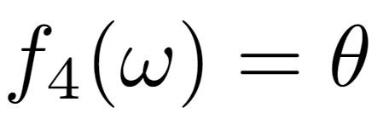
Partial Order Example
What can we conclude?
Non-increasing Resource
Non-increasing Resource
What can we not conclude?

Slide 35
Quantifying Resourcefulness
Given some:
we can use the partial order to determine if or is more useful

Slide 36
Ideally:
We want a function of and that tells us when there exists an allowed between them
when is one is not less resourceful than the other
In some important cases, this has been achieved
Pure State under LOCC (Nielsen's theorem)

Slide 37

Ideally:
Nielsen's theorem
= LOCC
= Separable States
In some important cases, this has been achieved
Pure State under LOCC (Nielsen's theorem)

Slide 38
Ideally:
We want a function of and that tells us when there exists an allowed between them
when is one is not less resourceful than the other
In some important cases, this has been achieved
Pure State under LOCC (Nielsen's theorem)
Energy incoherent states under thermal operations
All states under noisy operations.

Slide 39
In general:
This will be too complicated
Instead use Resource Measures

Slide 40

Resource Measures
M is a function from:
The set of density operators
The positive real numbers

Slide 41
Resource Measures
Such that:
M is monotonic under allowed operations
M decreases if the state is less resourceful

Slide 42
Resource Measures
Such that:
M is zero if the state has no resource

Slide 43
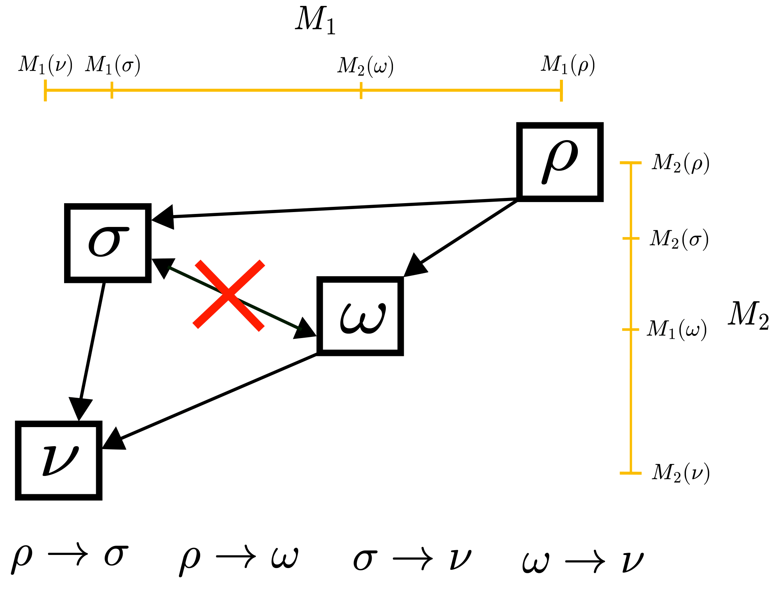
Resource Measures don’t capture the full ordering
Allowed operations exists

Slide 44
Resource Measures don’t capture the full ordering
Allowed operation does not exist

Slide 45
Resource Measures don’t capture the full ordering

Slide 46
Resource Measures don’t capture the full ordering
Decreasing

Slide 47
Resource Measures don’t capture the full ordering

Slide 48


Complete Montone's do capture the full ordering
If
and
full order recovered

Slide 49
Operation Interpretations of Resource Measures
Success probability in state discrimination or state exclusion task
Work of formation
M quantifies the ability to succeed in the operational task
Examples of operational tasks:
Fidelity of teleportation

Slide 50

Operation Interpretations of Resource Measures
Success probability in state discrimination or state exclusion task
Fidelity of Teleportation
Work of formation
= LOCC
Quantifier of the ability to successful teleport quantum information using
= Separable States
Examples of operational tasks:
Fidelity of teleportation

Slide 51

Operation Interpretations of Resource Measures
Success probability in state discrimination or state exclusion task
Fidelity of Teleportation
Work of formation
= LOCC
= Separable States
Examples of operational tasks:
Fidelity of teleportation

Slide 52
Operation Interpretations of Resource Measures
M quantifies the ability to succeed in the operational task
Examples of operational tasks:
Fidelity of teleportation
Success probability in state discrimination or state exclusion task
Work of formation

Slide 53
In Summary:
Allowed Operations
Free Objects
Quantum Channels:
Complete Positive Trace Preserving Map
Quantum States:
Positive semi-definite, trace one, operators

Slide 54
In Summary:
Resource Measures
In general, they do not capture the full partial order
Aim to give them operational interpretations

Slide 55
Resource Enhancement in Quantum Resource Theories

Slide 56
Resource Enhancement
A resource is a useful property.
There is therefore an incentive to increase the amount one has.
However, allowed operations are resource non-generating.

Slide 57
Resource Enhancement
Global resource non-generating operations
Locally resource increasing in some subspace

Slide 58
Resource Enhancement
Maximally Resourceful

Slide 59
Resource Enhancement
Partially Resourceful

Slide 60
Resource Enhancement
Resourceless – a free state

Slide 61

Resource Enhancement

Slide 62
Resource Enhancement
Allowed Operations

Slide 63
Resource Enhancement

Slide 64
Resource Enhancement

Slide 65
Resource Enhancement
Total resource not increased
Local resource has increased

Slide 66


Resource Enhancement

Slide 67
Resource Enhancement
?
>

Slide 68
Resource Enhancement

Slide 69
Resource Enhancement

Slide 70

Resource Distillation

Slide 71

Resource Distillation

Slide 72

Resource Distillation

Slide 73
Resource Enhancement
Free states

Slide 74
Resource Enhancement Summary
Use Global resource non-generating operations to locally increase the resource in some subspace
Exploit differences in the structures of single party and multipartite resource theories
Typically, been studied via distillation.

Slide 75
Resource Concentration
Conclusion
Jump to

Slide 76
Aim: Local Enhancement of Resource
A
B
Relocate Resource

Slide 77
Aim: Local Enhancement of Resource
A
B
Resource non-generating unitary dynamics
(allowed unitaries)
Unitary Dynamics
Trace out

Slide 78



Resource Concentration
Where is a resource non-generating unitary
is a resource quantifier (a monotone)

Slide 79
Motivation for Resource Concentration
Simplest feasible case of resource enhancement
Only two copies of the input state
No free states
Only allowed global unitaries, no allowed global channels
Allow a bottom-up understanding of resource enhancement to be built

Slide 80
Resource Concentration: Expected Behaviour
Cannot increase the resource if its maximally resourceful

Slide 81
Resource Concentration: Expected Behaviour
Cannot increase the resource if there is no resource

Slide 82
We applied this to two different resources:
Unspeakable Coherence
Jump to
Informational non-equilibrium (Purity)
Jump to

Slide 83
Unspeakable Coherence Concentration
How to quantify coherence: Distinguishing speakable and unspeakable notions, Iman Marvian & Robert W. Spekkens, Phys. Rev. A, 2016

Slide 84


Resource Theory of Unspeakable Coherence
Free States
Allowed Operations
Free states (states with no coherence with respect to the eigenstates of L) are those that are symmetric under translation generated by L

Slide 85
Unspeakable Coherence Concentration
Framework

Slide 86



Framework
has no coherence between the eigenspaces of

Slide 87

Framework
generates no coherence between the eigenspaces of

Slide 88




Framework
generates no coherence between the eigenspaces of
is conserved under the dynamics
Expectation Values conserved:
Coherence non-generating unitaries are well physically motivated
Individual unitary acts within each degenerate subspace of
All higher order moments conserved:
Probabilities conserved:

Slide 89

Characterise when:
Coherence of
>
Coherence of
A
B
When restricting to unitary dynamics that are coherence non-generating:
Conservation is additive

Slide 90
Characterise when:
Coherence of
>
Coherence of
A
B
When restricting to unitary dynamics that are coherence non-generating:

Slide 91
Qubits

Slide 92
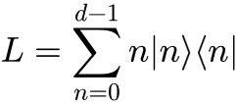





Qubits

Slide 93


Qubits
Such that:

Slide 94

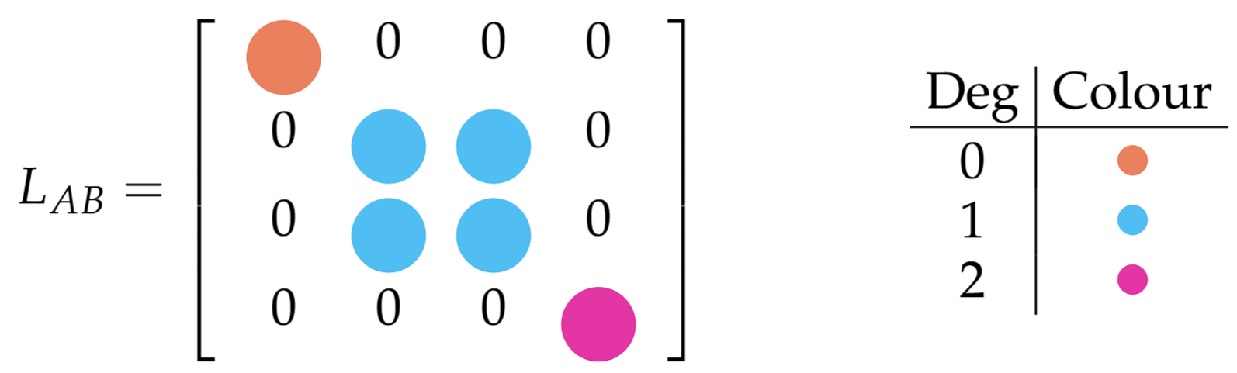


Qubits

Slide 95
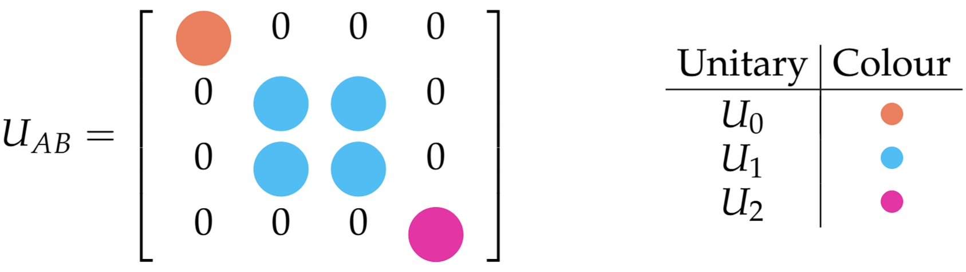

Qubits
Two dimensional unitary
Or
Effective Qubit Unitary in subspace
One dimensional
unitary

Slide 96

Qubits

Slide 97



Qubits
Observation 1:
Observation 2:
If
If
As expected

Slide 98
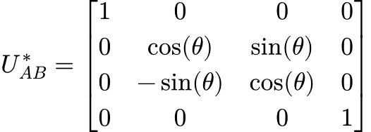
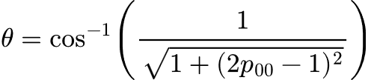
Qubits
Optimal Unitary

Slide 99
Qubits
Effective single qubit rotation in the subspace

Slide 100
The two-qubit case can therefore be completely characterised
But what if I would like to increase the local coherence of my qubit beyond ?

Slide 101

The two-qubit case can therefore be completely characterised
Qubit Concatenation
But what if I would like to increase the local coherence of my qubits beyond ?

Slide 102

A
B
Optimal unitary when inputting two

Slide 103
A
B
A
B

Slide 104

A
B

Slide 105
A
B
A
B

Slide 106


A
B

Slide 107
Optimal unitary for given input state

Slide 108


Slide 109
Optimal unitary for given input state
Greedy Coherence Enhancement Protocol

Slide 110
This protocol is completely constructive
Greedy Coherence Enhancement Protocol

Slide 111
Input states
Completely Constructive
steps
However
Inefficient

Slide 112



Qubit Concatenation
at the
step
at the
step
These are coupled, non-linear recurrence relations

Slide 113
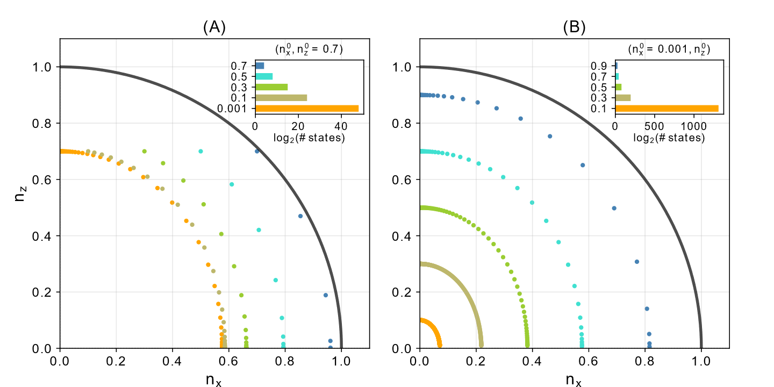
Qubit Concatenation

Slide 114

Qubit Concatenation
Input state:
State at step 1
State at step 2
State at step 3
Final State

Slide 115
Qubit Concatenation

Slide 116
Informational Non-equilibrium (Purity) Concentration
The resource theory of informational nonequilibrium in thermodynamics, Gour et al., Physics Reports, 2015
Conclusion
Jump to

Slide 117

Informational Non-equilibrium
Colloquially: the resource (informational non-equilibrium) of a state is a measure of how “far” that state is from the maximally mixed state (the informational equilibrium state)
Allowed Operations Free States
Noisy Operations Maximally mixed state
We care about the subset of allowed operations that are unitary
Notes:
Noisy operations are a strict subset of unital operations. But there exists a noisy operation between two states if and only if there also exists a unital operation between them too.

Slide 118
Resource Theory of Informational Non-equilibrium
Colloquially: the resource (informational non-equilibrium) of a state is a measure of how “far” that state is from the maximally mixed state (the informational equilibrium state)
Free States
Allowed Operations
We care about the subset of allowed operations that are unitary

Slide 119

Informational Non-equilibrium
Special case of the resource theory of thermodynamics
Allows the informational contributions to thermodynamics to be isolated from the energetic ones.
Mathematical simple and hence a good test bed for new ideas.
such that
Notes:
Noisy operations are a strict subset of unital operations. But there exists a noisy operation between two states if and only if there also exists a unital operation between them too.

Slide 120

Measuring Informational Non-equilibrium
d-dimensional maximally mixed state
Notes:
Noisy operations are a strict subset of unital operations. But there exists a noisy operation between two states if and only if there also exists a unital operation between them too.

Slide 121
Measuring Informational Non-equilibrium
This is a good measure of informational non-equilibrium
Monotonic under allowed operations:
Faithful:
i.e is a free state (here we have only one free state)
Notes:
Noisy operations are a strict subset of unital operations. But there exists a noisy operation between two states if and only if there also exists a unital operation between them too.

Slide 122


Measuring Informational Non-equilibrium
- Maximum Eigenvalue
Notes:
Noisy operations are a strict subset of unital operations. But there exists a noisy operation between two states if and only if there also exists a unital operation between them too.

Slide 123





Informational Non-equilibrium Concentration
Does there exists a two-qudit unitary, , achieving
All are resource non-increasing when considering informational non-equilibrium
where
Notes:
Noisy operations are a strict subset of unital operations. But there exists a noisy operation between two states if and only if there also exists a unital operation between them too.

Slide 124


Main Result
For a d-dimensional state ,
Where
- The sum over the d largest eigenvalues of

Slide 125


Initial Takeaways
This is true for all resource measures
No concentration for two qubits:
For all , one can always find a such that
Concentration is bounded by initial resource content:
Notes:
Unique to qubits that informational non-equilibrium concentration is not possible. Need to understand why true for all metrics

Slide 126
A notion of “Bound” Informational Non-equilibrium

Slide 127


A notion of “Bound” Informational Non-equilibrium
If , then .
If is not a pure state, and not the maximally mixed state, but the above is satisfied, then,
is resourceful but that resource cannot be concentrated.
We coin the term bound informational non-equilibrium to describe such states

Slide 128
Bound Resource

Slide 129

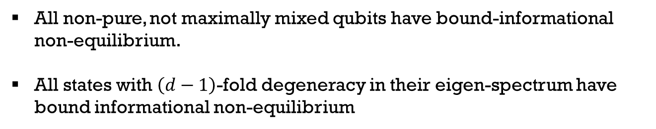
A notion of “Bound” Informational Non-equilibrium
All non-pure, not maximally mixed qubits have bound-informational non-equilibrium.
All states with $\left(d−1\right)$-fold degeneracy in their eigen-spectrum have bound informational non-equilibrium
Some pure state

Slide 130

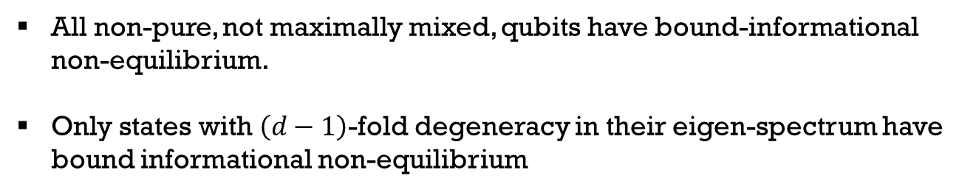
A notion of “Bound” Informational Non-equilibrium
All non-pure, not maximally mixed, qubits have bound-informational non-equilibrium.
Only states with $\left(d−1\right)$-fold degeneracy in their eigen-spectrum have bound informational non-equilibrium
Dephasing channels acting on pure states produce states with bound informational non-equilibrium

Slide 131
Qutrit Example

Slide 132



Qutrits
As
The optimal amount of informational non-equilibrium that be concentrated given two qutrits is always given by the above equation

Slide 133
Qutrits
(applied on )
The dynamics that optimally concentrate informational non-equilibrium given two qutrits is independent of the state

Slide 134
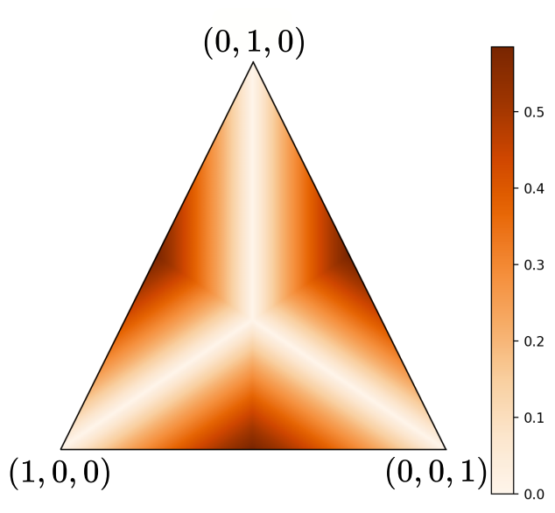

Qutrits
System A’s local change in resource
Symmetric due to the ordering of the eigenvalues
States with bound informational non-equilibrium
Maximum Concentration for states where:

Slide 135

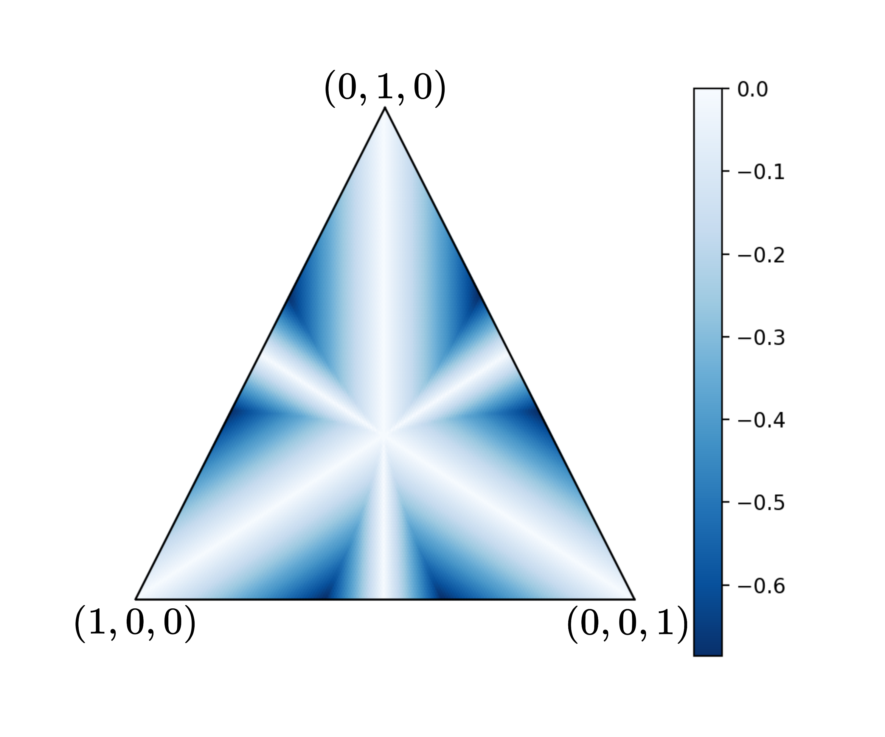
Qutrits
Max change
Zero change

Slide 136
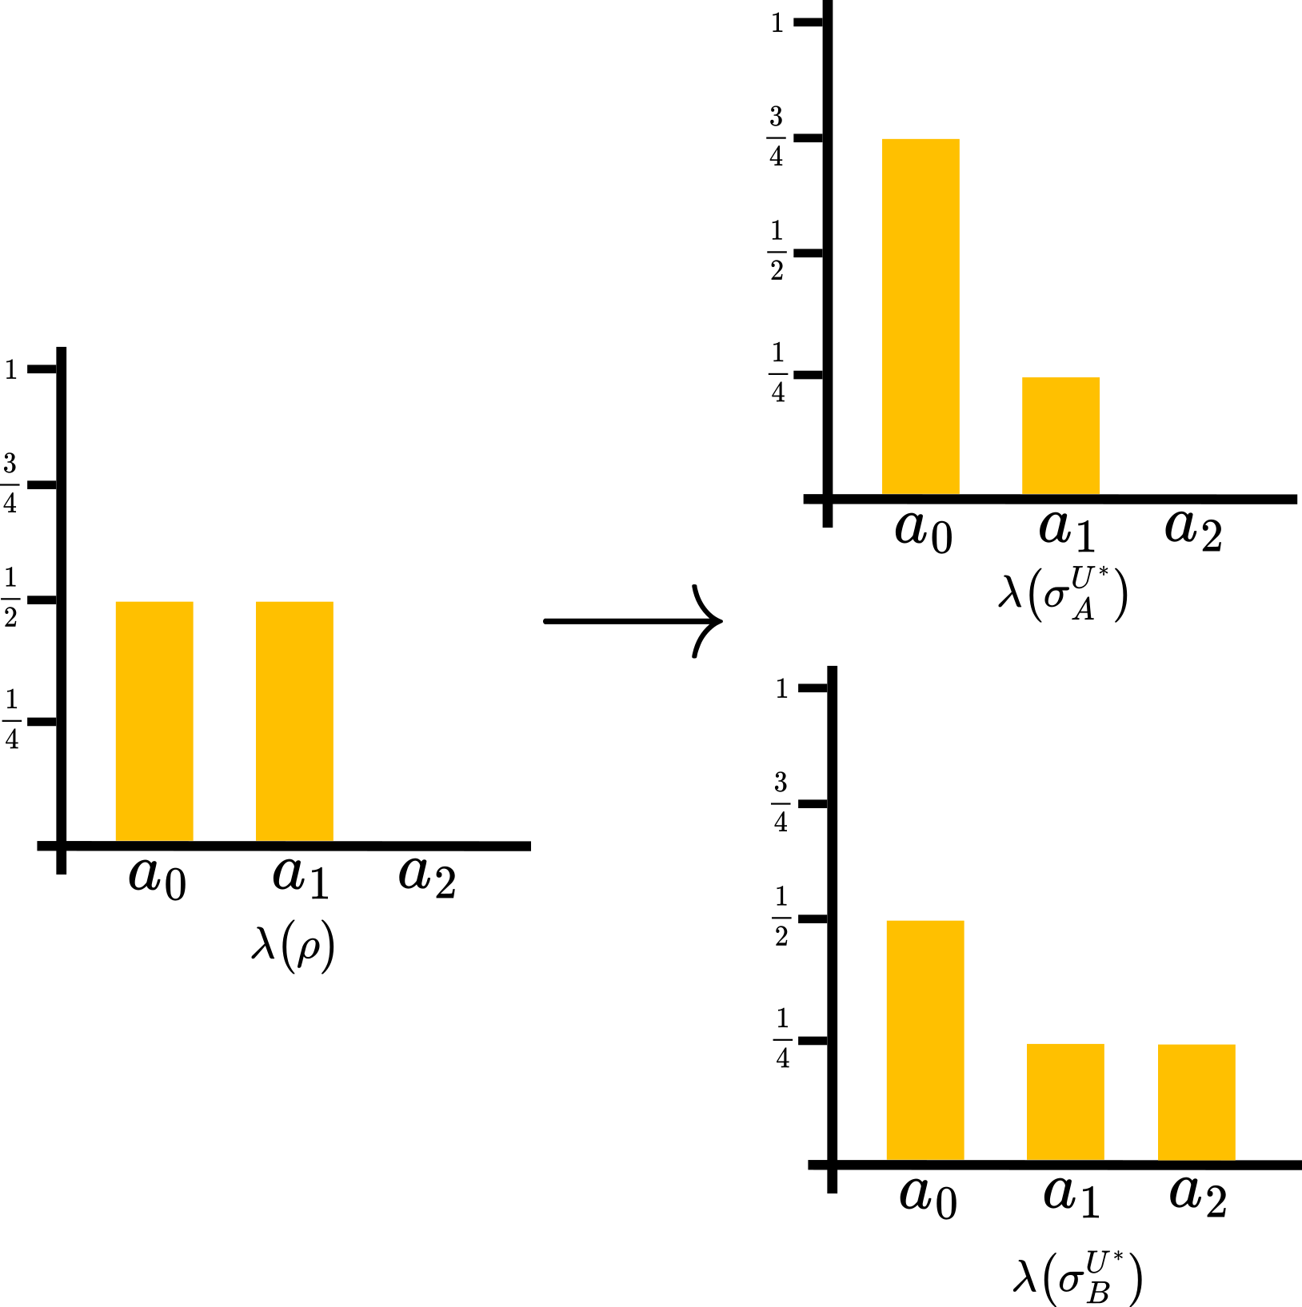
Qutrits

Slide 137


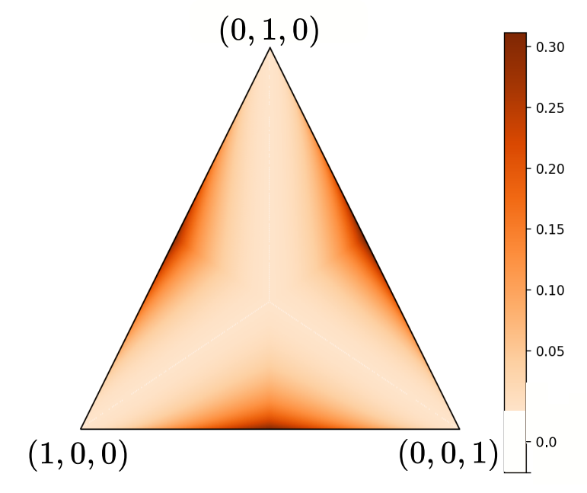
Qutrits
,
Two-qutrit optimal concentration must generate global correlation:

Slide 138
Resource Concentration: Expected Behaviour
Cannot increase the resource if one state has no resource

Slide 139
Future Directions
Apply to another other resource theory, e.g., thermodynamics.
Explore the notion of concentration of non-static resources
Measurement, dynamics.
Find physically relevant scenarios where concentration is useful.

Slide 140
The More The Merrier - Resource Enhancement in Quantum Resource Theories
Informational nonequilibrium concentration
Chung-Yun Hsieh, Benjamin Stratton, Hao-Cheng Weng, Valerio Scarani, Phys. Rev. A, 2025
Unspeakable Coherence Concentration
Benjamin Stratton, Chung-Yun Hsieh, Paul Skrzypczyk, arXiv:2512.04255v1, 2025.
Quantum Resource Theories, Eric Chitambar and Gilad Gour, Reviews of Modern Physics, 2019
An Introductory Review of the Resource Theory Approach to Thermodynamics, Matteo Lostaglio, Reports on Progress in Physics, 2019

Slide 141
Quantum Resource Theory Overview
Conceptual Foundations – Extra Slides

Slide 142
Physically Constrained Universe
Set of all objects
How resourceful this object is
Resource can be quantified by there “distance” to the free objects
Free objects
Resourceful Object
Free objects – these are the objects the agent can reach under the allowed operations

Slide 143
Physically Constrained Universe
Set of all objects
A
Free objects
Object A > Object B
B
Free objects – these are the objects the agent can reach under the allowed operations

Slide 144
What is a Resource?
A resource is anything that allows our agent to overcome the physical constraints of the system

Slide 145
Allow us to define value
Focus the question:
Under a given set of physical constraints, what properties of quantum objects become valuable?
Useful property Resource
Answering these question is the goal of quantum resource theories.

Slide 146
Unspeakable Coherence Concentration
Framework – Extra Slides

Slide 147




Resource Theory of Unspeakable Coherence -Modes
Modes evolve independently under allowed operations
an allowed
operation

Slide 148
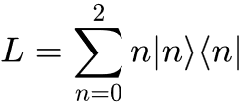
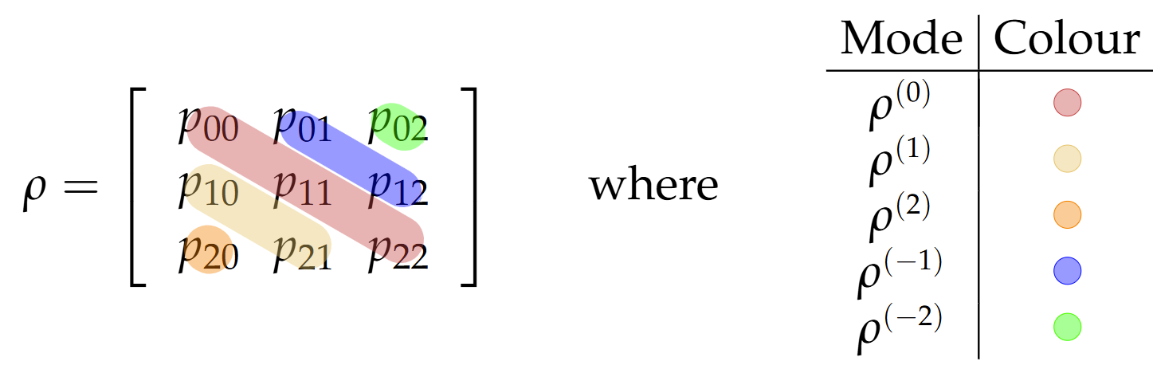
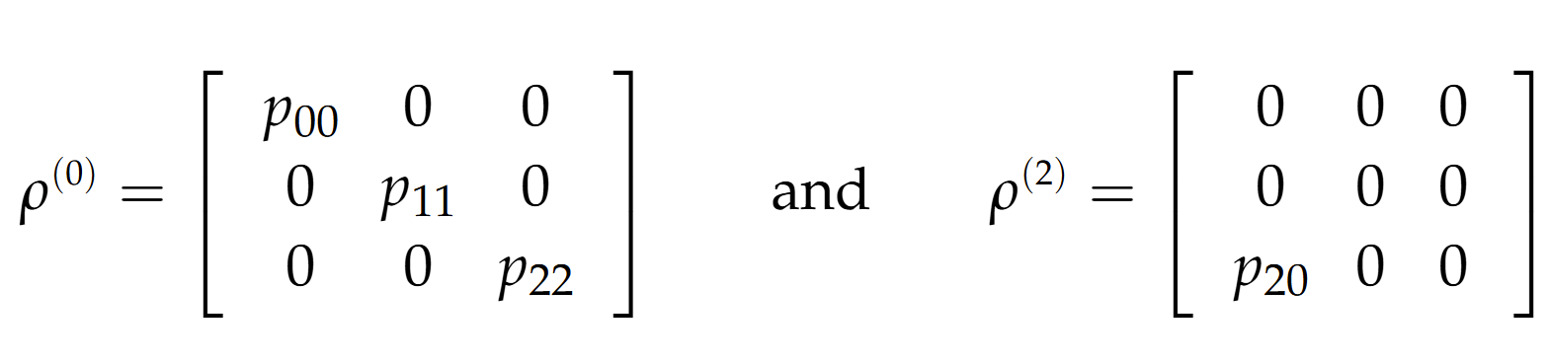
Resource Theory of Unspeakable Coherence -Modes

Slide 149


Resource Theory of Unspeakable Coherence - Modes
Resource Measure
if

Slide 150
Unspeakable Coherence Concentration
Bloch Sphere – Extra Slides

Slide 151

Bloch Sphere
Rotation about Z-axis of the Bloch Sphere:

Slide 152


Bloch Sphere
as

Slide 153
Bloch Sphere
Real Plane

Slide 154




Real Plane

Slide 155

Real Plane
Fixed Point 1:

Slide 156

Real Plane
Fixed Point 1:
Fixed point 2:

Slide 157
Real Plane
Fixed Point 1:
Can focus only on this quadrant
Fixed point 2:

Slide 158
Unspeakable Coherence Concentration
Qubit Concatenation – Extra Slides

Slide 159


Qubit Concatenation - Purity Bound

Slide 160

Qubit Concatenation
Fixed points of recurrence relations:
( - Axis)
( - Axis)

Slide 161
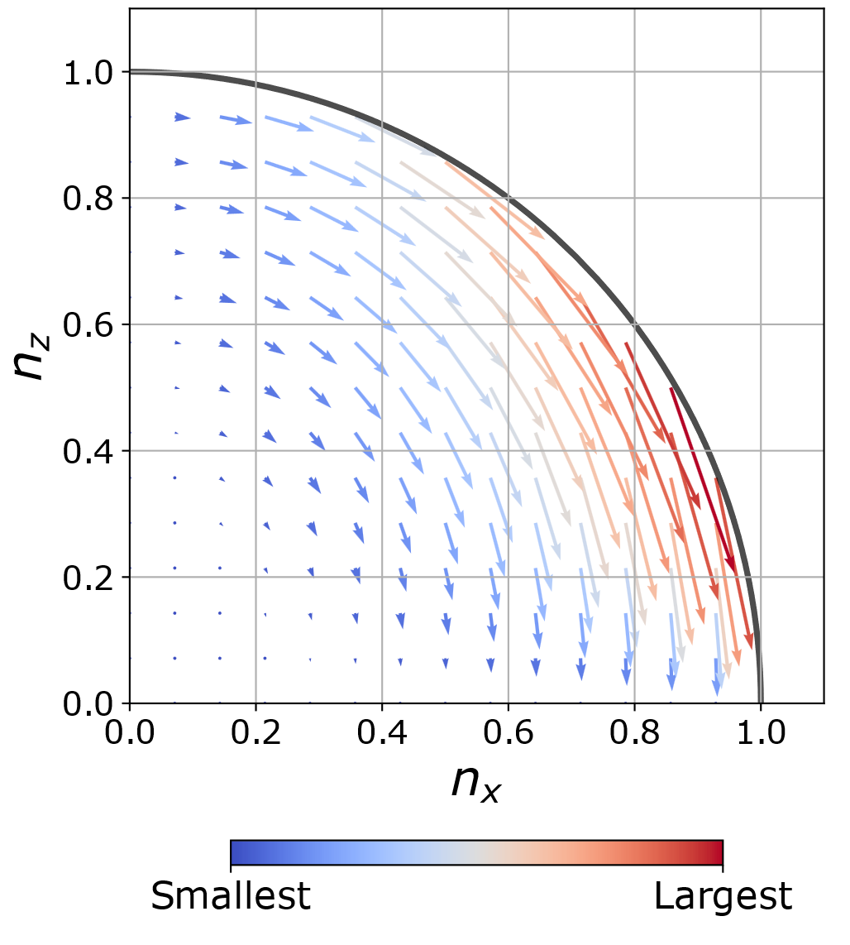

Slide 162
Unspeakable Coherence Concentration
d-dimensional case – Extra Slides

Slide 163
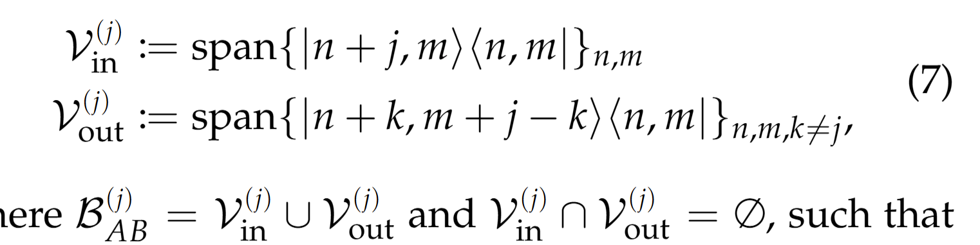
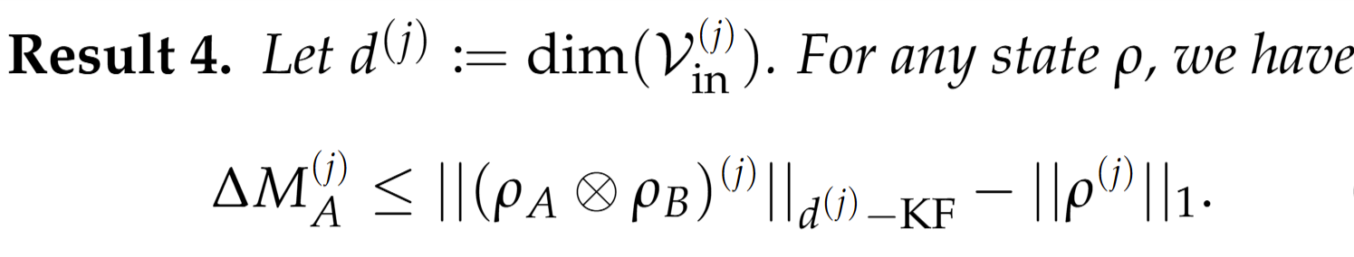
jth mode subspace

Slide 164
Unspeakable Coherence Concentration
Initial Correlations – Extra Slides

Slide 165
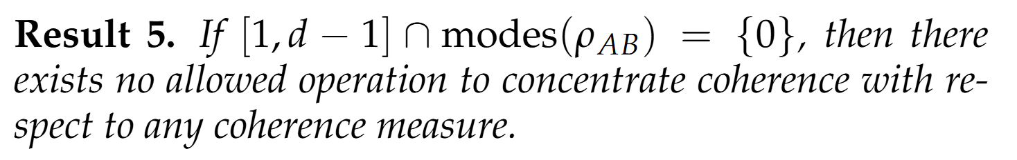
Initial Correlations
Example:
No concentration for all p, despite the state being entangled for some p

Slide 166
Informational Non-equilibrium (Purity) Concentration
Correlations, Entanglement and Concentration – Extra Slides

Slide 167




Correlations and Concentration
Can correlations activate concentration?
Maximally entangled state over AB
Let have bound informational non-equilibrium.
Global correlations can active concentration, and bound informational non-equilibrium is not robust to noise
, if applied
Change in in system A

Slide 168

Entanglement and Concentration
What about entanglement?
What can I concentrate with:
of pure state
of initial marginal
Vs what I concentrate with:

Slide 169
Entanglement and Concentration
What about entanglement?
What can I concentrate with:
Vs what I concentrate with:
Entanglement Advantage

Slide 170
Informational Non-equilibrium (Purity) Concentration
Informational Non-equilibrium vs Purity – Extra Slides

Slide 171
Informational Non-equilibrium vs Purity
Purity
The physical property about whether the system in a pure state
Informational non-equilibrium
The physical property about whether the system not in the maximally mixed state
Dimension independent
Dimension dependent
Notes:
Noisy operations are a strict subset of unital operations. But there exists a noisy operation between two states if and only if there also exists a unital operation between them too.

Slide 172



Informational Non-equilibrium vs Purity
Notes:
Noisy operations are a strict subset of unital operations. But there exists a noisy operation between two states if and only if there also exists a unital operation between them too.

