Slide 1


AbstractVM
Epitech, 2019-2020
-

Slide 2
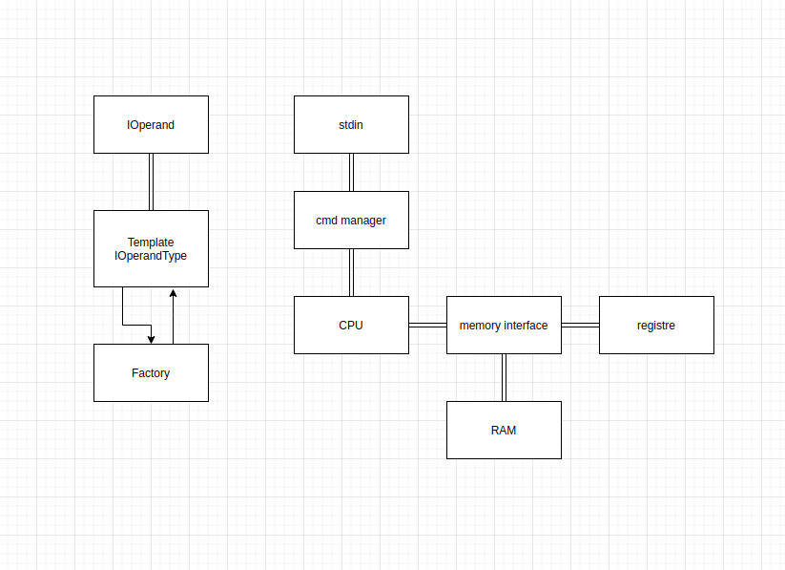

What is that
Abstract
Project?

Slide 3
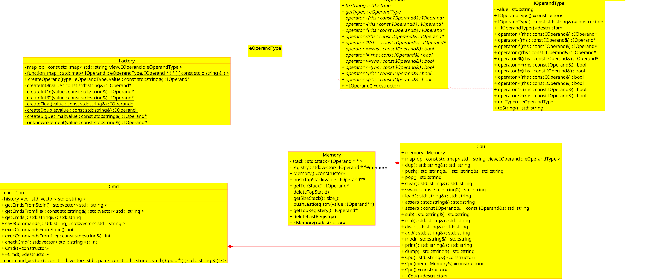
UML

Slide 4
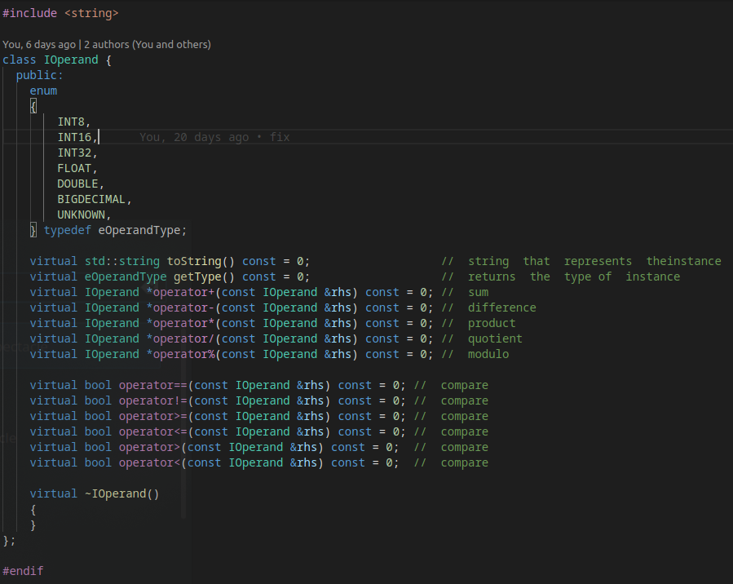
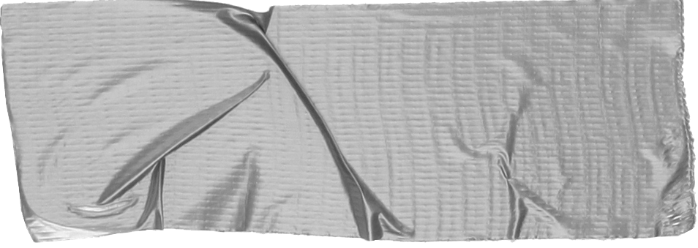

Class : IOperand
About:
Design Pattern: Prototype

Slide 5
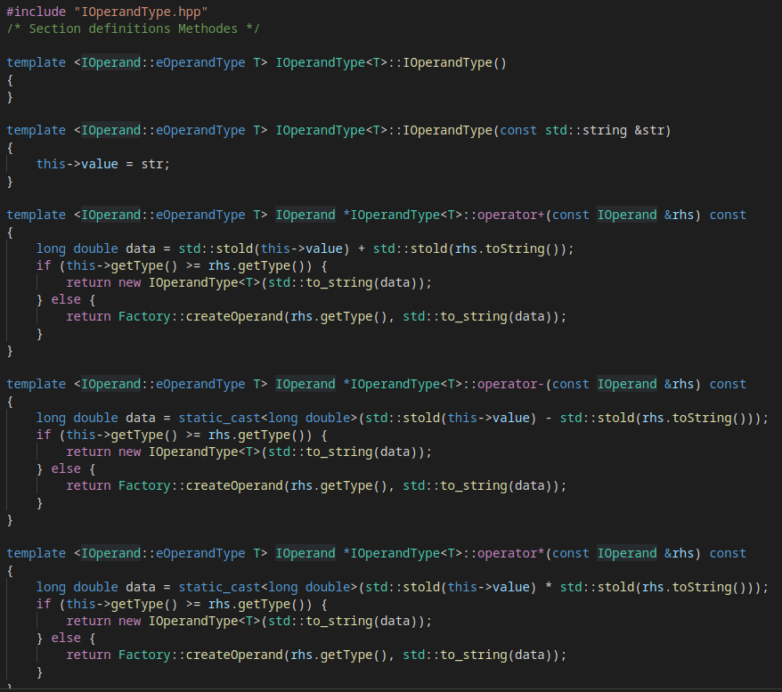
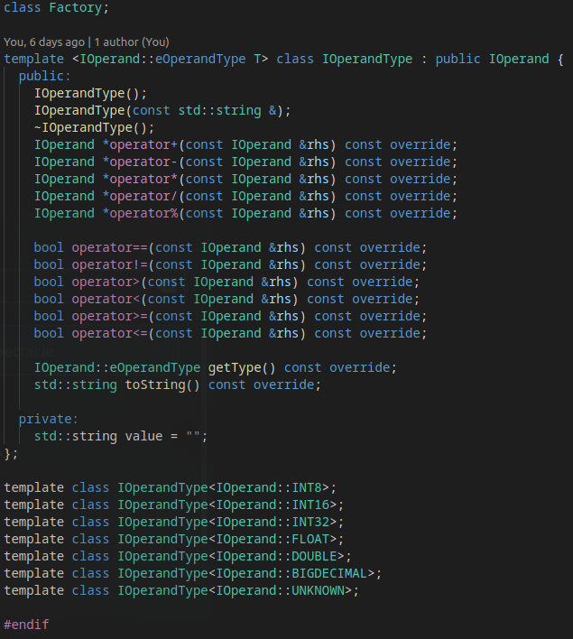
Class : IOperandType

Slide 6
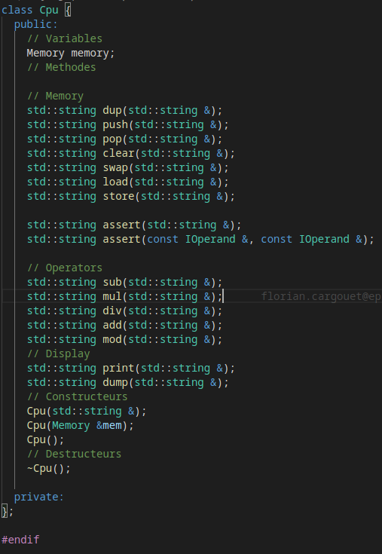
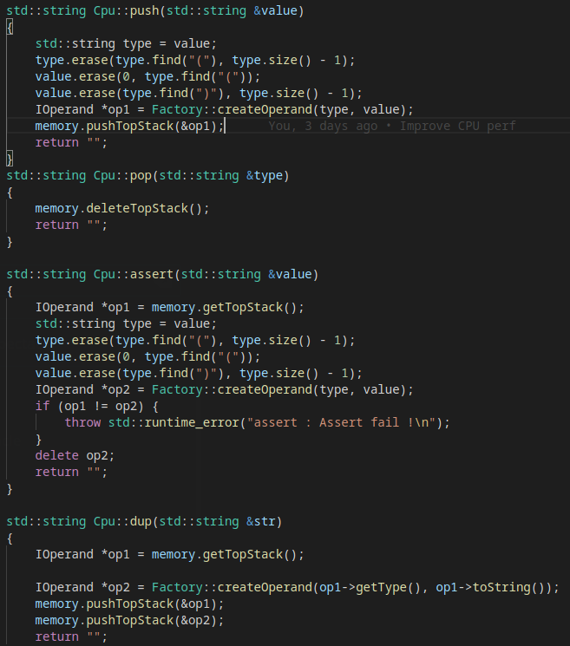
Class : Cpu

Slide 7
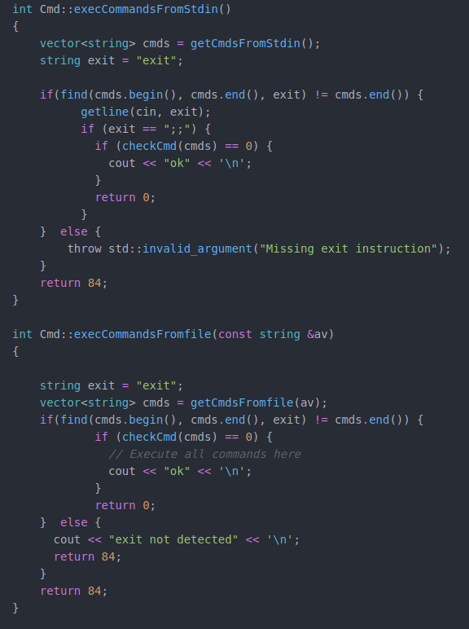
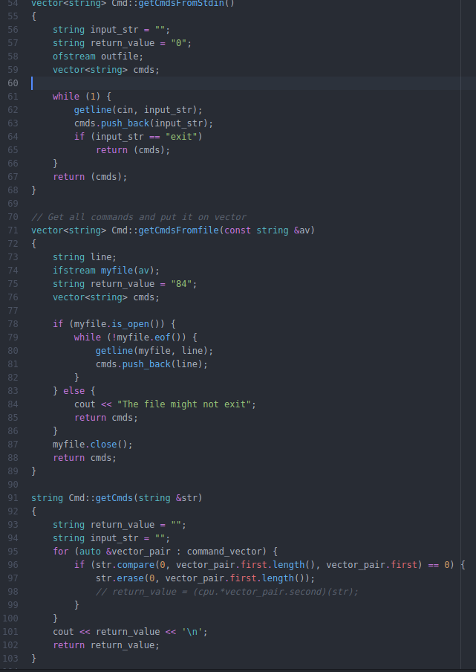
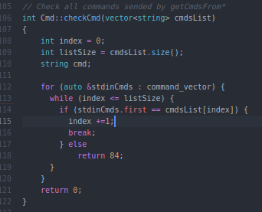
Class : CmdManager

Slide 8
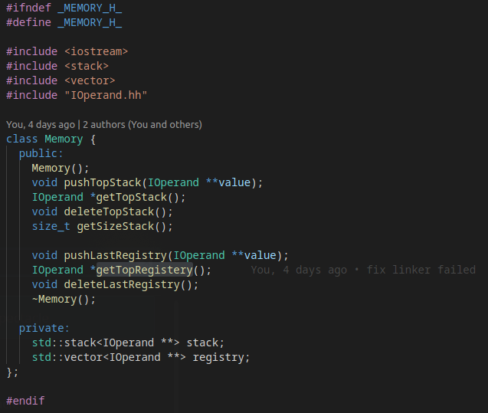
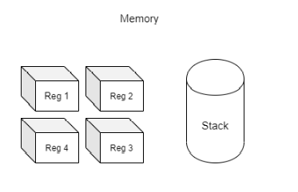
Class : Memory

Slide 9
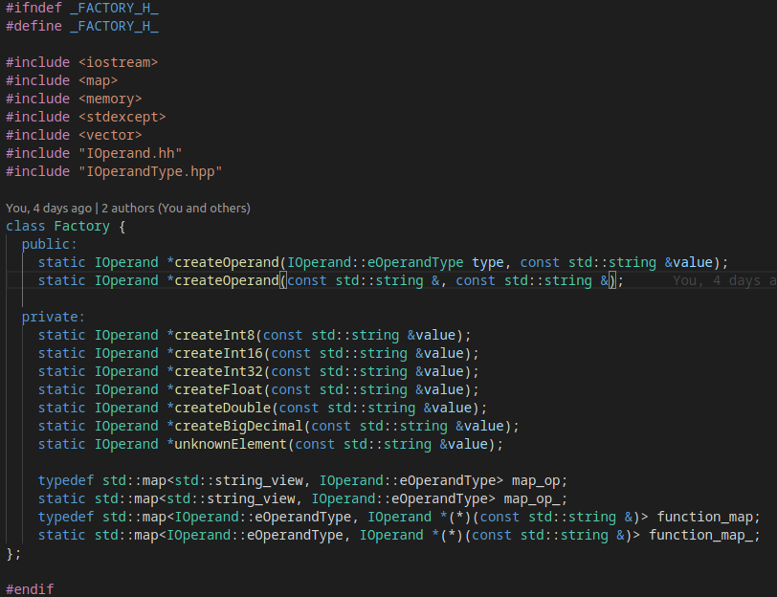
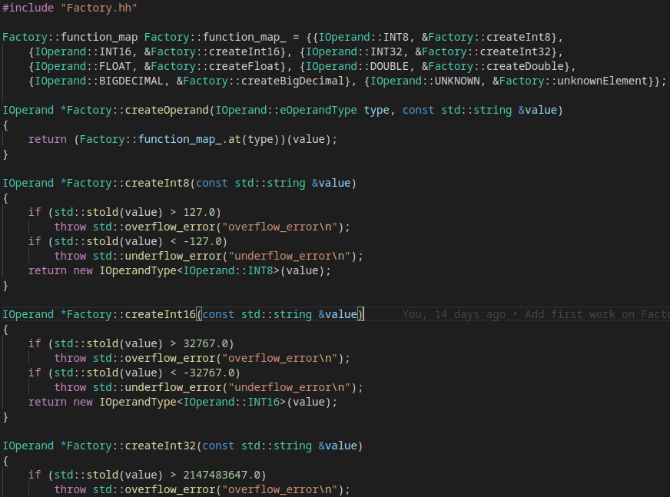
Class : Factory

Slide 10
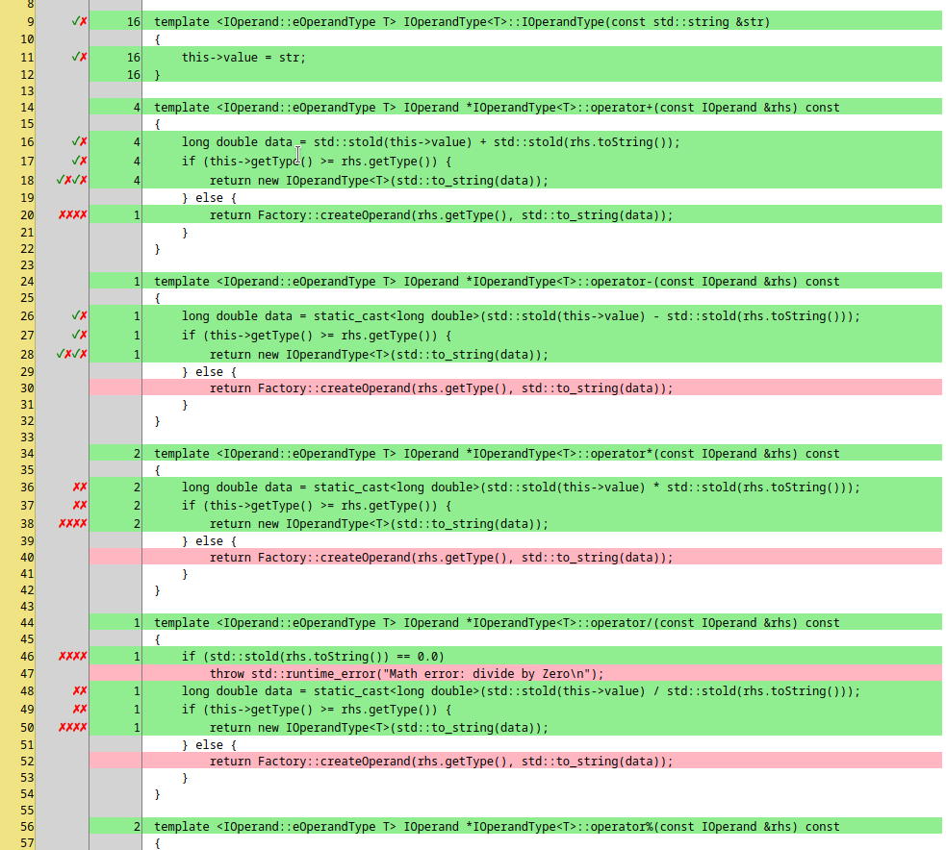
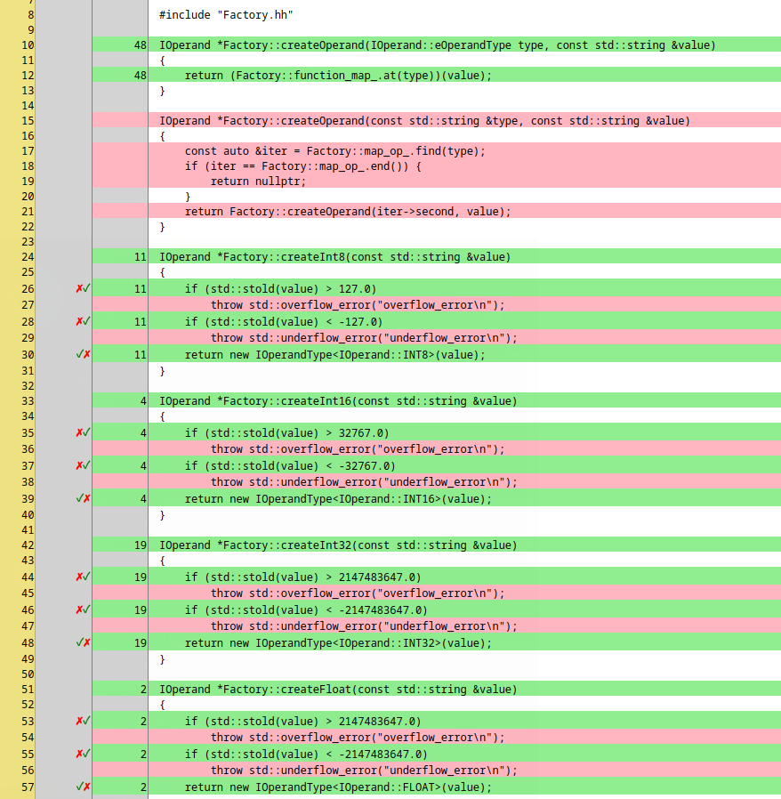
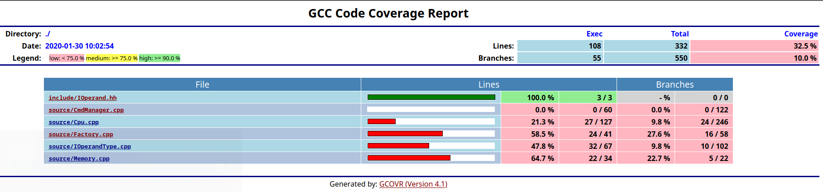
Coverage
With GCOVR

Slide 11
Trello
Umbrello
Draw.io
VSC and Atom

Slide 12
The functional aspect
Working
IOperand and others.
Memory (Stack and Reg)
Overload Operator
Partially working
CPU (Some CMD)
CmdManager
Not working
Parsing and cmd cleanning

Slide 13
What if we had to redo it ?

Slide 14
Merci de votre écoute

