Slide 1

The Return of JavaScript
Three Projects Driving JavaScript's Renaissance

Slide 2




What’s this about?
Why you should care about JavaScript
3 Open-Source JavaScript Projects:

Slide 3

Me
JavaScript
Notes:
My background

Slide 4
Why JavaScript?

Slide 5
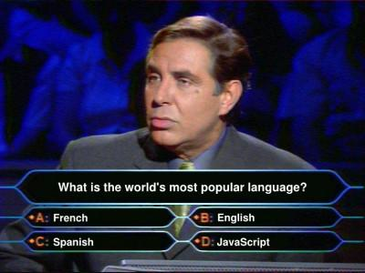
Notes:
1 billion PCs world-wide
Google/Apple/Twitter/Facebook know this
Since 2001, has oscillated between 10th and 8th position (ruby 8th and 27th, python 4th and 13th, perl 5th and 10th, PHP 4th and 10th, VB 4th and 7th)

Slide 6
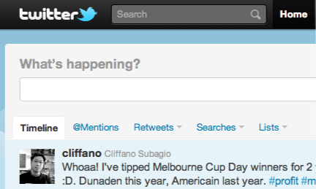
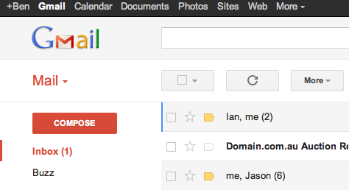
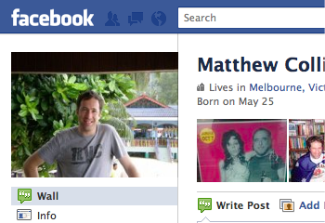
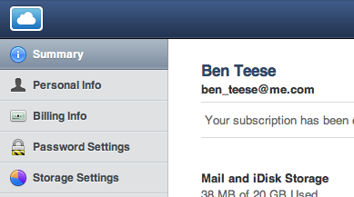
Single Page Apps

Slide 7

Notes:
- Don’t confuse the DOM with JavaScript
- It’s actually a pretty nifty functional language

Slide 8
jQuery is not enough
Notes:
jQuery is not enough

Slide 9
Notes:
MVC Scales
MVC is well known
Knockout.js/JavaScriptMVC/Sproutcore/Cappucino
Created by Jeremy Ashkenas
UI Agnostic
Lightweight
Got momentum

Slide 10
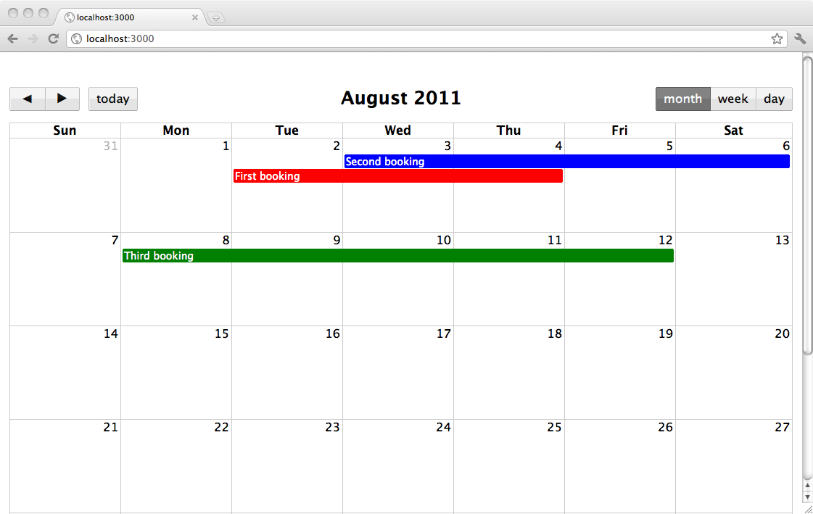

Slide 11
Models and Collections
var Booking = Backbone.Model.extend();
var Bookings = Backbone.Collection.extend({
model: Booking,
url: '/bookings'
});
Notes:
Models and Collections:
- Back-end synchronization
- Event generation
- Client-side validation

Slide 12
Views
var BookingsView = Backbone.View.extend({
initialize: function(){
_.bind(this, 'addAll', 'handleClick');
this.collection.bind('reset', this.addAll);
},
render: function() {
this.el.fullCalendar({
eventClick: this.handleClick
});
},
addAll: function() {
this.el.fullCalendar('addEventSource', this.collection.toJSON());
},
handleClick: function(booking) {
...
}
});
Notes:
Views:
- Intermediate DOM and models
- Subscribe to events from both
- Convention-based

Slide 13
Putting it all together
var bookings = new Bookings();
new BookingsView({el: $("#calendar"), collection: bookings}).render();
bookings.fetch();

Slide 14

Notes:
- Permalinks
- Back-buttons
- Gracefull fallback

Slide 16
What is Node?
JavaScript outside the browser
IO-focussed
Event-based
Notes:
Some people say JavaScript on the server, but that’s not necessarily the case
JavaScript on the server is not new - there was LiveWire
When you add IO, JavaScript becomes a fully-featured scripting language
10K Connection Problem

Slide 17
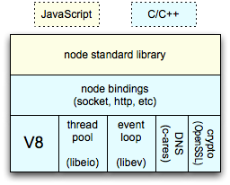
Node.js Architecture
Notes:
IO: Network/Filesystem
Process Management
Module system
Extensibility
Crypto
Http
V8:
1. Netscape invented JavaScript
2. Microsoft let JavaScript stagnate
3. Rise of Firefox (SpiderMonkey) and now Chrome (V8) has reinvigorated JS engine performance

Slide 18
var express = require('express');
var sqlite = require('sqlite');
var db = new sqlite.Database();
...
var app = express.createServer();
app.get('/bookings', function(req, res){
db.execute('SELECT * FROM bookings', function (error, rows) {
if (error) {
res.send(error.message, 500);
} else {
res.send(JSON.stringify(rows));
}
});
});
app.listen(3001);
Notes:
npm:
4300
support for:
underscore
mysql
couchdb
express:
- routing & request processing
- view rendering
- session support
- middleware support via connect

Slide 19
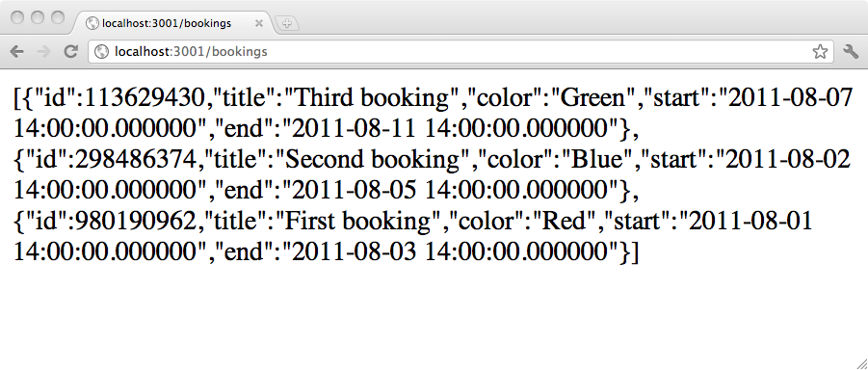

Slide 20
What Node is Not
Easy as synchronous programming
Full-stack web framework
A stable API

Slide 21
Notes:
Compiled to JavaScript,
Optionally interpreted with Node
Invented by Jeremy Ashkenas
Excellent Rails support
Compiler is written in CoffeeScript

Slide 22
Why use CoffeeScript?
Classes
Scope and Binding
Everything evaluates to something

Slide 23
JavaScript CoffeeScript
var Booking =
Backbone.Model.extend();
var Bookings =
Backbone.Collection.extend({
model: Booking,
url: '/bookings'
});
class Booking extends Backbone.Model
class Bookings extends Backbone.Collection
model: Booking
url: '/bookings'
var bookings = new Bookings();
booking = new Bookings
Notes:
Significant Whitespace
Classes - including easy superclass calls, etc
Abbreviated hashes
No confusion about variable scoping var events = new Events();

Slide 24
JavaScript CoffeeScript
var BookingsView =
Backbone.View.extend({
initialize: function() {
_.bind(this, 'addAll',
'handleClick');
this.collection.bind('reset',
this.addAll);
},
render: function() {
this.el.fullCalendar({
eventClick: this.handleClick
});
},
addAll: function() {
this.el.fullCalendar(
'addEventSource',
this.collection.toJSON());
},
handleClick: function(booking) {
...
}
});
class BookingsView extends Backbone.View
initialize: ->
@collection.bind 'reset', @addAll
render: =>
@el.fullCalendar
eventClick: @handleClick
addAll: =>
@el.fullCalendar 'addEventSource',
@collection.toJSON()
handleClick: (booking) =>
...
Notes:
Function notation
Abbreviate ‘this’
Context-setting
20% less code!

Slide 25
List Comprehensions
JavaScript
positiveNumbers = [1, 2, 3, 4];
negativeNumbers = [];
for (var i = 0; i < positiveNumbers.length; i++) {
negativeNumbers.push(-positiveNumbers[i]);
}
CoffeeScript
negativeNumbers = (-num for num in [1, 2, 3, 4])
Notes:
Everything is an expression
Can be added with libraries
Map-like functionality built into the language
The value of a loop is an array of a loops iteration values

Slide 26

Stockholm Syndrome

Slide 27
Let’s wrap this up
Users demanding responsive apps
JavaScript isn’t going anywhere
New generation of tools
Give JavaScript a chance :)

Slide 28
For more information...
github.com/bent

Slide 29
Questions?

Slide 30
Applause

