Slide 1
Dashboard for Sales
This is a visual representation of how sales went for the online shop in the month of december

Slide 2
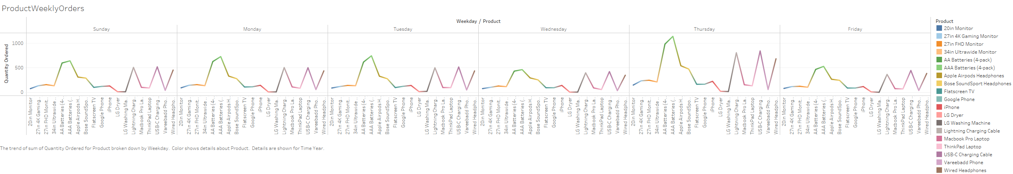
This is a visual reprensatation of how well the products sold in each day.
Best selling Item is the AA battery and highest orders came in on Thursdays.
There were demands for AA batteries on Thursdays.
Wednesdays recorded low sales for all the products

Slide 3
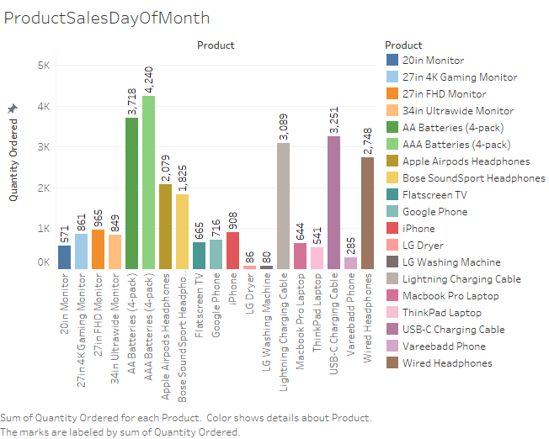
This visualizes the product that sold the most.
Most Ordered or sold Product
Least Ordered
Product

Slide 4
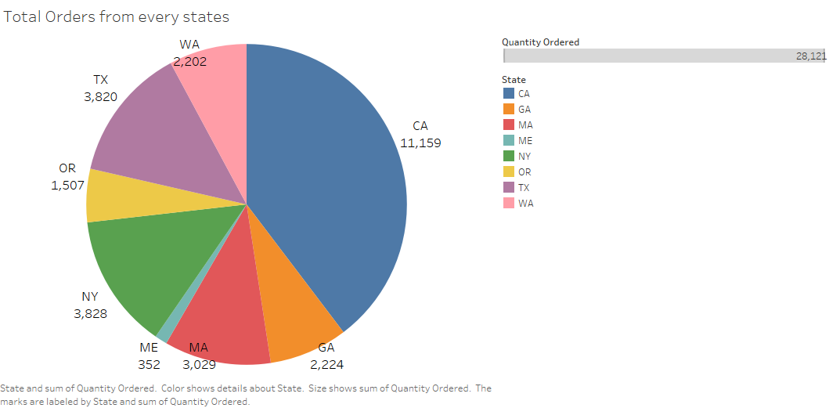
California is the state with most orders.
California has 40% of total orders.
Maine has the least orders.

Slide 5
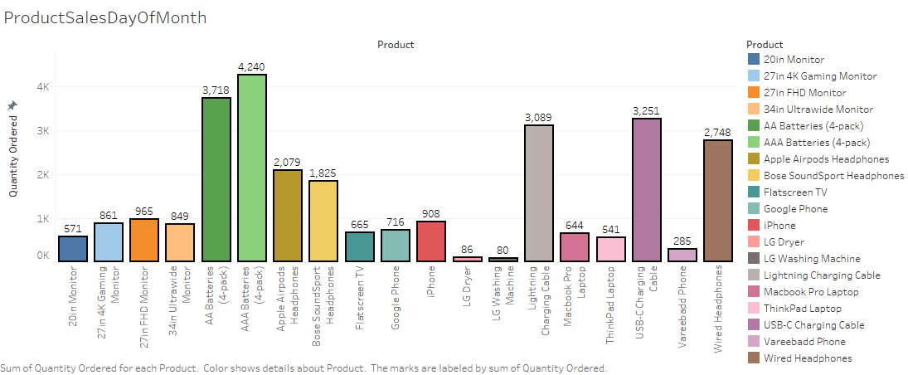
Number of Items Sold in December

Slide 6
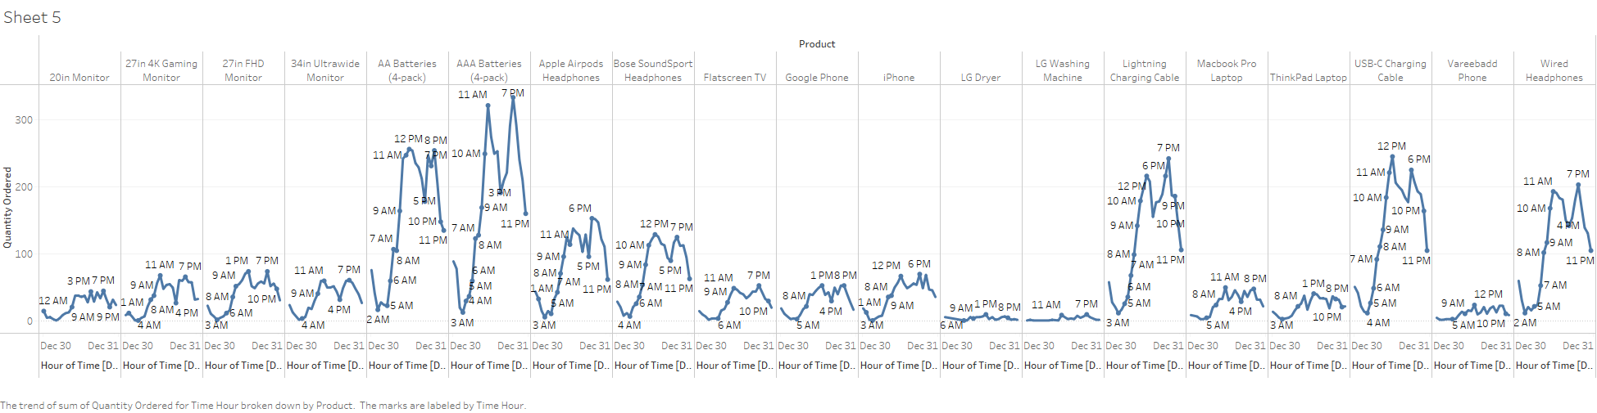
Time Visualization

Slide 7
